Slide 1
CI453 Group Project
Ben Highgate, Ahmed El-Hawat, Michael Ugwumba, Minas Fakhori

Slide 2
Agenda
Project management
The Website and the features
Group Communication
Legal & ethical considerations

Slide 3
Promo vid

Slide 4
Project Management
Research
· Brainstorming
·Target audience research
· Designing of the website
1
Planning
· To do list and delegation of tasks. (Trello)
· Time management. (Gantt chart)
2
Development
· HTML
· CSS
· JS
3
Combining and testing the websites
· Github
· HTML validation
· CSS validation
· Black box test
4

Slide 5
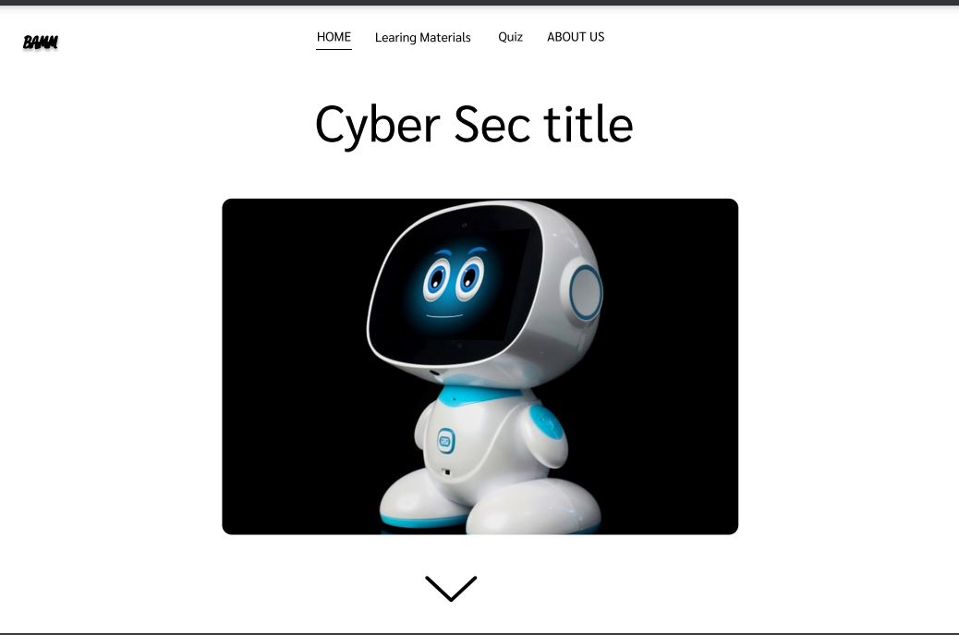
Research
1
Research
· Target audience research
· Brainstorming
· Designing of the website

Slide 6
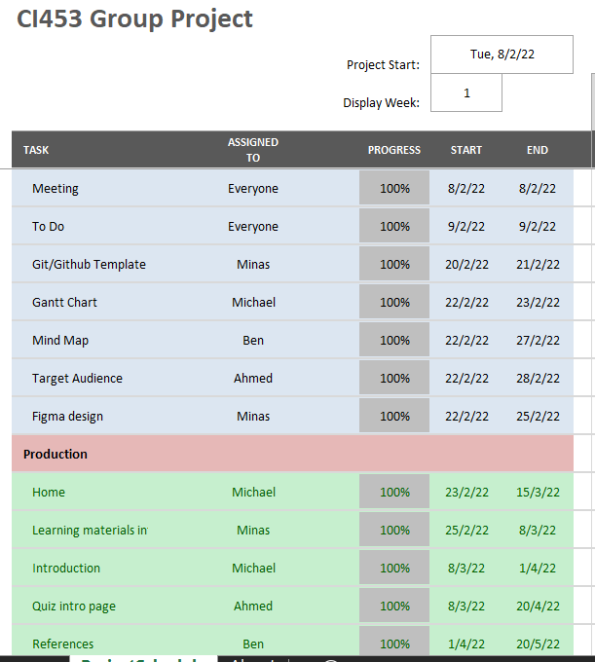
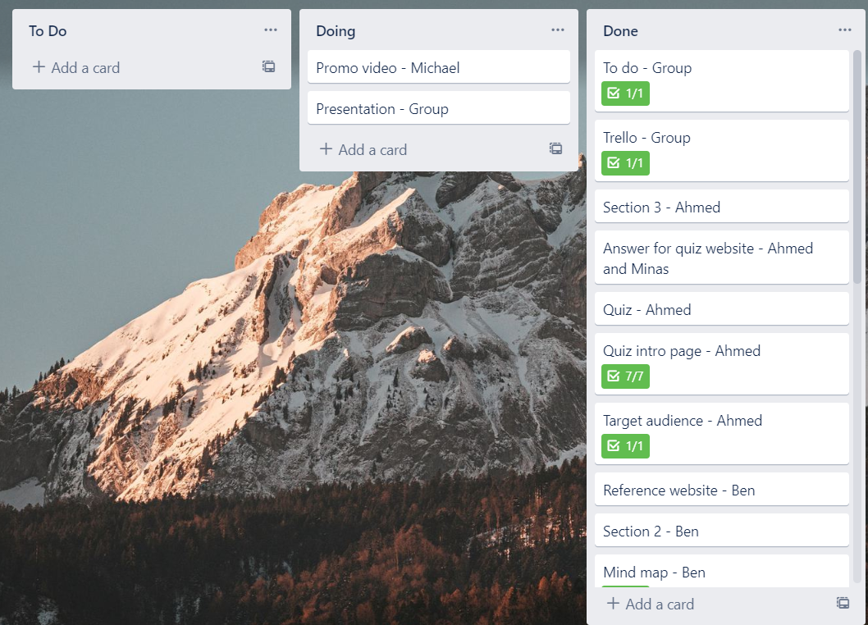
Planning
2
Planning
· To do list and delegation of tasks. (Trello)
· Time management. (Gantt chart)

Slide 7
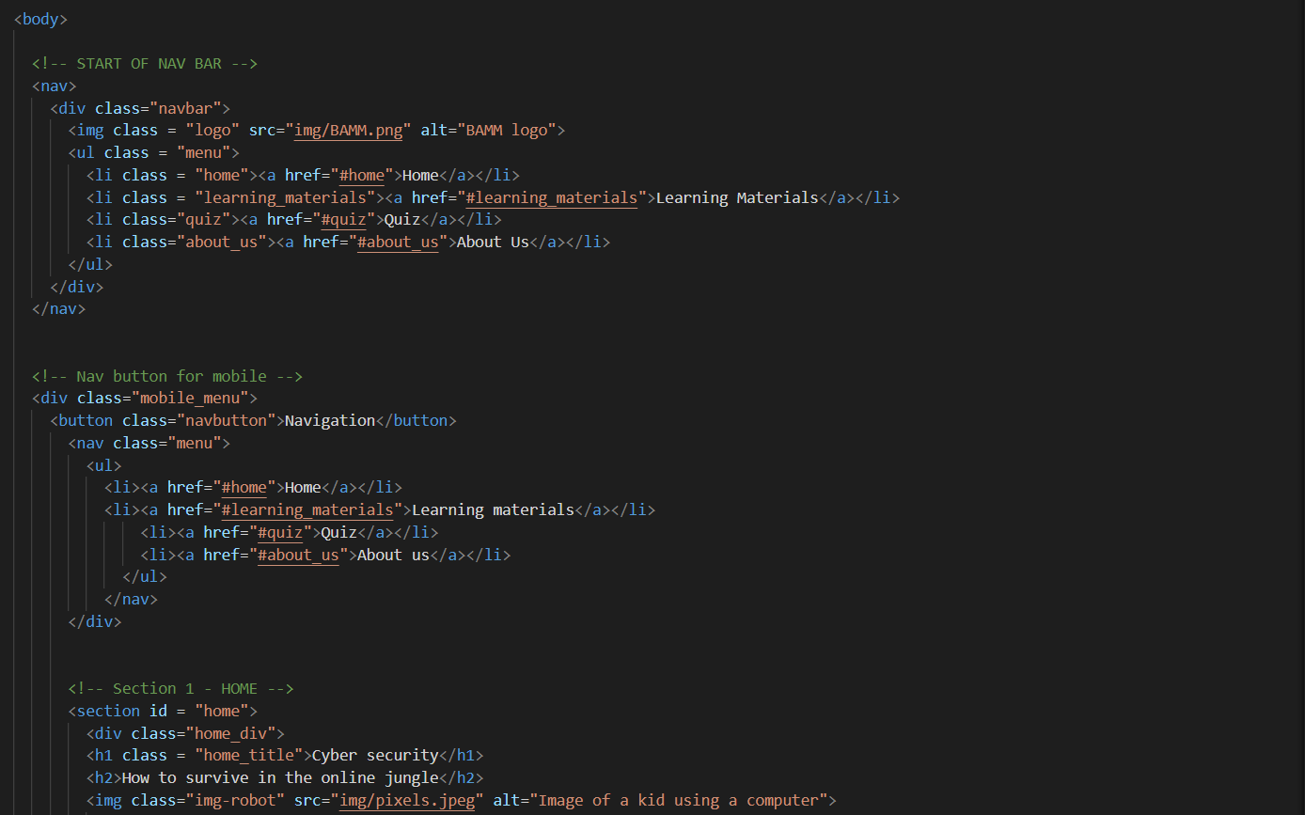
Development
3
Development
· HTML
· CSS
· JS

Slide 8
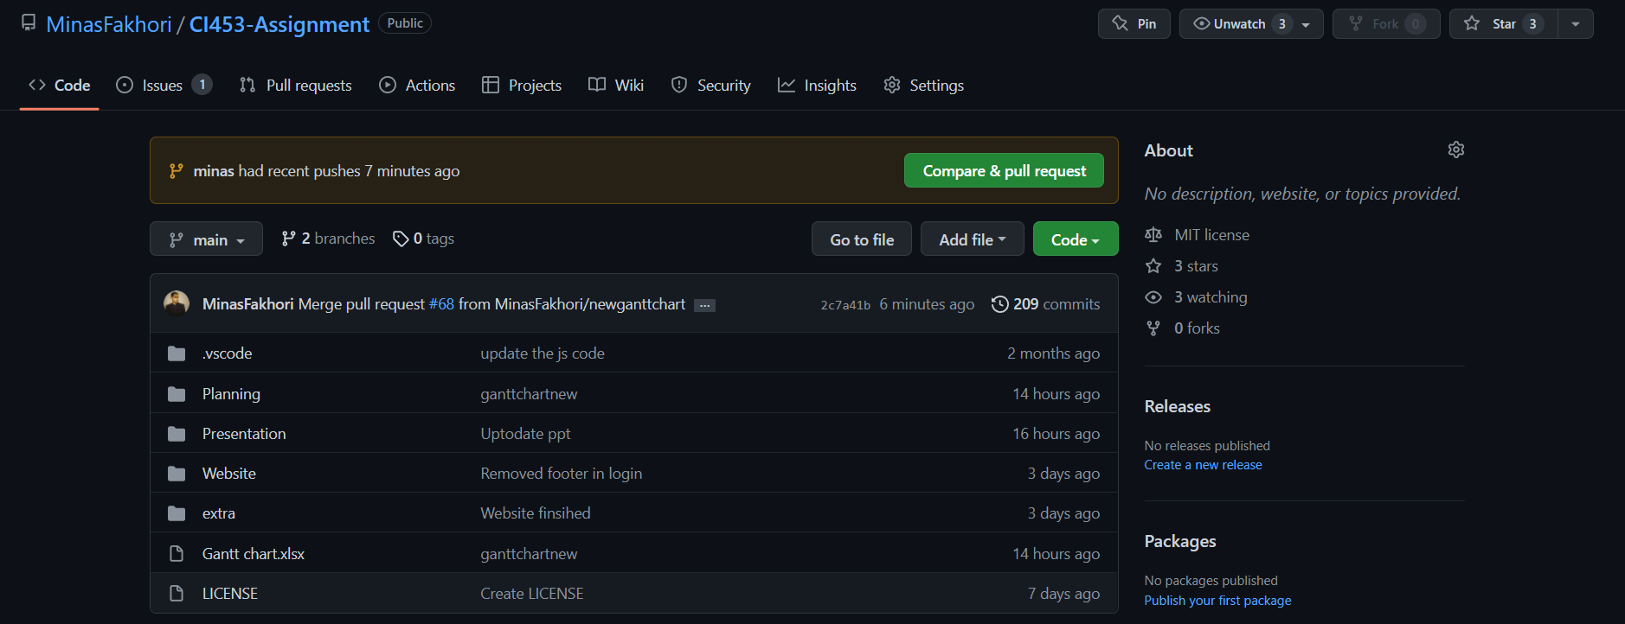
Combining and testing the websites
4
Combining and testing the websites
· Github
· HTML validation
· CSS validation
· Black box test

Slide 9
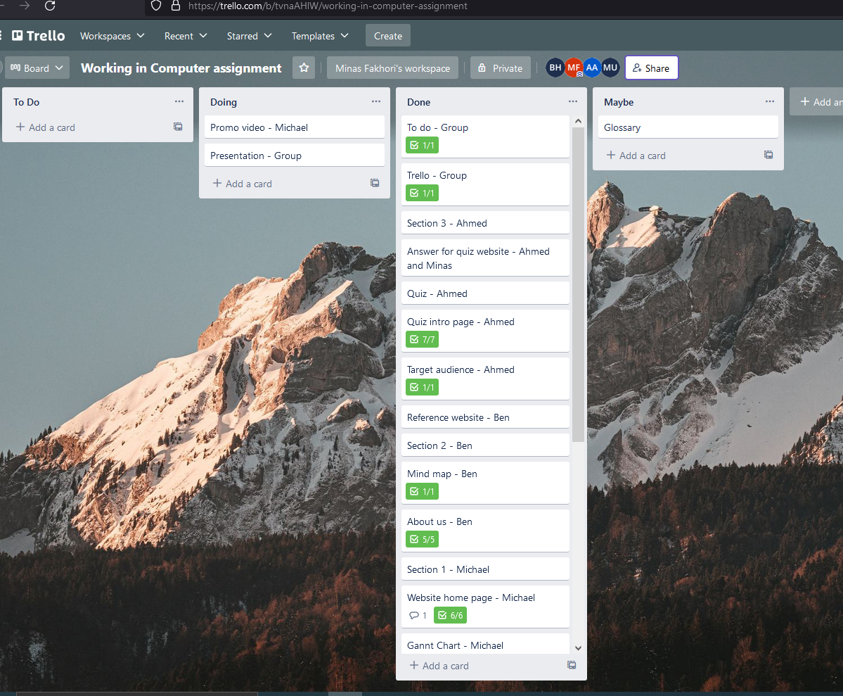
Group communication
Tools
Subtitle
Discord
GitHub
Trello
This PowerPoint theme uses its own unique set of colors, fonts, and effects to create the overall look and feel of these slides.
PowerPoint has tons of themes to give your presentation just the right personality.

Slide 10
Website features
Features
Interactive quiz
Navigation
Page previews
Accessibility features
***The contact page (best)
Responsive

Slide 11
Legal & ethical considerations
References

Slide 12
What have we learned?

Slide 13
Thank you

Slide 14
Questions?

