Slide 1
CI453 Group Project
Ben Highgate, Ahmed El-Hawat, Michael Ugwumba, Minas Fakhori

Slide 2
Agenda
Project management
Group communication
Website features
Legal & ethical considerations

Slide 3
Promo vid

Slide 4

Project Management
Brainstorming, design, planning, and research on target audience.
1
Delegation of tasks, research on topics.
2
Development of html, CSS and JavaScript for website features.
3
Testing, reviewing and editing.

Slide 5
Project management

Slide 6
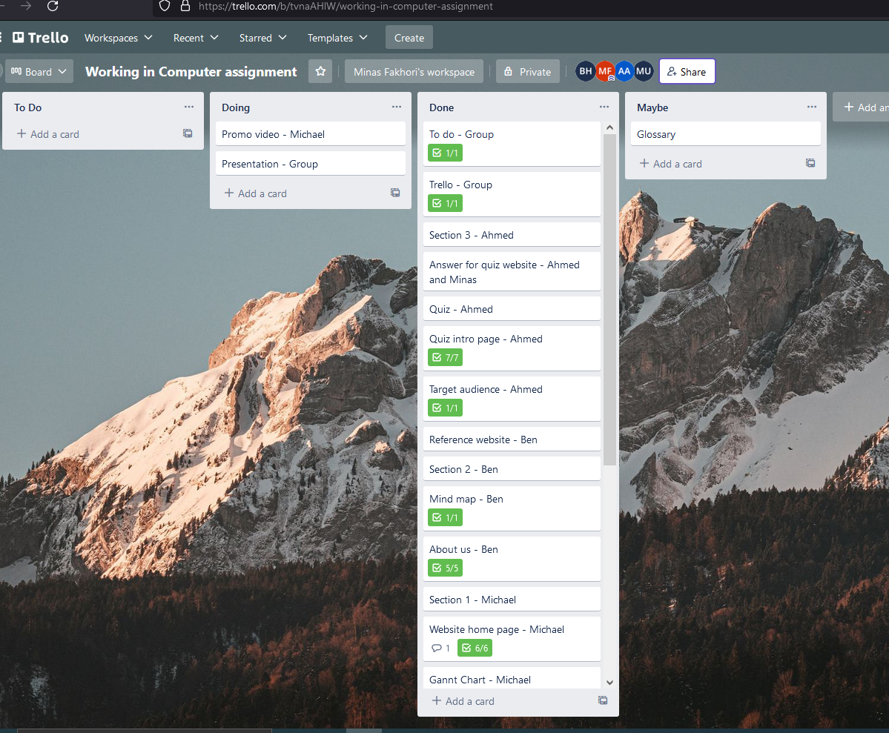
Group communication
Tools
Subtitle
Discord
GitHub
Trello
This PowerPoint theme uses its own unique set of colors, fonts, and effects to create the overall look and feel of these slides.
PowerPoint has tons of themes to give your presentation just the right personality.

Slide 7
Website features
Features
Interactive quiz
Navigation
Page previews
Accessibility features
***The contact page (best)
Responsive

Slide 8
Legal & ethical considerations
References

Slide 9
What have we learned?

Slide 10
Thank you

Slide 11
Questions?

