Slide 1
Notes on: Mixed dimensional isogeometric FE-BE coupling analysis for solid–shell structures
Two different ways of mapping of DOFs of solid and shell
Condition of interface equilibrium for constructing ‘monolithic’ stiffness matrix

Slide 2
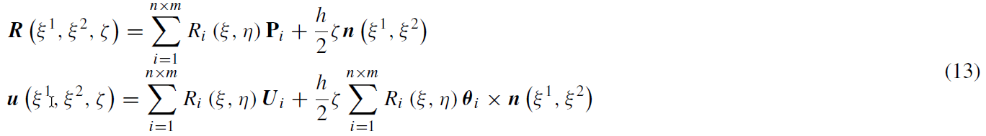
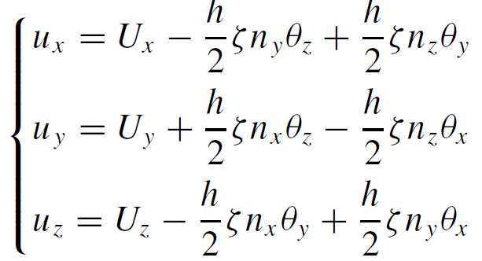
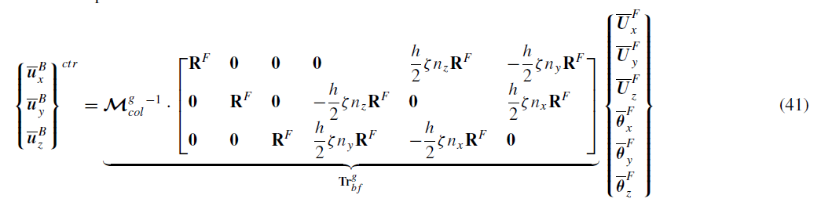


Direct kinematic coupling
Geometry description for R-M shell
$${Tr}_{bf}^{g}$$
Displacement field for Solids (translation only)
(in global coordinates system)
Translation and rotation fields for shell (in global coordinates system)

Slide 3
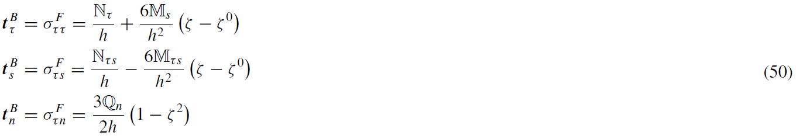
Weak coupling formulation based on work equality
Force equilibrium condition on the coupling interface

Slide 4
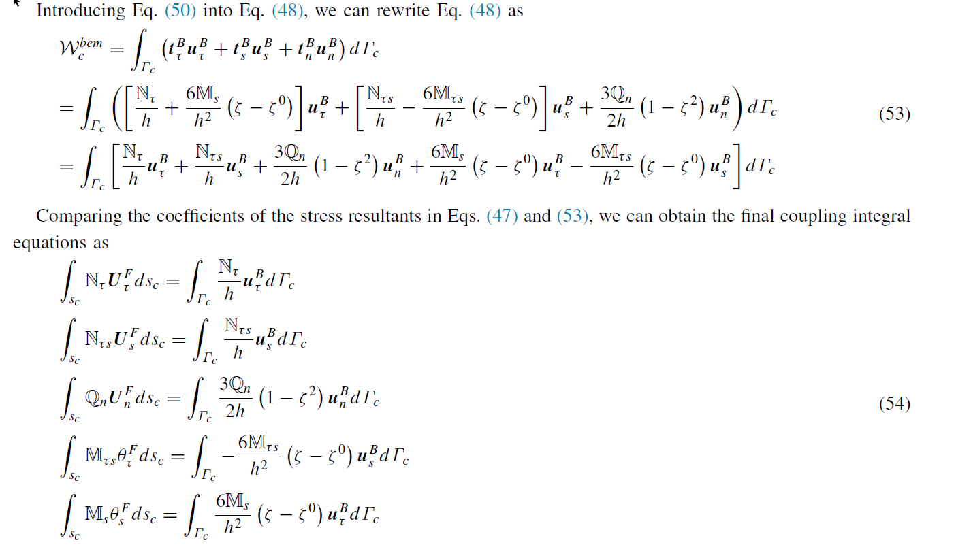
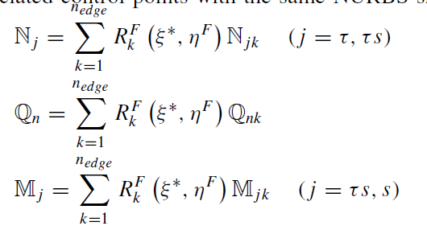
Weak coupling formulation based on work equality
Discretizing stress resultants
Transform for local coos to global coos

Slide 5
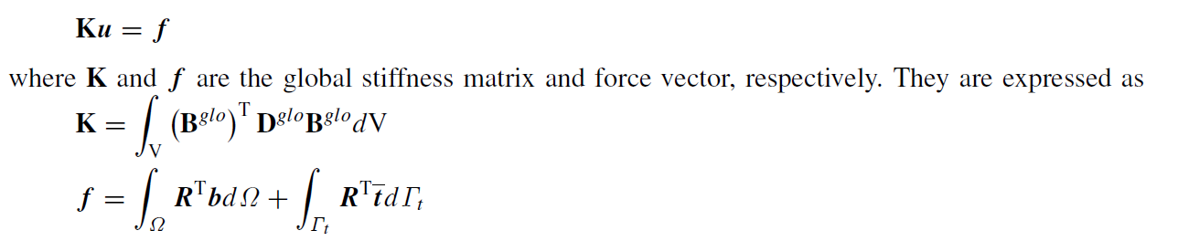
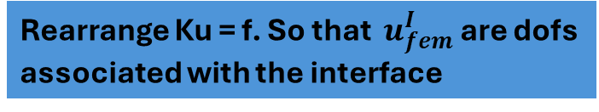
Governing equations of the coupled system Part 1: Shell - FEM
Rearrange Ku = f. So that $u_{fem}^{I}$are dofs associated with the interface
Integral of body forces and tractions on all surfaces except interface surface
Only traction in the interface

Slide 6
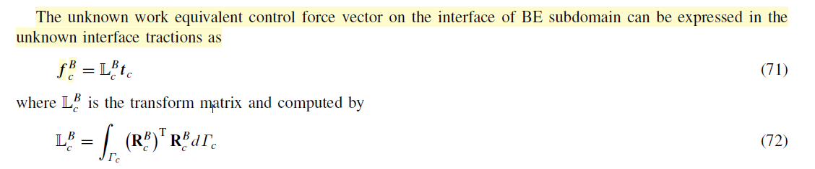
Governing equations of the coupled system Part 2: Solid - BEM
For BEM, there are no body forces. In paragraph 3.2, it is explained how to rearrange the displacements of BEM. Finally

Slide 7
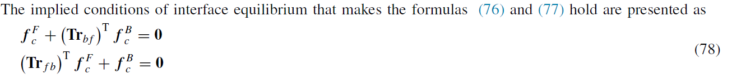
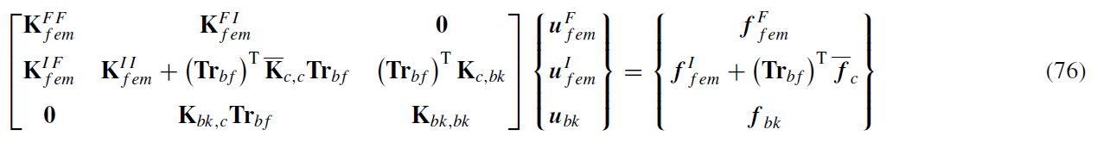
Governing equations of the coupled system Final coupling
Direct kinematic coupling
Weak coupling formulation
Finally:

Slide 8
Notes on: Numerical procedure to couple shell to solid elements by using Nitsche’s method
Notes regards only Shell element MITC4 (method for MITC4ts is the same)
Continuity condition is reached using penalty method
Nitsche method is used to impose the constraint condition

Slide 9
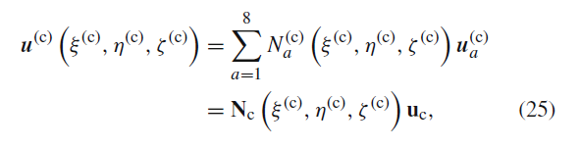



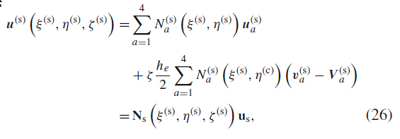
Continuity condition on connecting surface
Penalty factor

Slide 10



Traction work on interface is zero
α Nitche parameter

Slide 11
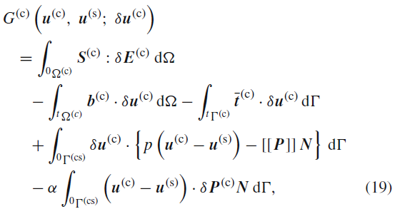
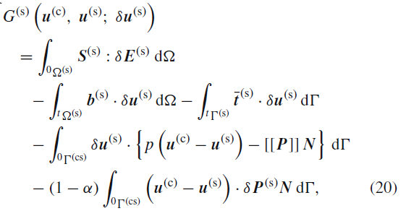
Variation of potential energy for δυc, δυs

Slide 12



Incremental form of variational equations

Slide 13
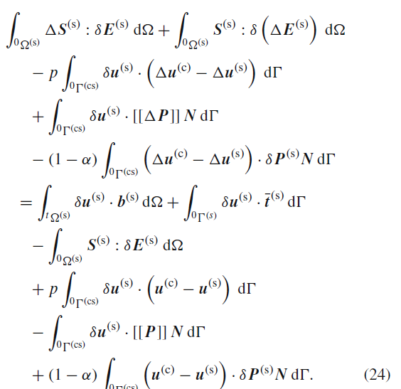
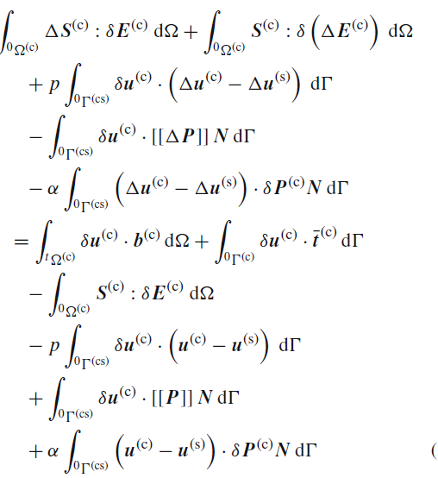

Slide 14
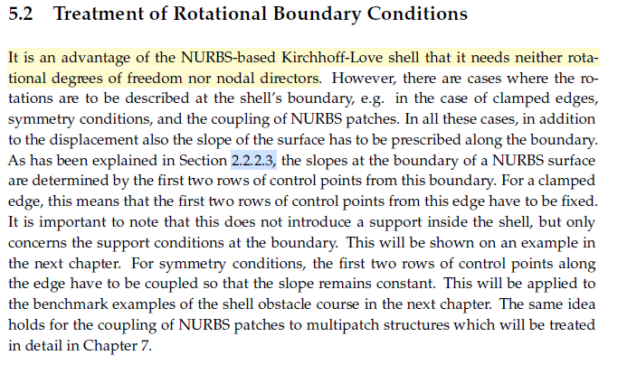
Goals
Do we want to couple thick or thin elements?
Isogeometric Analysis and Shape Optimal Design of Shell Structures Josef M. Kiendl

Slide 15
Goals
Do we want monolithic or partitioned coupling?
For monolithic we can implement the same as 1st paper
For partition we can use Mortat based mapping for 1. displacements and 2. force equilibrium (integrals of tractions of solid and shell)
The difference is that solid will use B-spline basis functions (QuEso) and shell NURBS
For simplification we can say that the surface of the interface of solid (or edge) is not trimmed

Slide 16
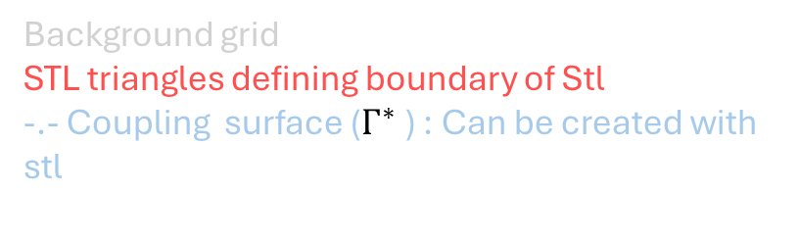
Solid
Background grid
STL triangles defining boundary of Stl
-.- Coupling surface ($Γ^{∗}$) : Can be created with stl

Slide 17
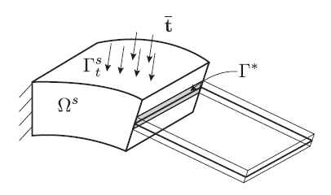
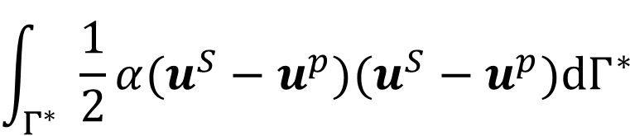
Penalty (deformation penalty for coupling)
$$\int_{Γ^{∗}}{\frac{1}{2}α(u^{S}−u^{p})(u^{S}−u^{p})dΓ^{∗} }$$

Slide 18
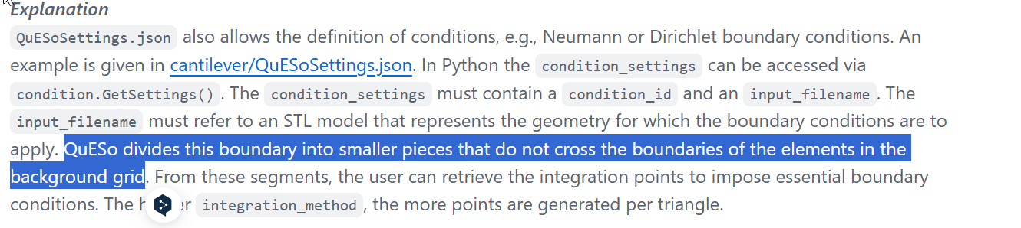
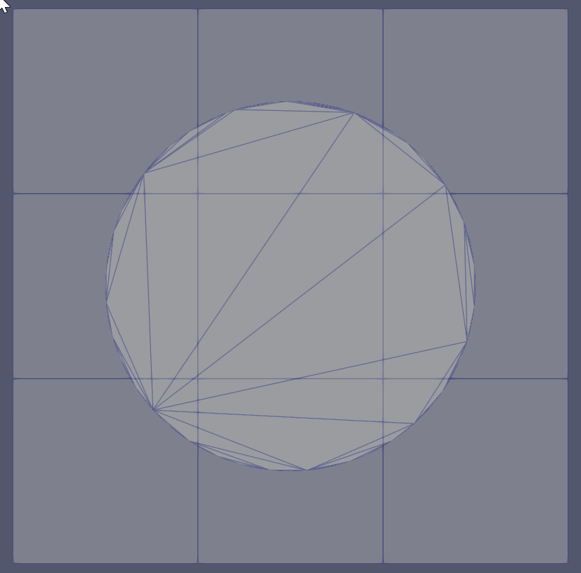
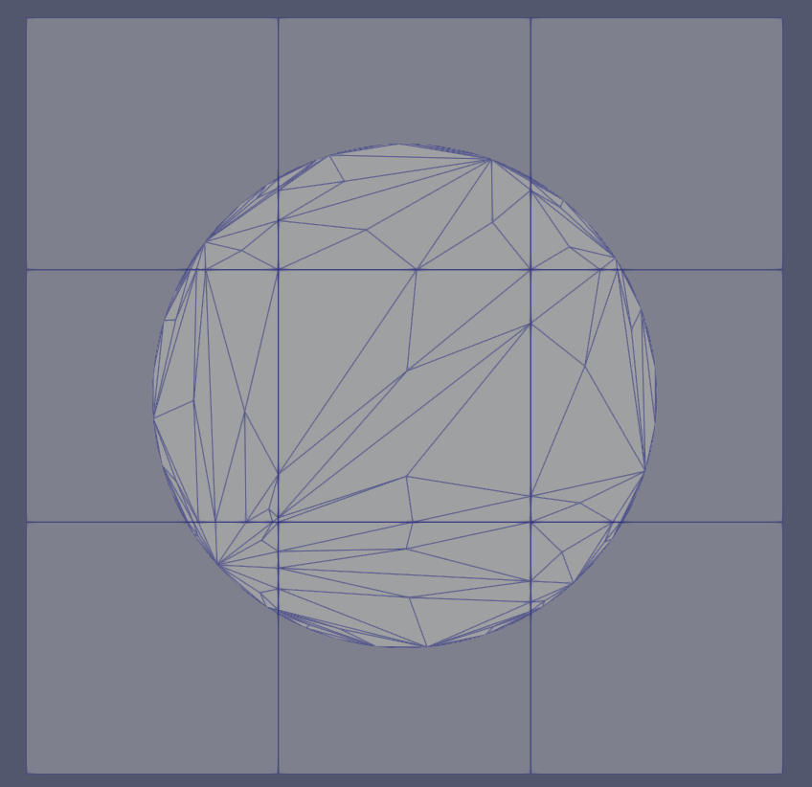

Slide 20







$$Γ^{c}$$
$$Γ_{N}^{so}$$
$$Γ_{N}^{sh}$$
$$Ω^{so}$$
$$Ω^{sh}$$
$$Γ_{D}^{so}$$
$$Γ_{D}^{sh}$$

Slide 21
Goal:
Quadrature point Geometries (Boundary of Solid)
Quadrature point Geometries (Boundary of Shell)
Coupling Geometries

Slide 22
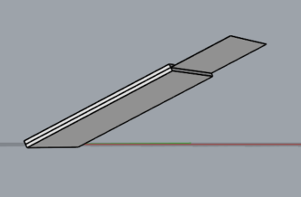
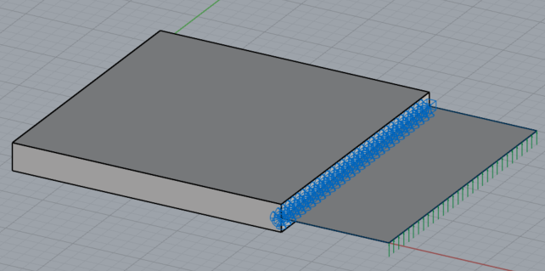
Created two examples
Cuboid with faces parallel to cartesian axis Example 02
Cuboid with faces not parallel to cartesian axis
Example 03

Slide 23
Before implementation
Queso model part Neumann BCs (coupling interface)
Queso model part Dirichlet BCs
Cocodrilo: LoadCondition
Cocodrilo: Support, Support Rotational (coupling interface)
For both cases the brep_ids of the shell curve in the coupling interface is [6]

Slide 24
Before implementation
Get Geometry of IgaModelPart which lies on the coupling interface (curve)
Create PointerVector<Geometry<Node>> to store master(solid) and slave(shell) geometries and IntegrationPointsArrayType to store the local coordinates for every integration point of coupling interface of the solid
Loop on Neumann Conditions of Solid (where integration points are):
Pass Geometry of condition to PointerVector of the master (the geometries are quadrature point geometries)
Project integration point of the solid to Geometry of IgaModelPart and obtain local coordinates and store it to IntegrationPointsArrayType
Create Quadrature Point Geometries using the Geometry of IgaModelPart
Loop and create Coupled_Quadrature_Point_Geometries
Combine Solid and Shell (this step in not done in the beginning because combination reorders the IDs of the geometries of shells and solids to avoid having the same id. In step 1 we need to take the geometry by knowing the ID of the geometry which lies on the interface)

Slide 25
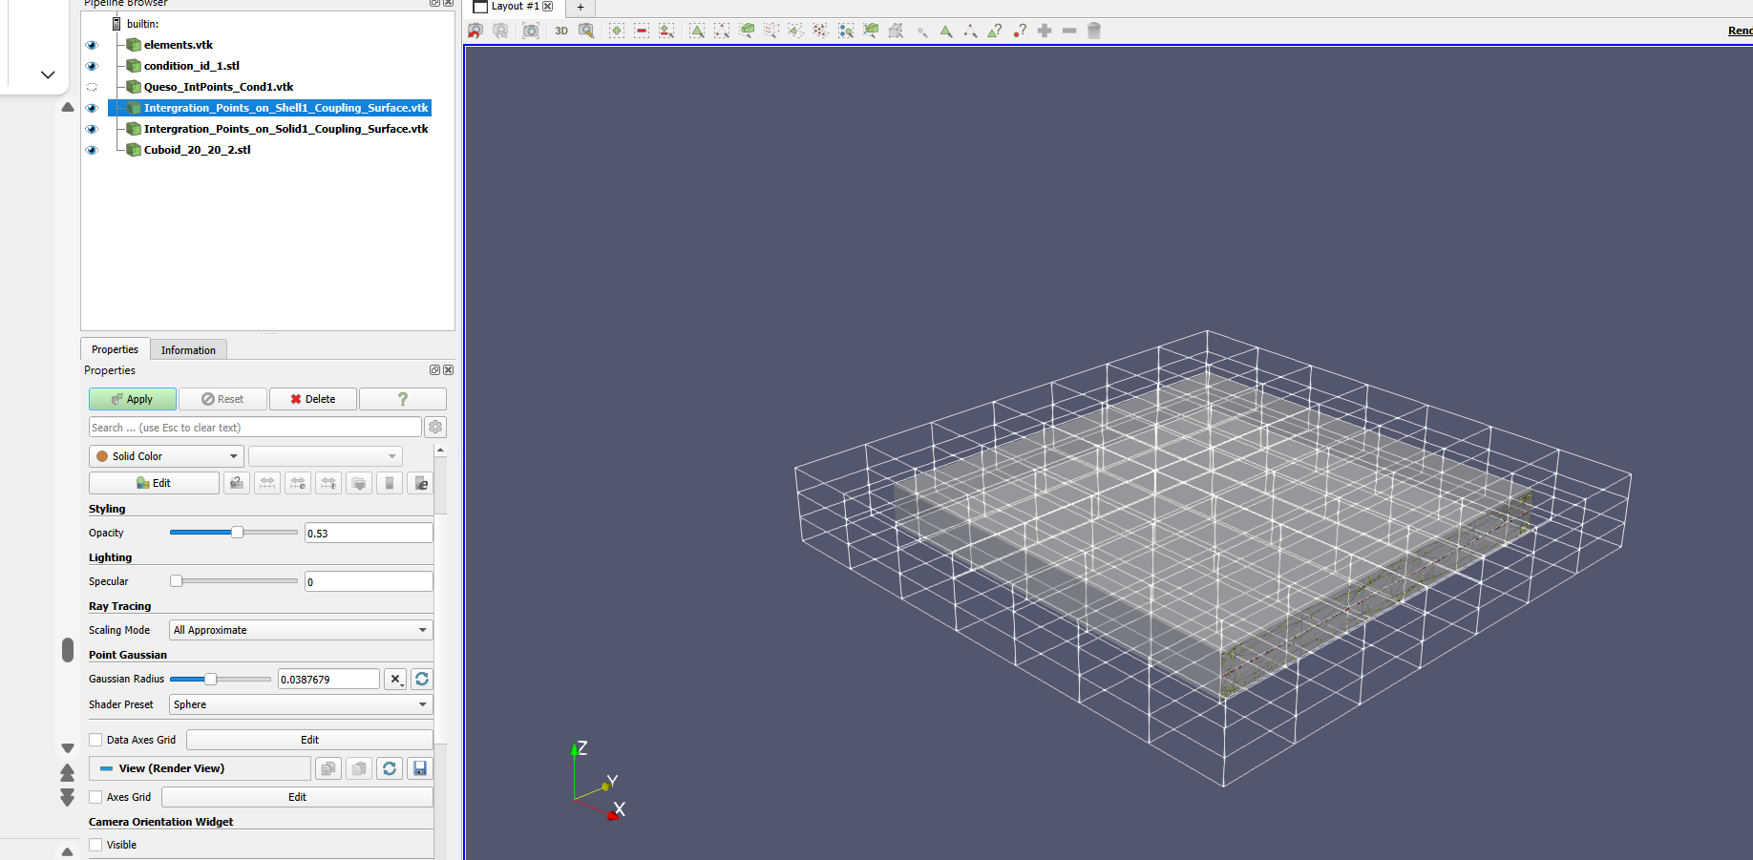
Example 02

Slide 26
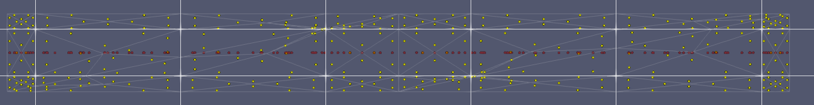
Example 02

Slide 27
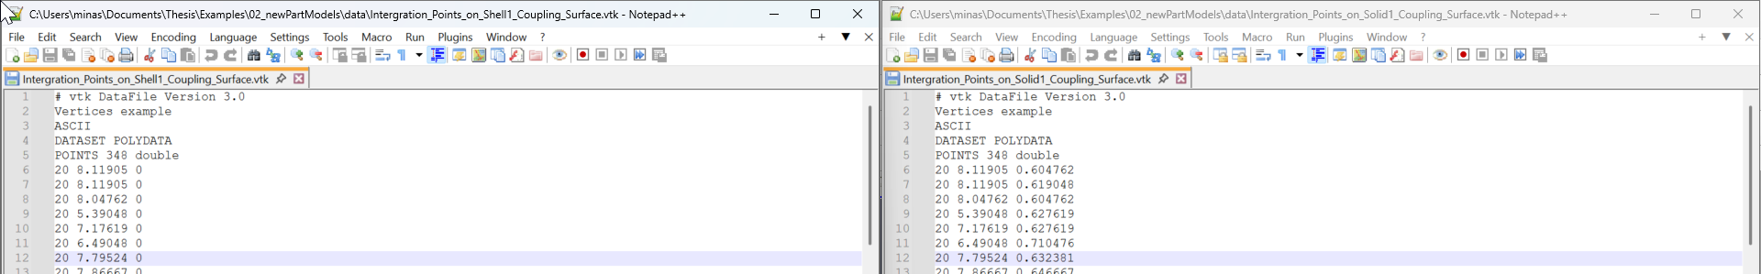
Example 02

Slide 28
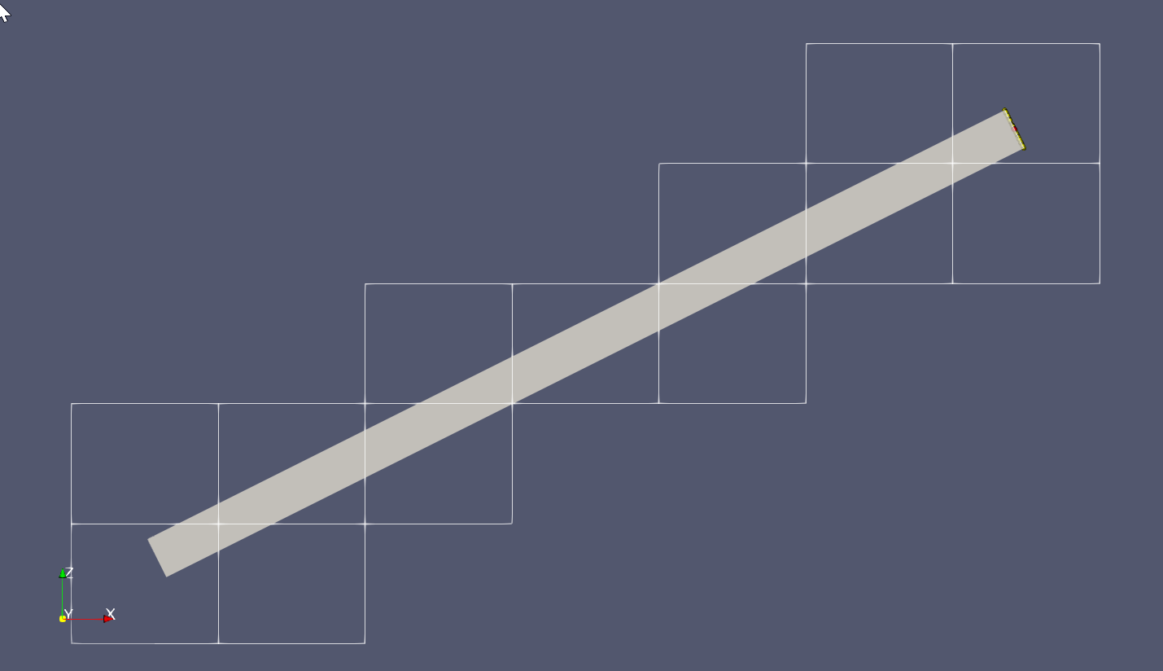
Example 03
Queso Neumann BCs
Queso Dirichlet BCs

Slide 29
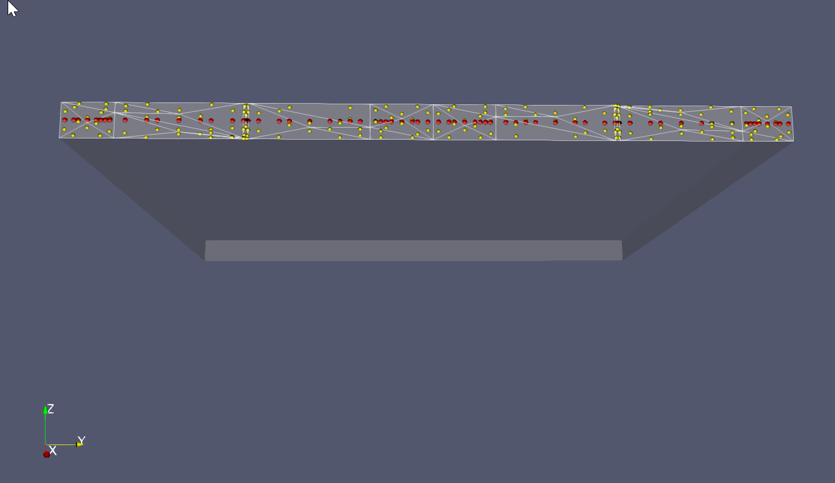
Example 03

Slide 30
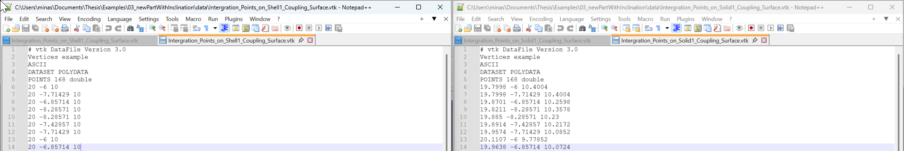
Example 03

Slide 31
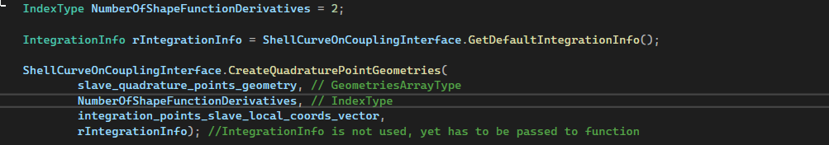
Questions:
1. NumberOfShapeFunctionDerivatives : is that the order of the derivaties that we want to store?
2. IntegrationInfo is not used because we have already the integration points
3. On Coupled_Quadrature_Point_Geometries the master(solid) geometry is QuadraturePointGeometry and for the slave(shell) QuadraturePointCurveOnSurfaceGeometry. Shouldn’t the master(solid) geometry be QuadraturePointSurfaceInVolumeGeometry ?
4. For QuESo: Integration points for Dirichlet_BCs are 1 per triangle while for Neumann BCs are for 3 per triangle. Why is that?

Slide 32
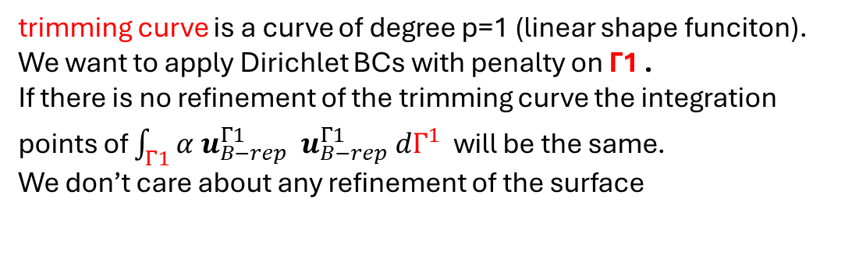
Questions:
Note: For queso integration points for Dirichlet BCs are 1/triangle and for Neumann 3/triangle, no matter the polynomial order of polynomial degree of the shape functions associated with the “finite elements” used in the 3D background grid.
My understanding is that for each triangle we have a discretization with 3 nodes and linear shape function associated to them. They are the boundary representation of the volume and they don’t depend from the polynomial degree of the shape functions of the background grid. There is just a mapping of the nodes and their shape functions of each triangle with the CPs and parametric space of the background grid. The deformations on the b-rep of the solid will be of continuity C1 ?
Similarity with shells?
trimming curve Γ1
trimming curve is a curve of degree p=1 (linear shape funciton). We want to apply Dirichlet BCs with penalty on Γ1 . If there is no refinement of the trimming curve the integration points of $\int_{Γ1}{α u_{B−rep}^{Γ1} u_{B−rep}^{Γ1} dΓ^{1}}$ will be the same. We don’t care about any refinement of the surface
surface

Slide 33
Next steps
Create coupling condition including the coupling geometries
Start inserting parameters on the process to be easier (for example choosing the b_rep id from the shell, choosing which models to combine, which model to delete by name)

Slide 34

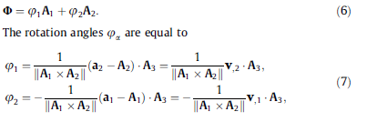

Coupling interface area instead of line
Express displacement field of shell body as a function of mid-surface displacement field
v: Displacement field of midsurface
See Chapter 2.1 from https://www.sciencedirect.com/science/article/pii/S0045782512003337

Slide 35


Slide 36

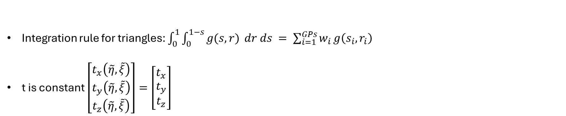



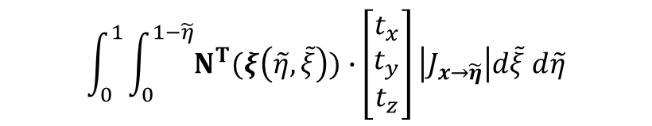

Integration points for Neumann BCs (QueSo)
$$\int_{Γ^{Ν}}{\overline{t}} ∙δu dΓ^{Ν}= \int_{0}^{1}{\int_{0}^{1−\tilde{η}}{δu(ξ(\tilde{η},\tilde{ξ}))∙ \overline{t}\left(\tilde{η},\tilde{ξ}\right)} \left|J_{x→\tilde{η}}\right| d\tilde{ξ} d\tilde{η}= }{δ\hat{u}}^{Τ}\int_{0}^{1}{\int_{0}^{1−\tilde{η}}{Ν^{Τ}(ξ\left(\tilde{η},\tilde{ξ}\right))∙}\left[\begin{aligned}t_{x}\left(\tilde{η},\tilde{ξ}\right) \\ t_{y}\left(\tilde{η},\tilde{ξ}\right) \\ t_{z}\left(\tilde{η},\tilde{ξ}\right)\end{aligned}\right]\left|J_{x→\tilde{η} }\right|d\tilde{ξ} d\tilde{η}}$$
Integration rule for triangles: $\int_{0}^{1}{\int_{0}^{1−s}{g(s,r)} dr ds }= \sum_{i=1}^{GPs}{w_{i}}g\left(s_{i},r_{i}\right)$
t is constant $\left[\begin{aligned}t_{x}\left(\tilde{η},\tilde{ξ}\right) \\ t_{y}\left(\tilde{η},\tilde{ξ}\right) \\ t_{z}\left(\tilde{η},\tilde{ξ}\right)\end{aligned}\right]=\left[\begin{aligned}t_{x} \\ t_{y} \\ t_{z}\end{aligned}\right]$
$$N1\left(\tilde{η},\tilde{ξ}\right)=1 −\tilde{η} −\tilde{ξ}$$
3
$$N2\left(\tilde{η},\tilde{ξ}\right)=\tilde{η}$$
$$\int_{0}^{1}{\int_{0}^{1−\tilde{η}}{Ν^{Τ}(ξ\left(\tilde{η},\tilde{ξ}\right))∙}\left[\begin{aligned}t_{x} \\ t_{y} \\ t_{z}\end{aligned}\right]\left|J_{x→\tilde{η}}\right|d\tilde{ξ} d\tilde{η}}$$
$$\tilde{ξ}$$
$$N3\left(\tilde{η},\tilde{ξ}\right)=\tilde{ξ}$$
1
$$\tilde{η}$$
2

Slide 37
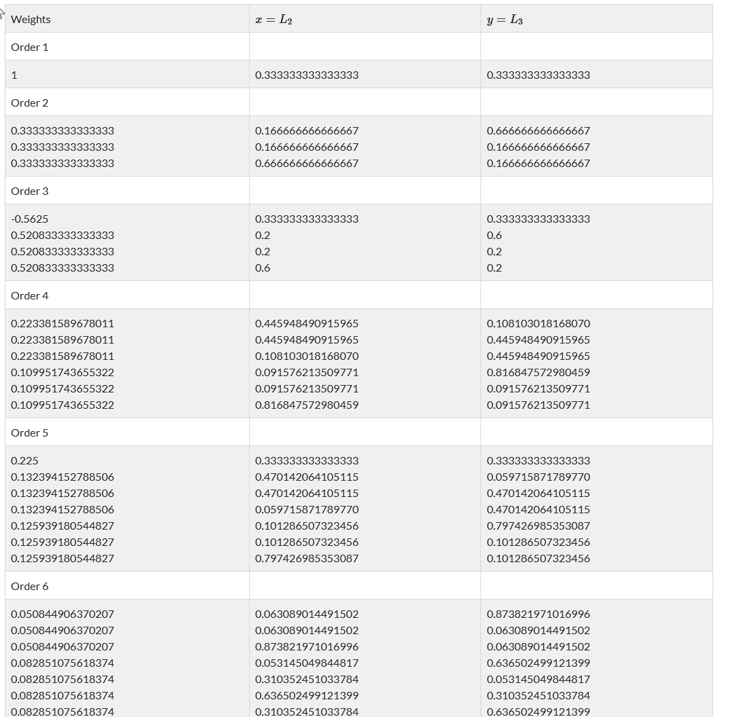
Quadrature points for triangles
https://mathsfromnothing.au/triangle-quadrature-rules/
In Queso we take 3 integration points. They are more than 1 so we are on the safe side

Slide 38
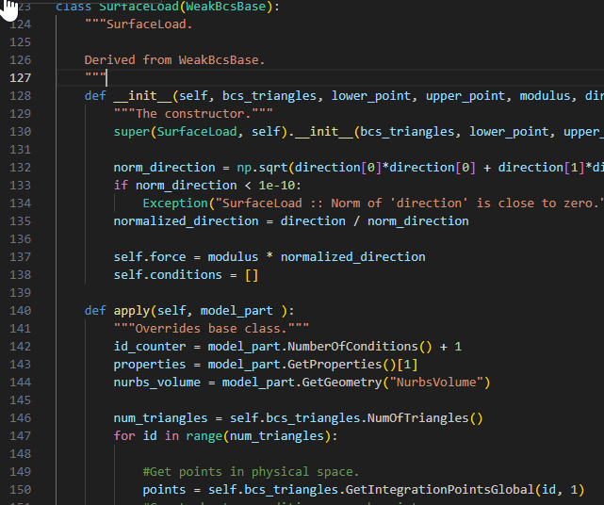
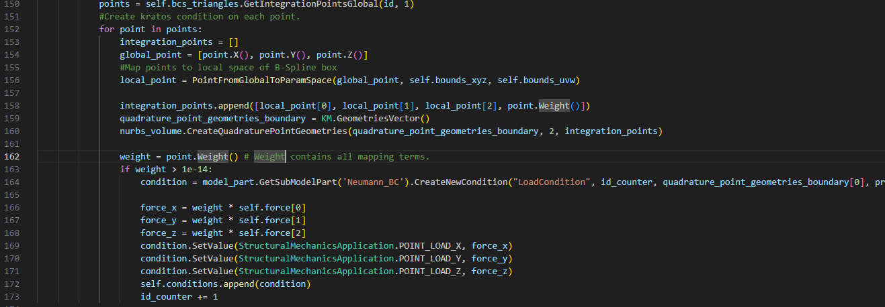
Integration points on the boundaries for Solid

Slide 39
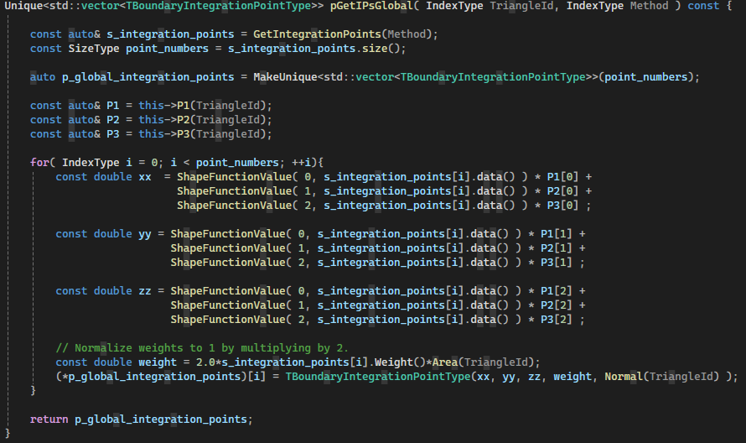
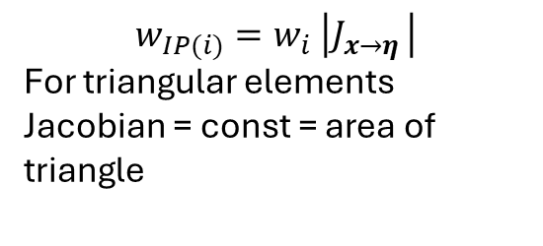
Integration points on the boundaries for Solid
C:\QuESo\queso\containers\triangle_mesh_interface.hpp
$$x_{IP(i)}=N1(η_{i},ξ_{i}) x_{1}+N2(η_{i},ξ_{i}) x_{2}+N3(η_{i},ξ_{i}) x_{3}$$
$$y_{IP(i)}=N1(η_{i},ξ_{i})y_{1}+N2(η_{i},ξ_{i})y_{2}+N3(η_{i},ξ_{i})y_{3}$$
$$z_{IP(i)}=N1(η_{i},ξ_{i})z_{1}+N2(η_{i},ξ_{i})z_{2}+N3(η_{i},ξ_{i})z_{3}$$
$$w_{IP(i)}=w_{i} \left|J_{x→η }\right|$$
For triangular elements Jacobian = const = area of triangle

Slide 40
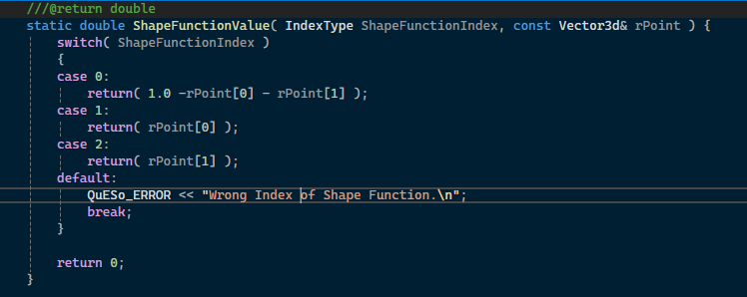





Integration points on the boundaries for Solid
C:\QuESo\queso\containers\triangle_mesh_interface.hpp
$$N1\left(\tilde{η},\tilde{ξ}\right)=1 −\tilde{η} −\tilde{ξ}$$
3
$$N2\left(\tilde{η},\tilde{ξ}\right)=\tilde{η}$$
$$\tilde{ξ}$$
$$N3\left(\tilde{η},\tilde{ξ}\right)=\tilde{ξ}$$
1
$$\tilde{η}$$
2

