Slide 1
Java Programming
KNOWZILLA

Slide 2
JVM (Java Virtual Machine) Architecture
JVM (Java Virtual Machine) is an abstract machine.
It is a specification that provides runtime environment in which java bytecode can be executed. What is JVM
It is:
A specification where working of Java Virtual Machine is specified. But implementation provider is independent to choose the algorithm. Its implementation has been provided by Oracle and other companies.
An implementation Its implementation is known as JRE (Java Runtime Environment).
Runtime Instance Whenever you write java command on the command prompt to run the java class, an instance of JVM is created.
KNOWZILLA

Slide 3
What it does
It does
Loads code
Verifies code
Executes code
Provides runtime environment
JVM provides definitions for the:
Memory area
Class file format
Register set
Garbage-collected heap
Fatal error reporting etc.
KNOWZILLA

Slide 4
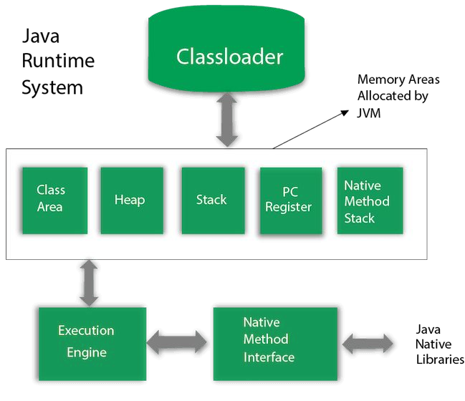
KNOWZILLA

Slide 5
1) Classloader
Classloader is a subsystem of JVM which is used to load class files.
Whenever we run the java program, it is loaded first by the classloader.
Class(Method) Area
Class(Method) Area stores per-class structures such as the runtime constant pool, field and method data, the code for methods.
Heap
It is the runtime data area in which objects are allocated.
Stack
Java Stack stores frames. It holds local variables and partial results, and plays a part in method invocation and return.
KNOWZILLA

Slide 6
Program Counter Register
PC (program counter) register contains the address of the Java virtual machine instruction currently being executed.
Native Method Stack
It contains all the native methods used in the application.
Execution Engine It contains:
A virtual processor
Interpreter: Read bytecode stream then execute the instructions.
Just-In-Time(JIT) compiler:
KNOWZILLA

Slide 7
8) Java Native Interface
Java Native Interface (JNI) is a framework which provides an interface to communicate with another application written in another language like C, C++, Assembly etc.
Java uses JNI framework to send output to the Console or interact with OS libraries.
KNOWZILLA

Slide 8
Constructors in Java
In Java, a constructor is a block of codes similar to the method. It is called when an instance of the class is created.
At the time of calling constructor, memory for the object is allocated in the memory.
It is a special type of method which is used to initialize the object.
Every time an object is created using the new() keyword, at least one constructor is called.
KNOWZILLA

Slide 9
Rules for creating Java constructor
There are two rules defined for the constructor.
Constructor name must be the same as its class name
A Constructor must have no explicit return type
A Java constructor cannot be abstract, static, final, and synchronized
KNOWZILLA

Slide 10
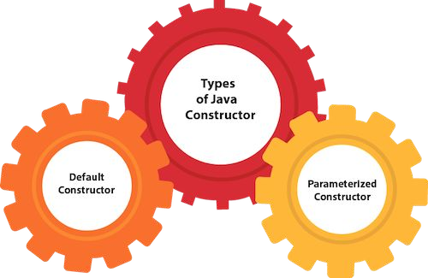
KNOWZILLA

Slide 11
Java Default Constructor
A constructor is called "Default Constructor" when it doesn't have any parameter.
Syntax of default constructor:
<class_name>()
{ }
KNOWZILLA

Slide 12
public class Bike1
{
Bike1()
{
System.out.println("Bike is created");
}
public static void main(String args[])
{
Bike1 b=new Bike1();
}
}
Bike is created
KNOWZILLA

Slide 13
Java Parameterized Constructor
A constructor which has a specific number of parameters is called a parameterized constructor.
Why use the parameterized constructor?
The parameterized constructor is used to provide different values to distinct objects.
However, you can provide the same values also.
●
KNOWZILLA

Slide 14
class Rectangle
{
int area, length, breadth;
// Parameterized constructor Rectangle(int l, int b)
{
length = l; breadth = b;
}
void getArea()
{
area = length * breadth; System.out.println("Area of rectangle : " + area);
}
}
KNOWZILLA

Slide 15
public class FindArea
{
public static void main(String[] args)
{
Rectangle rs = new Rectangle(10, 20); rs.getArea();
}
}
KNOWZILLA

Slide 16
Constructor Overloading in Java
In Java, a constructor is just like a method but without return type.
It can also be overloaded like Java methods.
Constructor overloading in Java is a technique of having more than one constructor with different parameter lists.
They are arranged in a way that each constructor performs a different task.
They are differentiated by the compiler by the number of parameters in the list and their types.
KNOWZILLA

Slide 17
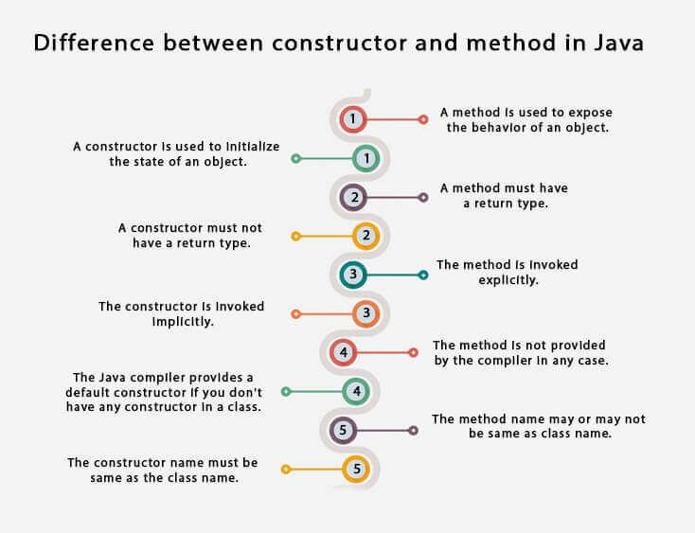
KNOWZILLA

Slide 18
Inheritance in Java
Inheritance in Java is a mechanism in which one object acquires all the properties and behaviors of a parent object.
It is an important part of OOPs (Object Oriented programming system).
The idea behind inheritance in Java is that you can create new classes that are built upon existing classes.
When you inherit from an existing class, you can reuse methods and fields of the parent class.
Moreover, you can add new methods and fields in your current class also.
Inheritance represents the IS-A relationship which is also known as a parent-child
relationship.
KNOWZILLA

Slide 19
Terms used in Inheritance
Class: A class is a group of objects which have common properties. It is a template or blueprint from which objects are created.
Sub Class/Child Class / Derived Class : Subclass is a class which inherits the other class. It is also called a derived class, extended class, or child class.
Super Class/Parent Class/ Base Class : Superclass is the class from where a subclass inherits the features. It is also called a base class or a parent class.
KNOWZILLA

Slide 20
Syntax :
class derived-class extends base-class
{
//methods and fields
}
The extends keyword indicates that you are making a new class that derives from an existing class.
KNOWZILLA

Slide 21
Types of inheritance in java
On the basis of class, there can be two types of inheritance in java:
Single,
multilevel
In java programming, multiple and hybrid inheritance is supported through interface only.
KNOWZILLA

Slide 22
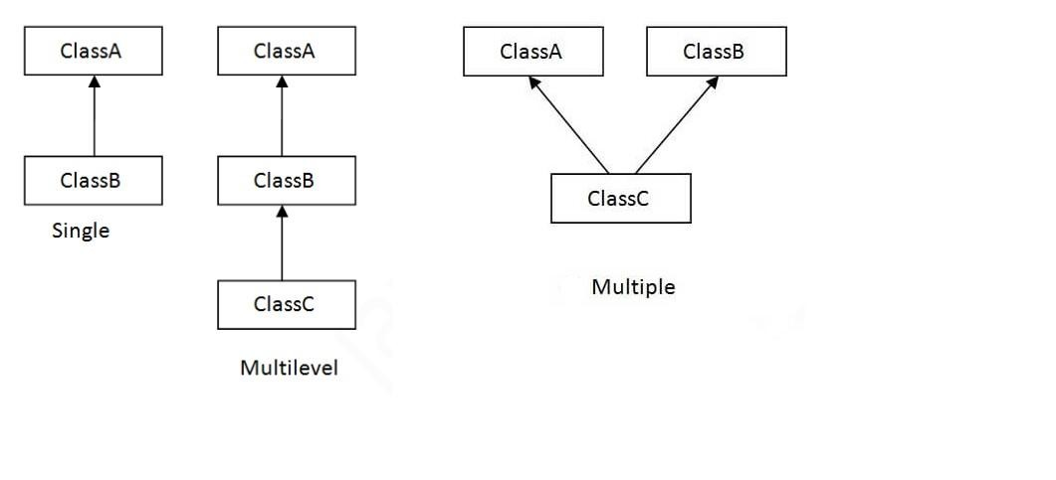
KNOWZILLA

Slide 23
Single Inheritance
When a class inherits another class, it is known as a single inheritance.
class Animal
{
void eat()
{
System.out.println("eating...");
}
}
class Dog extends Animal
{
void bark()
{
System.out.println("barking...");
}
}
class TestInheritance
{
public static void main(String args[])
{
Dog d=new Dog(); d.bark();
d.eat();
KNOWZILLA
}
}

Slide 24
Multilevel Inheritance
When there is a chain of inheritance, it is known as multilevel inheritance.
class Animal
{
void eat()
{
System.out.println("eating...");
}
}
class Dog extends Animal
{
void bark()
{
System.out.println("barking...");
}
}
class BabyDog extends Dog
{
void weep()
{
System.out.println("weeping...");
}
}
KNOWZILLA

Slide 25
class TestInheritance2
{
public static void main(String args[])
{
BabyDog d=new BabyDog(); d.weep();
d.bark();
d.eat();
}
}
KNOWZILLA

Slide 26
Method Overloading in Java
If a class has multiple methods having same name but different in parameters, it is known as Method Overloading.
If we have to perform only one operation, having same name of the methods increases the readability of the program.
Advantage of method overloading
Method overloading increases the readability of the program.
Different ways to overload the method
There are two ways to overload the method in java
By changing number of arguments
By changing the data type
KNOWZILLA

Slide 27
class TestOverloading1
class Adder
{
static int add(int a,int b)
{
return a+b;
}
static int add(int a,int b,int c)
{
return a+b+c;
}
}
{
public static void main(String[] args)
{
System.out.println(Adder.add(11,11)); System.out.println(Adder.add(11,11,11));
}
}
KNOWZILLA
OUTPUT :
22
33

Slide 28
class Adder
{
static int add(int a, int b)
{
return a+b;
}
static double add(double a, double b)
{
return a+b;
}
}
class TestOverloading2
{
public static void main(String[] args)
{
System.out.println(Adder.add(11,11)); System.out.println(Adder.add(12.3,12. 6));
KNOWZILLA
}
OUTPUT :
22
}
24.9

Slide 29
Super Keyword
The super keyword refers to superclass (parent) objects.
It is used to call superclass methods, and to access the superclass constructor.
The most common use of the super keyword is to eliminate the confusion between superclasses and subclasses that have methods with the same name.
super can be used to refer immediate parent class instance variable.
super can be used to invoke immediate parent class method.
super() can be used to invoke immediate parent class constructor.
KNOWZILLA

Slide 30
1) super is used to refer immediate parent class instance variable.
We can use super keyword to access the data member or field of parent class.
It is used if parent class and child class have same fields.
KNOWZILLA

Slide 31
class Animal{
String color="white";
}
class Dog extends Animal{ String color="black";
void printColor(){ System.out.println(color);//prints color of Dog class
System.out.println(super.color);//prints color of Animal class
}
}
class TestSuper1{
public static void main(String args[]){ Dog d=new Dog();
d.printColor();
}
}
KNOWZILLA

Slide 32
2) super can be used to invoke parent class method
The super keyword can also be used to invoke parent class method.
KNOWZILLA
It should be used if subclass contains the same method as parent class.
In other words, it is used if method is overridden

Slide 33
class Animal
{
void eat()
{
System.out.println("eating...");
}
}
class Dog extends Animal
{
void eat()
{
System.out.println("eating bread...");
}
void bark()
{
System.out.println("barking...");
}
KNOWZILLA

Slide 34
void work()
{
super.eat();
bark();
}
}
class TestSuper2
{
public static void main(String args[])
{
Dog d=new Dog(); d.work();
}
}
KNOWZILLA

Slide 35
3) super is used to invoke parent class constructor.
The super keyword can also be used to invoke the parent class constructor.
Let's see a simple example:
KNOWZILLA

Slide 36
class Animal
{
Animal()
{
System.out.println("animal is created");
}
}
class Dog extends Animal
{
Dog()
{
super();
System.out.println("dog is created");
}
}
KNOWZILLA

Slide 37
class TestSuper3
{
public static void main(String args[])
{
Dog d=new Dog();
}
}
Output:
KNOWZILLA
animal is created
dog is created

Slide 38
final Keyword In Java
The final keyword in java is used to restrict the user.
The java final keyword can be used in many context. Final can be:
variable
method
class
The final keyword can be applied with the variables, a final variable that have no value it is called blank final variable or uninitialized final variable.
KNOWZILLA

Slide 39
1) Java final variable
If you make any variable as final, you cannot change the value of final variable(It will be constant)
KNOWZILLA
final int speedlimit=90;//final variable

Slide 40
2) Java final method
If you make any method as final, you cannot override it.
final void run()
{
System.out.println("running");
}
KNOWZILLA

Slide 41
3) Java final class
If you make any class as final, you cannot extend it.
class Bike{}
final class Honda1 extends Bike{
void run()
{
System.out.println("running safely with 100kmph");
}
public static void main(String args[])
{
Honda1 honda= new Honda1(); honda.run();
}
}
KNOWZILLA

Slide 42
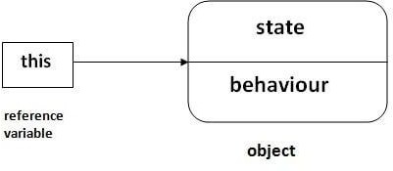
this keyword in Java
There can be a lot of usage of Java this keyword. In Java, this is a reference variable that refers to the current object.
KNOWZILLA

Slide 43
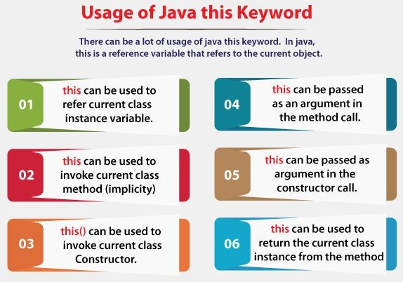
KNOWZILLA

Slide 44
1) this: to refer current class instance variable
The this keyword can be used to refer current class instance variable.
If there is ambiguity between the instance variables and parameters, this keyword resolves the problem of ambiguity
KNOWZILLA

Slide 45
class Student
{
int rollno; String name; float fee;
Student(int rollno,String name,float fee)
{
this.rollno=rollno; this.name=name; this.fee=fee;
}
void display()
{
System.out.println(rollno+" "+name+" "+fee);
}
}
KNOWZILLA

Slide 46
class TestThis2
{
public static void main(String args[])
{
Student s1=new Student(111,"ankit",5000f); Student s2=new Student(112,"sumit",6000f); s1.display();
s2.display();
}
}
KNOWZILLA

Slide 47
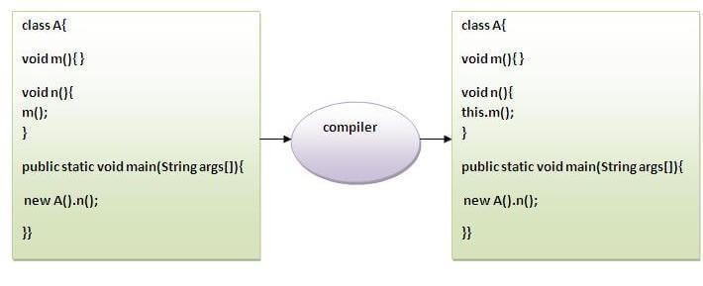
2) this: to invoke current class method
You may invoke the method of the current class by using the this keyword.
If you don't use the this keyword, compiler automatically adds this keyword while invoking the method.
Let's see the example
KNOWZILLA

Slide 48
class A
{
void m()
{
System.out.println("hello m");
}
void n()
{
System.out.println("hello n");
//m();//same as this.m()
this.m();
}
}
class TestThis4
{
public static void main(String args[])
{
A a=new A(); a.n();
}
}
OUTPUT :
hello n hello m
KNOWZILLA

Slide 49
3) this() : to invoke current class constructor
The this() constructor call can be used to invoke the current class constructor.
It is used to reuse the constructor. In other words, it is used for constructor chaining.
Calling default constructor from parameterized constructor:
class A
{
A()
{
System.out.println("hello a");
}
A(int x)
{
this(); System.out.println(x);
}
}
class TestThis5
{
public static void main(String args[])
{
A a=new A(10);
}
}
KNOWZILLA
hello a 10

Slide 50
4) this: to pass as an argument in the method
The this keyword can also be passed as an argument in the method.
It is mainly used in the event handling.
Let's see the example:
class S2
{
void m(S2 obj)
{
System.out.println("method is invoked");
}
void p()
{
m(this);
}
public static void main(String args[])
{
S2 s1 = new S2(); s1.p();
}
}
KNOWZILLA
method is invoked

Slide 51
5) this: to pass as argument in the constructor call
We can pass the this keyword in the constructor also.
It is useful if we have to use one object in multiple classes. Let's see the example:
KNOWZILLA

Slide 52
class B
{
A4 obj;
B(A4 obj)
{
this.obj=obj;
}
void display()
{
System.out.println(obj.data);//using data member of A4 class
}
}
class A4
{
int data=10;
A4()
{
B b=new B(this); b.display();
}
public static void main(String args[])
{
A4 a=new A4();
}
}
KNOWZILLA

Slide 53
6) this keyword can be used to return current class instance
We can return this keyword as an statement from the method.
In such case, return type of the method must be the class type (non-primitive).
Let's see the example:
Syntax of this that can be returned as a statement
return_type method_name()
{
return this;
}
KNOWZILLA

Slide 54
class A
{
A getA()
{
return this;
}
void msg()
{
System.out.println("Hello java");
}
}
class Test1
{
public static void main(String args[])
{
new A().getA().msg();
}
}
KNOWZILLA
Hello java

Slide 55
Interface in Java
An interface in Java is a blueprint of a class.
It has static constants and abstract methods.
It is used to achieve abstraction and multiple inheritance in Java.
In other words, you can say that interfaces can have abstract methods and variables.
It cannot have a method body.
KNOWZILLA

Slide 56
Why use Java interface?
There are mainly three reasons to use interface.
They are given below.
It is used to achieve abstraction.
By interface, we can support the functionality of multiple inheritance.
It can be used to achieve loose coupling.
KNOWZILLA

Slide 57
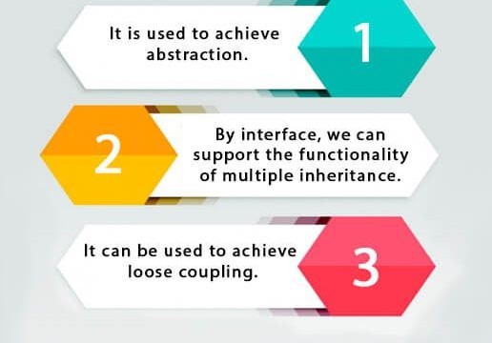
KNOWZILLA

Slide 58
How to declare an interface?
An interface is declared by using the interface keyword.
It provides total abstraction; means all the methods in an interface are declared with the empty body, and all the fields are public, static and final by default.
A class that implements an interface must implement all the methods declared in the interface.
KNOWZILLA

Slide 59
Syntax:
interface interface_name
{
// declare constant fields
// declare methods that abstract
}
KNOWZILLA

Slide 60
Example
interface printable
{
void print();
}
class A6 implements printable{ public void print()
{
System.out.println("Hello");
}
public static void main(String args[]){ A6 obj = new A6();
obj.print();
}
}
KNOWZILLA

Slide 61
Example
interface Bank
{
float rateOfInterest();
}
class SBI implements Bank
{
public float rateOfInterest()
{
return 9.15f;
}
}
KNOWZILLA

Slide 62
class PNB implements Bank
{
public float rateOfInterest()
{
return 9.7f;
}
}
class TestInterface2{
public static void main(String[] args)
{
Bank b=new SBI();
System.out.println("ROI: "+b.rateOfInterest());
}
}
KNOWZILLA

Slide 63
KNOWZILLA

Slide 64
Example
public void speedUp(int increment)
{
speed = speed + increment;
}
public void applyBrakes(int decrement) speed = speed - decrement;
public void printStates() System.out.println("speed: " + speed
+ " gear: " + gear);
import java.io.*; interface Vehicle
{
void changeGear(int a); void speedUp(int a); void applyBrakes(int a);
}
class Bicycle implements Vehicle
{
int speed; int gear;
public void changeGear(int newGear)
{
gear = newGear;
}
{
}
KNOWZILLA
{
}
}

Slide 65
public void applyBrakes(int decrement)
class Bike implements Vehicle
{
int speed; int gear;
public void changeGear(int newGear)
{
gear = newGear;
}
public void speedUp(int increment)
{
speed = speed + increment;
}
{
speed = speed - decrement;
}
public void printStates() {
KNOWZILLA
System.out.println("speed: " + speed
+ " gear: " + gear);
}
}

Slide 66
class GFG {
public static void main (String[] args)
{
Bicycle bicycle = new Bicycle(); bicycle.changeGear(2); bicycle.speedUp(3); bicycle.applyBrakes(1);
System.out.println("Bicycle present state :"); bicycle.printStates();
//creating instance of the bike. Bike bike = new Bike();
bike.changeGear(1); bike.speedUp(4); bike.applyBrakes(3);
System.out.println("Bike present state :"); bike.printStates();
OUTPUT :
Bicycle present state : speed: 2 gear: 2
Bike present state : speed: 1 gear: 1
KNOWZILLA
}
}

Slide 67
Multiple inheritance using Interface
interface Printable
{
void print();
}
interface Showable
{
void print();
}
KNOWZILLA

Slide 68
class TestInterface3 implements Printable, Showable{
public void print()
{
System.out.println("Hello");
}
public static void main(String args[])
{
TestInterface3 obj = new TestInterface3(); obj.print();
}
}
KNOWZILLA

Slide 69
Abstract class in Java
A class which is declared with the abstract keyword is known as an abstract class in
Java.
It can have abstract and non-abstract methods (method with the body).
Abstraction is a process of hiding the implementation details and showing only functionality to the user.
KNOWZILLA

Slide 70
A class which is declared as abstract is known as an abstract class.
It can have abstract and non-abstract methods.
It needs to be extended and its method implemented.
It cannot be instantiated.
KNOWZILLA

Slide 71
An abstract class must be declared with an abstract keyword.
It can have abstract and non-abstract methods.
It cannot be instantiated.
It can have constructors and static methods also.
It can have final methods which will force the subclass not to change the body of the method.
KNOWZILLA

Slide 72
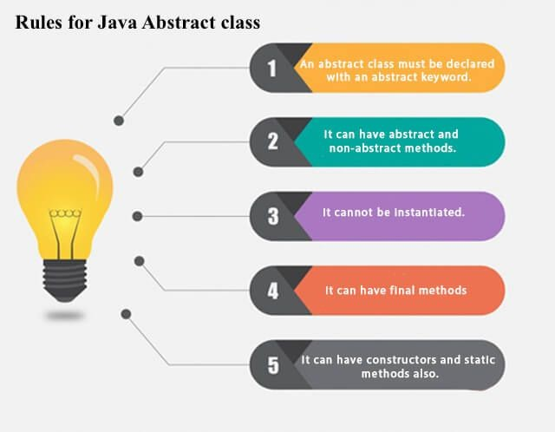
KNOWZILLA

Slide 73
abstract class Bike{
abstract void run();
}
class Honda4 extends Bike{ void run()
{
System.out.println("running safely");
}
public static void main(String args[])
{
Bike obj = new Honda4(); obj.run();
}
}
KNOWZILLA

Slide 74
Difference between abstract class and interface
Abstract class | Interface
1) Abstract class can have abstract and non-abstract methods. | Interface can have only abstract methods. Since Java 8, it can have default and static methods also.
2) Abstract class doesn't support multiple inheritance. | Interface supports multiple inheritance.
3) Abstract class can have final, non-final, static and non-static variables. | Interface has only static and final variables.
4) Abstract class can provide the implementation of interface. | Interface can't provide the implementation of abstract class.
KNOWZILLA

Slide 75
5) The abstract keyword is used to declare abstract class. | The interface keyword is used to declare interface.
6) An abstract class can extend another Java class and implement multiple Java interfaces. | An interface can extend another Java interface only.
7) An abstract class can be extended using keyword "extends". | An interface can be implemented using keyword "implements".
8) A Java abstract class can have class members like private, protected, etc. | Members of a Java interface are public by default.
KNOWZILLA

Slide 76
Wrapper classes in Java
The wrapper class in Java provides the mechanism to convert primitive into object and object into primitive.
Since J2SE 5.0, autoboxing and unboxing feature convert primitives into objects and objects into primitives automatically.
The automatic conversion of primitive into an object is known as autoboxing and vice-versa unboxing
KNOWZILLA

Slide 77
Use of Wrapper classes in Java
Change the value in Method: Java supports only call by value. So, if we pass a primitive value, it
will not change the original value. But, if we convert the primitive value in an object, it will change the original value.
Serialization: We need to convert the objects into streams to perform the serialization. If we have a primitive value, we can convert it in objects through the wrapper classes.
Synchronization: Java synchronization works with objects in Multithreading.
java.util package: The java.util package provides the utility classes to deal with objects.
Collection Framework: Java collection framework works with objects only. All classes of the collection framework (ArrayList, LinkedList, Vector, HashSet, LinkedHashSet, TreeSet, PriorityQueue, ArrayDeque, etc.) deal with objects only.
KNOWZILLA

Slide 78
Primitive Type | Wrapper class
boolean | Boolean
char | Character
byte | Byte
short | Short
int | Integer
long | Long
float | Float
double | Double
KNOWZILLA

Slide 79
Autoboxing
The automatic conversion of primitive data type into its corresponding wrapper class is known as autoboxing, for example, byte to Byte, char to Character, int to Integer, long to Long, float to Float, boolean to Boolean, double to Double, and short to Short.
KNOWZILLA

Slide 80
public class WrapperExample1
{
public static void main(String args[])
{
//Converting int into Integer int a=20;
Integer i=Integer.valueOf(a);//converting int into Integer explicitly
Integer j=a;//autoboxing, now compiler will write Integer.valueOf(a) internally System.out.println(a+" "+i+" "+j);
}
}
KNOWZILLA

Slide 81
Unboxing
The automatic conversion of wrapper type into its corresponding primitive type is known as unboxing.
It is the reverse process of autoboxing.
Since Java 5, we do not need to use the intValue() method of wrapper classes to convert the wrapper type into primitives.
KNOWZILLA

Slide 82
public class WrapperExample2{
public static void main(String args[])
{
//Converting Integer to int Integer a=new Integer(3);
int i=a.intValue();//converting Integer to int explicitly
int j=a;//unboxing, now compiler will write a.intValue() internally System.out.println(a+" "+i+" "+j);
}
}
KNOWZILLA

Slide 83
Package in Java
Package in Java is a mechanism to encapsulate a group of classes, sub packages and interfaces.
A Package can be defined as a grouping of related types (classes, interfaces, enumerations and annotations ) providing access protection and namespace management.
Package in java can be categorized in two form, built-in package and user-defined package. Some of the existing packages in Java are −
java.lang − bundles the fundamental classes
java.io − classes for input , output functions are bundled in this package
It is a good practice to group related classes implemented by you so that a programmer can easily determine that the classes, interfaces, enumerations, and annotations are related.
KNOWZILLA

Slide 84
Advantage of Java Package
Java package is used to categorize the classes and interfaces so that they can be easily maintained.
Java package provides access protection.
Java package removes naming collision.
The package keyword is used to create a package in java.
KNOWZILLA

Slide 85
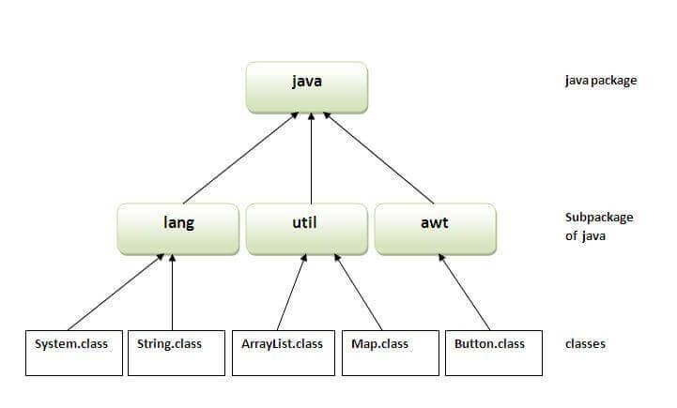
KNOWZILLA

Slide 86
Example of java package
package mypack;
public class Simple
{
public static void main(String args[])
{
System.out.println("Welcome to package");
}
}
KNOWZILLA

Slide 87
How to compile java package
If you are not using any IDE, you need to follow the syntax given below:
javac -d directory javafilename
For example
javac -d . Simple.java
KNOWZILLA

Slide 88
How to run java package program
You need to use fully qualified name e.g. mypack.Simple etc to run the class.
To Compile: javac -d . Simple.java
The -d is a switch that tells the compiler where to put the class file i.e. it represents destination.
The . represents the current folder.
To Run: java mypack.Simple
KNOWZILLA

Slide 89
How to access package from another package?
There are three ways to access the package from outside the package.
import package.*;
import package.classname;
fully qualified name.
KNOWZILLA

Slide 90
1) Using packagename.*
If you use package.* then all the classes and interfaces of this package will be accessible but not subpackages.
The import keyword is used to make the classes and interface of another package accessible to the current package.
//save by A.java package pack; public class A{
public void msg(){System.out.println("Hello");}
}
KNOWZILLA

Slide 91
//save by B.java
package mypack;
import pack.*;
KNOWZILLA
class B{
public static void main(String args[]){ A obj = new A();
obj.msg();
}
}

Slide 92
2) Using packagename.classname
If you import package.classname then only declared class of this package will be accessible.
KNOWZILLA

Slide 93
//save by A.java
package pack; public class A
{
public void msg(){System.out.println("Hello");}
}
package mypack;
import pack.A; class B
{
public static void main(String args[])
{
A obj = new A(); obj.msg();
}
}
KNOWZILLA

Slide 94
3) Using fully qualified name
If you use fully qualified name then only declared class of this package will be accessible.
Now there is no need to import.
But you need to use fully qualified name every time when you are accessing the class or interface.
It is generally used when two packages have same class name e.g. java.util and java.sql packages contain Date class.
KNOWZILLA

Slide 95
Example of package by import fully qualified name
//save by A.java
package pack; public class A
{
public void msg()
{
System.out.println("Hello");
}
}
KNOWZILLA

Slide 96
//save by B.java
package mypack; class B{
public static void main(String args[])
{
pack.A obj = new pack.A();//using fully qualified name obj.msg();
}
}
Output:Hello
KNOWZILLA

Slide 97
Multithreading in Java
Multithreading in Java is a process of executing multiple threads simultaneously.
A thread is a lightweight sub-process, the smallest unit of processing.
KNOWZILLA
Multiprocessing and multithreading, both are used to achieve multitasking.
However, we use multithreading than multiprocessing because threads use a shared memory area.

Slide 98
Advantages of Java Multithreading
1) It doesn't block the user because threads are independent and you can perform multiple operations at the same time.
2) You can perform many operations together, so it saves time.
KNOWZILLA
3) Threads are independent, so it doesn't affect other threads if an exception occurs in a single thread

Slide 99
Multitasking
Multitasking is a process of executing multiple tasks simultaneously. We use multitasking to utilize the CPU. Multitasking can be achieved in two ways:
Process-based Multitasking (Multiprocessing)
Thread-based Multitasking (Multithreading)
KNOWZILLA

Slide 100
1) Process-based Multitasking (Multiprocessing)
Each process has an address in memory. In other words, each process allocates a separate memory area.
A process is heavyweight.
Cost of communication between the process is high.
Switching from one process to another requires some time for saving and loading registers, memory maps, updating lists, etc.
KNOWZILLA

Slide 101
2) Thread-based Multitasking (Multithreading)
Threads share the same address space.
A thread is lightweight.
Cost of communication between the thread is low.
KNOWZILLA

Slide 102
What is Thread in java
A thread is a lightweight subprocess, the smallest unit of processing.
It is a separate path of execution.
Threads are independent.
If there occurs exception in one thread, it doesn't affect other threads.
It uses a shared memory area.
KNOWZILLA

Slide 103
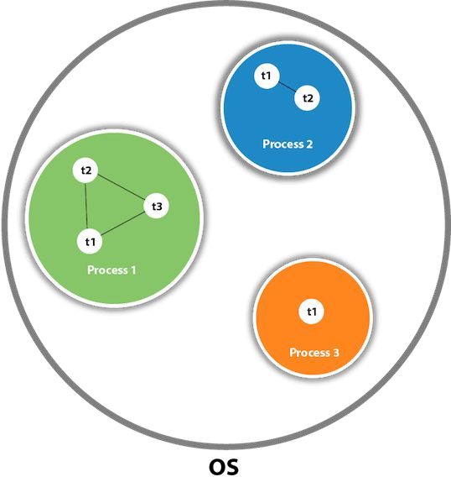
KNOWZILLA

Slide 104
Java Thread class
Java provides Thread class to achieve thread programming.
Thread class provides constructors and methods to create and perform operations on a thread.
KNOWZILLA
Thread class extends Object class and implements Runnable interface

Slide 105
Life cycle of a Thread (Thread States)
A thread can be in one of the five states.
According to sun, there is only 4 states in thread life cycle in java new, runnable, non-runnable and terminated.
There is no running state.
But for better understanding the threads, we are explaining it in the 5 states.
The life cycle of the thread in java is controlled by JVM.
The java thread states are as follows:
KNOWZILLA

Slide 106
New
Runnable
Running
Non-Runnable (Blocked)
Terminated
KNOWZILLA

Slide 107
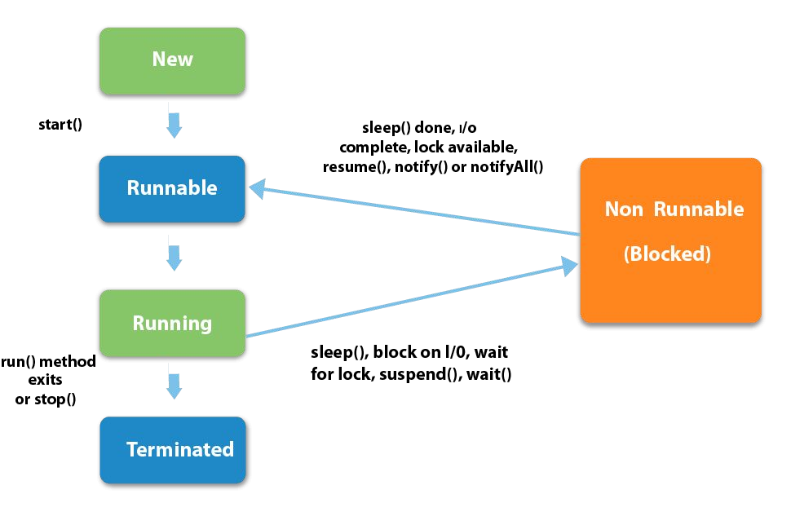
KNOWZILLA

Slide 108
1) New
The thread is in new state if you create an instance of Thread class but before the invocation of start() method.
2) Runnable
KNOWZILLA
The thread is in runnable state after invocation of start() method, but the thread scheduler has not selected it to be the running thread.
3) Running
The thread is in running state if the thread scheduler has selected it.

Slide 109
4) Non-Runnable (Blocked)
This is the state when the thread is still alive, but is currently not eligible to run.
5) Terminated
KNOWZILLA
A thread is in terminated or dead state when its run() method exits

Slide 110
How to create thread
There are two ways to create a thread:
By extending Thread class
By implementing Runnable interface.
KNOWZILLA

Slide 111
Thread class
Thread class provide constructors and methods to create and perform operations on a thread.
Thread class extends Object class and implements Runnable interface.
Commonly used Constructors of Thread class:
KNOWZILLA
Thread()
Thread(String name)
Thread(Runnable r)
Thread(Runnable r,String name)

Slide 112
Commonly used methods of Thread class
public void run(): is used to perform action for a thread.
public void start(): starts the execution of the thread.JVM calls the run() method on the thread.
public void sleep(long miliseconds): Causes the currently executing thread to sleep (temporarily cease execution) for the specified number of milliseconds.
public void join(): waits for a thread to die.
public void join(long miliseconds): waits for a thread to die for the specified miliseconds.
public int getPriority(): returns the priority of the thread.
public int setPriority(int priority): changes the priority of the thread.
public String getName(): returns the name of the thread.
public void setName(String name): changes the name of the thread
KNOWZILLA

Slide 113
Runnable interface:
The Runnable interface should be implemented by any class whose instances are intended to be executed by a thread.
Runnable interface have only one method named run().
KNOWZILLA
1. public void run(): is used to perform action for a thread.

Slide 114
Starting a thread:
start() method of Thread class is used to start a newly created thread.
It performs following tasks:
A new thread starts(with new callstack).
The thread moves from New state to the Runnable state.
When the thread gets a chance to execute, its target run() method will run
KNOWZILLA

Slide 115
Thread Example by extending Thread class
class Multi extends Thread
{
public void run()
{
System.out.println("thread is running...");
}
public static void main(String args[])
{
Multi t1=new Multi(); t1.start();
}
KNOWZILLA
}
Output:
thread is running..

Slide 116
Thread Example by implementing Runnable interface
class Multi implements Runnable
{
public void run()
{
System.out.println("thread is running...");
}
public static void main(String args[])
{
Multi m1=new Multi(); Thread t1 =new Thread(m1); t1.start();
}
KNOWZILLA
}
Output : thread is running...

Slide 117
Sleep method in java
The sleep() method of Thread class is used to sleep a thread for the specified amount of time.
Syntax of sleep() method in java
The Thread class provides two methods for sleeping a thread:
public static void sleep(long miliseconds)throws InterruptedException
public static void sleep(long miliseconds, int nanos)throws InterruptedException
KNOWZILLA

Slide 118
class TestSleepMethod1 extends Thread
{
public void run()
{
for(int i=1;i<5;i++)
{
try{
Thread.sleep(500);
}
catch(InterruptedException e)
{
System.out.println(e);
}
System.out.println(i);
}
}
KNOWZILLA

Slide 119
public static void main(String args[])
{
TestSleepMethod1 t1=new TestSleepMethod1(); TestSleepMethod1 t2=new TestSleepMethod1(); t1.start();
t2.start();
}
}
KNOWZILLA

Slide 120
Output :
1
1
As you know well that at a time only one thread is executed.
2
KNOWZILLA
If you sleep a thread for the specified time,the thread scheduler picks up another thread and so on.
2
3
3
4
4

Slide 121
Naming Thread and Current Thread
Naming Thread
The Thread class provides methods to change and get the name of a thread. By default, each thread has a name i.e. thread-0, thread-1 and so on.
By we can change the name of the thread by using setName() method.
The syntax of setName() and getName() methods are given below:
KNOWZILLA
public String getName(): is used to return the name of a thread.
public void setName(String name): is used to change the name of a thread.

Slide 122
class TestMultiNaming1 extends Thread{
public void run()
{
System.out.println("running...");
}
public static void main(String args[]){ TestMultiNaming1 t1=new TestMultiNaming1(); TestMultiNaming1 t2=new TestMultiNaming1(); System.out.println("Name of t1:"+t1.getName()); System.out.println("Name of t2:"+t2.getName()); t1.start();
t2.start(); t1.setName("Sonoo Jaiswal");
System.out.println("After changing name of t1:"+t1.getName());
}
}
KNOWZILLA

Slide 123
Output:
Name of t1:Thread-0
Name of t2:Thread-1 id of t1:8
running...
After changeling name of t1:Sonoo Jaiswal running...
KNOWZILLA

Slide 124
Priority of a Thread (Thread Priority):
Each thread have a priority.
Priorities are represented by a number between 1 and 10.
In most cases, thread schedular schedules the threads according to their priority (known as preemptive scheduling).
But it is not guaranteed because it depends on JVM specification that which scheduling it chooses.
KNOWZILLA
3 constants defined in Thread class:
public static int MIN_PRIORITY
public static int NORM_PRIORITY
public static int MAX_PRIORITY
Default priority of a thread is 5 (NORM_PRIORITY).
The value of MIN_PRIORITY is 1 and the value of MAX_PRIORITY is 10.

Slide 125
{
public void run()
{
System.out.println("running thread name is:"+Thread.currentThread().getName()); System.out.println("running thread priority is:"+Thread.currentThread().getPriority());
}
public static void main(String args[])
{
TestMultiPriority1 m1=new TestMultiPriority1(); TestMultiPriority1 m2=new TestMultiPriority1(); m1.setPriority(Thread.MIN_PRIORITY); m2.setPriority(Thread.MAX_PRIORITY); m1.start();
m2.start();
}
}
KNOWZILLA

Slide 126
Output:
running thread name is:Thread-0
running thread priority is:10 running thread name is:Thread-1 running thread priority is:1
KNOWZILLA

Slide 127
Daemon Thread in Java
Daemon thread in java is a service provider thread that provides services to the user thread.
Its life depend on the mercy of user threads i.e. when all the user threads dies, JVM terminates this thread automatically.
There are many java daemon threads running automatically e.g. gc, finalizer etc.
You can see all the detail by typing the jconsole in the command prompt.
The jconsole tool provides information about the loaded classes, memory usage, running threads etc
It provides services to user threads for background supporting tasks. It has no role in life than to serve user threads.
Its life depends on user threads.
It is a low priority thread.
KNOWZILLA

Slide 128
The java.lang.Thread class provides two methods for java daemon thread.
1) public void setDaemon(boolean status)
used to mark the current thread as daemon thread or user thread. public boolean isDaemon()
used to check that current is daemon.
2)
KNOWZILLA

Slide 129
public class TestDaemonThread1 extends Thread
{
public void run()
{
if(Thread.currentThread().isDaemon())
{
//checking for daemon thread System.out.println("daemon thread work");
}
Else
{
System.out.println("user thread work");
}
}
KNOWZILLA

Slide 130
public static void main(String[] args)
{
TestDaemonThread1 t1=new TestDaemonThread1();//creating thread TestDaemonThread1 t2=new TestDaemonThread1(); TestDaemonThread1 t3=new TestDaemonThread1();
t1.setDaemon(true);//now t1 is daemon thread
KNOWZILLA
t1.start();//starting threads
t2.start();
t3.start();
}
}

Slide 131
Output :
daemon thread work
user thread work user thread work
KNOWZILLA

Slide 132
Synchronization in Java
Synchronization in java is the capability to control the access of multiple threads to any shared resource.
Java Synchronization is better option where we want to allow only one thread to access the shared resource. The synchronization is mainly used to
To prevent thread interference.
To prevent consistency problem.
Types of Synchronization
There are two types of synchronization
Process Synchronization
Thread Synchronization
Here, we will discuss only thread synchronization.
KNOWZILLA

Slide 133
Thread Synchronization
There are two types of thread synchronization mutual exclusive and inter-thread communication.
Mutual Exclusive
Synchronized method.
Synchronized block.
static synchronization.
Cooperation (Inter-thread communication in java)
KNOWZILLA

Slide 134
Mutual Exclusive
Mutual Exclusive helps keep threads from interfering with one another while sharing data.
This can be done by three ways in java:
by synchronized method
by synchronized block
by static synchronization
KNOWZILLA

Slide 135

Deadlock in java
Deadlock in java is a part of multithreading.
Deadlock can occur in a situation when a thread is waiting for an object lock, that is acquired by another thread and second thread is waiting for an object lock that is acquired by first thread.
Since, both threads are waiting for each other to release the lock, the condition is called deadlock.
KNOWZILLA

Slide 136
public class TestDeadlockExample1 {
public static void main(String[] args) { final String resource1 = "ratan jaiswal"; final String resource2 = "vimal jaiswal";
// t1 tries to lock resource1 then resource2 Thread t1 = new Thread()
{
public void run()
{
synchronized (resource1) { System.out.println("Thread 1: locked resource 1");
KNOWZILLA

Slide 137
try {
Thread.sleep(100);
} catch (Exception e) {}
KNOWZILLA
synchronized (resource2) {
System.out.println("Thread 1: locked resource 2");
}
}
}
};

Slide 138
// t2 tries to lock resource2 then resource1
Thread t2 = new Thread() {
public void run() {
synchronized (resource2) { System.out.println("Thread 2: locked resource 2");
KNOWZILLA
try {
Thread.sleep(100);
} catch (Exception e) {}

Slide 139
synchronized (resource1) {
System.out.println("Thread 2: locked resource 1");
}
}
}
};
t1.start();
t2.start();
}
}
KNOWZILLA

Slide 140
Output:
Thread 1: locked resource 1
Thread 2: locked resource 2
KNOWZILLA

Slide 141
Inter-thread communication in Java
Inter-thread communication or Co-operation is all about allowing synchronized threads to communicate with each other.
Cooperation (Inter-thread communication) is a mechanism in which a thread is paused running in its critical section and another thread is allowed to enter (or lock) in the same critical section to be executed.
It is implemented by following methods of Object class:
wait()
notify()
notifyAll()
KNOWZILLA

Slide 142
1) wait() method
Causes current thread to release the lock and wait until either another thread invokes the notify() method or the notifyAll() method for this object, or a specified amount of time has elapsed.
public final void wait()throws InterruptedException
waits until object is notified.
public final void wait(long timeout)throws InterruptedException waits for the specified amount of time.
KNOWZILLA

Slide 143
2) notify() method
Wakes up a single thread that is waiting on this object's monitor.
If any threads are waiting on this object, one of them is chosen to be awakened. The choice is arbitrary and occurs at the discretion of the implementation.
KNOWZILLA
Syntax:
public final void notify()

Slide 144
3) notifyAll() method
Wakes up all threads that are waiting on this object's monitor.
KNOWZILLA
Syntax:
public final void notifyAll()

Slide 145
Difference between wait and sleep?
wait() | sleep()
wait() method releases the lock | sleep() method doesn't release the lock.
is the method of Object class | is the method of Thread class
is the non-static method | is the static method
is the non-static method | is the static method
should be notified by notify() or notifyAll() methods | after the specified amount of time, sleep is completed.
KNOWZILLA

Slide 146
Java String
In Java, string is basically an object that represents sequence of char values.
An array of characters works same as Java string. For example:
char[] ch={'j','a','v','a','t','p','o','i','n','t'};
String s=new String(ch);
is same as:
String s="javatpoint";
KNOWZILLA

Slide 147
What is String in java
Generally, String is a sequence of characters.
But in Java, string is an object that represents a sequence of characters. The java.lang.String class is used to create a string object.
How to create a string object?
KNOWZILLA
There are two ways to create String object:
By string literal
By new keyword

Slide 148
1) String Literal
Java String literal is created by using double quotes. For Example:
String s="welcome";
Each time you create a string literal, the JVM checks the "string constant pool" first. If the string already exists in the pool, a reference to the pooled instance is returned.
If the string doesn't exist in the pool, a new string instance is created and placed in the pool. For example:
String s1="Welcome";
String s2="Welcome";//It doesn't create a new instance
KNOWZILLA

Slide 149
2) By new keyword
1. String s=new String("Welcome");//creates two objects and one reference variable
In such case, JVM will create a new string object in normal (non-pool) heap memory, and the literal "Welcome" will be placed in the string constant pool.
The variable s will refer to the object in a heap (non-pool).
KNOWZILLA

Slide 150
public class StringExample
{
public static void main(String args[])
{
String s1="java";//creating string by java string literal
char ch[]={'s','t','r','i','n','g','s'};
String s2=new String(ch);//converting char array to string
String s3=new String("example");//creating java string by new keyword System.out.println(s1);
System.out.println(s2); System.out.println(s3);
}
}
KNOWZILLA

Slide 151
No. | Method | Description
1 | char charAt(int index) | returns char value for the particular index
2 | int length() | returns string length
3 | static String format(String format, Object... args) | returns a formatted string.
4 | static String format(Locale l, String format, Object... args) | returns formatted string with given locale.
5 | String substring(int beginIndex) | returns substring for given begin index.
KNOWZILLA

Slide 152
6 | String substring(int beginIndex, int endIndex) | returns substring for given begin index and end index.
7 | boolean contains(CharSequence s) | returns true or false after matching the sequence of char value.
8 | static String join(CharSequence delimiter, CharSequence... elements) | returns a joined string.
9 | static String join(CharSequence delimiter, Iterable<? extends CharSequence> elements) | returns a joined string.
10 | boolean equals(Object another) | checks the equality of string with the given object.
11 | boolean isEmpty() | checks if string is empty.
12 | String concat(String str) | concatenates the specified string.
13 | String replace(char old, char new) | replaces all occurrences of the specified char value.
KNOWZILLA

Slide 153
14
String replace(CharSequence old, CharSequence new)
replaces all occurrences of the
specified CharSequence.
15
static String equalsIgnoreCase(String another)
compares another string. It
doesn't check case.
16
String[] split(String regex)
returns a split string matching
regex.
17
String[] split(String regex, int limit)
returns a split string matching
regex and limit.
KNOWZILLA
18
String intern()
returns an interned string.
19
int indexOf(int ch)
returns the specified char value
index.
20
int indexOf(int ch, int fromIndex)
returns the specified char value
index starting with given index.

Slide 154
21 | int indexOf(String substring) | returns the specified substring index.
22 | int indexOf(String substring, int fromIndex) | returns the specified substring index starting with given index.
23 | String toLowerCase() | returns a string in lowercase.
24 | String toLowerCase(Locale l) | returns a string in lowercase using specified locale.
25 | String toUpperCase() | returns a string in uppercase.
26 | String toUpperCase(Locale l) | returns a string in uppercase using specified locale.
27 | String trim() | removes beginning and ending spaces of this string.
28 | static String valueOf(int value) | converts given type into string. It is an overloaded method.
KNOWZILLA

Slide 155
class Testimmutablestring
{
public static void main(String args[])
{
String s="Sachin";
s.concat(" Tendulkar");//concat() method appends the string at the end System.out.println(s);//will print Sachin because strings are immutable objects
}
}
KNOWZILLA
Output:
Sachin

Slide 156
String compare by equals() method
The String equals() method compares the original content of the string. It compares values of string for equality.
String class provides two methods:
public boolean equals(Object another) compares this string to the specified object.
public boolean equalsIgnoreCase(String another) compares this String to another string, ignoring case.
KNOWZILLA
Hello 1
HELLO 2
hello 3

Slide 157
class Teststringcomparison1
{
public static void main(String args[])
{
String s1="Sachin"; String s2="Sachin";
String s3=new String("Sachin"); String s4="Saurav";
System.out.println(s1.equals(s2));//true System.out.println(s1.equals(s3));//true System.out.println(s1.equals(s4));//false
}
}
class Teststringcomparison1
{
public static void main(String args[])
{
String s1="Sachin"; String s2="sachin";
String s3=new String("Sachin"); String s4="Saurav";
System.out.println(s1.equalsIgnoreCase(s2));//true System.out.println(s1.equals(s2));//false System.out.println(s1.equalsIgnoreCase(s3));//true System.out.println(s1.equalsIgnoreCase(s4));//false
}
KNOWZILLA
}

Slide 158
String compare by compareTo() method
The String compareTo() method compares values lexicographically and returns an integer value that describes if first string is less than, equal to or greater than second string.
Suppose s1 and s2 are two string variables. If:
s1 == s2 :0
s1 > s2 :positive value
s1 < s2 :negative value
KNOWZILLA

Slide 159
class Teststringcomparison4
{
public static void main(String args[])
{
String s1="Sachin"; String s2="Sachin"; String s3="Ratan";
System.out.println(s1.compareTo(s2));//0 System.out.println(s1.compareTo(s3));//1(because s1>s3) System.out.println(s3.compareTo(s1));//-1(because s3 < s1 )
}
}
Output: 0
1
-1
Sachin Sachon Sachin 6
KNOWZILLA
compareToIgnoreCase()

Slide 160
String Concatenation by concat() method
The String concat() method concatenates the specified string to the end of current string. Syntax:
public String concat(String another)
Example
class TestStringConcatenation3
{
public static void main(String args[])
{
String s1="Sachin "; String s2="Tendulkar"; String s3=s1.concat(s2);
// String s3=s2.concat(s1); // Tendulkar Sachin
System.out.println(s3);//Sachin Tendulkar
}
}
OUTPUT :
KNOWZILLA
Sachin Tendulkar

Slide 161
Java String toLowerCase()
The java string toLowerCase() method returns the string in lowercase letter.
In other words, it converts all characters of the string into lower case letter.
The toLowerCase() method works same as toLowerCase(Locale.getDefault()) method. It internally uses the default locale.
KNOWZILLA

Slide 162
public class StringLowerExample
{
public static void main(String args[])
{
String s1="JAVACLASS stARTING";
String s1lower=s1.toLowerCase();
// String s1lower=s1.toUpperCase(); System.out.println(s1lower);
}
}
OUTPUT:
javaclass starting
KNOWZILLA
// Make all the character upper case

Slide 163
trim() method
The string trim() method eliminates white spaces before and after string.
String s=" Sachin ";
System.out.println(s); System.out.println(s.trim());
KNOWZILLA
Sachin
Sachin

Slide 164
startsWith()
and endsWith() method
String s="Sachin";
System.out.println(s.startsWith("Sa")); System.out.println(s.endsWith("n"));
KNOWZILLA
true
true

Slide 165
charAt() method
The string charAt() method returns a character at specified index.
String s="Sachin";
System.out.println(s.charAt(0)); System.out.println(s.charAt(3));
KNOWZILLA
S
h

Slide 166
length() method
The string length() method returns length of the string.
String s="Sachin";
System.out.println(s.length());
//6
KNOWZILLA

Slide 167
Java StringBuffer class
Java StringBuffer class is used to create mutable (modifiable) string. The StringBuffer class in java is same as String class except it is mutable i.e. it can be changed.
Constructor of StringBuffer
StringBuffer()
creates an empty string buffer with the initial capacity of 16. StringBuffer(String str)
creates a string buffer with the specified string. StringBuffer(int capacity)
creates an empty string buffer with the specified capacity as length.
KNOWZILLA

Slide 168
Java StringBuilder class
Java StringBuilder class is used to create mutable (modifiable) string. The Java StringBuilder class is same as StringBuffer class except that it is non-synchronized. It is available since JDK 1.5.
Constructor of StringBuilder
StringBuilder()
creates an empty string Builder with the initial capacity of 16. StringBuilder(String str)
creates a string Builder with the specified string. StringBuilder(int length)
creates an empty string Builder with the specified capacity as length.
KNOWZILLA

Slide 169
Difference between String and StringBuffer
1)
String class is immutable. StringBuffer class is mutable. 2)
String is slow and consumes more memory when you concat too many strings because every time it creates new instance.
StringBuffer is fast and consumes less memory when you cancat strings. 3)
String class overrides the equals() method of Object class. So you can compare the contents of two strings by equals() method.
StringBuffer class doesn't override the equals() method of Object class.
KNOWZILLA

Slide 170
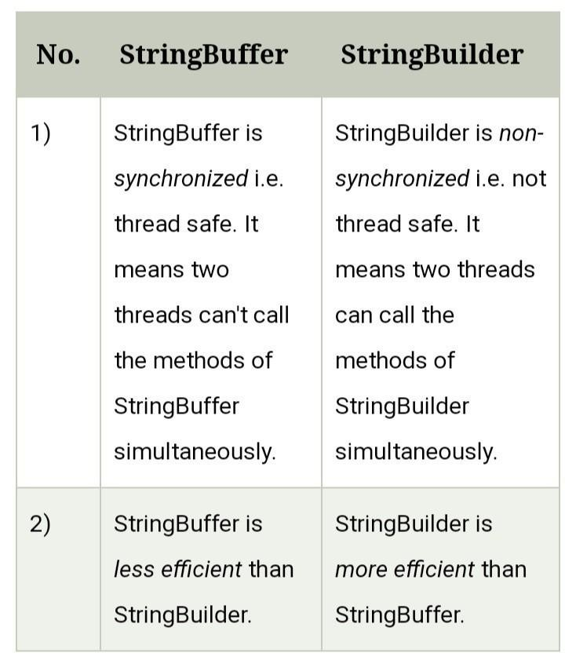
Difference between StringBuffer and StringBuilder
KNOWZILLA

Slide 171
Exception Handling in Java
The Exception Handling in Java is one of the powerful mechanism to handle the runtime errors so that normal flow of the application can be maintained.
Exception Handling is a mechanism to handle runtime errors such as ClassNotFoundException, IOException, SQLException, RemoteException, etc.
Types of Java Exceptions
There are mainly two types of exceptions: checked and unchecked. Here, an error is considered as the unchecked exception. According to Oracle, there are three types of exceptions:
Checked Exception
Unchecked Exception
Error
KNOWZILLA

Slide 172
Difference between Checked and Unchecked Exceptions
Checked Exception
The classes which directly inherit Throwable class except RuntimeException and Error are known as checked exceptions e.g. IOException, SQLException etc.
Checked exceptions are checked at compile-time.
Unchecked Exception
The classes which inherit RuntimeException are known as unchecked exceptions e.g. ArithmeticException, NullPointerException, ArrayIndexOutOfBoundsException etc.
Unchecked exceptions are not checked at compile-time, but they are checked at runtime.
Error
Error is irrecoverable e.g. OutOfMemoryError, VirtualMachineError, AssertionError etc.
KNOWZILLA

Slide 173
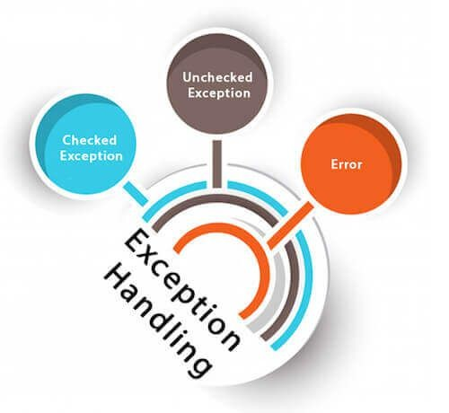
KNOWZILLA

Slide 174
Java Exception Keywords
try
The "try" keyword is used to specify a block where we should place exception code. The try block must be followed by either catch or finally.
It means, we can't use try block alone.
catch
The "catch" block is used to handle the exception.
It must be preceded by try block which means we can't use catch block alone.
It can be followed by finally block later.
finally
The "finally" block is used to execute the important code of the program.
It is executed whether an exception is handled or not.
KNOWZILLA

Slide 175
throw
The "throw" keyword is used to throw an exception.
throws
The "throws" keyword is used to declare exceptions.
It doesn't throw an exception.
It specifies that there may occur an exception in the method.
It is always used with method signature.
KNOWZILLA

Slide 176
Error vs Exception
Error: An Error indicates serious problem that a reasonable application should not try to
catch.
Exception: Exception indicates conditions that a reasonable application might try to catch
KNOWZILLA

Slide 177
Exception Handling Example
public class JavaExceptionExample
{
public static void main(String args[])
{
try{ //code that may raise exception int data=100/0;
}
catch(ArithmeticException e)
{
System.out.println(e);
} //rest code of the program System.out.println("rest of the code...");
}
}
OUTPUT:-
Exception in thread main java.lang.ArithmeticException:/ by zero
rest of the code...
KNOWZILLA

Slide 178
Common Scenarios of Java Exceptions
There are given some scenarios where unchecked exceptions may occur. They are as follows:
A scenario where ArithmeticException occurs
If we divide any number by zero, there occurs an ArithmeticException.
int a=50/0;//ArithmeticException
KNOWZILLA

Slide 179
2) A scenario where NullPointerException occurs
If we have a null value in any variable, performing any operation on the variable throws a NullPointerException.
String s=null;
System.out.println(s.length());//NullPointerException
KNOWZILLA

Slide 180
3) A scenario where NumberFormatException occurs
The wrong formatting of any value may occur NumberFormatException. Suppose I have a string variable that has characters, converting this variable into digit will occur NumberFormatException.
String s="abc";
int i=Integer.parseInt(s);//NumberFormatException
KNOWZILLA

Slide 181
4) A scenario where ArrayIndexOutOfBoundsException occurs
If you are inserting any value in the wrong index, it would result in ArrayIndexOutOfBoundsException as shown below:
int a[]=new int[5];
a[10]=50; //ArrayIndexOutOfBoundsException
KNOWZILLA

Slide 182
Java try block
Java try block is used to enclose the code that might throw an exception.
It must be used within the method.
If an exception occurs at the particular statement of try block, the rest of the block code will not execute.
So, it is recommended not to keeping the code in try block that will not throw an exception.
Java try block must be followed by either catch or finally block.
KNOWZILLA

Slide 183
try{
//code that may throw an exception
}catch(Exception_class_Name ref){}
KNOWZILLA
try{
//code that may throw an exception
}finally{}

Slide 184
Java catch block
Java catch block is used to handle the Exception by declaring the type of exception within the parameter.
The declared exception must be the parent class exception ( i.e., Exception) or the generated exception type.
However, the good approach is to declare the generated type of exception.
The catch block must be used after the try block only.
You can use multiple catch block with a single try block.
KNOWZILLA

Slide 185
public class TryCatchExample1
{
public static void main(String[] args)
{
int data=50/0; //may throw exception System.out.println("rest of the code");
}
}
KNOWZILLA
Exception in thread "main" java.lang.ArithmeticException: / by zero

Slide 186
public class TryCatchExample2
{
public static void main(String[] args)
{
try
{
int data=50/0; //may throw exception
} //handling the exception catch(ArithmeticException e)
{
System.out.println(e);
}
System.out.println("rest of the code");
}
KNOWZILLA
}
java.lang.ArithmeticException: / by zero rest of the code

Slide 187
public class TryCatchExample9 {
public static void main(String[] args) { try
{
int arr[]= {1,3,5,7};
System.out.println(arr[10]); //may throw exception
} // handling the array exception catch(ArrayIndexOutOfBoundsException e)
{
System.out.println(e);
}
System.out.println("rest of the code");
}
KNOWZILLA
}
java.lang.ArrayIndexOutOfBoundsException: 10 rest of the code

Slide 188
Java Nested try block
The try block within a try block is known as nested try block in java.
Why use nested try block
Sometimes a situation may arise where a part of a block may cause one error and the entire block itself may cause another error.
In such cases, exception handlers have to be nested.
KNOWZILLA

Slide 189
class Excep6{
public static void main(String args[])
{
try{ try{
System.out.println("going to divide"); int b =39/0;
}catch(ArithmeticException e)
{
System.out.println(e);
}
KNOWZILLA

Slide 190
try
{
int a[]=new int[5]; a[5]=4;
}catch(ArrayIndexOutOfBoundsException e)
{
System.out.println(e);
}
System.out.println("other statement);
}catch(Exception e)
{
System.out.println("handeled");
}
System.out.println("normal flow..");
}
KNOWZILLA

Slide 191
Java finally block
Java finally block is a block that is used to execute important code such as closing connection, stream etc.
Java finally block is always executed whether exception is handled or not.
Java finally block follows try or catch block.
KNOWZILLA
Why use java finally
Finally block in java can be used to put "cleanup" code such as closing a file, closing connection etc.

Slide 192
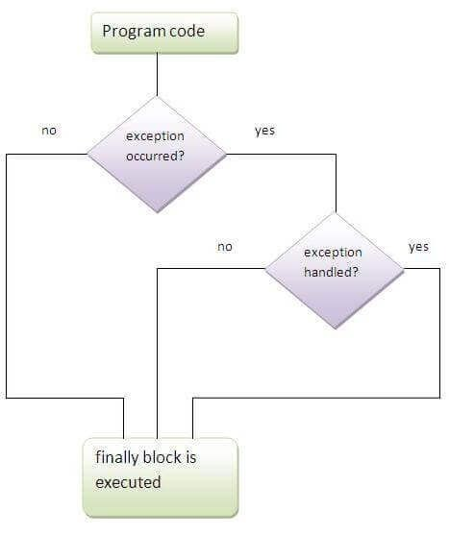
KNOWZILLA

Slide 193
EXAMPLE
finally
{
System.out.println("finally block is always executed");
}
System.out.println("rest of the code...");
}
}
Output:
Exception in thread main java.lang.ArithmeticException:/ by zero
finally block is always executed
public class TestFinallyBlock2
{
public static void main(String args[])
{
try
{
int data=25/0; System.out.println(data);
}
catch(ArithmeticException e)
{
System.out.println(e);
}
KNOWZILLA
rest of the code...

Slide 194
Java throw keyword
The Java throw keyword is used to explicitly throw an exception.
We can throw either checked or uncheked exception in java by throw keyword.
The throw keyword is mainly used to throw custom exception.
We will see custom exceptions later.
The syntax of java throw keyword is given below.
KNOWZILLA

Slide 195
1. throw exception;
Let's see the example of throw IOException.
1. throw new IOException("sorry device error);
KNOWZILLA

Slide 196
Java throw keyword example
In this example, we have created the validate method that takes integer value as a parameter.
If the age is less than 18, we are throwing the ArithmeticException otherwise print a message welcome to vote.
KNOWZILLA

Slide 197
public class TestThrow1
{
static void validate(int age)
{
if(age<18)
throw new ArithmeticException("not valid"); else
System.out.println("welcome to vote");
}
public static void main(String args[])
{
validate(13);
System.out.println("rest of the code...");
}
}
OUTPUT :
Exception in thread main java.lang.ArithmeticException:not valid
KNOWZILLA

Slide 198
Java throws keyword
The Java throws keyword is used to declare an exception.
It gives an information to the programmer that there may occur an exception so it is better for the programmer to provide the exception handling code so that normal flow can be maintained.
Exception Handling is mainly used to handle the checked exceptions.
If there occurs any unchecked exception such as NullPointerException, it is programmers fault that he is not performing check up before the code being used.
Syntax of java throws
return_type method_name() throws exception_class_name{
//method code
}
KNOWZILLA

Slide 199
EXAMPLE
import java.io.*;
class M
{
void method()throws IOException
{
throw new IOException("device error");
}
}
KNOWZILLA

Slide 200
public class Testthrows2
{
public static void main(String args[])
{
try
{
M m=new M(); m.method();
}
catch(Exception e)
{
System.out.println("exception handled");
}
System.out.println("normal flow...");
} }
KNOWZILLA

Slide 201
Difference between throw and throws
throw | throws
Java throw keyword is used to explicitly throw an exception. | Java throws keyword is used to declare an exception.
Checked exception cannot be propagated using throw only. | Checked exception can be propagated with throws.
Throw is followed by an instance. | Throws is followed by class.
Throw is used within the method. | Throws is used with the method signature.
You cannot throw multiple exceptions. | You can declare multiple exceptions e.g. public void method()throws IOException,SQLException.
KNOWZILLA

Slide 202
Difference between final, finally and finalize
No. | final | finally | finalize
1) | Final is used to apply restrictions on class, method and variable. Final class can't be inherited, final method can't be overridden and final variable value can't be changed. | Finally is used to place important code, it will be executed whether exception is handled or not. | Finalize is used to perform clean up processing just before object is garbage collected.
2) | Final is a keyword. | Finally is a block. | Finalize is a method.
KNOWZILLA

Slide 203
Java final example
class FinalExample
{
public static void main(String[] args)
{
final int x=100; x=200;//Compile Time Error
}
}
KNOWZILLA

Slide 204
Java finally example
class FinallyExample
{
public static void main(String[] args)
{
try{
int x=300;
}
catch(Exception e)
{
System.out.println(e);
}
Finally
{
System.out.println("finally block is executed");
}
}
}
KNOWZILLA

Slide 205
Java finalize example
class FinalizeExample{
public void finalize()
{
System.out.println("finalize called");
}
public static void main(String[] args)
{
FinalizeExample f1=new FinalizeExample();
FinalizeExample f2=new FinalizeExample();
f1=null; f2=null; System.gc();
}
}
KNOWZILLA

Slide 206
Java Applet
Applet is a special type of program that is embedded in the webpage to generate the dynamic content.
It runs inside the browser and works at client side.
Advantage of Applet
There are many advantages of applet. They are as follows:
It works at client side so less response time.
Secured
It can be executed by browsers running under many plateforms, including Linux, Windows, Mac Os etc.
KNOWZILLA

Slide 207
Lifecycle of Java Applet
Applet is initialized.
Applet is started.
Applet is painted.
Applet is stopped.
Applet is destroyed
KNOWZILLA

Slide 208
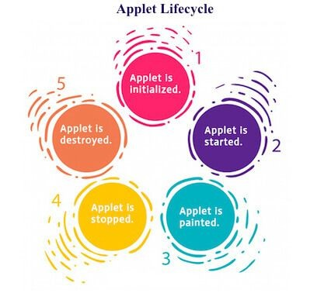
KNOWZILLA

Slide 209
Lifecycle methods for Applet:
The java.applet.Applet class 4 life cycle methods and java.awt.Component class provides 1 life cycle methods for an applet.
java.applet.Applet class
For creating any applet java.applet.Applet class must be inherited. It provides 4 life cycle methods of applet.
public void init(): is used to initialized the Applet. It is invoked only once.
public void start(): is invoked after the init() method or browser is maximized. It is used to start the Applet.
public void stop(): is used to stop the Applet. It is invoked when Applet is stop or browser is minimized.
public void destroy(): is used to destroy the Applet. It is invoked only once.
KNOWZILLA

Slide 210
java.awt.Component class
The Component class provides 1 life cycle method of applet.
public void paint(Graphics g): is used to paint the Applet. It provides Graphics class object that can be used for drawing oval, rectangle, arc etc.
How to run an Applet?
There are two ways to run an applet
By html file.
By appletViewer tool (for testing purpose).
KNOWZILLA

Slide 211
Simple example of Applet by html file:
To execute the applet by html file, create an applet and compile it.
After that create an html file and place the applet code in html file. Now click the html file.
import java.applet.Applet; import java.awt.Graphics; public class First extends Applet
{
public void paint(Graphics g)
{
g.drawString("welcome",150,150);
}
}
KNOWZILLA

Slide 212
myapplet.html
<html>
<body>
<applet code="First.class" width="300" height="300">
</applet>
</body>
</html>
KNOWZILLA

Slide 213
Simple example of Applet by appletviewer tool:
To execute the applet by appletviewer tool, create an applet that contains applet tag in comment and compile it.
After that run it by: appletviewer First.java. Now Html file is not required but it is for testing purpose only.
KNOWZILLA

Slide 214
//First.java
import java.applet.Applet; import java.awt.Graphics;
/*
<applet code="First.class" width="300" height="300">
</applet>
*/
c:\> javac First.java
c:\> appletviewer First.java
KNOWZILLA
public class First extends Applet{
public void paint(Graphics g){ g.drawString("Hello World",150,150);
}
}

Slide 215
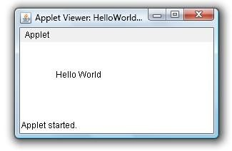
KNOWZILLA

Slide 216
*/
import java.awt.*; import java.applet.*;
public class DisplayImageInApplet extends Applet
{
Image img; public void init()
{
img = getImage(getCodeBase(),"Images/Juggler.gif");
}
public void paint(Graphics g)
{
g.drawImage(img,10,20,this);
}
}
KNOWZILLA

Slide 217
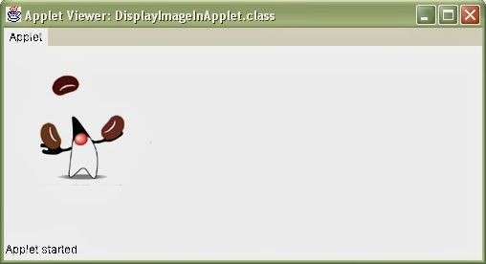
KNOWZILLA

Slide 218
Displaying Image in Applet
Applet is mostly used in games and animation.
For this purpose image is required to be displayed.
The java.awt.Graphics class provide a method drawImage() to display the image.
Syntax of drawImage() method:
1. public abstract boolean drawImage(Image img, int x, int y, ImageObserver observer):
is used draw the specified image.
KNOWZILLA

Slide 219
Other required methods of Applet class to display image:
public URL getDocumentBase(): is used to return the URL of the document in which applet is
embedded.
public URL getCodeBase(): is used to return the base URL.
KNOWZILLA

Slide 220
Example of displaying image in applet:
import java.awt.*;
import java.applet.*;
public class DisplayImage extends Applet { Image picture;
public void init() {
picture = getImage(getDocumentBase(),"sonoo.jpg");
}
public void paint(Graphics g) { g.drawImage(picture, 30,30, this);
}
}
KNOWZILLA

Slide 221
<html>
<body>
<applet code="DisplayImage.class" width="300" height="300">
</applet>
</body>
</html>
KNOWZILLA

Slide 222
Animation in Applet
Applet is mostly used in games and animation. For this purpose image is required to be moved.
import java.awt.*;
import java.applet.*;
public class AnimationExample extends Applet { Image picture;
public void init() {
picture =getImage(getDocumentBase(),"bike_1.gif");
}
KNOWZILLA

Slide 223
public void paint(Graphics g) {
for(int i=0;i<500;i++){ g.drawImage(picture, i,30, this);
try{Thread.sleep(100);}catch(Exception e){}
}
}
}
KNOWZILLA

Slide 224
myapplet.html
<html>
<body>
<applet code="DisplayImage.class" width="300" height="300">
</applet>
</body>
</html>
KNOWZILLA

Slide 225
Smiling Face
import java.applet.Applet;
g.fillOval(50,60,15,25); // Left Eye
import java.awt.*;
g.fillOval(120,60,15,25); // Right Eye
/* <applet code="SmileyExc.class" width="200" height="200">
int x[] = {95,85,106,95};
</applet>
int y[] = {85,104,104,85};
g.drawPolygon(x, y, 4); // Nose g.drawArc(55,95,78,50,0,-180); // Smile
KNOWZILLA
*/
public class SmileyExc extends Applet {
// drawArc(RectF oval, float startAngle, float sweepAngle, boolean useCenter, Paint paint)
g.drawLine(50,126,60,116); // Smile arc1 g.drawLine(128,115,139,126); // Smile arc2
public void paint(Graphics g) {
g.setColor(Color.yellow);
g.fillOval(20,20,150,150);
// For face
g.setColor(Color.black);
}
}

Slide 226
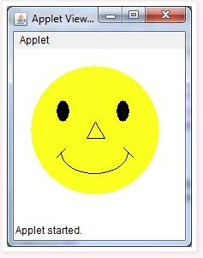
KNOWZILLA

Slide 227
import java.awt.*; import javax.swing.*;
public class rectangle extends JApplet {
Draw a rectangle using drawRect(int x, int y, int width, int height)
// paint the applet
public void paint(Graphics g)
{
// set Color for rectangle g.setColor(Color.red);
// draw a rectangle g.drawRect(100, 100, 200, 200);
}
}
public void init()
{
// set size setSize(400, 400); repaint();
}
KNOWZILLA

Slide 228
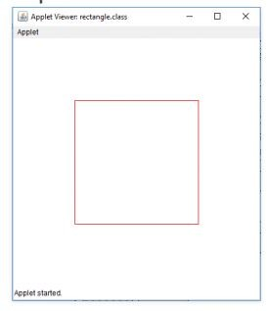
KNOWZILLA

Slide 229
import java.applet.*;
import java.awt.*;
g.fillRoundRect(130,50,120,70,15,15);
g.setColor(Color.RED); g.drawOval(20,160,160,100);
// drawOval( int X, int Y, int width, int height )
g.fillOval(180,160,160,100);
/* <applet code="Geo.class" width =300 height=300>
</applet>
*/
public class
Geo
extends Applet
KNOWZILLA
{
public void paint(Graphics g)
{
}
}
g.setColor(Color.GREEN);
g.drawLine(20,20,100,20);
g.drawRect(20,50,90,90);

Slide 230
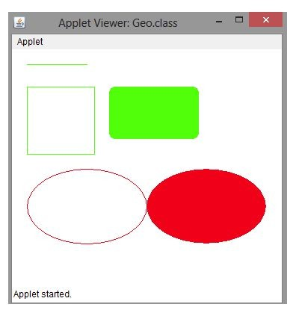
KNOWZILLA

Slide 231
Write an applet that draws four Vertical bars of equal size & of different colors such that they cover up the whole applet area
import java.applet.*; import java.awt.*;
/*
<applet code="equalBars.class" width="500" height="500">
</applet>
*/
public class equalBars extends Applet
{
Color[] clr = {Color.red, Color.green, Color.pink, Color.blue}; int cnt = 0;
KNOWZILLA

Slide 232
public void init()
{
setBackground(Color.black);
}
public void paint(Graphics g)
{
int w = getWidth(); int h = getHeight(); for(int i=0;i<4;i++)
{
g.setColor(clr[i]);
g.fillRect(w/4*i,0,w/4,h);
KNOWZILLA
// fillRect(int x, int y, int width, int height)
}
}
}

Slide 233

KNOWZILLA

Slide 234
Cartoon Character – Moving Hands
import java.applet.*; import java.awt.*;
/*
<applet code="Cartoon.class" width="500" height="700">
</applet>
*/
public class Cartoon extends Applet
{
int y = 200; public void init()
{
setBackground(Color.YELLOW);
}
KNOWZILLA

Slide 235
public void stop()
{
if (y==200) y = 50;
else
y = 200;
}
public void paint(Graphics g)
{ g.drawOval(200,50,100,100);
g.drawRect(50,150,400,50); g.drawRect(50,y,50,100); g.drawRect(400,y,50,100); g.drawRect(150,200,200,300); g.drawRect(150,500,50,100); g.drawRect(300,500,50,100);
}
KNOWZILLA

Slide 236
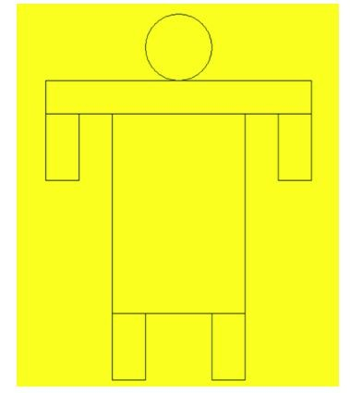
KNOWZILLA

Slide 237
Analog clock in Applet
import java.applet.*;
import java.awt.*; import java.util.*; import java.text.*;
public class MyClock extends Applet implements Runnable {
int width, height; Thread t = null;
boolean threadSuspended;
int hours=0, minutes=0, seconds=0; String timeString = "";
KNOWZILLA

Slide 238
public void init() {
width = getSize().width; height = getSize().height;
setBackground( Color.black ); }
public void start() {
if ( t == null ) {
t = new Thread( this );
t.setPriority( Thread.MIN_PRIORITY ); threadSuspended = false;
t.start();
}
KNOWZILLA

Slide 239
else {
if ( threadSuspended ) { threadSuspended = false; synchronized( this ) {
notify(); }
} } }
public void stop() { threadSuspended = true;
}
public void run() {
KNOWZILLA

Slide 240
Calendar cal = Calendar.getInstance();
hours = cal.get( Calendar.HOUR_OF_DAY );
if ( hours > 12 ) hours -= 12;
minutes = cal.get( Calendar.MINUTE ); seconds = cal.get( Calendar.SECOND );
SimpleDateFormat formatter
= new SimpleDateFormat( "hh:mm:ss", Locale.getDefault() ); Date date = cal.getTime();
timeString = formatter.format( date );
KNOWZILLA

Slide 241
// Now the thread checks to see if it should suspend itself
if ( threadSuspended ) {
synchronized( this ) {
while ( threadSuspended ) { wait();
} } }
repaint();
t.sleep( 1000 ); // interval specified in milliseconds
} }
catch (Exception e) { }
}
KNOWZILLA

Slide 242
void drawHand( double angle, int radius, Graphics g ) {
angle -= 0.5 * Math.PI;
int x = (int)( radius*Math.cos(angle) );
int y = (int)( radius*Math.sin(angle) );
g.drawLine( width/2, height/2, width/2 + x, height/2 + y );
}
void drawWedge( double angle, int radius, Graphics g ) { angle -= 0.5 * Math.PI;
int x = (int)( radius*Math.cos(angle) );
int y = (int)( radius*Math.sin(angle) );
KNOWZILLA

Slide 243
angle += 2*Math.PI/3;
int x2 = (int)( 5*Math.cos(angle) ); int y2 = (int)( 5*Math.sin(angle) ); angle += 2*Math.PI/3;
int x3 = (int)( 5*Math.cos(angle) );
int y3 = (int)( 5*Math.sin(angle) );
g.drawLine( width/2+x2, height/2+y2, width/2 + x, height/2 + y ); g.drawLine( width/2+x3, height/2+y3, width/2 + x, height/2 + y ); g.drawLine( width/2+x2, height/2+y2, width/2 + x3, height/2 + y3 );
}
KNOWZILLA

Slide 244
public void paint( Graphics g ) {
g.setColor( Color.gray );
drawWedge( 2*Math.PI * hours / 12, width/5, g ); drawWedge( 2*Math.PI * minutes / 60, width/3, g ); drawHand( 2*Math.PI * seconds / 60, width/2, g ); g.setColor( Color.white );
g.drawString( timeString, 10, height-10 );
}
}
KNOWZILLA

Slide 245
myapplet.html
<html>
<body>
<applet code="MyClock.class" width="300" height="300">
</applet>
</body>
</html>
KNOWZILLA

Slide 246
Applet Communication
java.applet.AppletContext class provides the facility of communication between applets. We provide the name of applet through the HTML file. It provides getApplet() method that returns the object of Applet.
KNOWZILLA
Syntax:
1. public Applet getApplet(String name){}

Slide 247
Write a program to generate a Bouncing Ball on Click
import java.applet.*;
import java.awt.*;
import java.awt.event.*;
public class ContextApplet extends Applet implements ActionListener{ Button b;
public void init(){ b=new Button("Click"); b.setBounds(50,50,60,50);
add(b); b.addActionListener(this);
}
KNOWZILLA

Slide 248
public void actionPerformed(ActionEvent e){
AppletContext ctx=getAppletContext(); Applet a=ctx.getApplet("app2"); a.setBackground(Color.yellow);
}
}
KNOWZILLA

Slide 249
myapplet.html
<html>
<body>
<applet code="ContextApplet.class" width="150" height="150" name="app1">
</applet>
<applet code="First.class" width="150" height="150" name="app2">
</applet>
</body>
</html>
KNOWZILLA

Slide 250
Java Swing
Java Swing tutorial is a part of Java Foundation Classes (JFC) that is used to create window-based applications.
It is built on the top of AWT (Abstract Windowing Toolkit) API and entirely written in java. Java Swing provides platform-independent and lightweight components.
Swing is more flexible and robust Some of the basic classes are
JApplet JFame JButton
KNOWZILLA

Slide 251
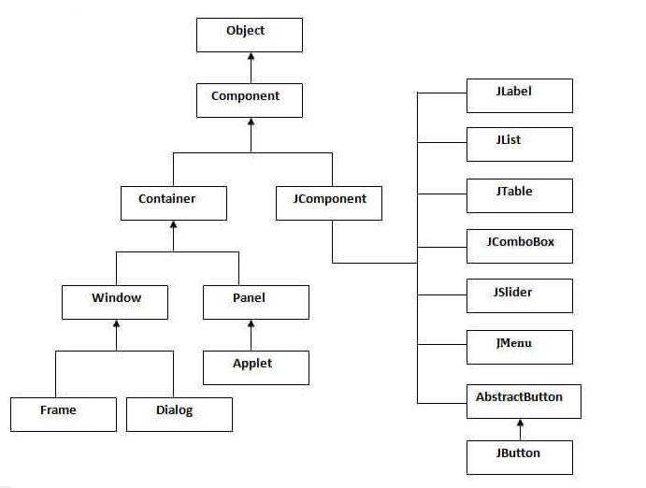
Hierarchy of Java Swing classes
KNOWZILLA

Slide 252
Features of Swing
Swing components are Lightweight
Having a number of built in controls
We can change the look and feel of the GUI
Swing is not thread safe
KNOWZILLA

Slide 253
import javax.swing.*;
f.setSize(400,500);//400 width and 500 height
A simple swing example where we are creating one button and adding it on the JFrame object inside the main() method.
public class FirstSwingExample
f.setLayout(null);//using no layout managers
{
f.setVisible(true);//making the frame visible
public static void main(String[] args)
}
{
}
JFrame f=new JFrame();//creating instance of JFrame
KNOWZILLA
JButton b=new JButton("click");//creating instance of JButton
javac FirstSwingExample .java
b.setBounds(130,100,100, 40);//x axis, y axis, width, height
java FirstSwingExample
f.add(b);//adding button in JFrame

Slide 254
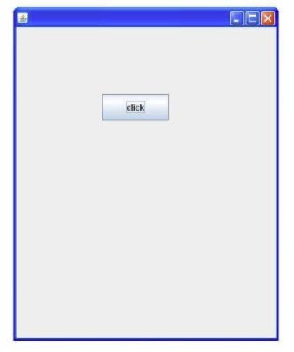
KNOWZILLA

Slide 255
Java JRadioButton
The JRadioButton class is used to create a radio button.
It is used to choose one option from multiple options.
It is widely used in exam systems or quiz.
It should be added in ButtonGroup to select one radio button only.
KNOWZILLA

Slide 256
import javax.swing.*;
public class RadioButtonExample {
bg.add(r1);bg.add(r2);
JFrame f;
f.add(r1);f.add(r2);
RadioButtonExample(){
f.setSize(300,300);
f=new JFrame();
f.setLayout(null);
f.setVisible(true);
JRadioButton r1=new JRadioButton("A) Male");
KNOWZILLA
JRadioButton r2=new JRadioButton("B) Female");
}
r1.setBounds(75,50,100,30);
public static void main(String[] args)
r2.setBounds(75,100,100,30);
{
ButtonGroup bg=new ButtonGroup();
new RadioButtonExample();
}
}

Slide 257
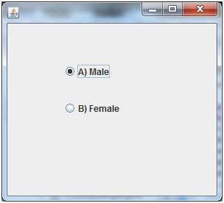
KNOWZILLA

Slide 258
Java JComboBox
The object of Choice class is used to show popup menu of choices.
Choice selected by user is shown on the top of a menu.
It inherits JComponent class.
KNOWZILLA

Slide 259
import javax.swing.*;
public class ComboBoxExample {
f.setLayout(null);
JFrame f;
f.setSize(400,500);
ComboBoxExample(){
f.setVisible(true);
f=new JFrame("ComboBox Example");
}
String
country[]={"India","Aus","U.S.A","England","Newzealand"};
public static void main(String[] args)
{
KNOWZILLA
JComboBox cb=new JComboBox(country);
new ComboBoxExample();
cb.setBounds(50, 50,90,20);
}
f.add(cb);
}

Slide 260
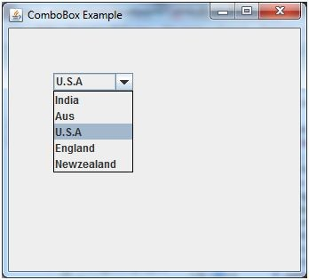
KNOWZILLA

Slide 261
Java JTable
The JTable class is used to display data in tabular form.
It is composed of rows and columns.
Let's see the declaration for javax.swing.JTable class.
KNOWZILLA

Slide 262
JTable jt=new JTable(data,column);
import javax.swing.*;
jt.setBounds(30,40,200,300);
public class TableExample {
JScrollPane sp=new JScrollPane(jt);
JFrame f;
f.add(sp);
TableExample(){
f.setSize(300,400);
f=new JFrame();
KNOWZILLA
f.setVisible(true);
String data[][]={ {"101","Amit","670000"},
}
{"102","Jai","780000"},
public static void main(String[] args) {
{"101","Sachin","700000"}};
new TableExample();
String column[]={"ID","NAME","SALARY"};
}
}

Slide 263
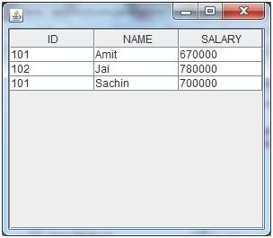
KNOWZILLA

