Slide 1

AREA-EFFICIENT 2D-DCT ARCHITECTURE
2022171005 권민찬
KECE463: VLSI DESIGN AND LABORATORY

Slide 2
Optimization Strategies
1. Efficient scheduling for the transposed memory
2. Zero substitution of high-frequency signals
3. Bit width reduction
4. Multiplier removal
5. Computation sharing
6. Synthesis-aware RTL optimization

Slide 3
Efficient TPMEM Scheduling
Z0
Z0_NEW
Z0
Ｘ
Z1
Z1
C0
C0
C1
C1
C2
C3
Z2
Z2
Z3
Z3
Corrupt!
Ping-pong structure
Dual-port w/o scheduling

Slide 4
Efficient TPMEM Scheduling
Z0_NEW
Z0_NEW_NEW
Z0
Z0
R/W
Z1
Z1
R/W
Z0_NEW
Z1_NEW
Z2_NEW
Z3_NEW
Z2
Z2
Z3
Z3
C0 (Transposed)
R0 (Transposed)
Phase 0: Row-wise write
Phase 1: Column-wise R/W
Phase 2: Row-wise R/W
Dual-port TPMEM with Proper Scheduling

Slide 5
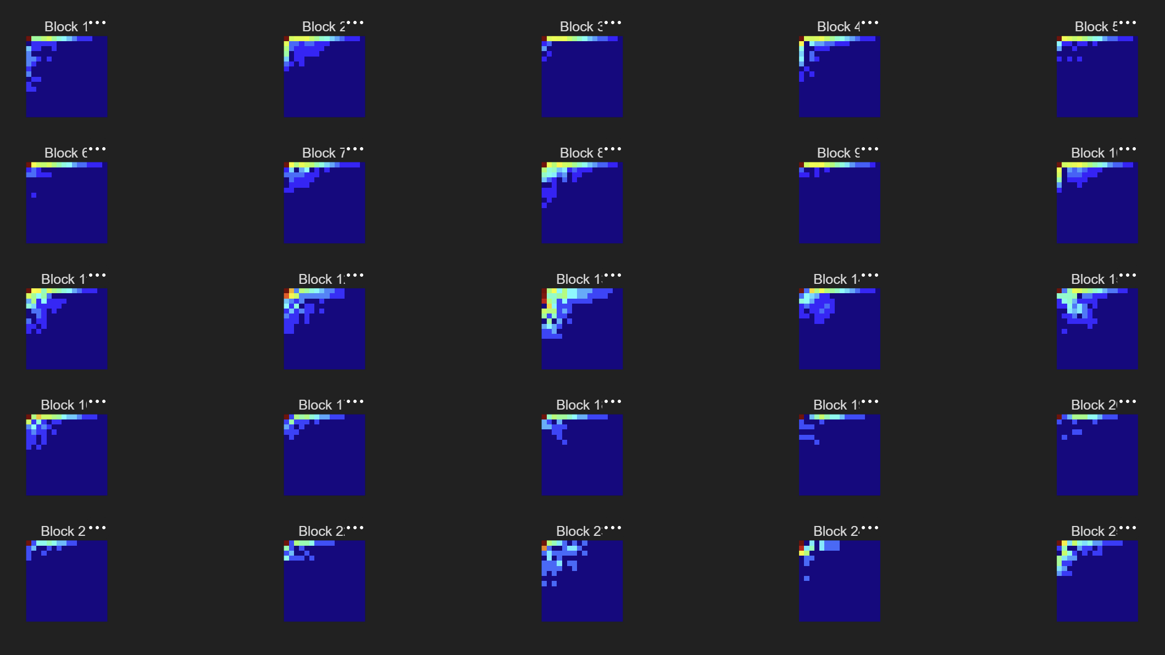
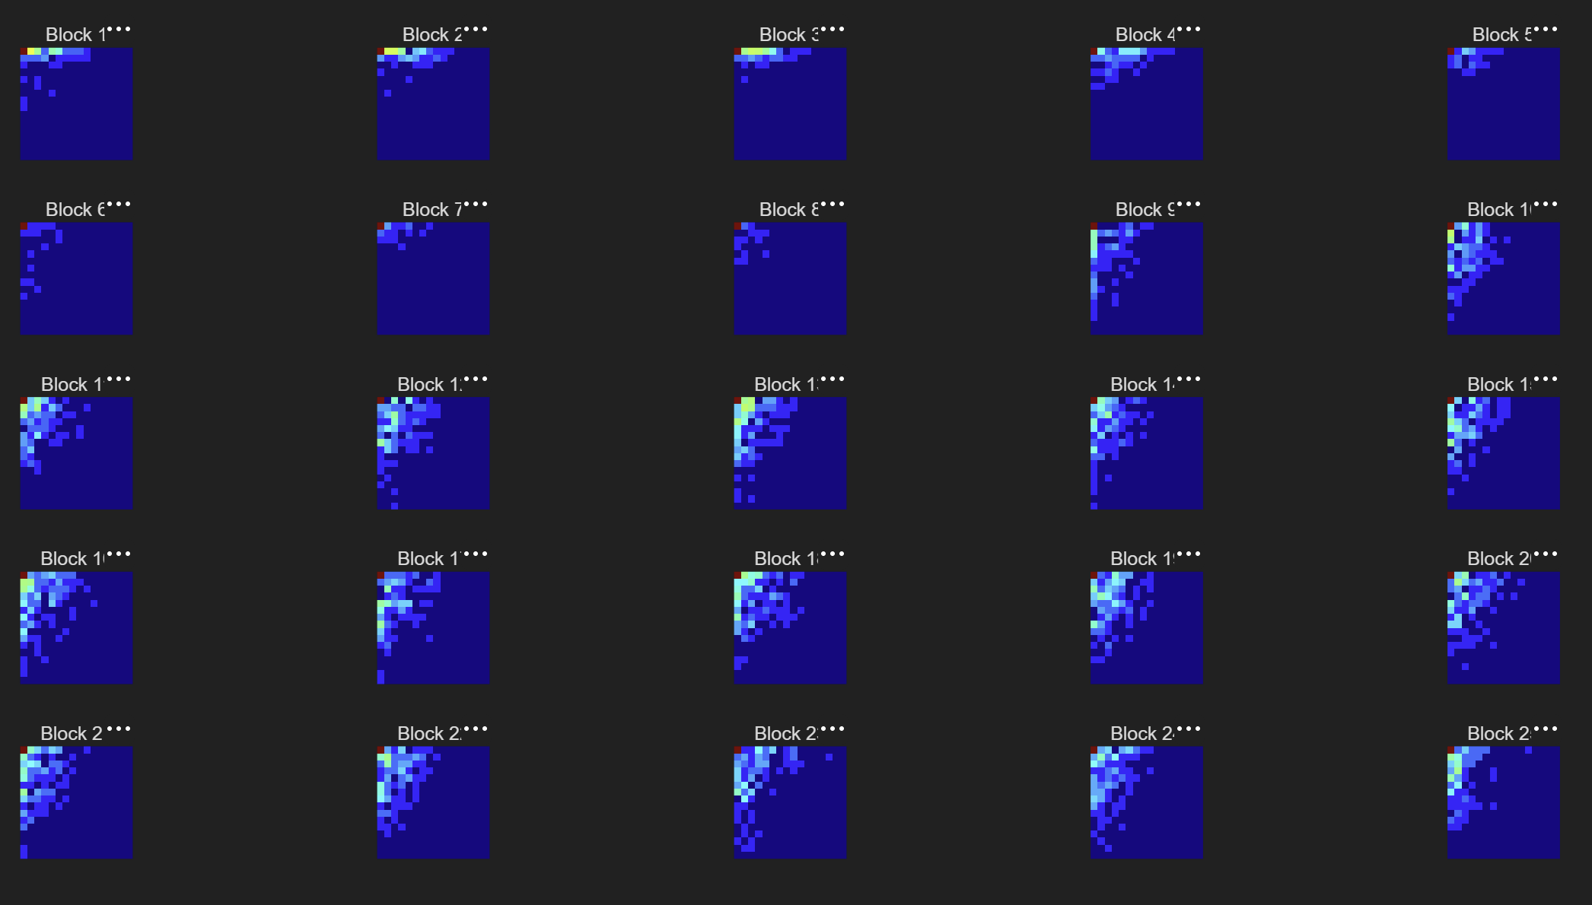
Quantization Profiling
High frequency signals (dark blue region) are mostly quantized to zero

Slide 6
Zero Substitution of AC Signals
Diagonal TPMEM2
Square TPMEM2
Discard!
Discard!
 | Diagonal | Square
# of Blocks | 136 Blocks | 144 Blocks
Non-combinational Area Reduction | 46.875% | 43.75%
Characteristics | Worse PSNR Potentially harder to schedule and code | Better PSNR Intuitive scheduling

Slide 7
Bit Width Profiling
Bit Width | C8 BW 12 | C8 BW10 | C6 BW12 | C6 BW10 | C6 BW9
Minimum PSNR | 30.11587 | 29.90643 | 29.96290 | 29.77558 | 29.01205
Optimal bit width w/o significant quality degradation

Slide 8
Truncation
1D-DCT
12-bit Integer
10-bit Integer
5-bit Decimal
LSB of the integer is lost!
Effectively dividing the result by 2.
2D-DCT
TPMEM2
14-bit Integer
5-bit Decimal
Q11.1
Q10.2
MATLAB expects Q11.1 format.
We should truncate the result to Q10.2 to compensate for the LSB loss in the first DCT

Slide 9
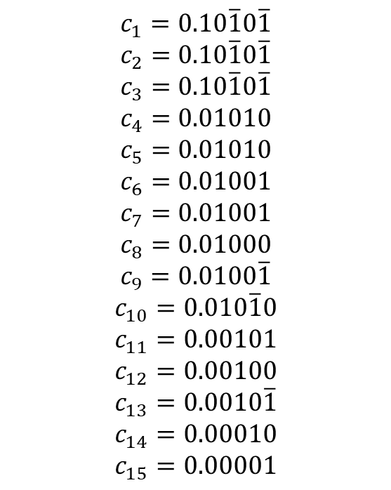

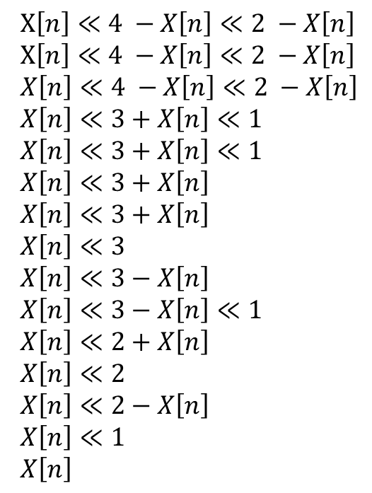
Multiplier Removal
$$c_{1}=0.10\overline{1}0\overline{1}$$
$$c_{2}=0.10\overline{1}0\overline{1}$$
$$c_{3}=0.10\overline{1}0\overline{1}$$
$$c_{4}=0.01010$$
$$c_{5}=0.01010$$
$$c_{6}=0.01001$$
$$c_{7}=0.01001$$
$$c_{8}=0.01000$$
$$c_{9}=0.0100\overline{1}$$
$$c_{10}=0.010\overline{1}0$$
$$c_{11}=0.00101$$
$$c_{12}=0.00100$$
$$c_{13}=0.0010\overline{1}$$
$$c_{14}=0.00010$$
$$c_{15}=0.00001$$
$X\left[n\right]≪4 −X\left[n\right]≪2 −X\left[n\right]$
$X\left[n\right]≪4 −X\left[n\right]≪2 −X\left[n\right]$
$X\left[n\right]≪4 −X\left[n\right]≪2 −X\left[n\right]$
$X\left[n\right]≪3+X\left[n\right]≪1$
$X\left[n\right]≪3+X\left[n\right]≪1$
$X\left[n\right]≪3+X\left[n\right]$
$X\left[n\right]≪3+X\left[n\right]$
$X\left[n\right]≪3$
$X\left[n\right]≪3−X\left[n\right]$
$X\left[n\right]≪3−X\left[n\right]≪1$
$X\left[n\right]≪2+X\left[n\right]$
$X\left[n\right]≪2$
$X\left[n\right]≪2−X\left[n\right]$
$X\left[n\right]≪1$
$X\left[n\right]$
$× X[n]$ =

Slide 10
Computation Sharing
x0
+
s2_0
s2_0
+
s4_0
x15
-
d2_0
x1
+
s2_1
s2_7
-
d4_0
…
Reuse the computation results multiple times!
x14
-
d2_1
…
s2_3
+
s4_3
x7
+
s2_7
s2_4
-
d4_3
x8
-
d2_7

Slide 11
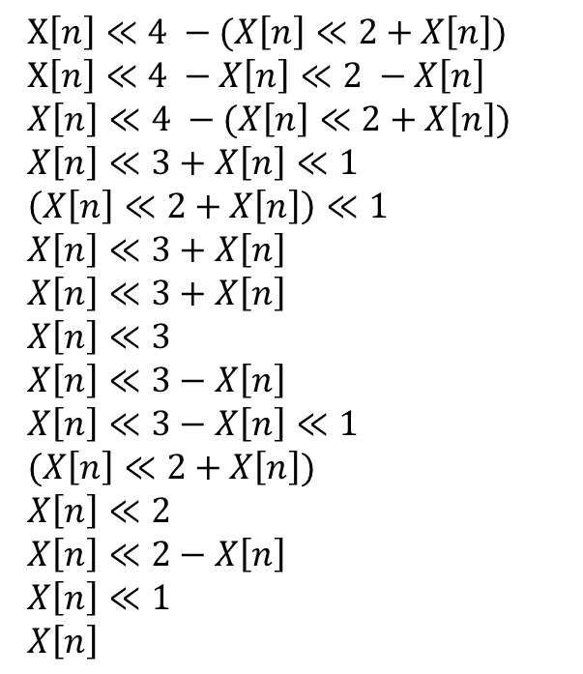
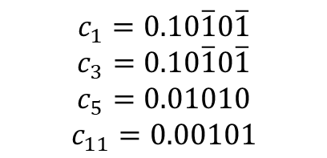
Computation Sharing
$X\left[n\right]≪4 −(X\left[n\right]≪2+X\left[n\right])$
$X\left[n\right]≪4 −X\left[n\right]≪2 −X\left[n\right]$
$X\left[n\right]≪4 −(X\left[n\right]≪2+X\left[n\right])$
$X\left[n\right]≪3+X\left[n\right]≪1$
$\left(X\left[n\right]≪2+X\left[n\right]\right)≪1$
$X\left[n\right]≪3+X\left[n\right]$
$X\left[n\right]≪3+X\left[n\right]$
$X\left[n\right]≪3$
$X\left[n\right]≪3−X\left[n\right]$
$X\left[n\right]≪3−X\left[n\right]≪1$
$(X\left[n\right]≪2+X\left[n\right])$
$X\left[n\right]≪2$
$X\left[n\right]≪2−X\left[n\right]$
$X\left[n\right]≪1$
$X\left[n\right]$
$$c_{1}=0.10\overline{1}0\overline{1}$$
$$c_{3}=0.10\overline{1}0\overline{1}$$
$$c_{5}=0.01010$$
$$c_{11}=0.00101$$

Slide 12
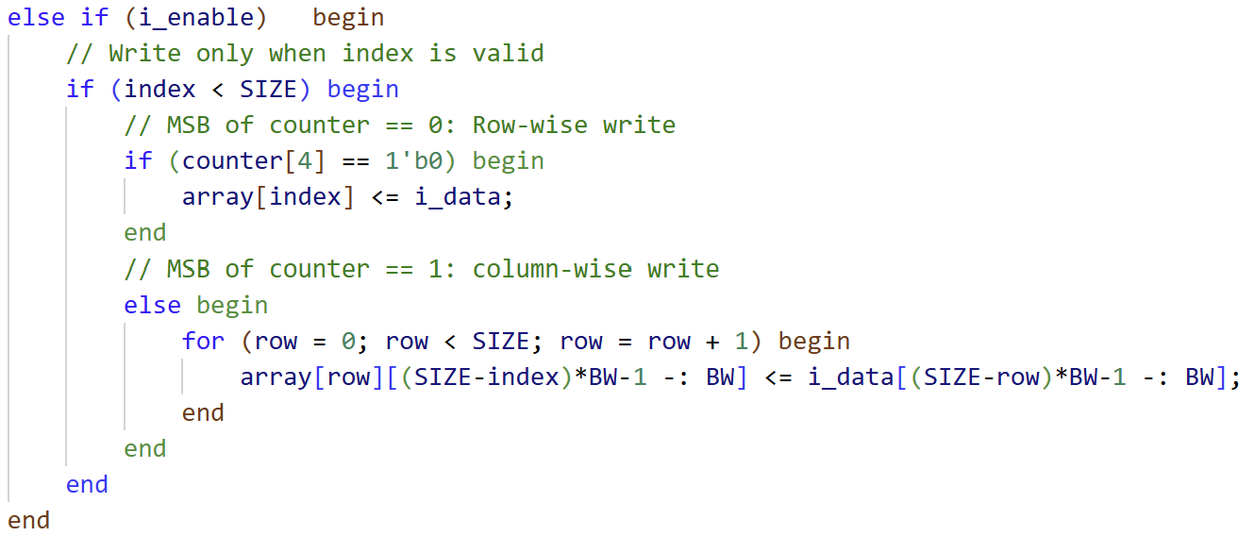
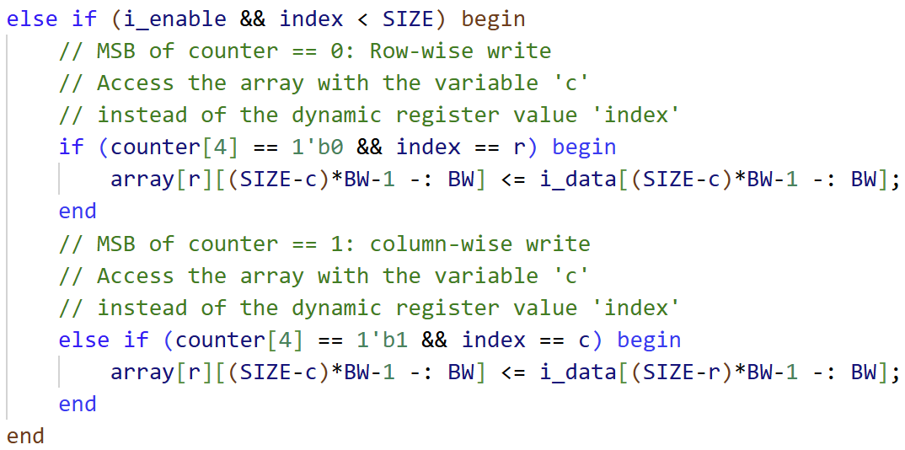
Synthesis-aware RTL Optimization
Guiding Design Compiler to:
1. Reduce the Combinational Logic Area in the Transposed Memory Module
Decoder
Enable
index
Router
Simple decoder!
Data
Wide data router!
Data bus

Slide 13
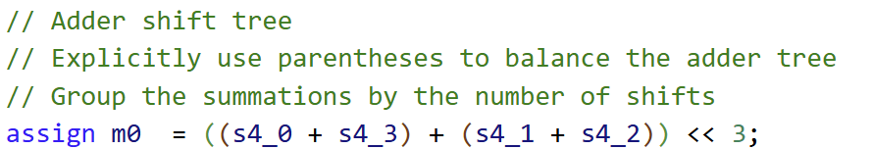

Synthesis-aware RTL Optimization
Guiding Design Compiler to:
2. Synthesize a Balanced Adder Tree in the DCT Module
 | Before |  | After
 | Combinational | Non-combinational | Combinational | Non-combinational
TPMEM1 | 443843 | 505471 | 379653 | 505355
TPMEM2 | 691625 | 367670 | 302414 | 370258
DCT_2D | 442516 | - | 398334 | -
Result of Synthesis-aware RTL Optimization

Slide 14
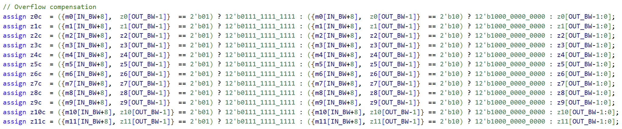
Glitch Handling
Sign reversal after truncation will cause glitches to occur.
NO
Saturate
sign(m) == sign(z)
YES
No-op

Slide 15
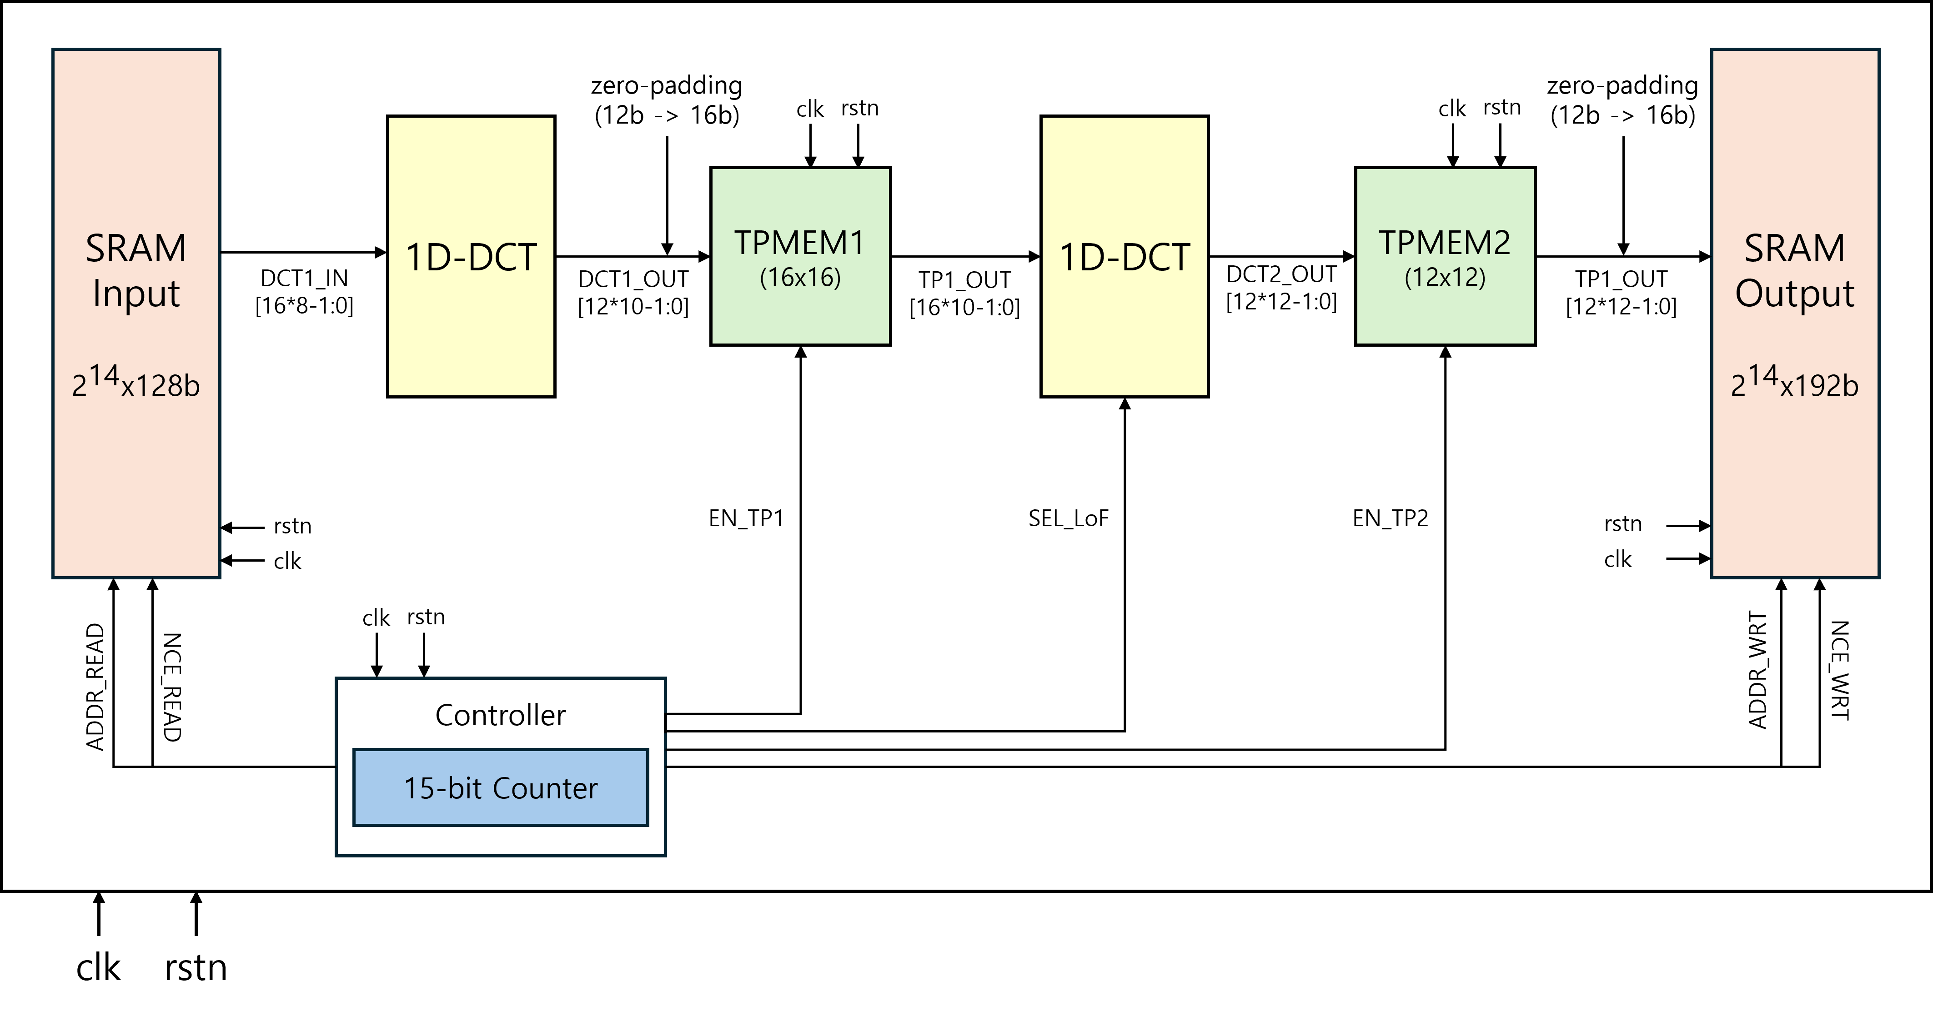
Architecture

Slide 16
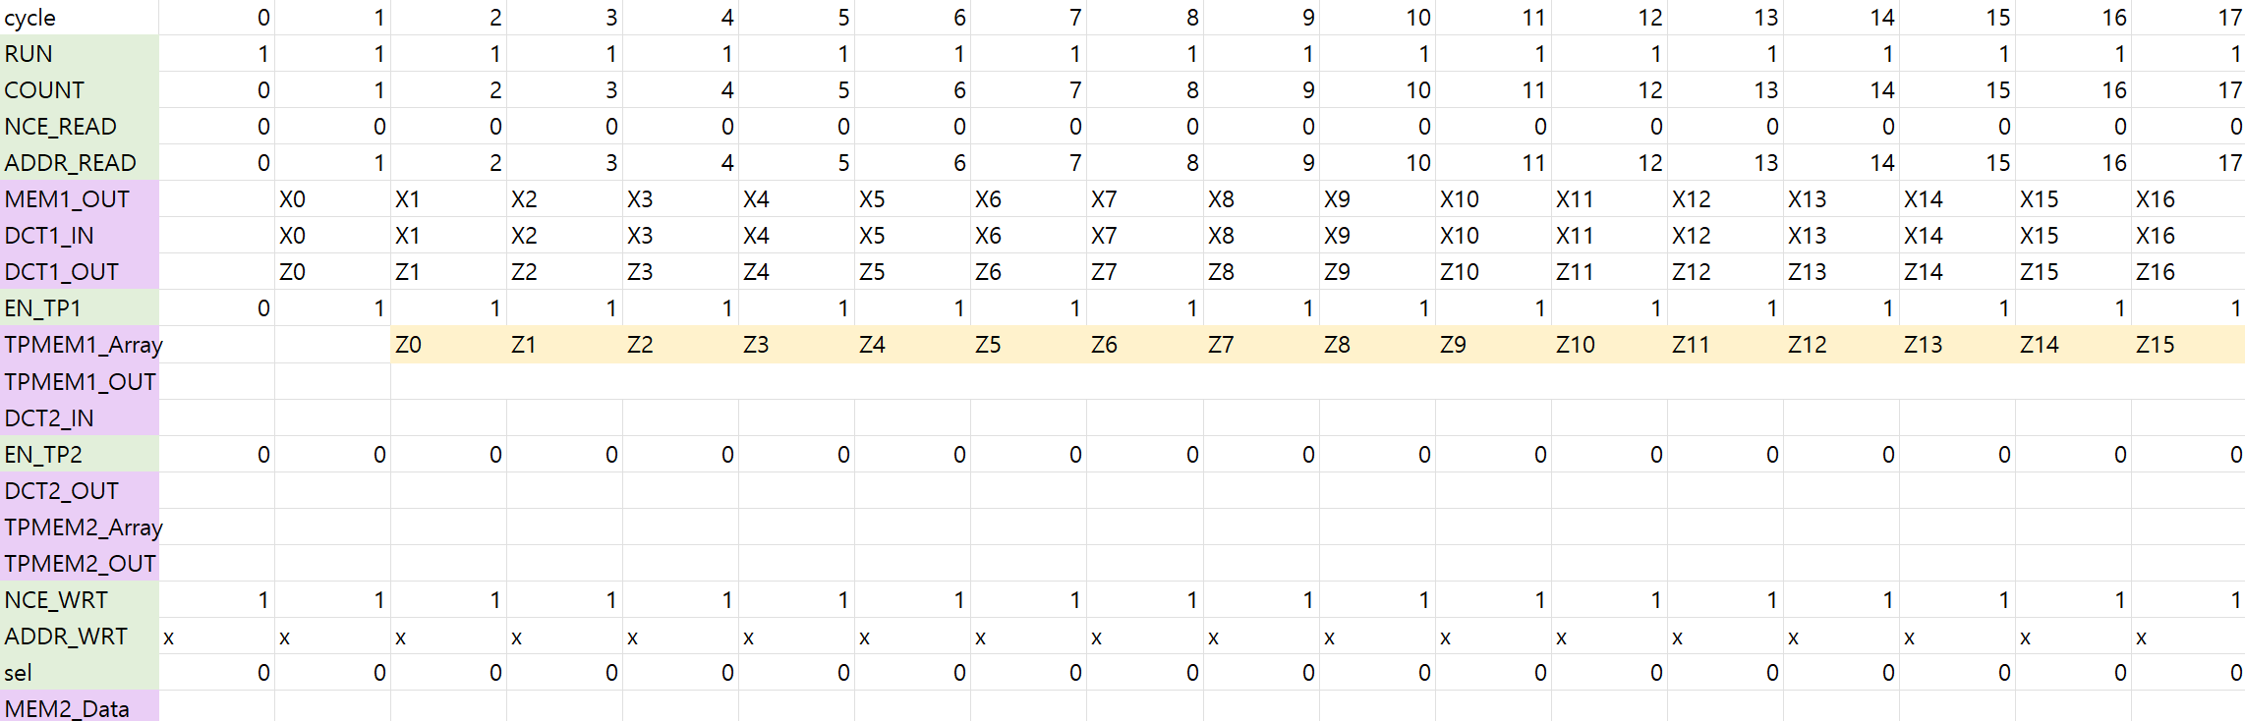
Dataflow and Control Signals

Slide 17
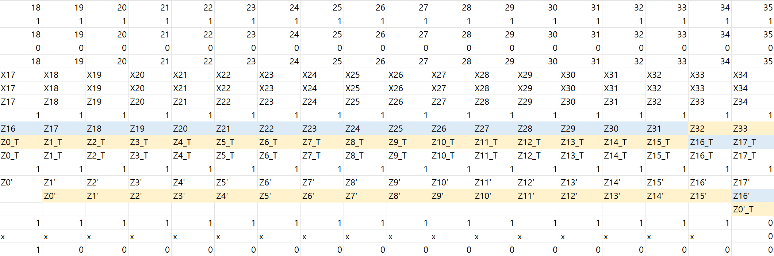
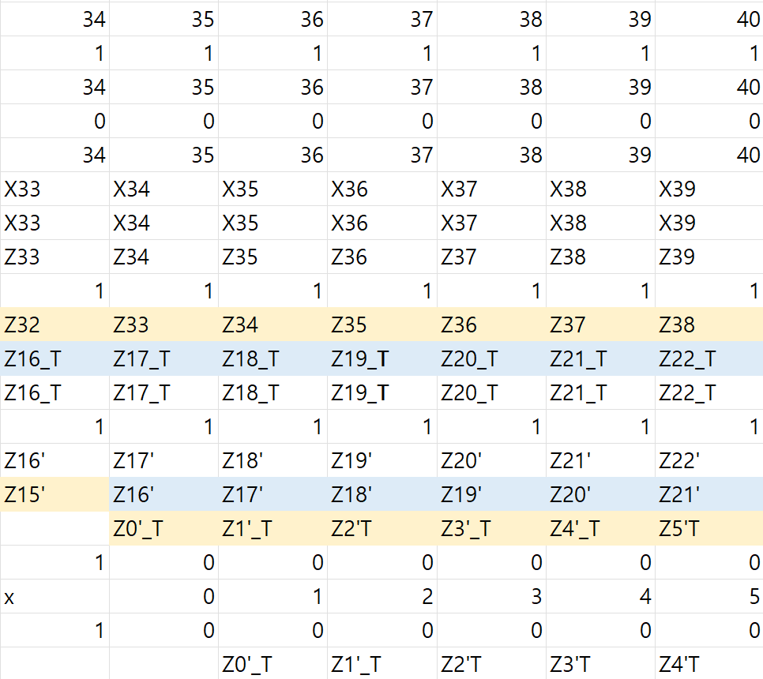
Dataflow and Control Signals

Slide 18
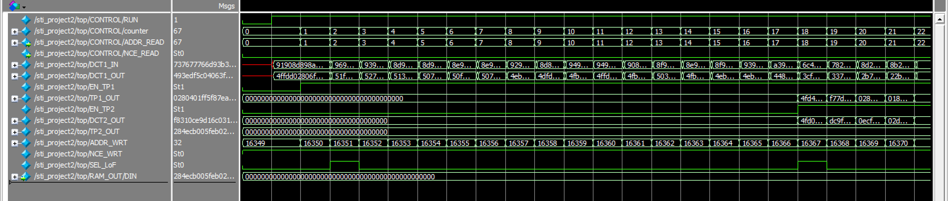
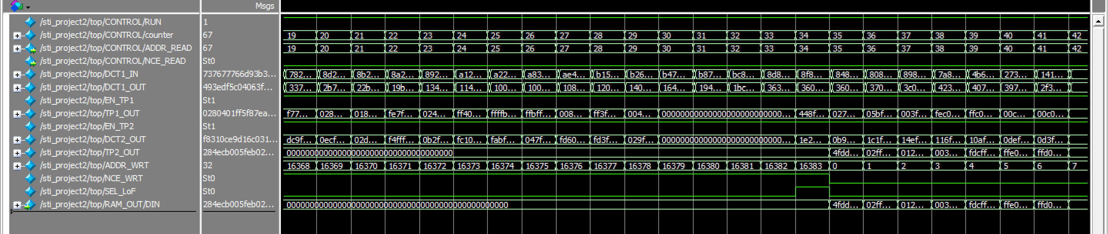
Waveform

Slide 19
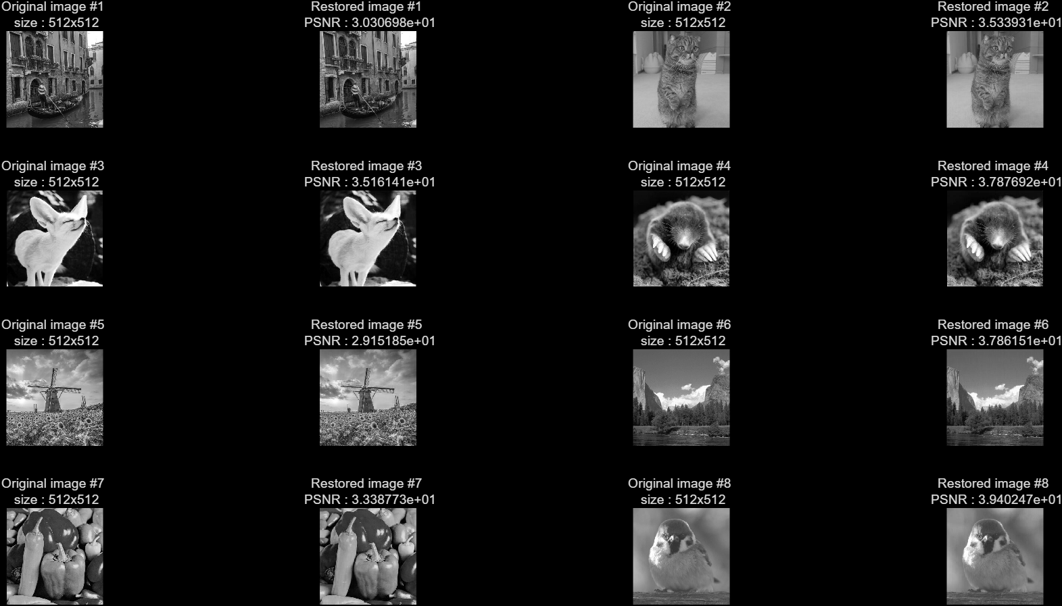
Final PSNR Results

Slide 20
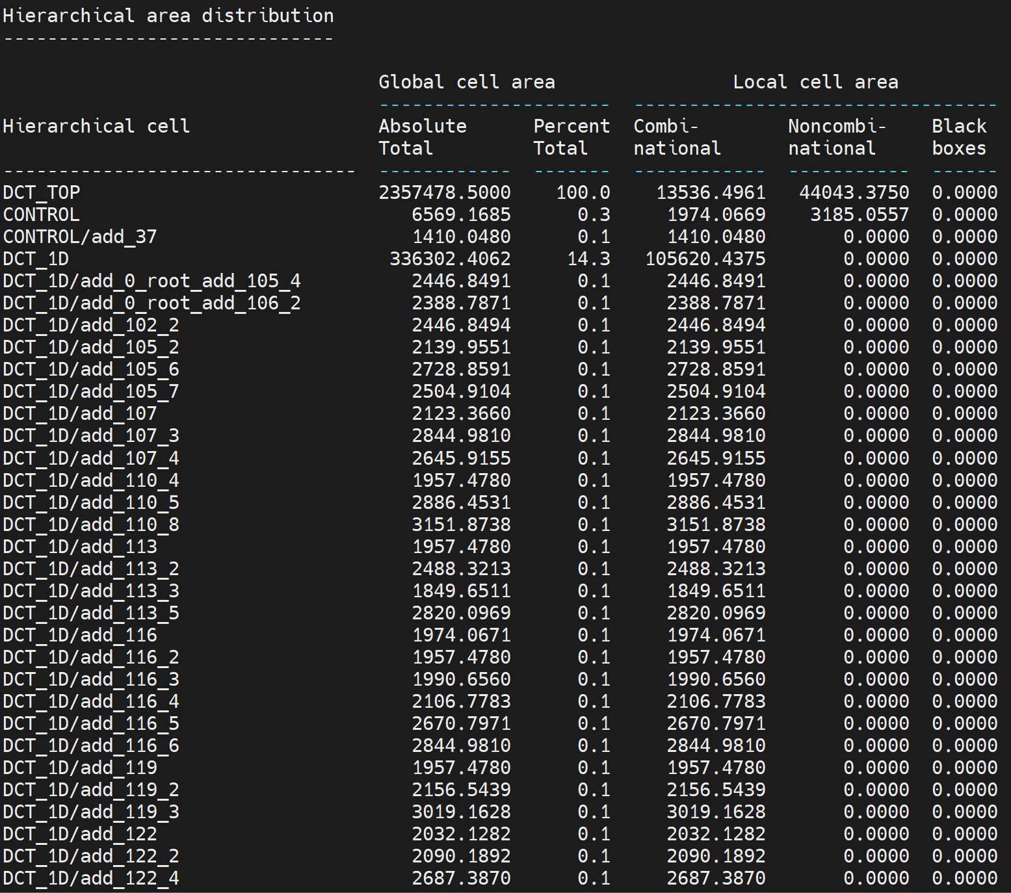
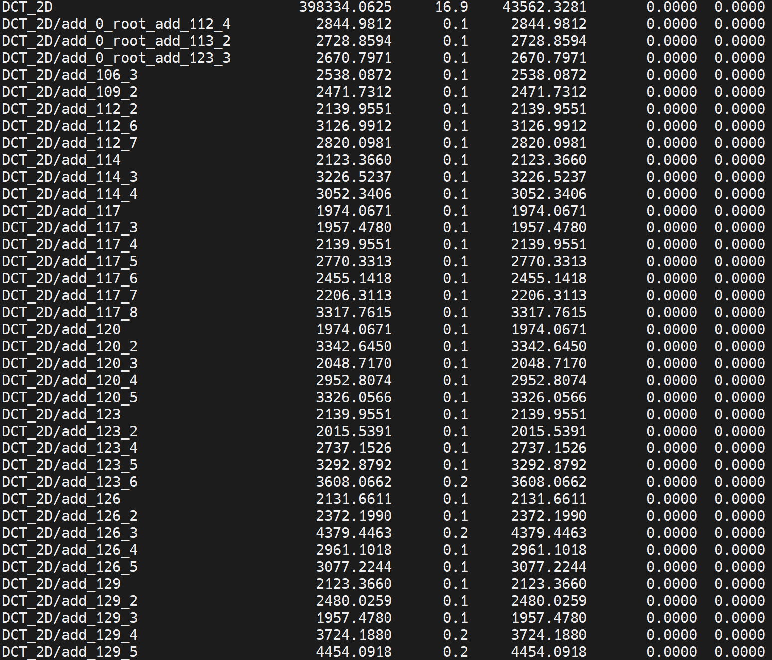
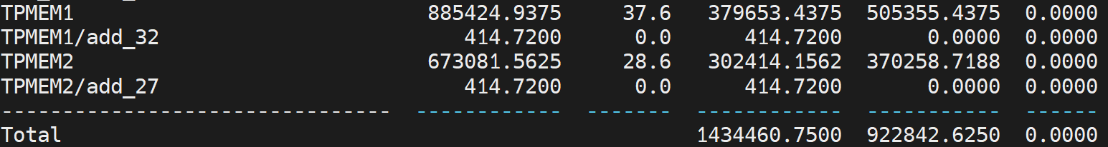
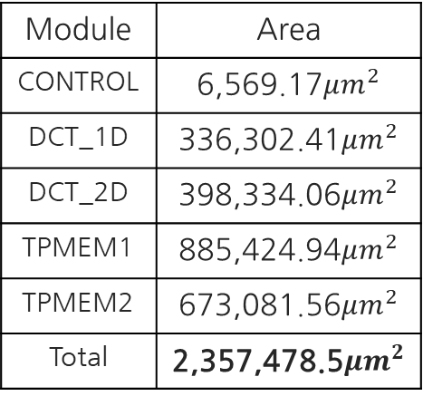
Synthesis Results
Module | Area
CONTROL | 6,569.17$μm^{2}$
DCT_1D | 336,302.41$μm^{2}$
DCT_2D | 398,334.06$μm^{2}$
TPMEM1 | 885,424.94$μm^{2}$
TPMEM2 | 673,081.56$μm^{2}$
Total | 2,357,478.5$μm^{2}$

Slide 21
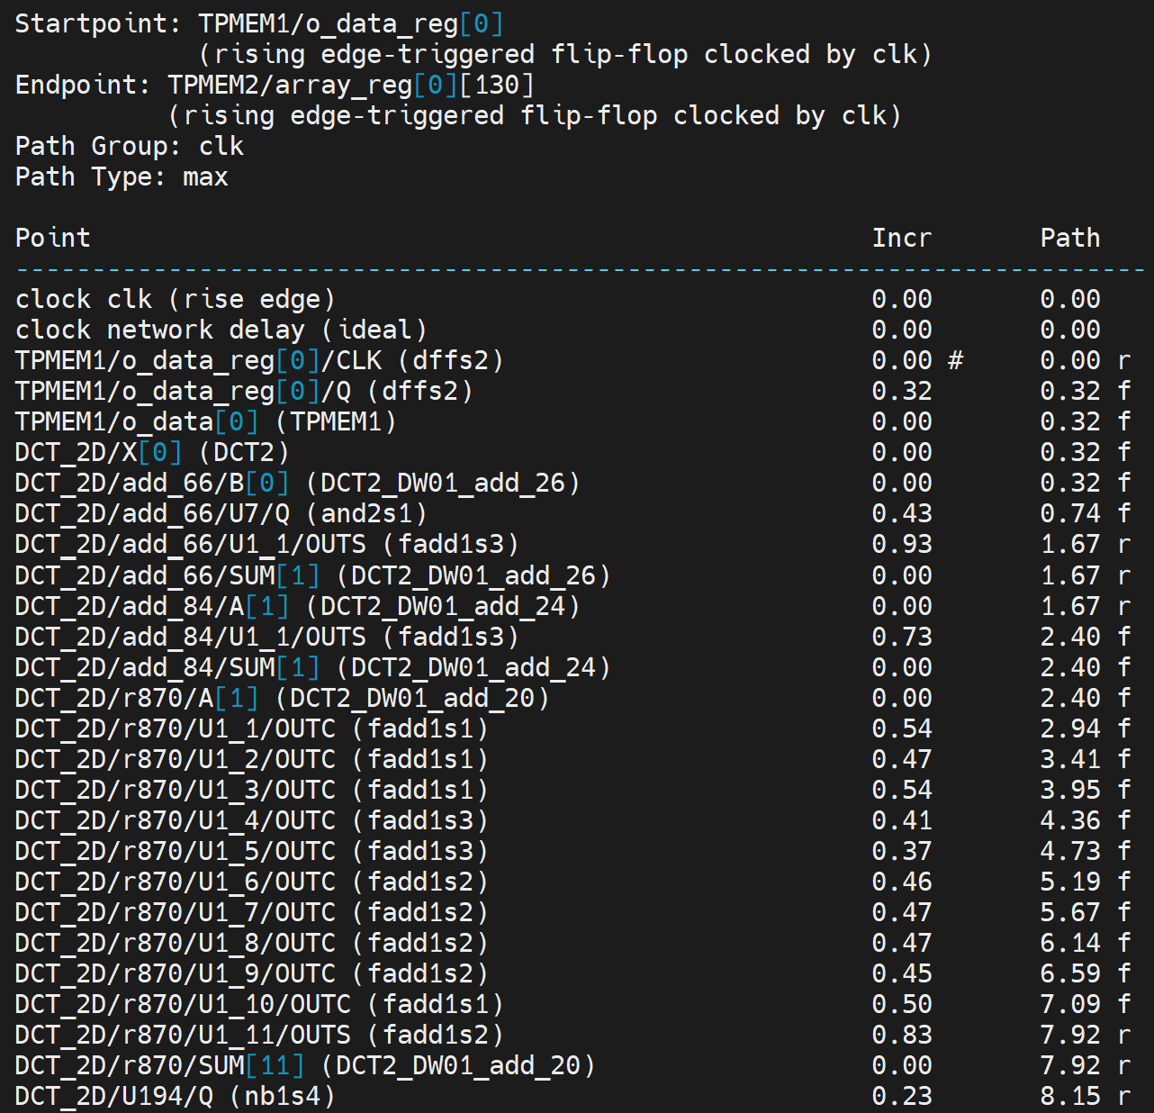
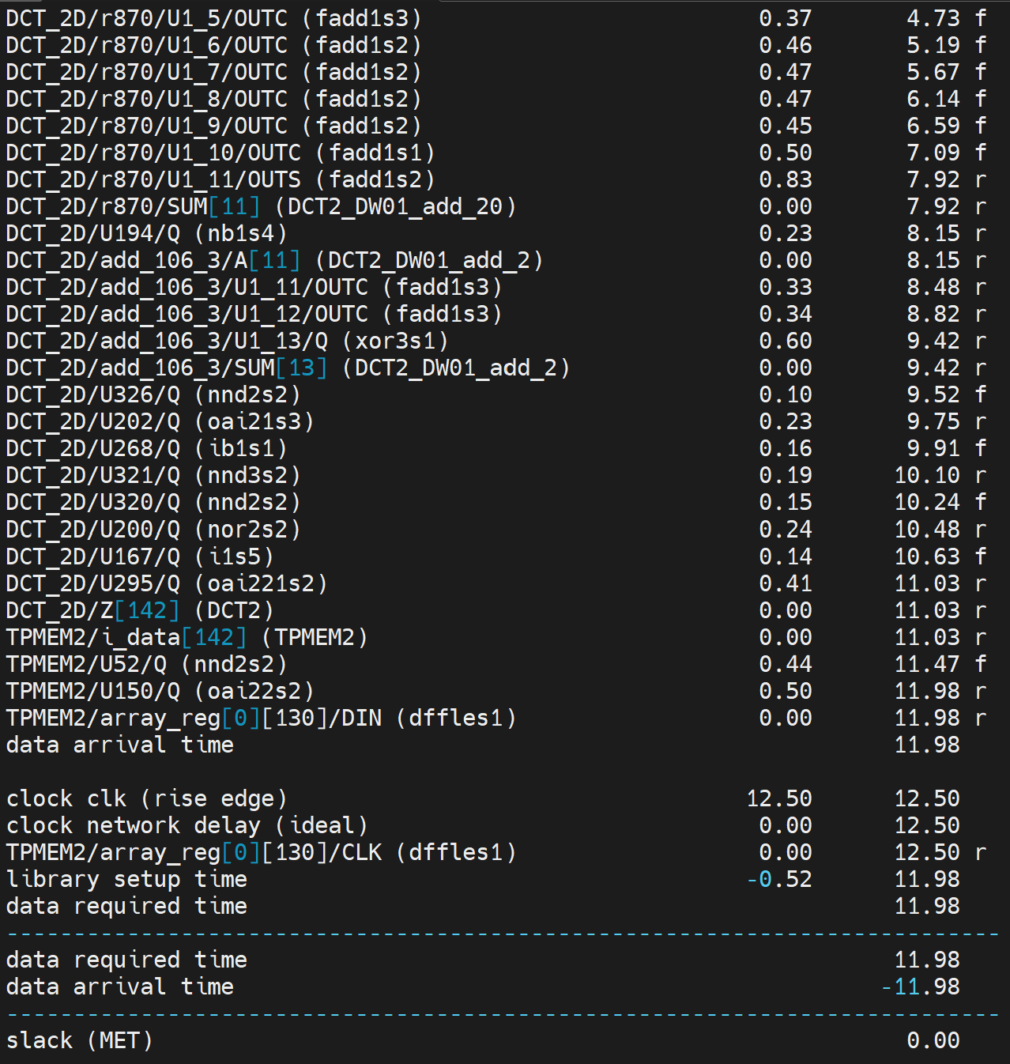
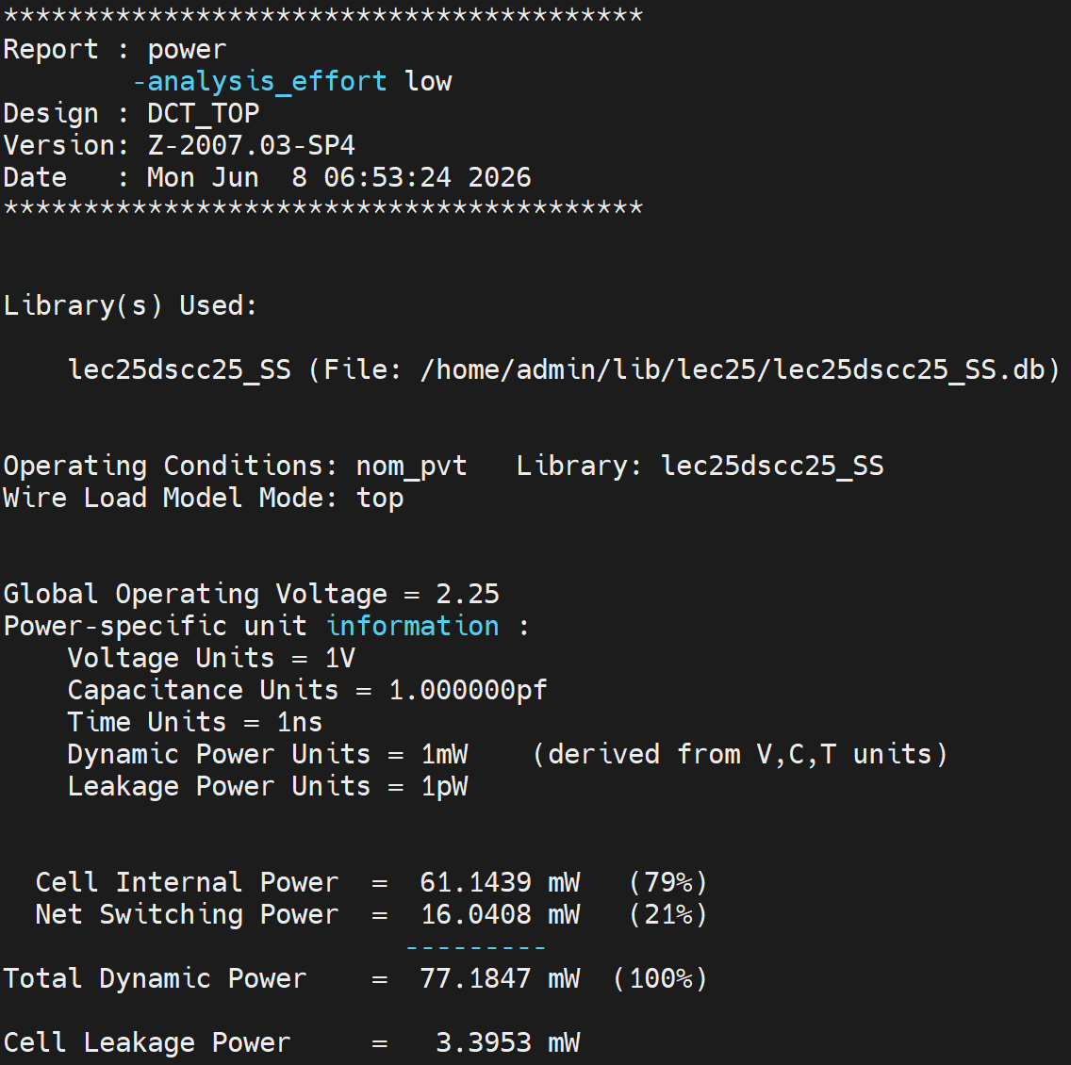
Synthesis Results
Timing: Met
Critical Path: TPMEM -> 2nd DCT -> TPMEM
Power: 77.1847mW

Slide 22
Thank You!

