Slide 1
Smart Parking Slots For Vehicles
- Mind Optimizers (Terna Engineering College, Navi Mumbai)
Ajesh DS
Sagar Gupta
Parth Vaidya
Swarajsingh Patil
Yash Shettigar

Slide 2
Problem Statement
Nowadays, we know that people commuting with personal vehicles has been ever increasing, leading to situations where it has become difficult for them to find a proper parking slot. In general, there are infrastructures for parking systems where people need to spend a lot of time in queues to buy tickets for the same. This situation becomes really irritating for these commuters in case of emergencies.

Slide 3
Our Idea
Our idea is to improve the traditional parking system. The approach to this problem comprises of a centralized system for managing parking spaces in different areas. Commuters can easily find and reserve a suitable parking slot near them using our Mobile App.

Slide 4
Idea Implementation
The app utilizes the user's location to find and suggest nearby parking spaces with slots available.
Once the user has selected a suitable parking slot and paid the initial fee for reserving the slot, the app will generate a ticket along with a QR Code which can be used to enter the parking area.
The user has to provide their QR Code to unlock and enter the chosen parking slot.
Once the user is ready to check out, they can scan their QR Code once again to open the gates of the parking slots.
If their vehicle was parked beyond time limit given by them, they'll have to pay the extra charges for checking out.

Slide 5



Technology Stack

Slide 6
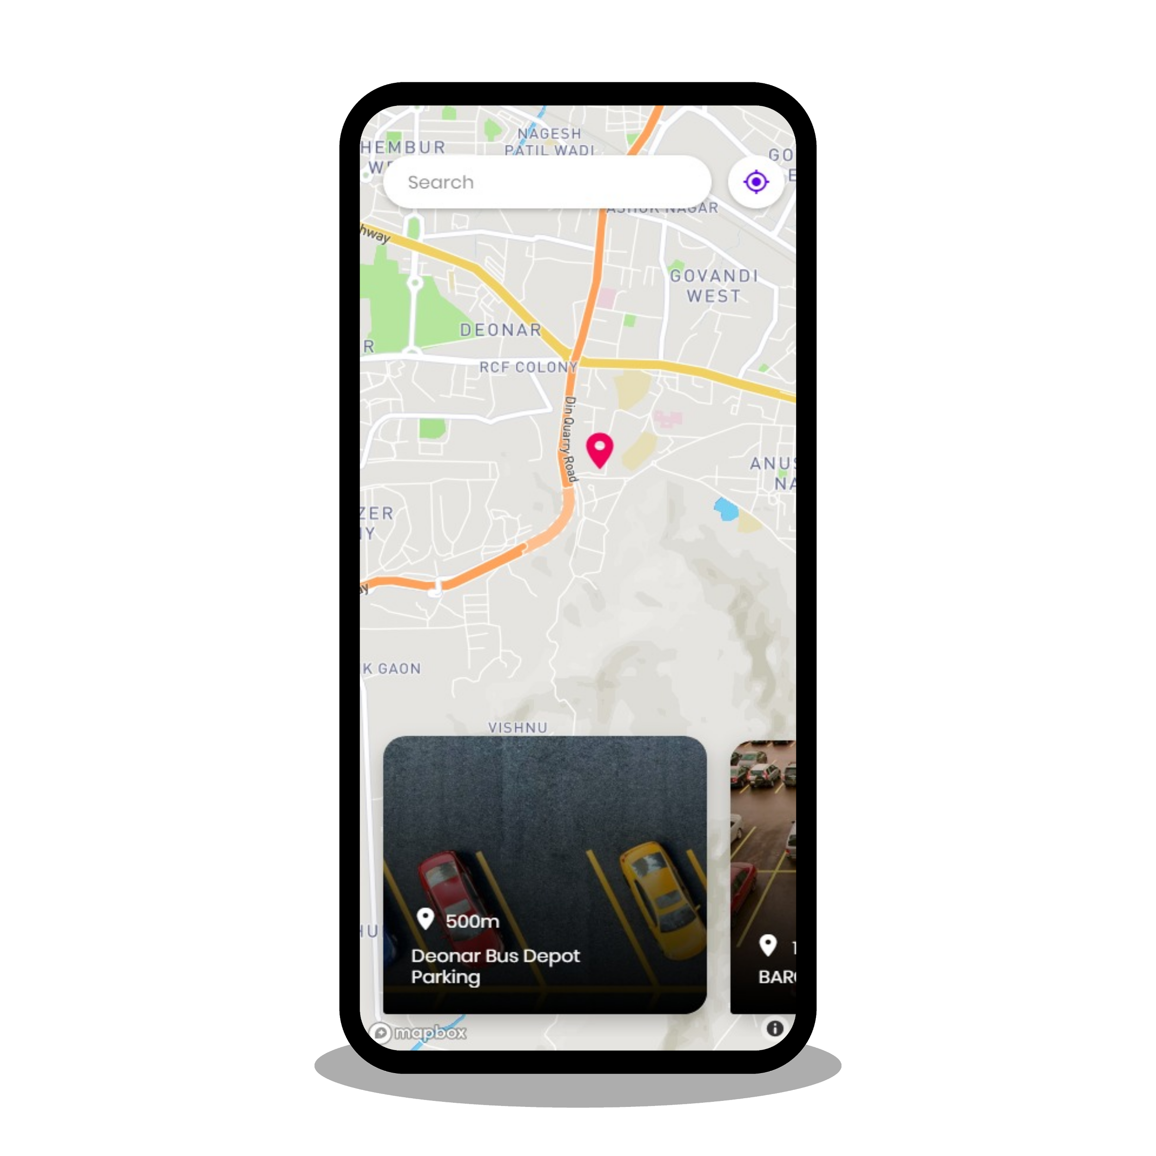
Usage Flow
App gets the user's location.
The app suggests the user all parking spaces with available slots within 1.5 km of their current location.
The user selects a preferable parking space and duration. They can now proceed to reserve a slot.
Once the user pays the initial reservation charges and the base price, a QR Code is generated.

Slide 7
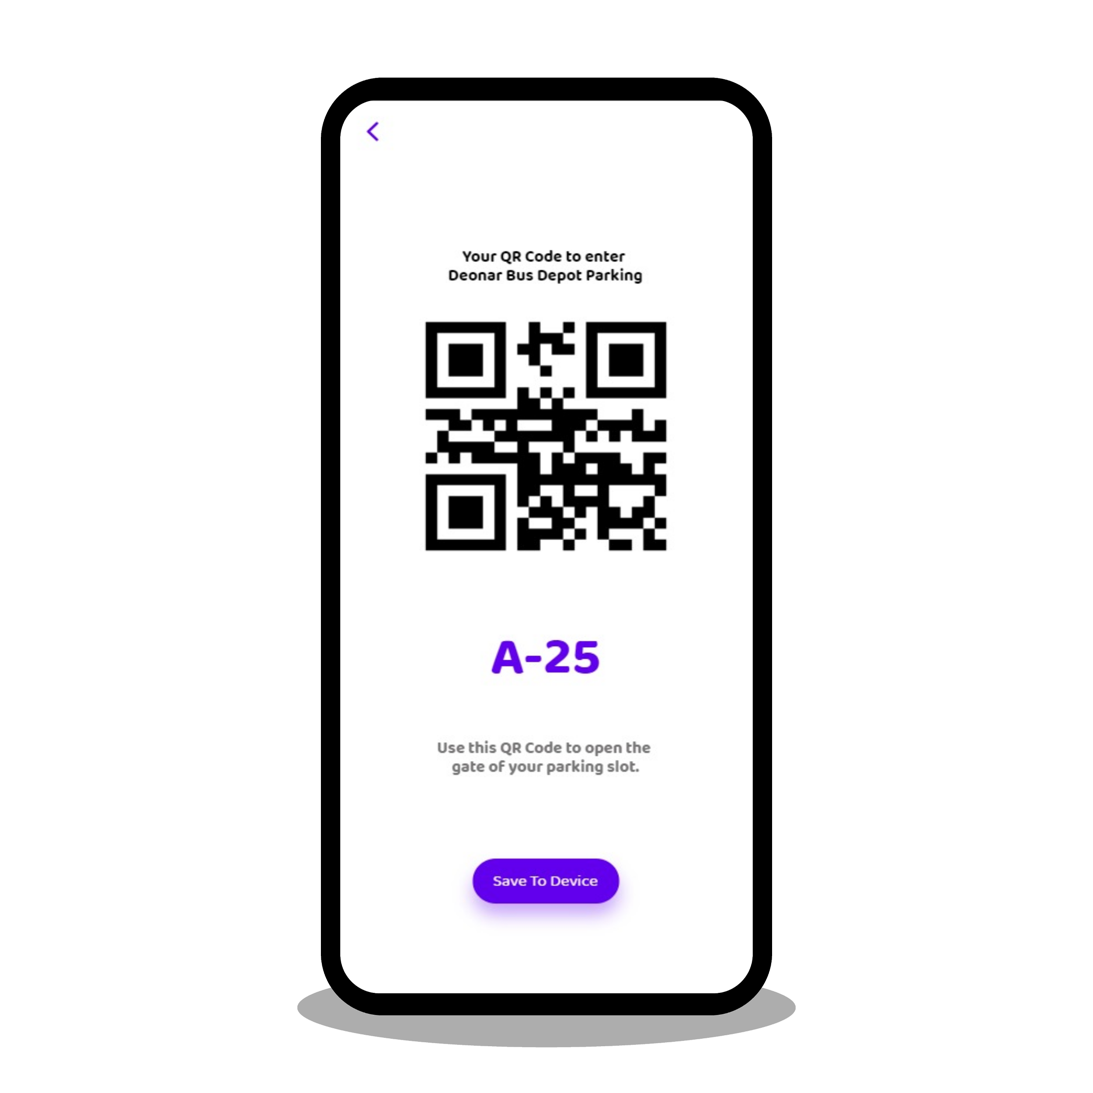
Usage Flow
The user reaches the location and displays their QR Code at the scanning device.
Once the QR Code is verified, the gate opens, and the user can park their vehicle.
Once the user is ready to check out, they scan their QR Code once again.
The gates will now open, and the user can check out.
User has to pay for any extra charges, the next time they use the app.

Slide 8
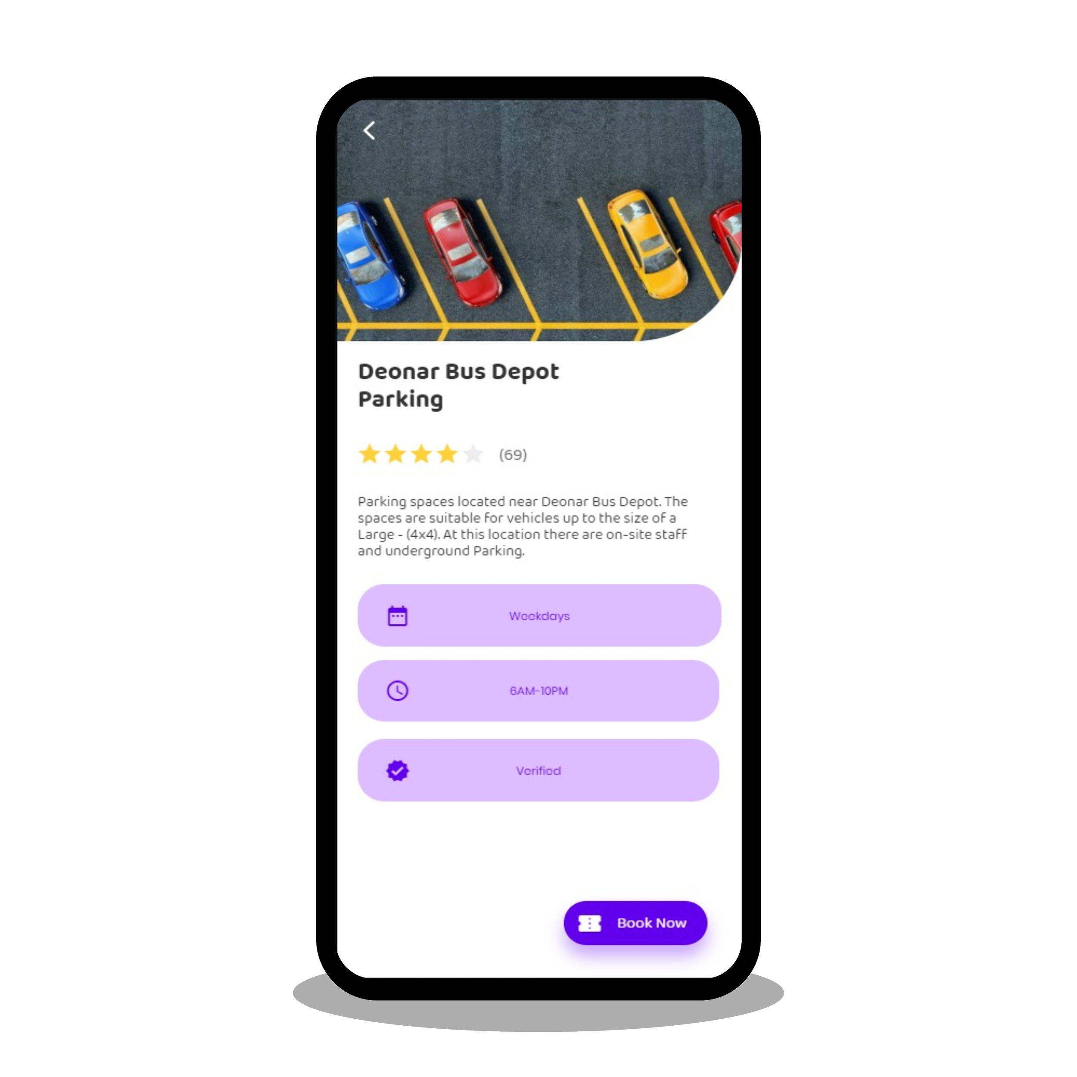
Business Logic
Once the user has selected a slot for reservation, an empty slot in the parking space is selected and locked for the current user.
Upon successful transaction, a ticket is generated along with a QR Code.
The current time is saved as the check-in time.
Extra charges are estimated as per the entry and exit times.

Slide 9
Thank You

