Slide 1


Intro
YoctoScheduler
Francesco Cogno
Matteo Teruzzi

Slide 2
Agenda
Why a new scheduler?
Architectural pillars
Implementation
Milestones
State of the art
Demo
Next steps

Slide 3
Why a new scheduler?
Windows Server has its own Task Scheduler
Machine dependent → Not really cloud aware (no SLA in single Azure machine)
SQL Server has its own SQL Server agent as task scheduler
Machine dependent → Not really cloud aware (no SLA in single Azure machine)
No equivalent feature in Azure DB → Not PaaS ready
Azure has Azure automation
PaaS service → Cloud ready
PowerShell based → Cumbersome to integrate and maintain
Hangfire.io
Elegant and with out-of-the box responsive management sections
OpenSource via LGPL → Legal issues

Slide 4
Architectural pillars
The scheduler must be:
Elastic
Able to gracefully handle unexpected shutdowns
Support T-SQL out-of-the box
Support PowerShell out-of-the box
Be expansible with custom tasks
Support custom scheduling
Support unattended execution and remote management commands
Offer a modern JSON REST management interface
Offer a PowerShell management interface
Support server side asymmetric encryption via certificates
Support both SQL Server and SQL Azure database
Both a stand-alone program and a windows service

Slide 5
Implementation
The scheduler is split in 4 sections:
Backend
T-SQL target Azure SQL DB v12
Code is tested both on Azure SQL DB and SQL Server 2014+
Code is noisy OLTP type
Scheduler
C# 4.6.1
Heavily multithreaded (no Tasks, no MARS)
Task support via reflection
REST Interface
Owin based JSON WebAPI
Simple Get/Post/Put/Delete verbs
Authorization (second milestone) via JSON web tokens.
Web site
Owin based AngularJS + Bootstrap Web forms
Support for various screen sizes
Client side JavaScript for caching

Slide 6
Milestones (1/2)
First milestone: “prosciutto”
Single task support for PowerShell, TSQL
Task status notification
Server and task death detection via keepalive
Server commands (abort task, shutdown server)
Autorestarting tasks
Server side asymmetric encryption via certificates
Elasticity
Standalone application or windows service based
REST API with no authentication/authorization
Management Web interface with no authentication/authorization (monitoring only)

Slide 7
Milestones (2/2)
Second milestone: “coppa”
REST API with authentication/authorization (JWT or Azure AD based)
Management Web interface with authentication/authorization (Azure AD based)
Workflow support (if success than… else then …)

Slide 8
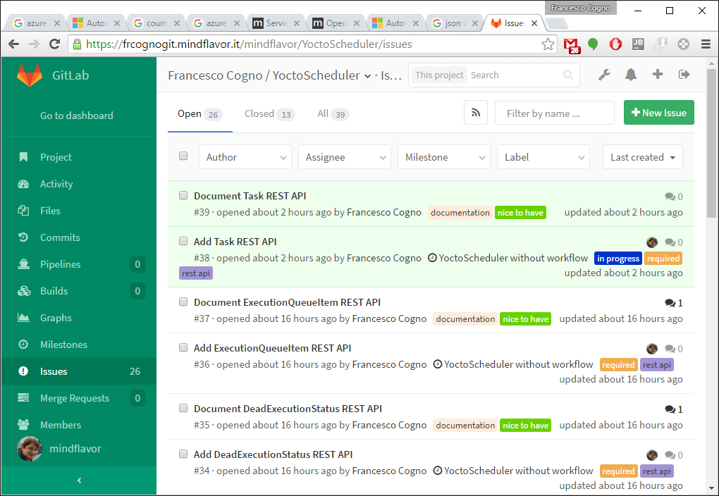
State of the art
Version 0.8.0.0
Single task support for TSQL (no PS)
Task status notification
Server and task death detection via keepalive
Server commands (abort, shutdown)
Autorestarting tasks
Server side asymmetric encryption via certificates
Elasticity
Ugly debug Standalone application
Partial REST API with no authentication/authorization
Over 25 open issues (and rising ☺) in the issue tracker (from database to C# and docs)

Slide 9
Demo

Slide 10
Next steps
High priority
Complete REST API interface
Migrate a Luca’s integration workload as single task
Close all the required issues in the issue tracker
Thorough testing
Medium priority
Complete a database review (indexes, queries, etc…)
Migrate to GitHub (defining a license)
Low priority
Perform a load test to define prerequisites (S0? CPU+RAM+IOPS?)

Slide 11
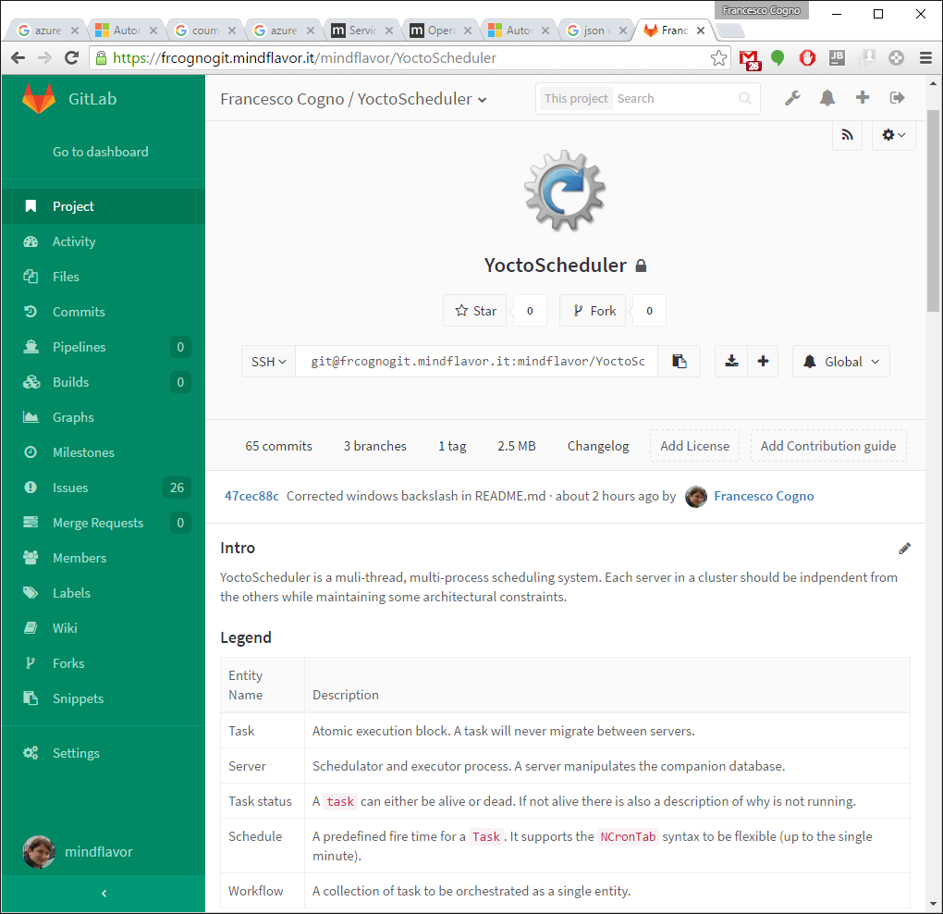
Resources
Source control:
https://frcognogit.mindflavor.it/mindflavor/YoctoScheduler
Issue tracker:
https://frcognogit.mindflavor.it/mindflavor/YoctoScheduler/issues

Slide 12

© 2012 Microsoft Corporation. All rights reserved. Microsoft, Windows, Windows Vista and other product names are or may be registered trademarks and/or trademarks in the U.S. and/or other countries.
The information herein is for informational purposes only and represents the current view of Microsoft Corporation as of the date of this presentation. Because Microsoft must respond to changing market conditions, it should not be interpreted to be a commitment on the part of Microsoft, and Microsoft cannot guarantee the accuracy of any information provided after the date of this presentation. MICROSOFT MAKES NO WARRANTIES, EXPRESS, IMPLIED OR STATUTORY, AS TO THE INFORMATION IN THIS PRESENTATION.

