Slide 1

Prepared by BridgeWorks · August 2026
Project delivery
walkthrough
Website · ordering · visibility · retention
Notes:
Open by saying this is a practical walkthrough, not a technical presentation. The goal is to show what was built, how the parts connect, and agree the final owner actions.
[Sources]
- OLIVIKS-HANDOVER-2026-07-14.md
- Oliviks Foundation contract and verified delivery records
[/Sources]

Slide 2
OLIVIKS KITCHEN · FOUNDATION HANDOVER
The system connects discovery and repeat orders
01 · DISCOVER
02 · ORDER
03 · RETURN
Find and trust
Choose a clear route
Stay connected
A faster website explains the food, story, location, reviews, and award.
Customers browse the menu, then continue to the existing shop, WhatsApp, Wolt, or Marwa.
Email and WhatsApp tools turn one visit into a relationship and a reason to come back.
02
Notes:
Explain the system as one customer journey. BridgeWorks did not replace the existing checkout. It made the path into that checkout clearer and added the retention layer around it.
[Sources]
- OLIVIKS-HANDOVER-2026-07-14.md §1
- OLIVIKS-ORDERING-JOURNEY-COMPARISON-2026-07-14.md
[/Sources]

Slide 3
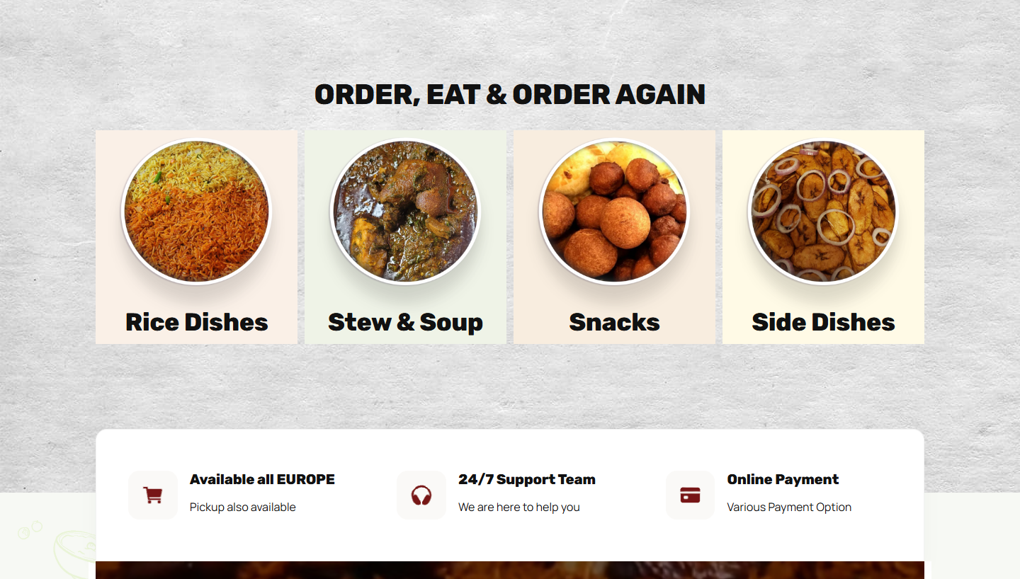
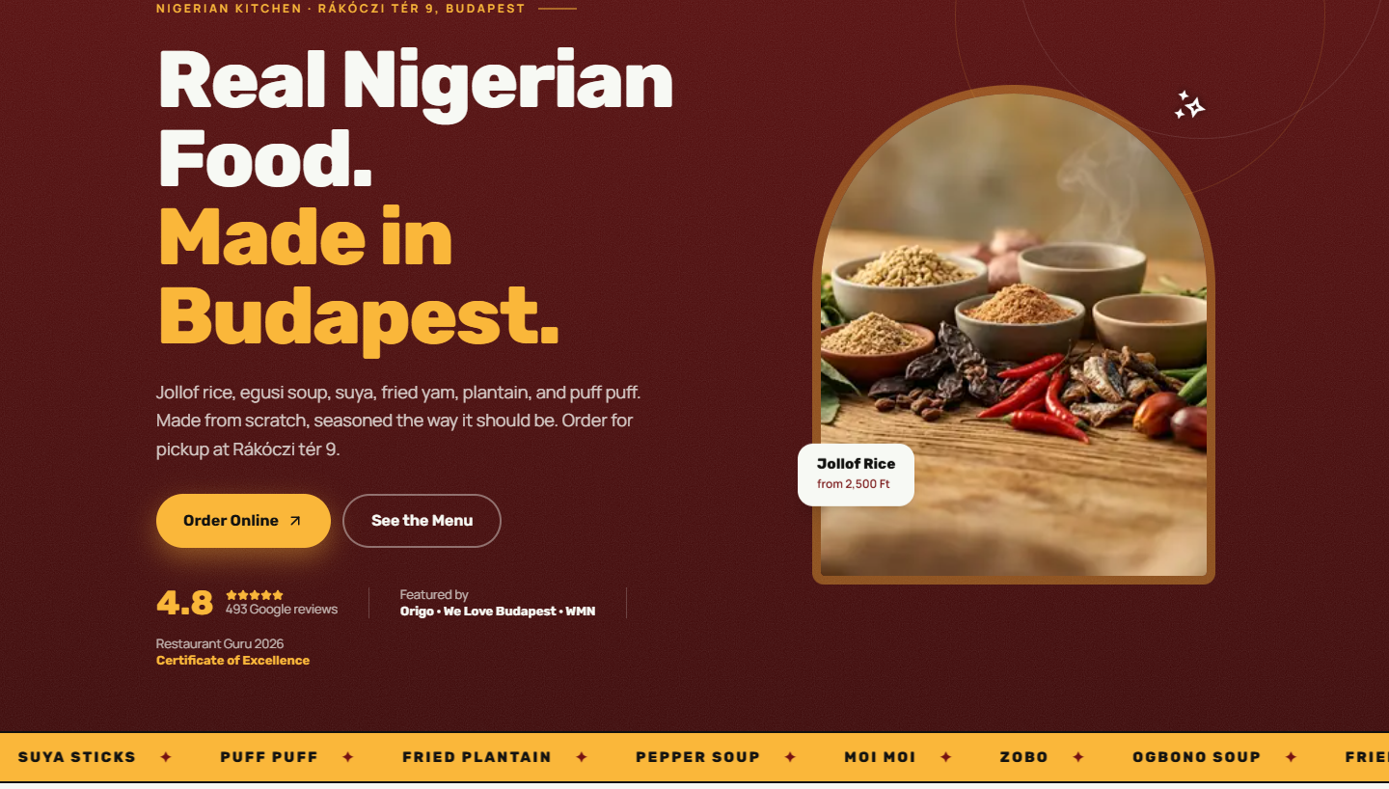
OLIVIKS KITCHEN · FOUNDATION HANDOVER
The new website makes the next step obvious
BEFORE · LEGACY SITE
AFTER · NEW PREVIEW
Many overlapping routes and a heavier storefront.
Clear story, proof, menu, and intent-specific order routes.
03
Notes:
Use the screenshots to show the shift from a shop-first surface to a clearer marketing and ordering journey. The new preview keeps the existing shop behind focused calls to action.
[Sources]
- evidence/before/legacy-home-desktop-2026-07-14.png
- evidence/after/preview-home-desktop-2026-07-14.png
- OLIVIKS-ORDERING-JOURNEY-COMPARISON-2026-07-14.md
[/Sources]

Slide 4
OLIVIKS KITCHEN · FOUNDATION HANDOVER
A faster mobile experience
2.84 s
390 KB
21
new preview mobile LCP
mobile transfer size
mobile resources
Compared with the legacy mobile trace: 23.28 s LCP, 5,556 KB transferred, and 102 resources.
Controlled one-run comparison on the public legacy site and Vercel preview. Repeat after domain cutover.
04
Notes:
Present the direction of change, not a guarantee. These are controlled comparative traces, not official PageSpeed scores. The production-domain check comes after cutover.
[Sources]
- OLIVIKS-FUNCTIONAL-PERFORMANCE-AUDIT-2026-07-14.md §Before-and-After Performance
[/Sources]

Slide 5
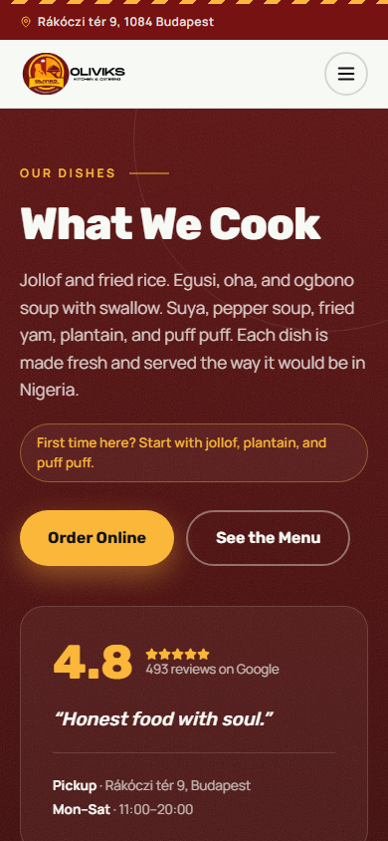
OLIVIKS KITCHEN · FOUNDATION HANDOVER
What BridgeWorks built and verified
• A responsive Next.js website with Home, Menu, About, Contact, Catering, Privacy, and Admin routes
• A 33-item menu mapped to the existing WooCommerce shop, plus WhatsApp and delivery-platform routes
• Restaurant schema, AI-readable business information, and local robots/sitemap routes
• Google profile improvements, review handling, and Restaurant Guru award proof
• MailerLite welcome automation, weekly-special templates, WhatsApp copy, and a printable counter QR card
33-item menu
05
Notes:
Move from the visible website into the wider system. Emphasize that the valuable delivery is the connected infrastructure, not only the visual redesign.
[Sources]
- OLIVIKS-DELIVERY-VERIFICATION-2026-07-14.md
- OLIVIKS-FUNCTIONAL-PERFORMANCE-AUDIT-2026-07-14.md
- OLIVIKS-HANDOVER-2026-07-14.md
[/Sources]

Slide 6
OLIVIKS KITCHEN · FOUNDATION HANDOVER
A weekly rhythm keeps the system useful
Keep the menu current
Send one weekly special
Protect trust
Update availability, photos, descriptions, and website prices. Keep WooCommerce prices aligned separately.
Use the MailerLite template, then reuse the same offer in the WhatsApp broadcast list.
Reply to new Google reviews, check ordering links, and flag any incorrect public information.
WHEN NEEDED
THU OR FRI
EVERY WEEK
06
Notes:
Use this slide as the live operating guide. Menu edits need the database reactivated first. WhatsApp broadcast-list creation happens on the owners' phone.
[Sources]
- OLIVIKS-HANDOVER-2026-07-14.md §3
- execution/email-whatsapp/HANDOVER.md
[/Sources]

Slide 7
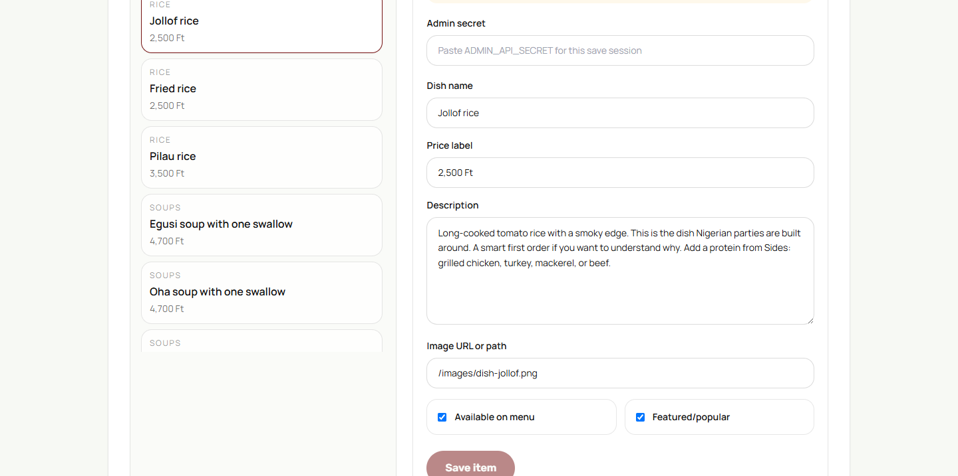
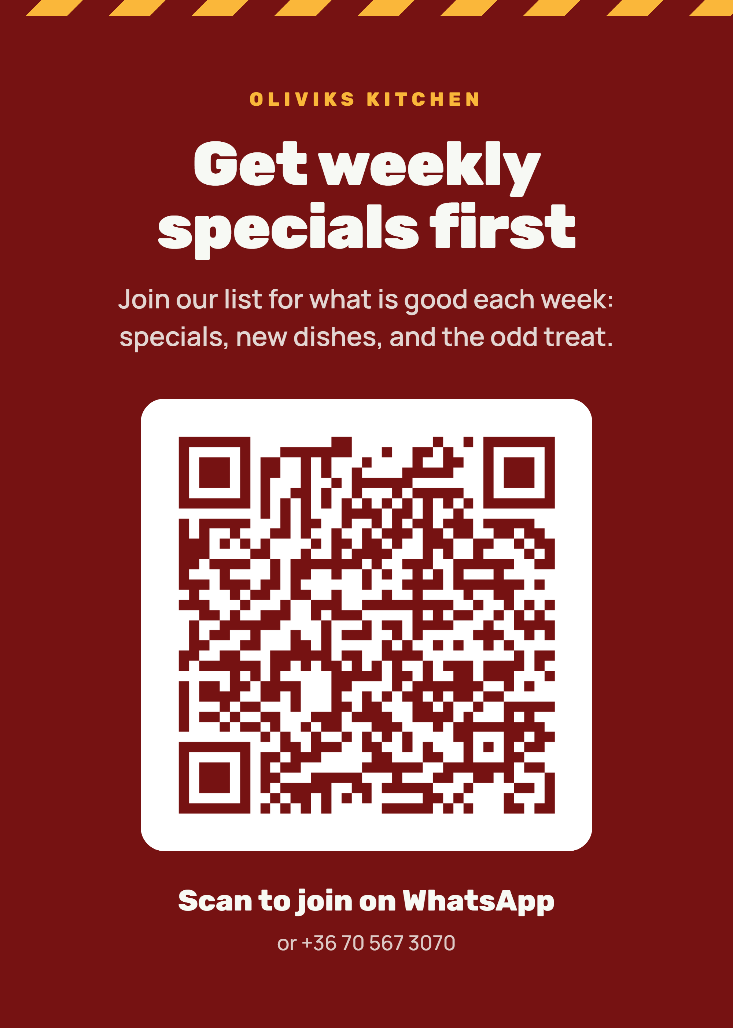
OLIVIKS KITCHEN · FOUNDATION HANDOVER
The walkthrough closes the owner gates
READY TO REVIEW
• Approve the new site content, menu, photos, address, and ordering wording
• Confirm the domain move from the legacy root to the new site
• Choose the final timing for one controlled signup and welcome-email test
Current note: the free-tier database paused on 31 July and must be reactivated before live menu editing.
OWNER SETUP
Reactivate the paused menu database, create the WhatsApp broadcast list, and place the counter QR card.
07
Notes:
Be transparent about current state. The site remains demonstrable through its static menu fallback, but live owner editing requires reactivating Supabase. Ask for content approval before any domain change.
[Sources]
- Gmail message 19fb8898252987bc, 2026-07-31
- OLIVIKS-COMPLETION-CHECKLIST-2026-07-14.md
- evidence/after/preview-admin-desktop-2026-07-14.png
[/Sources]

Slide 8
NEXT STEP
Approve.
Activate.
Hand over.
On the call we will review the build, complete the setup decisions, and capture your feedback.
office@bridgeworks.agency
Notes:
Close by asking for the three decisions: content approval, preferred setup/cutover sequence, and confirmation that the delivered system meets expectations. Then ask for candid feedback.
[Sources]
- OLIVIKS-SCOPE-AND-DECISIONS-2026-07-14.md
- OLIVIKS-HANDOVER-2026-07-14.md
[/Sources]

