Slide 1
Knygos.lt book tracker
Patrikas Styra

Slide 2
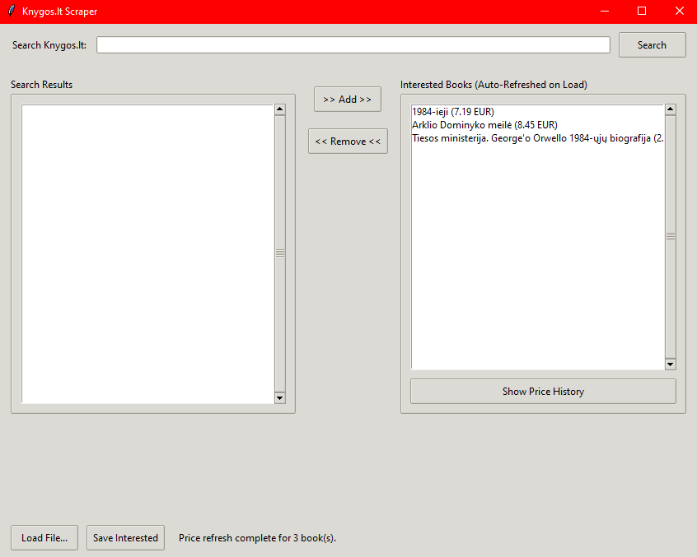
GUI

Slide 3
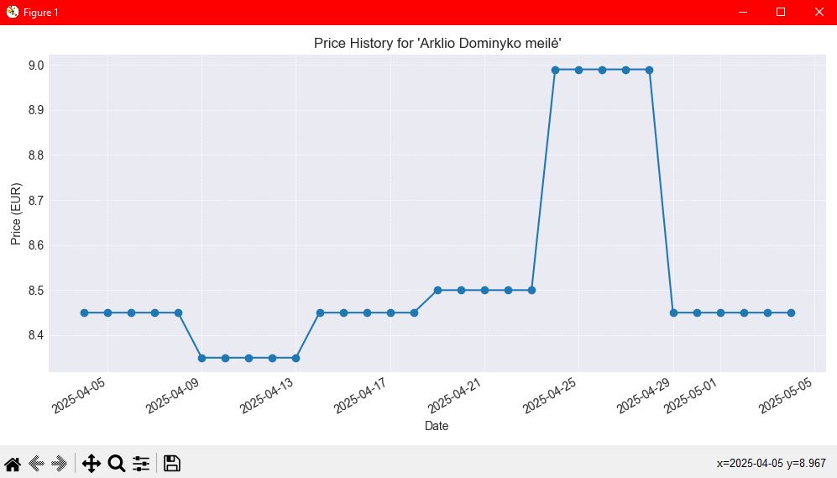
Price history (Example)

Slide 4
Features
Marking interested books and saving their information
Auto refresh of previously selected book prices on load

Slide 5
Summary
Written with Gemini LLM
GitHub repository link: https://github.com/Foteno/scraper_knygos
Learned that such a simple app can be made incredibly quickly by LLM models that have already seen similar data and can predict pretty accurately what the code should be for the given task.

