Slide 1
How to turn your scrap hardware into a machine learning workstation
Linda Zhou
December, 2018

Slide 2

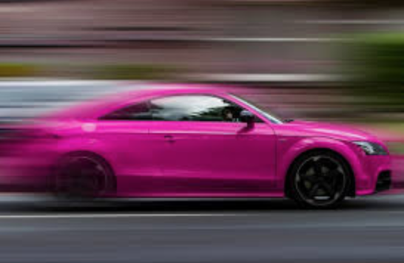
Problem: Find an Inexpensive GPU Environment
Budget: Less than $500
Fast Time to Results
Learn Python Deep Learning Frameworks

Slide 3
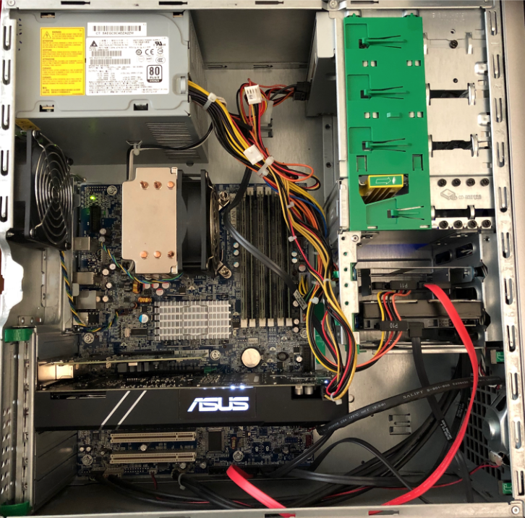
My Solution: Install GPU into a Scrap server

Slide 4
Summary
YOUR < $1,000 GPU BOX
1 NVIDIA GeForce GTX 1060 (less than $400)
1 HP z400 Series (less than $300)
Hardware
Available PCIe 3.0 Slot
Power Supply
Ethernet Cable Connection
Software:
SSH
Nvidia Driver and Nvidia-Docker
Tensorflow` Container: Refer this blog for detailed explanation https://data-ken.org/docker-for-data-scientists-part1.html
Happy
Learning

Slide 5

Linda Zhou

