Slide 1
win friends and influence people ~ Developers' edition
by Tyler Suard

Slide 2
social skills are:
predictable
repeatable
work on everyone
programmable

Slide 3
#1 Social skill for People and software
“You can win more friends in 2 months by becoming genuinely interested in other people than you can in 2 years by trying to get others to be interested in you.”
-Dale Carnegie, “How To Win Friends and Influence People”

Slide 4

the wrong way:
I'm pretty much a master at Python.
Ever hear of AI? Yeah, I invented that.
Trying to get others interested in you.

Slide 5
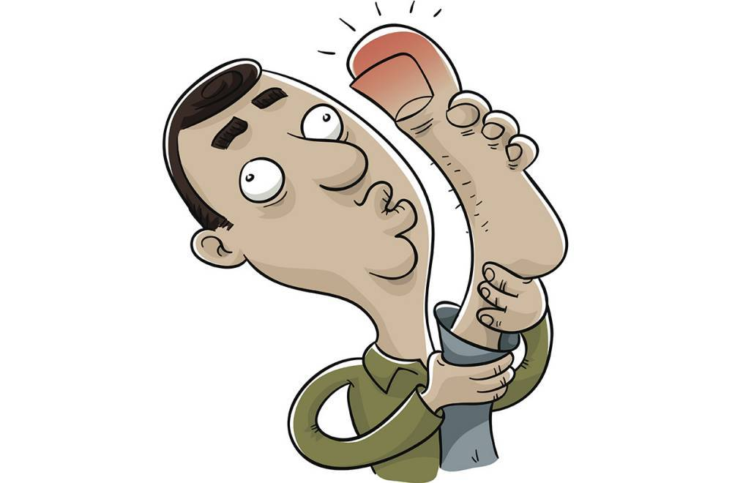

Social skills
A PERSON'S FAVORITE TOPIC IS ALWAYS HERSELF/HIMSELF.
>

Slide 6

the right way:
1. Stop talking about yourself.
Listen and ask questions.
2. Get the other person to talk about him or herself.
3. Pick conversation topics that the other person is interested in.

Slide 7
python demonstration

Slide 8
summary:
NO: MACHINE THAT IS INTERESTING TO THE USER.
YeS: MACHINE THAT IS INTERESTED IN THE USER

Slide 9
further questions:
tylersuard@gmail.com

