Slide 1
InferenceOps Investor Pitch

Slide 2
Problem: Complex ML deployments are costly & fragmented. Solution: InferenceOps simplifies deployment, monitoring & scaling with ethical AI.

Slide 3
Market: AI/ML Ops projected to exceed $20B by 2030. Target: Startups, SMEs, Enterprises.

Slide 4
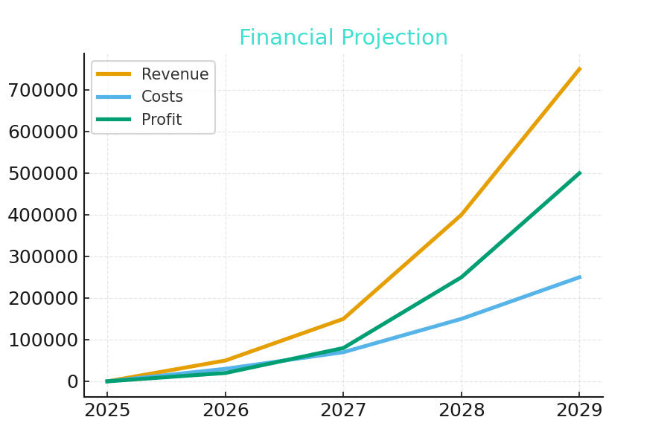
Financial Projection

Slide 5
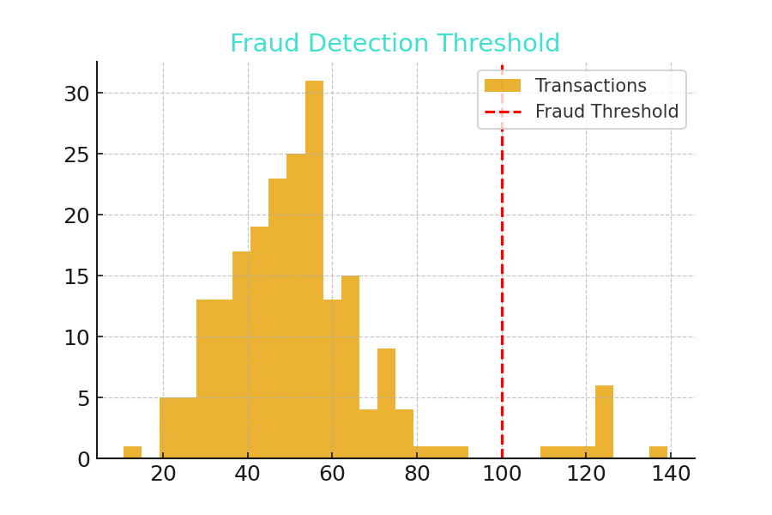
Fraud Detection Potential

