Slide 1
Ling 573 – D4
Group 5:
Paige Finkelstein, Jake Hoffman, Wesley Rose, Josh Tanner

Slide 2

Presentation Plan
System Architecture (Reminder)
Preprocessing Updates
Realization Updates
Ordering Updates
Results
Error Analysis
Conclusion and Relevant Reading
Notes:
Note that the focus will be on updates

Slide 3
Presentation Plan
System Architecture (Reminder)
Preprocessing Updates
Realization Updates
Ordering Updates
Results
Error Analysis
Conclusion and Relevant Reading
Notes:
Note that the focus will be on updates

Slide 4
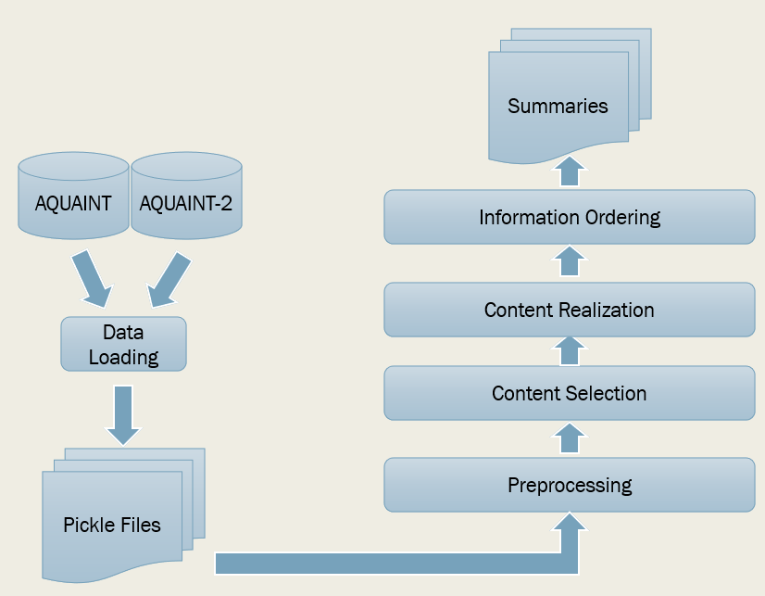
System Architecture
Weighted n-gram scoring:
Unigram + bigram probabilities and n sentences per article
Notes:
Note: Realization and Ordering had been switched.

Slide 5
Presentation Plan
System Architecture (Reminder)
Preprocessing Updates
Realization Updates
Ordering Updates
Results
Error Analysis
Conclusion and Relevant Reading
Notes:
Note that the focus will be on updates

Slide 6
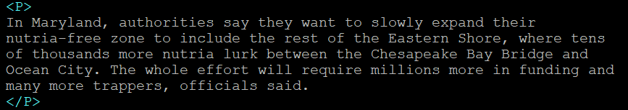
Preprocessing Updates
Lots of work to fix fragments
Line breaks mid-sentence in the corpus
(Order of operations within preprocessing)
Smarter quote detection
Leave in “scare quotes”
Removed a few more newspaper-specific phenomena
Associated Press reporters… contributed to this report.
Notes:
Add examples of fragments and solutions

Slide 7
Presentation Plan
System Architecture (Reminder)
Preprocessing Updates
Realization Updates
Ordering Updates
Results
Error Analysis
Conclusion and Relevant Reading

Slide 8
Realization Updates
Maximize word count
Realization
Good
Sentences
Final Set
Sentences from Selection
Sentence Screener
Sentence Compressor
Fill Extra Space
Rejects

Slide 9
Realization Updates
Move some screening into content selection
Only usable sentences are now available for realization
Selection
2 per article
< 2 per article
Remaining Realization
Old:
Sentence screener
Rejects
Selection
2 per article
Realization
New:
Notes:
To-do: maybe a visual?

Slide 10
Realization Updates
No more appositive removal
Some problems with spaCy parsing
Even in good cases, ROUGE-2 suffered
… Eric Harris and Dylan Klebold, also Columbine students, opened fire with at least four guns and dozens of bombs.
…Eric Harris and Dylan Klebold opened fire with at least four guns and dozens of bombs.
VS
Notes:
Mention – “Including the two killers” could be important to ROUGE-2 R. “two killers” in particular could be in sample summaries.

Slide 11
Realization Updates
Redundancy checker updates
Added unigram overlap
Still followed by spaCy word vector similarity
Norway, which is the world's third-largest oil exporter after Saudi Arabia and Russia and which normally has an average daily production of three million barrels, has seen its oil production reduced by some 205,000 barrels per day (bpd) since the platforms were closed.
Norway is the world's third-largest oil exporter after Saudi Arabia and Russia.
vs
Vector similarity: 0.859
Ngram overlap: 0.923

Slide 12
Realization Updates
More careful sentence-initial word removal
From D3: Fine-grained tags
New: List of exception words (now, soon, most)
Full sentence filtering updates
From D3: Questions, Quotes
New: Pronoun-initial sentences
Most had eaten cooked hot dogs the month before they became ill.

Slide 13
Presentation Plan
System Architecture (Reminder)
Preprocessing Updates
Realization Updates
Ordering Updates
Results
Error Analysis
Conclusion and Relevant Reading

Slide 14
Ordering Updates
D3: “Expert” approach from Bollegala et al., 2012
Chronology, topical closeness
D4: Additional features for first sentence
Positive feature: word count
Negative features: unlikely start terms
Highly unlikely: He, she, it, they, that, those, some, since
Somewhat unlikely: The

Slide 15
Ordering Updates: example
D3 Ordering
D4 Ordering
The destination is Medan, capital of North Sumatra, Indonesia.
The first batch of 100-ton cargoes was airlifted to Colombo, capital of Sri Lanka, Wednesday morning.
The official of the ministry said that at least 476,619 people were refugees, and the figure could increase as there were still many others uncounted by the officials.
An extremely powerful earthquake and the tsunami that followed devastated many parts of North Sumatra and Aceh on Dec. 26 last year, killing more than 100 ,000 people there.
Bangladesh has already sent medicines and other relief goods for the tsunami victims in Sri Lanka and the Maldives.
An extremely powerful earthquake and the tsunami that followed devastated many parts of North Sumatra and Aceh on Dec. 26 last year, killing more than 100,000 people there.
Bangladesh has already sent medicines and other relief goods for the tsunami victims in Sri Lanka and the Maldives.
The official of the ministry said that at least 476,619 people were refugees, and the figure could increase as there were still many others uncounted by the officials.
The destination is Medan, capital of North Sumatra, Indonesia.
The first batch of 100-ton cargoes was airlifted to Colombo, capital of Sri Lanka, Wednesday morning.

Slide 16
Presentation Plan
System Architecture (Reminder)
Preprocessing Updates
Realization Updates
Ordering Updates
Results
Error Analysis
Conclusion and Relevant Reading
Notes:
Note that the focus will be on updates

Slide 17
Results
Deliverable | ROUGE-2 R (devtest)
D2 | 0.06145
D3 | 0.08042
D4 | 0.08450
Config Field | Value
Selection method | N-gram
Unigram weight | .2
Bigram weight | .9
Unigram overlap threshold | .74
spaCy similarity threshold | .95
Data Set | ROUGE-2 R
Devtest | 0.08450
Evaltest | 0.10614

Slide 18
Presentation Plan
System Architecture (Reminder)
Preprocessing Updates
Realization Updates
Ordering Updates
Results
Error Analysis
Conclusion and Relevant Reading

Slide 19
Error Analysis
Fragments:
A look at the situation of seniors and others at a now-closed Columbine High.
Filtering them causes significant drop in ROUGE
Repetitive sentences:
An Iraqi reporter threw his shoes at visiting U.S. President George W. Bush and called him a "dog" in Arabic during a news conference with Iraqi Prime Minister Nuri al-Maliki in Baghdad on Sunday.
President George W. Bush ducked a pair of shoes hurled at his head--one shoe after the other--in the middle of a news conference with Iraqi Prime Minister Nouri al-Maliki.
(93.7% similar)... Lower threshold drops ROUGE
Referential issues
More than 100 Giant Pandas live there.

Slide 20
Error Analysis
Summaries with good content but no thesis:
Queen Elizabeth II sent a message to Papua New Guinea, which is a member of the Commonwealth, expressing her shock at the deaths.
Papua New Guinea, with a population of 4 million, is largely dependent on agriculture and mining.
Australia said it will provide transport for relief supplies and a mobile hospital to Papua New Guinea.
Igara said the population in the area affected by the tsunami was 8,000 to 10,000 people.
Dalle said it was impossible to say how many people were missing.

Slide 21
Error Analysis
Big range in scores
Dataset | Average | Max | Min | Range | Variance
Devtest | 0.08450 | 0.17742 | 0.01255 | 0.16487 | 0.00189
Evaltest | 0.10614 | 0.25847 | 0.01569 | 0.24278 | 0.00324

Slide 22
Error Analysis
Worst summary in devtest:
California has more threatened amphibians than any other state, according to Conservation International, accounting for 13 of the nation's 54.
The findings of more than 500 scientists were included in the first-ever global amphibian assessment, a three-year effort by researchers with IUCN-The World Conservation Union, the Center for Applied Biodiversity Science of Conservation International and NatureServe.
The survey found that 32 percent of amphibian species face extinction, compared to 12 percent of bird species and 23 percent of mammal species.
In New England, where native amphibian species aren't endangered, local declines are common.
Topic: Threat to frogs
Articles quite varied:
“U.S. mine tries to dig out from under local discontent in Peruvian Andes”
“Land consolidation benefits people and ecology”’
“A Third of Amphibian Species Face Extinction, Study Says”
Maybe query would help here?

Slide 23
Presentation Plan
System Architecture (Reminder)
Preprocessing Updates
Realization Updates
Ordering Updates
Results
Error Analysis
Conclusion and Relevant Reading

Slide 24
Conclusion
Simple rules work really well (instead of deep linguistic rules)
Clean the data!
No sentences with quotes
No sentences with questions
No sentences starting with pronouns
Weighted n-gram scores instead of topic-oriented selection
Order longer sentences first, avoiding specific words
Understand the difficulty of evaluating results
ROUGE-2 R is frustrating… but what would be better?
Danger of overfitting
Our system could be awful for non-news
However, generalized to evaltest pretty well

Slide 25
Related Reading
Content Selection:
Erkan and Radev, 2004
Otterbacher et al., 2008
Vanderwende et al., 2015
Content Realization:
Conroy et al., 2006
Zajic et al., 2007
Information Ordering:
Bollegala et al., 2012

Slide 26
Questions?

