Slide 1
Ling 573 – D3
Group 5:
Paige Finkelstein, Jake Hoffman, Wesley Rose, Josh Tanner

Slide 2
Deliverable 3
Updates to all Modules
Attempt query-focused selection
Non-trivial ordering
Somewhat improved realization

Slide 3
Presentation Plan
System Architecture
Content Selection
Content Realization
Information Ordering
Results and Analysis
Issues and Successes

Slide 4
Presentation Plan
System Architecture
Content Selection
Content Realization
Information Ordering
Results and Analysis
Issues and Successes

Slide 5
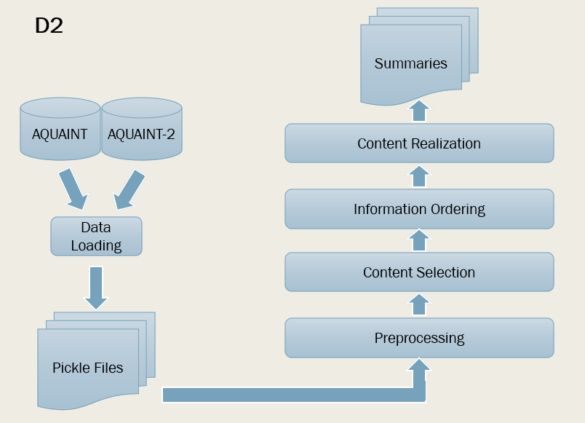
System Architecture

Slide 6
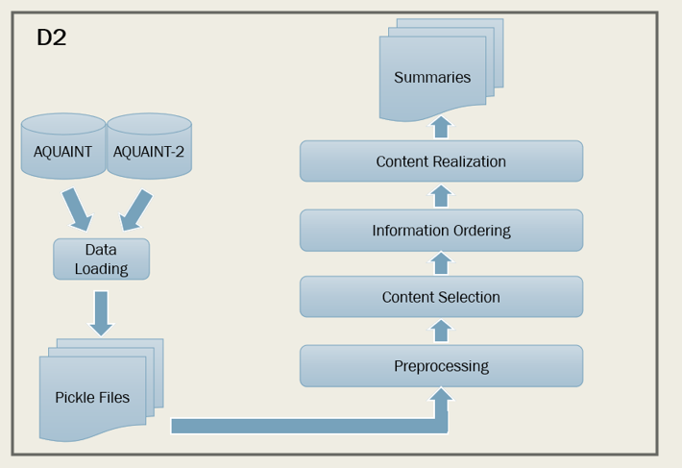
System Architecture
Summaries
AQUAINT
AQUAINT-2
Information Ordering
Content Realization
Data Loading
Content Selection
Pickle Files
Preprocessing

Slide 7
System Architecture
Summaries
AQUAINT
AQUAINT-2
Information Ordering
Content Realization
Data Loading
Content Selection
Pickle Files
Preprocessing

Slide 8
Content Selection:
D2: N-gram Heuristic
Weighted probabilities of 1-, 2-, and 3-grams and headline overlap
D3: Lots of experimentation
LexRank and biased LexRank
Updates to n-gram heuristic

Slide 9
Content Selection – LexRank Variations
Link Strength
Idf-modified-cosine
Word vector similarity
Idf-weighted vector similarity
Biasing
Topic narrative if available, otherwise title
Idf-weighted word overlap
Erkan and Radev (2004)
Otterbacher et al. (2008)
Notes:
For Link

Slide 10
Content Selection – N-gram Variations
New scoring methods
Cartesian pair score¹
Based on probability that 2 words occur in the same sentence
Query word score
Word overlap with query (topic narrative or title)
Selection method
Per-article
Limit to n sentences from each article
Re-weight probability distribution²:
P(n-gram)_{new} = P(n-gram) ²_{old}
Global
Treat all articles as one group of text
Otterbacher et al. (2008)
Vanderwende et al. (2015)
Notes:
For Link

Slide 11

Lexrank
Idf-modified cosine
Lexrank
Word vector similarity
N-gram heuristic
Per-article selection
Lexrank
Idf-weighted word vector similarity
Biased Lexrank
Idf-weighted word overlap
N-gram heuristic
Cartesian pair score
N-gram heuristic
Query word score
N-gram heuristic
Global selection

Slide 12

N-gram heuristic
Per-article selection
Traditional Scoring
Unigram Reweighting
(More configuration details in results)

Slide 13
A New Challenger? Next steps for content selection
Feature-based machine learning (Hong and Nenkova, 2014)
Pre-processed Sentences
Feature Extraction:
N-gram heuristic
LexRank
…
…
Highest Scoring Sentences
Trained
Classifier

Slide 14
System Architecture
Summaries
AQUAINT
AQUAINT-2
Information Ordering
Content Realization
Data Loading
Content Selection
Pickle Files
Preprocessing

Slide 15
Content Realization
Redundancy Checker
spaCy vector similarity or BERT for paraphrase detection
New rules
Remove all sentences with quotes
Remove all sentences with question marks
Remove sentences shorter than a target length
Modified rules
Sentence-initial adverb removal¹: Switch to fine-grained POS
Appositive removal²: More logic to strip out the full clause
Configurability!
Conroy et al. (2006)
Zajic et al. (2007)
Notes:
(Moved from Ordering)
Fine-grained POS: lets us leave in adverb particles? Also, only remove coordinating conjunctions and leave in subordinating and preposition?

Slide 16
System Architecture
Summaries
AQUAINT
AQUAINT-2
Information Ordering
Content Realization
Data Loading
Content Selection
Pickle Files
Preprocessing

Slide 17
Information Ordering
Expanded on “preference learning” from Bollegala et al. (2019).
Chronological expert
Weighting based on features:
publication date
sentence position
position 0 or 1
Topical-closeness expert
Based on spaCy word vector similarity
Succession likelihood
BERT
Configurable

Slide 18
Presentation Plan
System Architecture
Content Selection
Content Realization
Information Ordering
Results and Analysis
Issues and Successes

Slide 19
Results
Deliverable | ROUGE-1 R | ROUGE-2 R
D2 | 0.21649 | 0.06145
D3 | 0.25856 | 0.08042
Config Name | Value (D2) | Value (D3)
λ1 (unigram) | .4 | .2
λ2 (bigram) | .7 | .9
λ3 (trigram) | .05 | 0
λ4 (headline) | .05 | 0
Selection method | N/A | Per article
Sents per article | N/A | 2
Similarity metric | spaCy | spaCy
Similarity Threshold | .97 | .87
Length limit | N/A | 4
Notes:
Talk about BERT for similarity – why didn’t we use it?

Slide 20

Analysis and Ablation Studies
Content Selection Approach | Rouge-2 R
Per-article (1 sent-per) | .07306
Per-article (2 sents-per) | .08042
Global | .07810
Biased Global (weight=.1) | .07793
Biased Global (weight=.2) | .07812
Biased LexRank | .06882
Ablation Study | Rouge-2 R
Best Performance | 0.08042
No redundancy check | 0.07821
No quote removal | 0.07494
No question removal | 0.08033
No preprocessing | 0.07179
No sentence-initial adverb removal | 0.08042
No appositive removal | 0.0808
No length limit | 0.07978

Slide 21
Presentation Plan
System Architecture
Data Loading
Preprocessing
Content Selection
Information Ordering
Content Realization
Results and Analysis
Issues and Successes

Slide 22
Issues and Successes: Successes
N-gram heuristic
Keeps outperforming expectations
Information Ordering
No metric, but noticeable readability improvements
Preprocessing
Adds a lot of value
Configuration File
Helps with experimentation / parameter search

Slide 23
Issues and Successes: Issues
Sentence fragments
The people knowledgeable about the case said.
Overtrimming / bad trimming:
They also claim that the measure will make California, already the United States’ leading hub for biotech industries, a world hub of stem cell research too.
(Appositive removal a net loss for ROUGE-2 R)
Short output summaries
Too many trimming operations with no stopping rule

Slide 24
Issues and Successes: Issues
Coreference Issues
They said their priority was making sure the school was safe.
“Officers Kenneth Boss Edward and Richard Murphy” repeated 3 times
Redundancy
More than 100 giant pandas live there.
More than 1,500 giant pandas live wild in China, according to a survey by the State Forestry Administration.
Metrics vs. Subjective Judgements
Interdependency of modules

Slide 25
Related Work / Sources
Content Selection:
Erkan and Radev (2004)
Otterbacher et al. (2008)
Vanderwende et al. (2015)
Content Realization:
Conroy et al., 2006
Zajic et al., 2007
Information Ordering:
Bollegala et al., 2012

Slide 26
Questions?

