Slide 1
VerdictOS – Agentic Courtroom for Enterprise Decisions
UiPath Hackathon Submission
Team: MindMesh
UiPath AgentHack. Build the AI agents of tomorrow.

Slide 2




Team Name - MindMesh Project Name - VerdictOS ​
Hardeep Singh Senior Consultant (hsingh1@tsp.tech)
Nawazish Ahmad
Consultant (nahmad@tsp.tech)
Gitish Arora
Consultant (garora1@tsp.tech)
Ashish Negi
Senior Consultant (anegi1@tsp.tech)

Slide 3
Problem statement and proposed solution
Problem
Solution
​
• Organizations process thousands of governance, compliance, and risk-related requests every month.​
​
• Manual review processes are slow, inconsistent, and difficult to scale.​
​
• Risk assessment often requires input from multiple teams such as Finance, Legal, Cyber Security, and Compliance.
VerdictOS is an Agentic Governance Platform built on UiPath.​
The platform automatically ingests requests, extracts data, business context, and orchestrates multiple AI agents to evaluate financial, legal, cyber, reputation, and behavioral risks.​
A Debate Agent consolidates findings and recommends approval, rejection, or escalation before human review and final execution.​

Slide 4
Benefits and technologies used
Details
Benefits, impact and outcomes
End-user​ | Finance Analysts • Procurement Teams • Compliance Officers Risk Management Teams • Internal Auditors
User department​ | Finance • Procurement • Compliance • Governance Risk & Controls • Internal Audit
Industries​ | Industry-agnostic solution for enterprise governance.
UiPath products used​ | Maestro • Agent Builder • Document Understanding • Action Center • Integration Service • Data Fabric • Storage Bucket • Asset
Other - integrations / APIs / technologies used​ | ServiceNow • ngrok • OpenAI / LLM Models • Slack
Reduce manual invoice review effort.
Improve fraud detection
Accelerate payment approval decisions
Enable explainable AI decision-making
Maintain complete auditability
Human review only for exceptions
Strengthen compliance governance

Slide 5
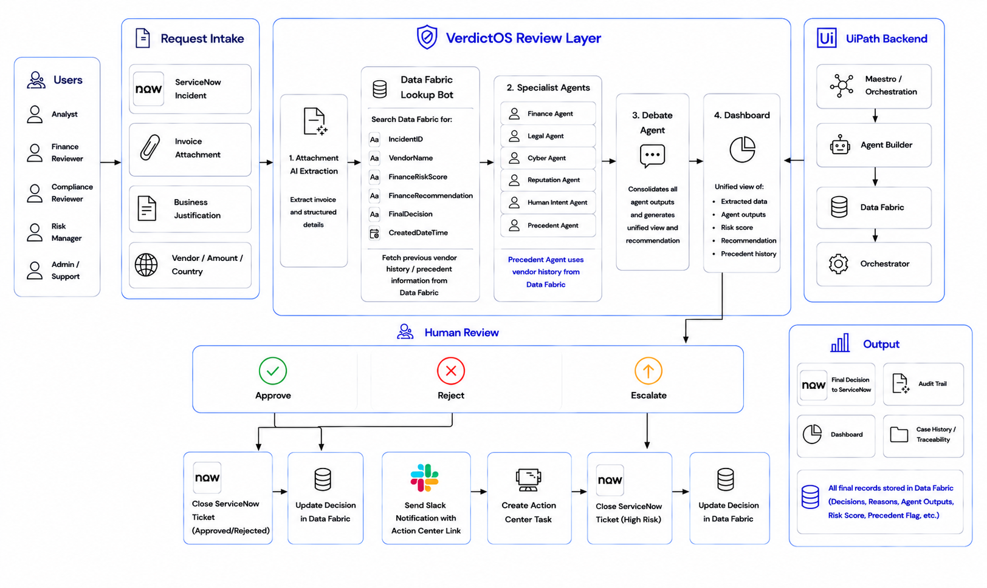
Solution architecture

Slide 6
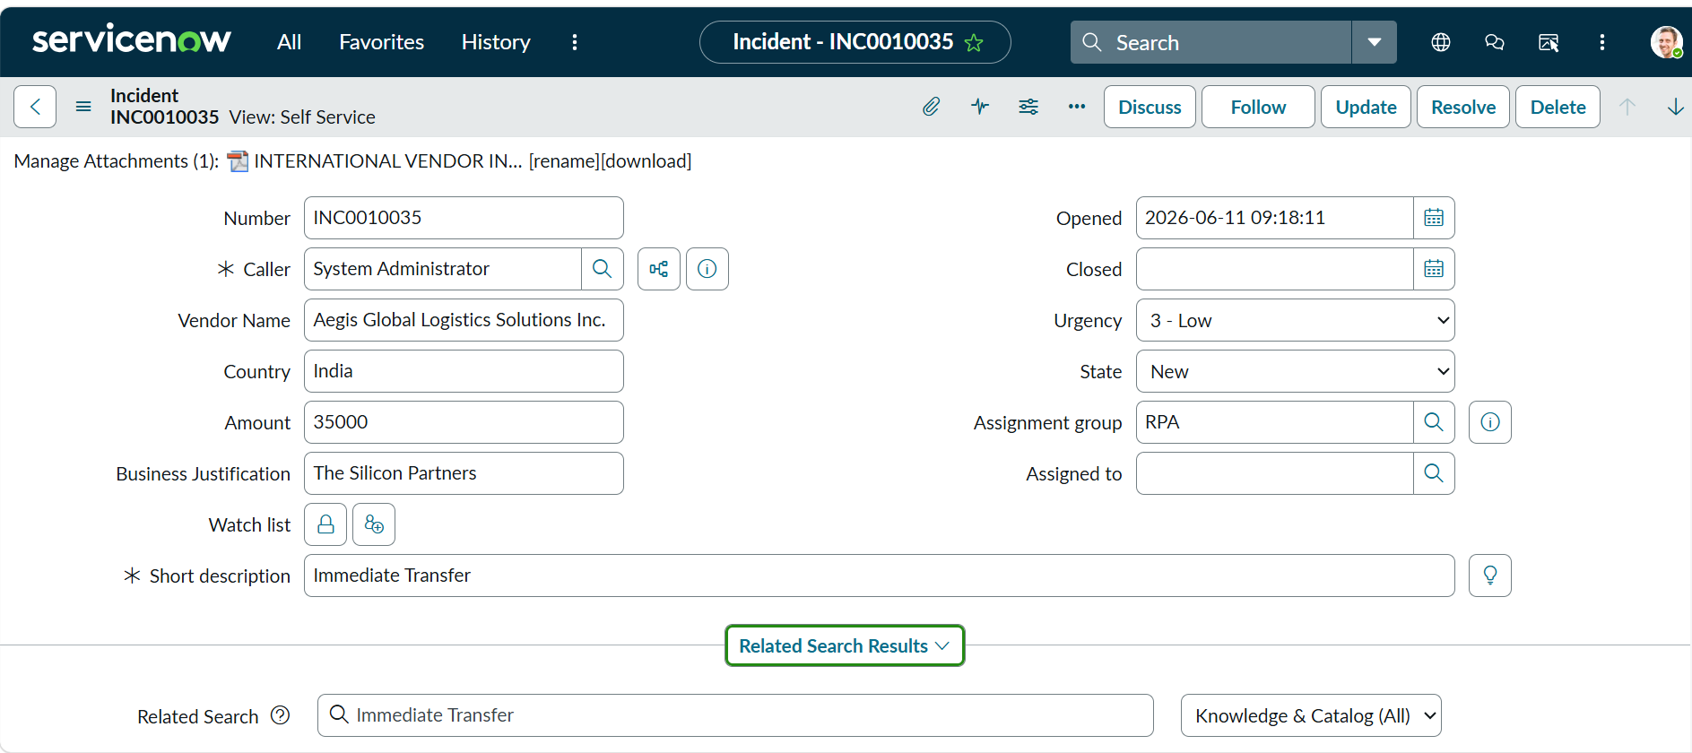
VerdictOS Demo Walkthrough
1 ServiceNow Ticket Created
SIMPLIFIED AGENTIC REVIEW
Vendor, amount, justification, urgency and attachment are captured.
1
▱
AI extracts key details from attachments
↓
2
◯
Data Fabric (Previous record)
↓
Specialist Agents
3
₹
⚖
♙
Finance
Legal
Cyber
↓
4
⚖
Debate Agent
Combines findings into one recommendation
5
♙
Human Review App
Exceptions only
Demo inputs captured
↓
INC0010035
Vendor + Country
₹35,000
Attachment
✓
Approve
×
Reject
↗
Escalate

Slide 7
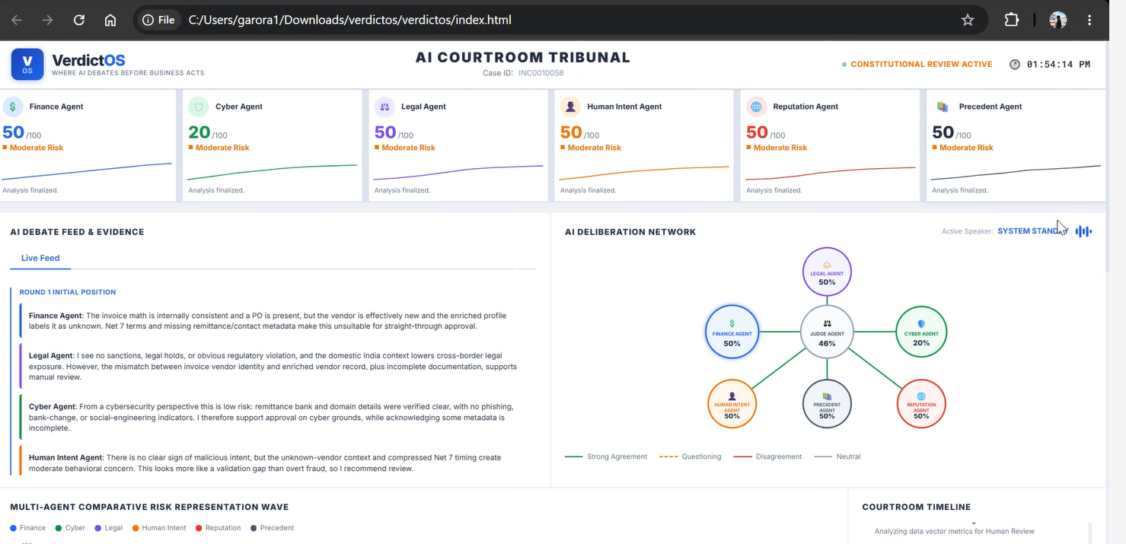
Decision Intelligence & Agent Output Data
What VerdictOS reads, enriches, evaluates, and sends for human review

Slide 8
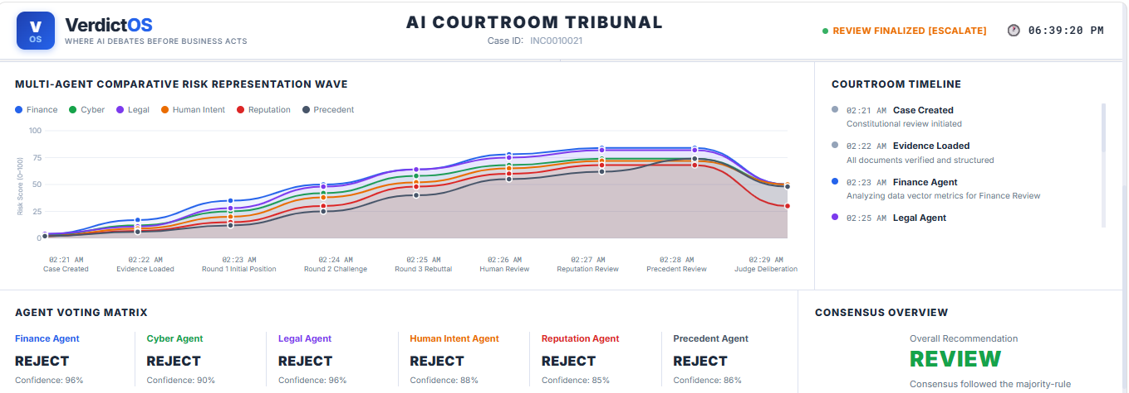
Decision Intelligence & Agent Output Data
What VerdictOS reads, enriches, evaluates, and sends for human review

Slide 9
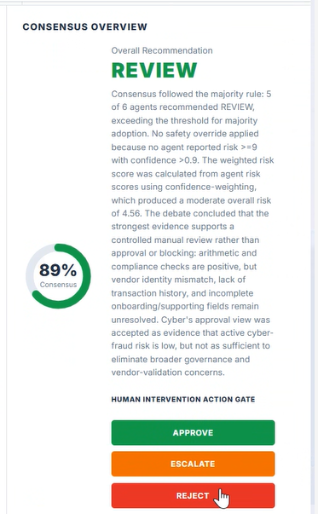
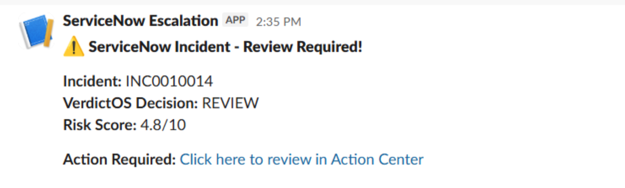
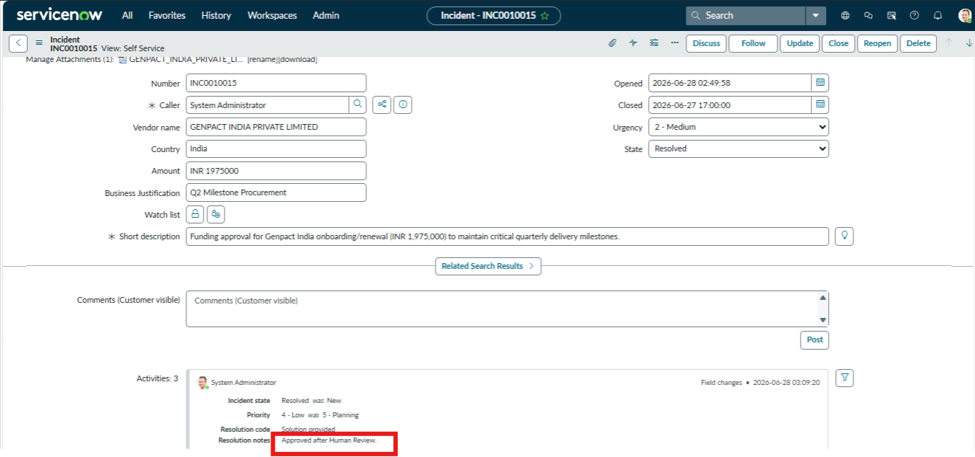
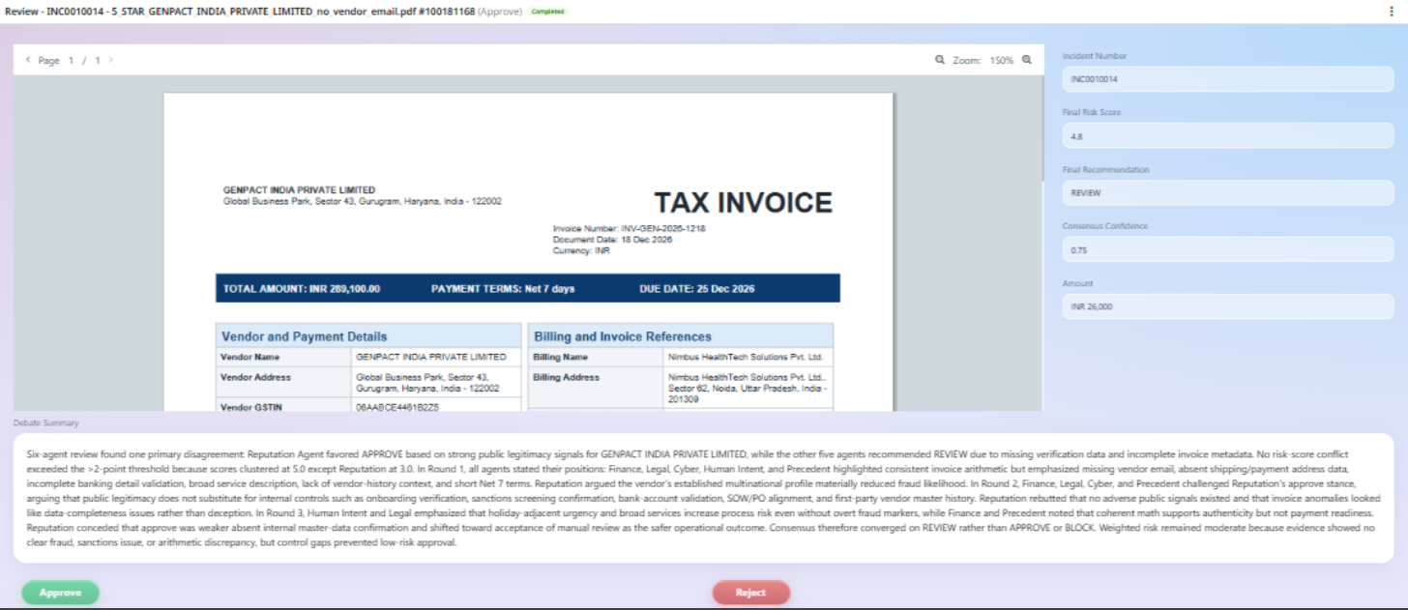
Human Review, Explainability & ServiceNow
Final governance control: AI recommendation, human decision, and audit-ready evidence
Human Review App
Slack Notification
Update ServiceNow
Reviewer receives one final recommendation with evidence.
Slack Notification with Action Center Link
Closes the servicenow ticket as per Approve or Reject.
Approve
Review
Reject
Escalate
Final decision updated back to ServiceNow / audit store
1
Explainable
2
Traceable
3
Audit-ready
4
Controlled
reason + evidence
full case path
logged decision
human action captured

Slide 10
VerdictOS: Faster, explainable, audit-ready governance decisions.
AI prepares the evidence. Humans control the exceptions. Every decision stays traceable.
Built on UiPath
Agentic Governance
Audit-ready Decisions
1
2
3
Maestro, Agent Builder, Document Understanding, Apps, Action Center
Specialist agents evaluate finance, legal, cyber, intent, reputation, and precedent risks
Final recommendation, evidence, human action, and audit trail captured end-to-end

