Slide 1
Pebble Asset Tracker
Intelligent Asset Management Platform
Developed by Mindstix Foundation Trust
Project Overview & User Guide

Slide 2
The Challenge
Why organizations need a better asset management solution
Manual asset tracking in spreadsheets is time-consuming and error-prone
Poor visibility into real-time asset status and location
Inefficient assignment and collection workflows
Missed maintenance schedules and warranty expirations
Difficulty maintaining audit trails for compliance
Hours spent on manual reporting
Pebble Asset Tracker | Mindstix Foundation Trust

Slide 3
Our Solution
Pebble Asset Tracker — automate the complete asset lifecycle
Reduces administrative time by 70%+ through automation
Real-time visibility across the entire asset lifecycle
Automated maintenance reminders and warranty tracking
Data-driven analytics and instant report generation
Proactive alerts for overdue maintenance
Enterprise-ready, scalable platform for IT organizations
Pebble Asset Tracker | Mindstix Foundation Trust

Slide 4
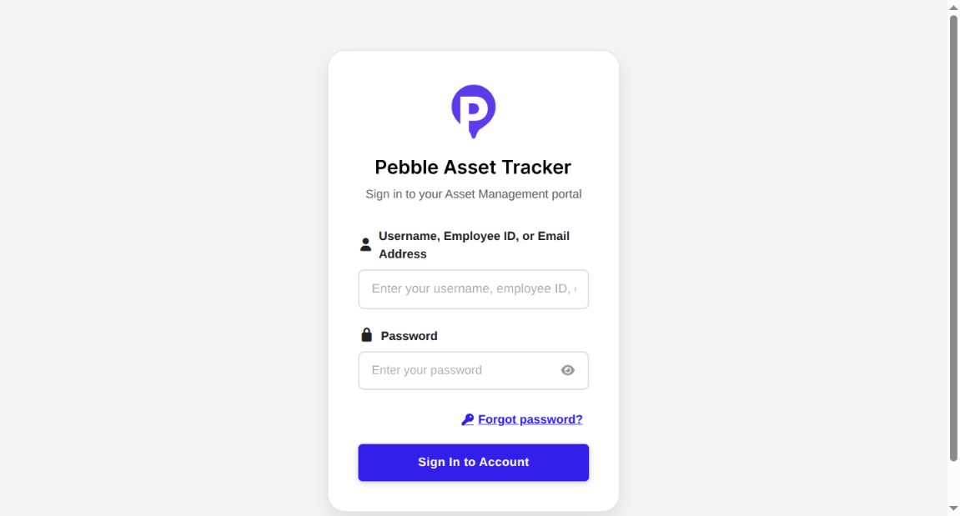
Getting Started — Login
Secure authentication to access the platform
Navigate to the application URL
Sign in with username, employee ID, or email
JWT-based secure authentication
Password reset available via email
Role-based access after login
Pebble Asset Tracker | Mindstix Foundation Trust

Slide 5
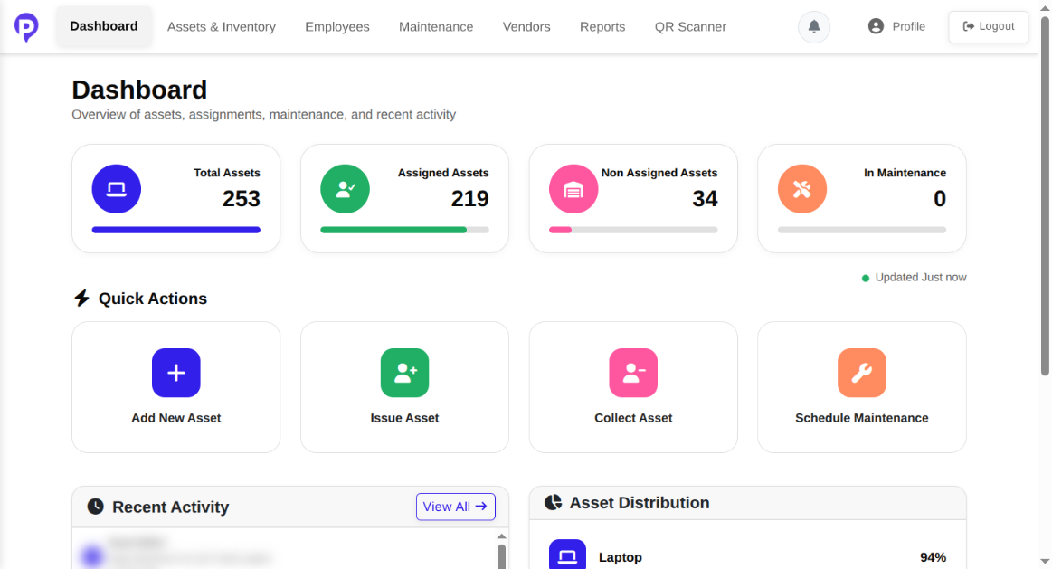
Dashboard Overview
Real-time metrics and quick actions at a glance
Total, assigned, and available asset counts
Maintenance status summary
Quick actions: Add, Issue, Collect, Schedule
Recent activity feed
Asset distribution charts
Pebble Asset Tracker | Mindstix Foundation Trust

Slide 6
Core Modules
Six integrated modules for complete asset management
Asset Management
Assignment Management
Lifecycle tracking, serial numbers, bulk CSV import
Issue & collect workflows, condition docs
Maintenance
Employee Management
Scheduling, cost tracking, automated alerts
Profiles, asset mapping, bulk import
Vendor Management
Reports & Analytics
Supplier & service provider directory
Dashboard KPIs, PDF/Excel/CSV export
Pebble Asset Tracker | Mindstix Foundation Trust

Slide 7
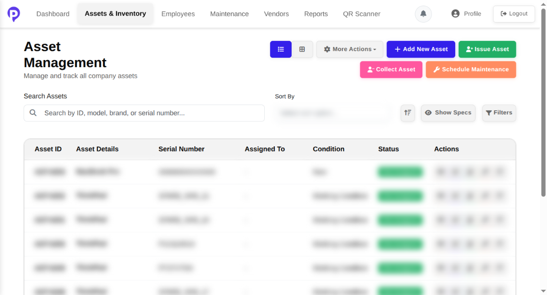
Asset Management
Complete inventory with search, filters, and bulk operations
View all assets in list or grid view
Search by ID, model, brand, or serial number
Add assets individually or bulk upload via CSV
Issue, collect, and schedule maintenance
Track status, condition, and location
Pebble Asset Tracker | Mindstix Foundation Trust

Slide 8
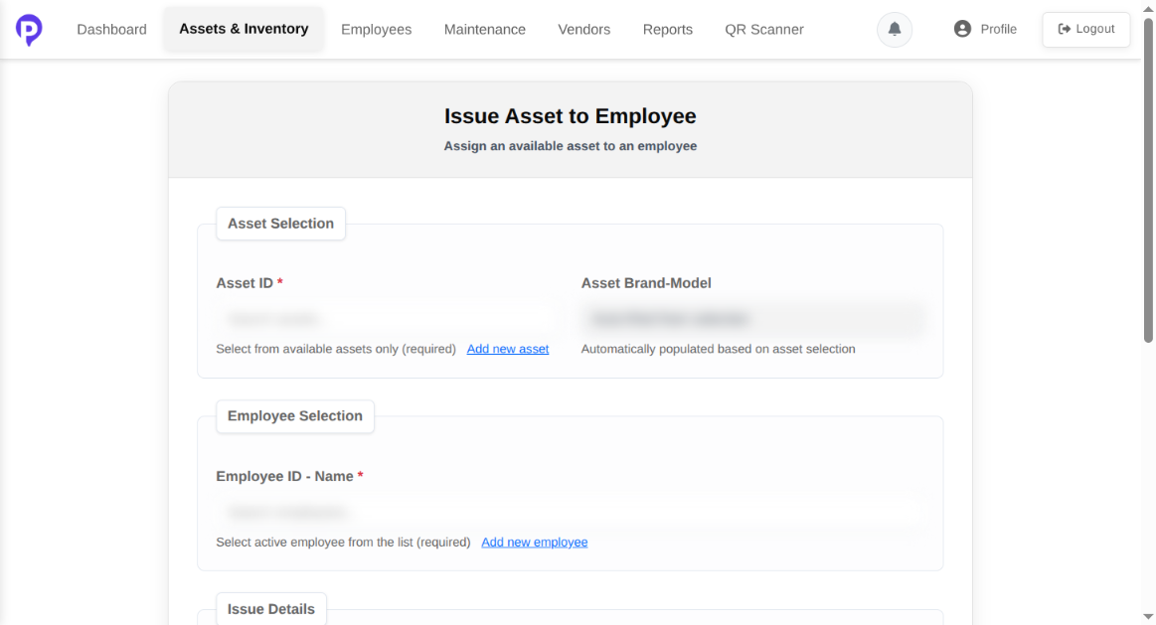
Issue Asset Workflow
Assign available assets to employees in minutes
Select from available assets only
Choose active employee from dropdown
Document issue reason and date
Add optional notes for context
Asset brand-model auto-populated
Pebble Asset Tracker | Mindstix Foundation Trust

Slide 9
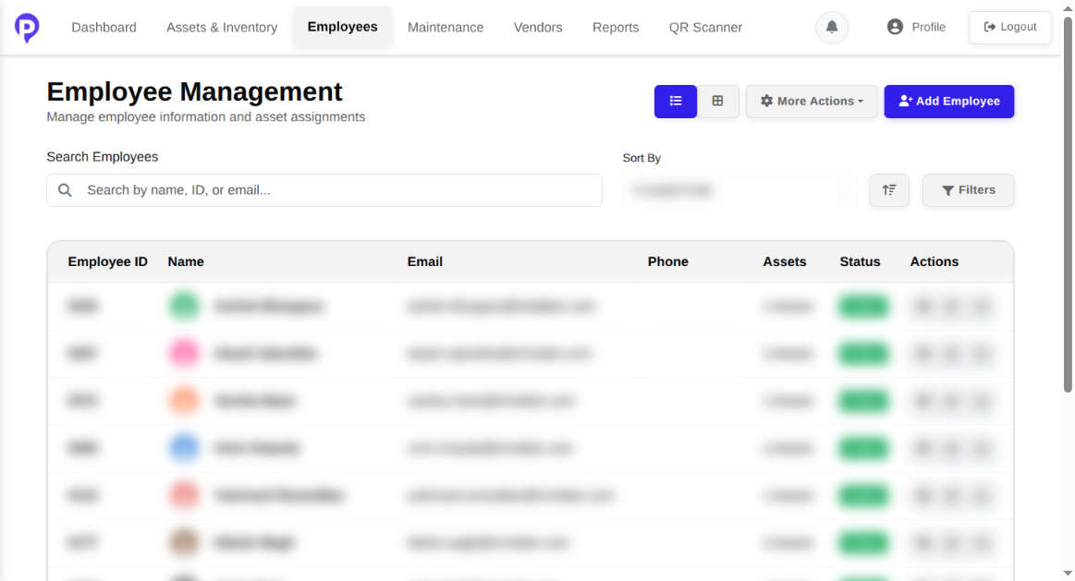
Employee Management
Manage employee profiles and asset assignments
Employee directory with search and filters
View assets assigned to each employee
Bulk import employees via CSV
Issue assets directly from employee view
Track employee status (Active/Inactive)
Pebble Asset Tracker | Mindstix Foundation Trust

Slide 10
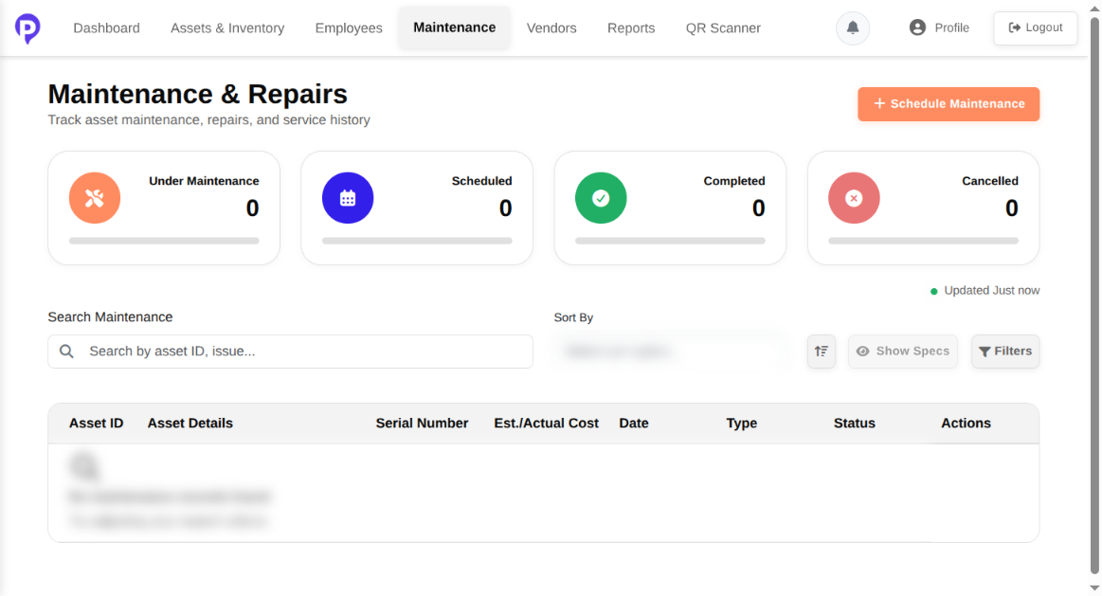
Maintenance & Repairs
Track maintenance status and service history
Status cards: Under Maintenance, Scheduled, Completed, Cancelled
Search and filter maintenance records
Schedule preventive or corrective maintenance
Track estimated and actual costs
Link maintenance to service vendors
Pebble Asset Tracker | Mindstix Foundation Trust

Slide 11
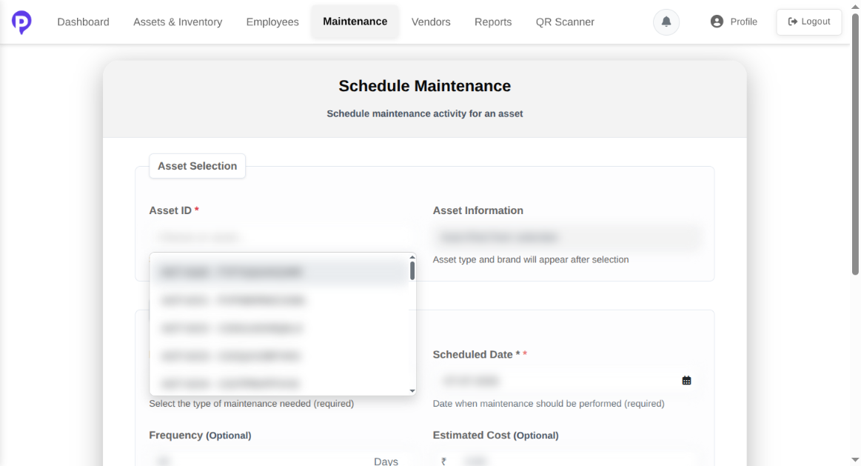
Schedule Maintenance
Plan preventive and corrective maintenance activities
Select asset that needs maintenance
Choose maintenance type (Preventive, Corrective, etc.)
Set scheduled date and frequency
Enter estimated cost and description
Asset details auto-populated on selection
Pebble Asset Tracker | Mindstix Foundation Trust

Slide 12
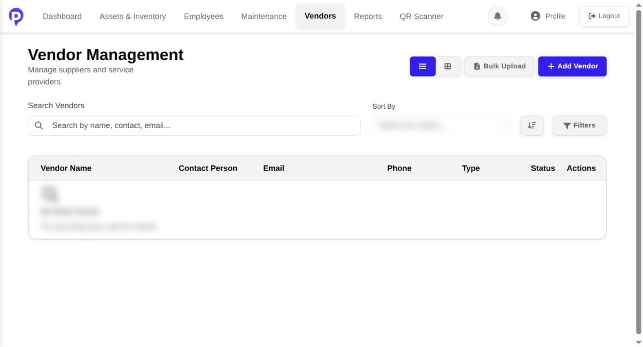
Vendor Management
Centralized supplier and service provider directory
Manage vendor profiles and contacts
Classify as supplier, service provider, etc.
Bulk import vendor data via CSV
Link vendors to maintenance tasks
Track active/inactive vendor status
Pebble Asset Tracker | Mindstix Foundation Trust

Slide 13
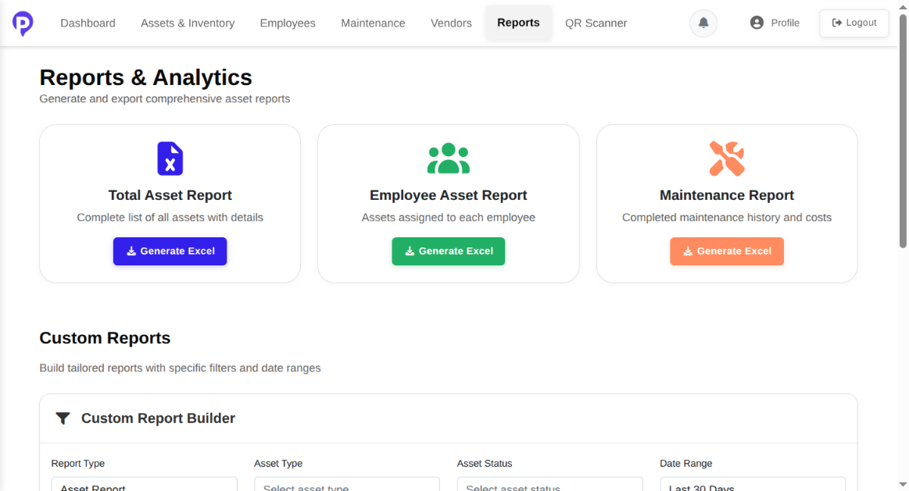
Reports & Analytics
Generate and export comprehensive asset reports
Pre-built reports: Asset, Employee, Maintenance
One-click Excel export for each report type
Custom report builder with filters
Analytics dashboard with charts
Export to PDF, Excel, or CSV
Pebble Asset Tracker | Mindstix Foundation Trust

Slide 14
System Architecture
Modern full-stack web application
Frontend
(Vue.js 3 + TypeScript)
Database
(PostgreSQL + Prisma)
→
REST API (NestJS)
→
Frontend: Vue 3, Vite, Bootstrap 5, Pinia, Vue Router
Backend: NestJS, JWT auth, Swagger API docs at /api/docs
Database: PostgreSQL with Prisma ORM and migrations
Security: Role-based access, bcrypt passwords, token refresh
Pebble Asset Tracker | Mindstix Foundation Trust

Slide 15
Development Setup
Run the application locally
Prerequisites: Node.js 18+, PostgreSQL 12+, npm 8+
Backend: asset-mgt-be → npm install → .env → prisma migrate → npm run seed → npm run start:dev
Frontend: asset-mgt-fe/frontend → npm install → VITE_API_BASE_URL → npm run dev
Backend: http://localhost:3000 | Swagger: /api/docs
Frontend: http://localhost:5173
Pebble Asset Tracker | Mindstix Foundation Trust

Slide 16
Project Team
Mindstix Foundation Trust
Role | Name
Project Idea | Roshan Kulkarni, CEO — Mindstix Software Labs
Project Manager | Siddhant Raut
Developers | Uday Narsale & Nishant Bondre
Repositories: asset-mgt-fe (Frontend) | asset-mgt-be (Backend API)
Pebble Asset Tracker | Mindstix Foundation Trust

Slide 17
Thank You
Pebble Asset Tracker
Simplifying asset management for IT companies
Empowering organizations, one asset at a time.

