Slide 1
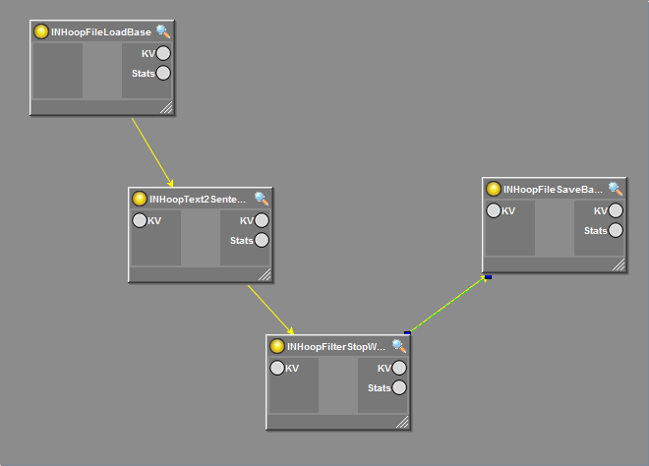
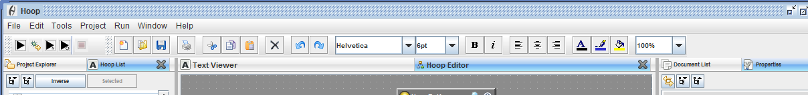
HoopGraphEditor
HoopVisualGraphComponent
HoopGraphEditor
HoopMainFrame

Slide 2
Given at construction time
HoopGraphEditor
HoopVisualGraphComponent
mxGraphComponent
extends
extends
HoopBasicGraphEditor
Given at construction time
extends
HoopEmbeddedJPanel
HoopVisualGraph
mxGraph
extends
extends
JPanel
HoopNodePanel
extends
HoopNodeRenderer
uses
HoopBase
extends
HoopJComponent
HoopBaseTyped
uses
extends
JComponent
HoopVisual
This is a light weight object that holds any visual information such as size and position. That way you can load lots of hoops on a cluster without loading visual information. The actual data is stored in a helper class: HoopVisualProperties
HoopMainFrame

