Slide 1
Hoop Highest Level Diagram
Graph Editor Class Diagram
Hoop Classes Overview
Mainframe UML
Data Design UML
UIMA-Hoop Data Design UML

Slide 2
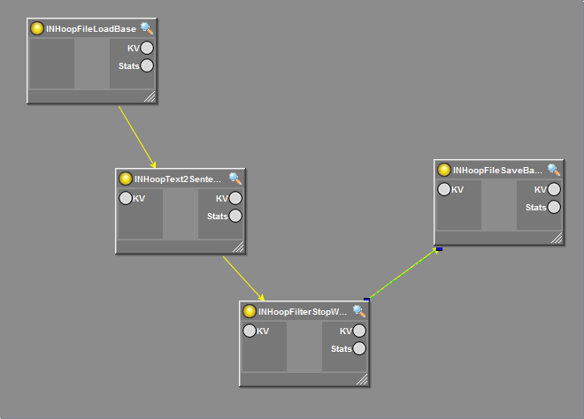
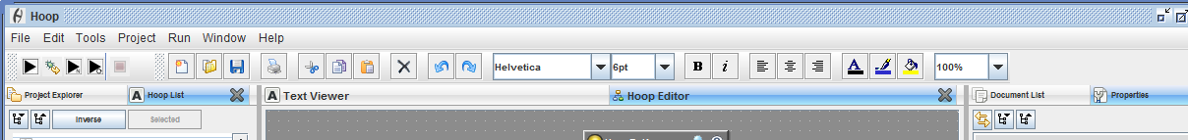
A
HoopVisualGraphComponent
HoopGraphEditor
HoopMainFrame

Slide 3
B
Given at construction time
HoopGraphEditor
HoopVisualGraphComponent
mxGraphComponent
extends
extends
HoopBasicGraphEditor
Given at construction time
extends
HoopEmbeddedJPanel
HoopVisualGraph
mxGraph
extends
extends
JPanel
HoopNodePanel
C
extends
HoopNodeRenderer
uses
HoopBase
extends
HoopJComponent
HoopBaseTyped
uses
extends
JComponent
HoopVisual
This is a light weight object that holds any visual information such as size and position. That way you can load lots of hoops on a cluster without loading visual information. The actual data is stored in a helper class: HoopVisualProperties
HoopMainFrame
D

Slide 4
C
edu.cmu.cs.in.hoop.hoops.base
HoopXMLBase
HoopAnalyze
HoopBase
edu.cmu.cs.in.base
uses
HoopControlBase
HoopStoredProperties
HoopBaseTyped
edu.cmu.cs.in.hoop.properties
edu.cmu.cs.in.hoop.properties.types
HoopVisual
HoopDisplayBase
uses
HoopLoadBase
HoopBooleanSerializable
HoopIOBase
HoopEnumSerializable
HoopSaveBase
This is a light weight object that holds any visual information such as size and position. That way you can load lots of hoops on a cluster without loading visual information. The actual data is stored in a helper class: HoopVisualProperties
HoopIntegerSerializable
HoopSerializable
HoopTransformBase
HoopStringSerializable
HoopXMLBase
HoopURISerializable

Slide 5
D

Slide 6
E

Slide 7
Hoop-UIMA compatibility is established by combining three distinct class systems from both architectures:
F1. Hoop/CAS Interface
F2. CPE/Hoop Execution Code Interface
F3. UIMA/Hoop KV data type specification
F4. Hoop/UIMA Analytic Interface

Slide 8
F
Hoop/CAS Interface
1
HoopKV
Serializable
implements
HoopKVClass
HoopKVInterface
implements
Core Hoop Classes
UIMA Compatible
+ Hoop Compatible
implements
AbstractCas
HoopKVDocument
Tags (HoopKVString)
Views (HoopKVString)
toXML
fromXML
implements
This mechanism makes our HoopKVDocument masquerade as JCasImpl, effectively creating a native UIMA Hoop analytic
JCas

Slide 9
F
CPE/Hoop Execution Code Interface
2
HoopRoot
Thread
implements
implements
StatusCallbackListener
HoopUIMACPEStatusProcessor
HoopUIMACPE
Uses
Uses

Slide 10
F
Hoop/UIMA Analytic Interface
3
HoopKVString
UIMAKVString
Implement or extend?
HoopKVBoolean
UIMAKVBoolean
Implement or extend?
HoopKVInteger
UIMAKVInteger
Implement or extend?
Native Hoop Classes
Custom UIMA Data Types

Slide 11
F
UIMA/Hoop KV data type specification
4
Annotator_ImplBase
JTextAnnotator
extends
implements
JTextAnnotator_ImplBase
UIMA Classes
Core Hoop Classes
extends
HoopBase (Alternative)

