Slide 1
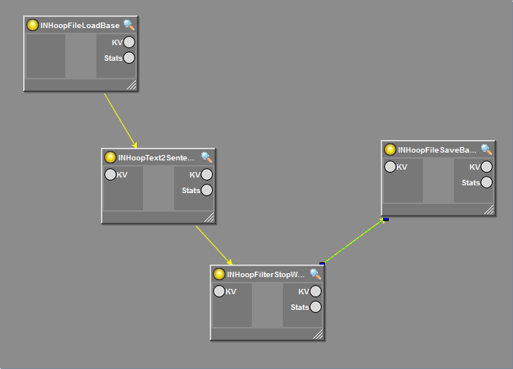
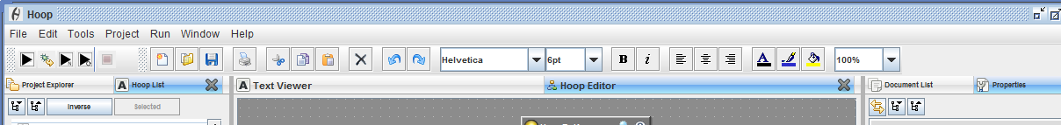
HoopVisualGraphComponent
HoopGraphEditor
HoopMainFrame

Slide 2
Given at construction time
HoopGraphEditor
HoopVisualGraphComponent
mxGraphComponent
extends
extends
HoopBasicGraphEditor
Given at construction time
extends
HoopEmbeddedJPanel
HoopVisualGraph
mxGraph
extends
extends
JPanel
HoopNodePanel
A
extends
HoopNodeRenderer
uses
HoopBase
extends
HoopJComponent
HoopBaseTyped
uses
extends
JComponent
HoopVisual
This is a light weight object that holds any visual information such as size and position. That way you can load lots of hoops on a cluster without loading visual information. The actual data is stored in a helper class: HoopVisualProperties
HoopMainFrame
B

Slide 3
A
edu.cmu.cs.in.hoop.hoops.base
HoopXMLBase
HoopAnalyze
HoopBase
edu.cmu.cs.in.base
uses
HoopControlBase
HoopStoredProperties
HoopBaseTyped
edu.cmu.cs.in.hoop.properties
edu.cmu.cs.in.hoop.properties.types
HoopVisual
HoopDisplayBase
uses
HoopLoadBase
HoopBooleanSerializable
HoopIOBase
HoopEnumSerializable
HoopSaveBase
This is a light weight object that holds any visual information such as size and position. That way you can load lots of hoops on a cluster without loading visual information. The actual data is stored in a helper class: HoopVisualProperties
HoopIntegerSerializable
HoopSerializable
HoopTransformBase
HoopStringSerializable
HoopXMLBase
HoopURISerializable

Slide 4
B

