Slide 1




Shop

Slide 2
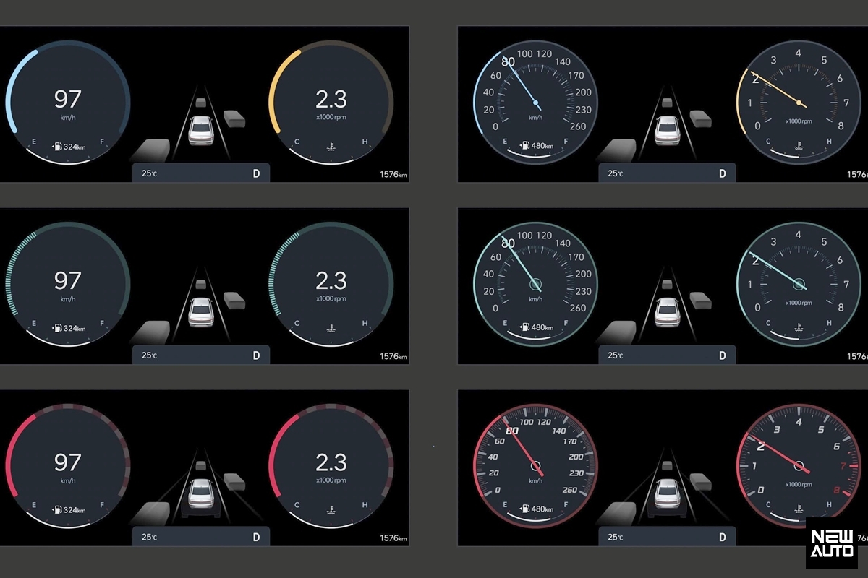

Slide 4
