Slide 1
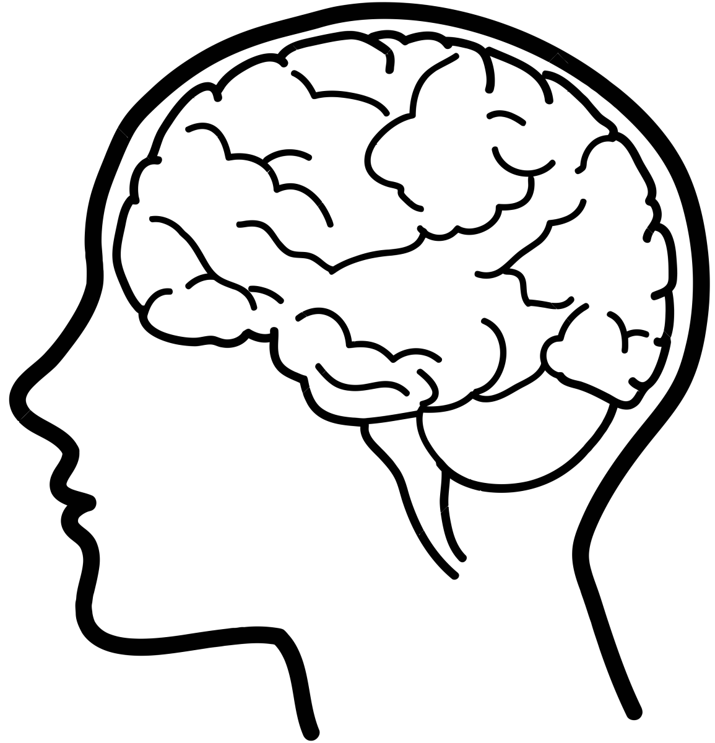
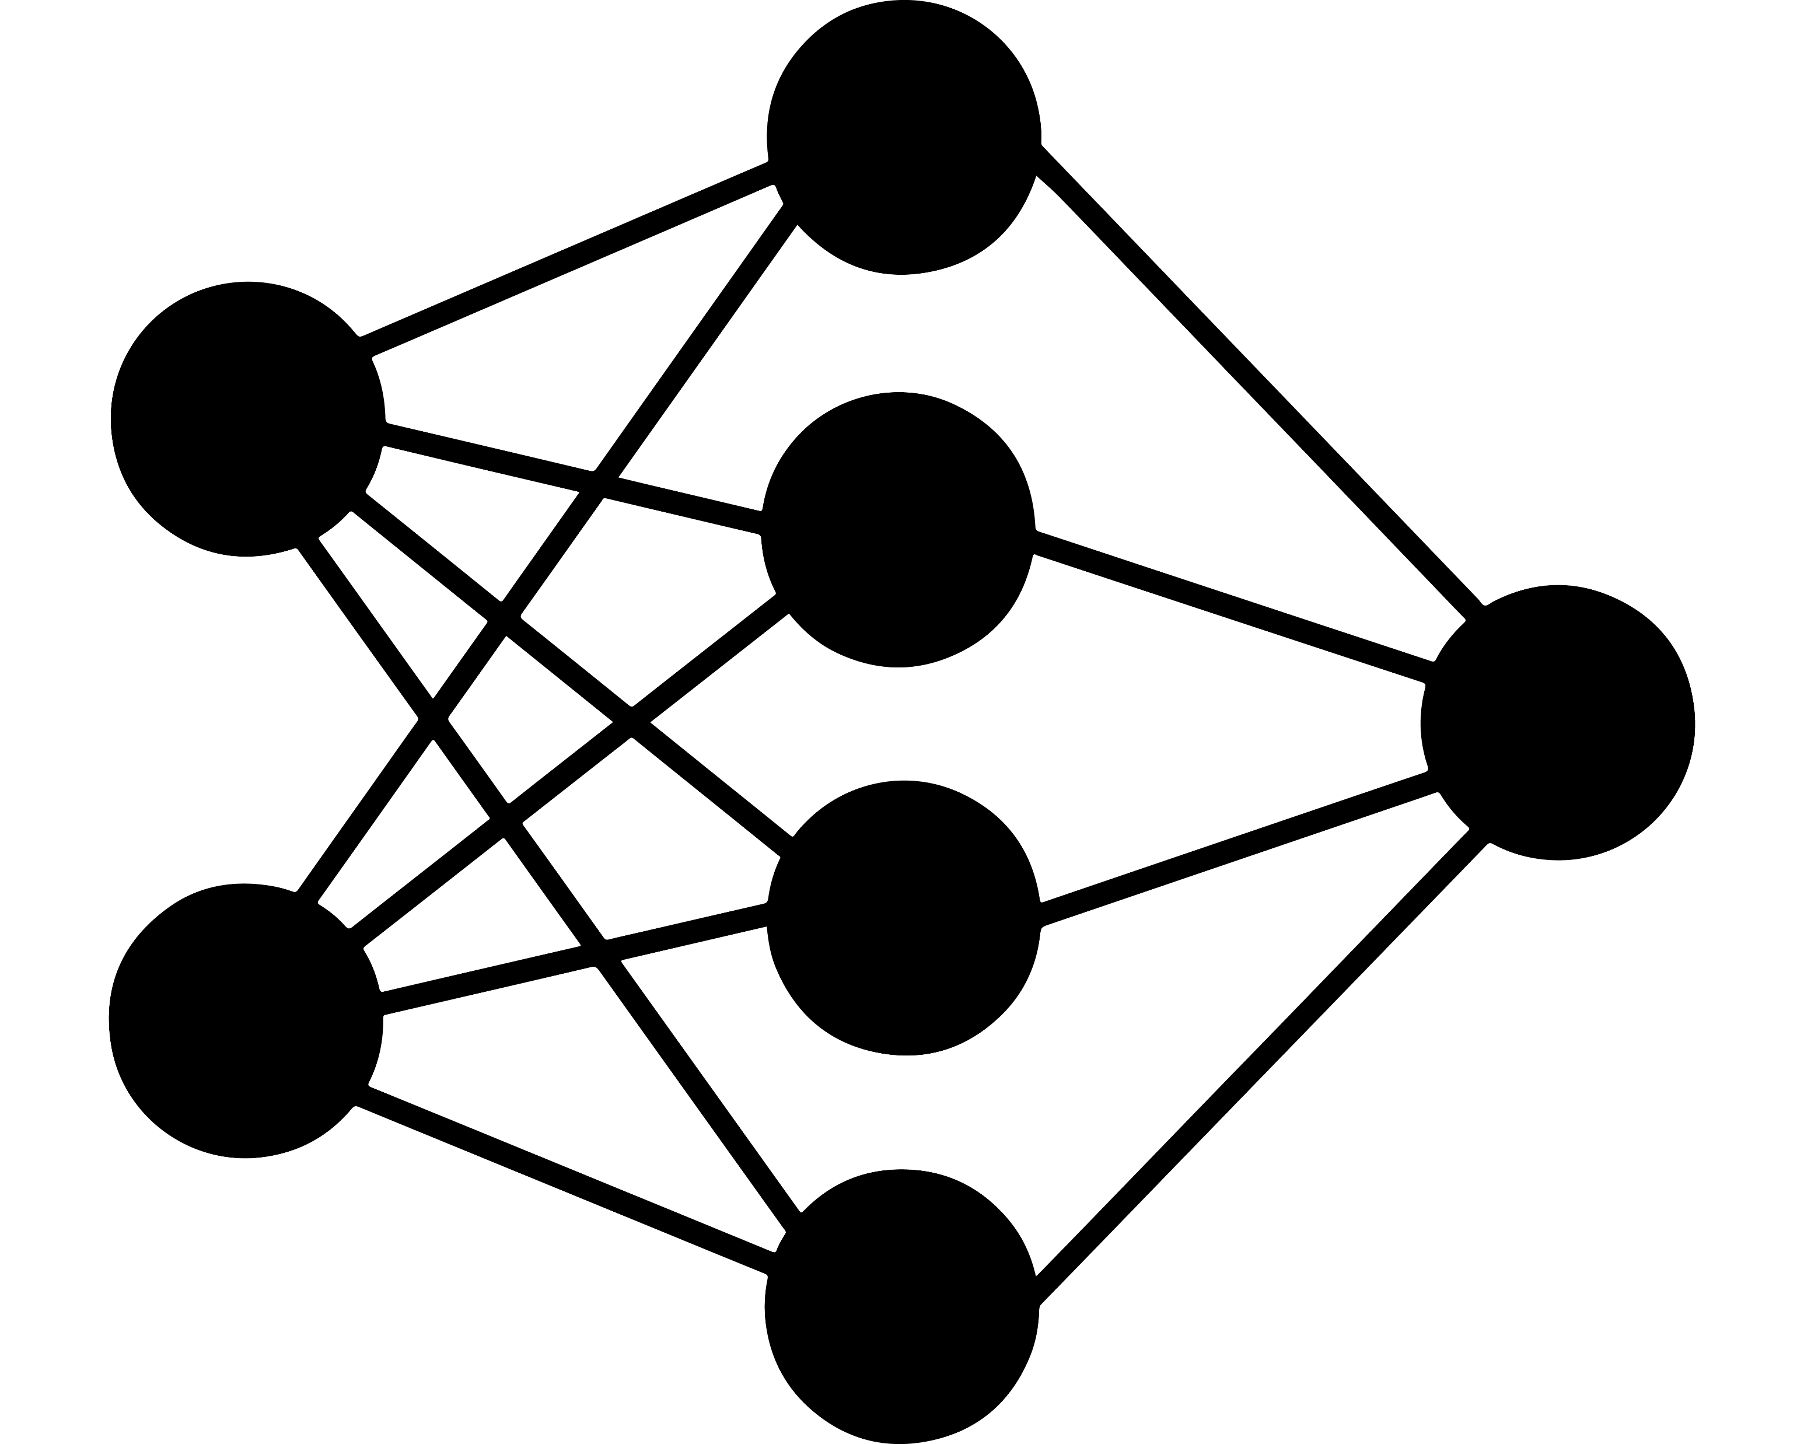

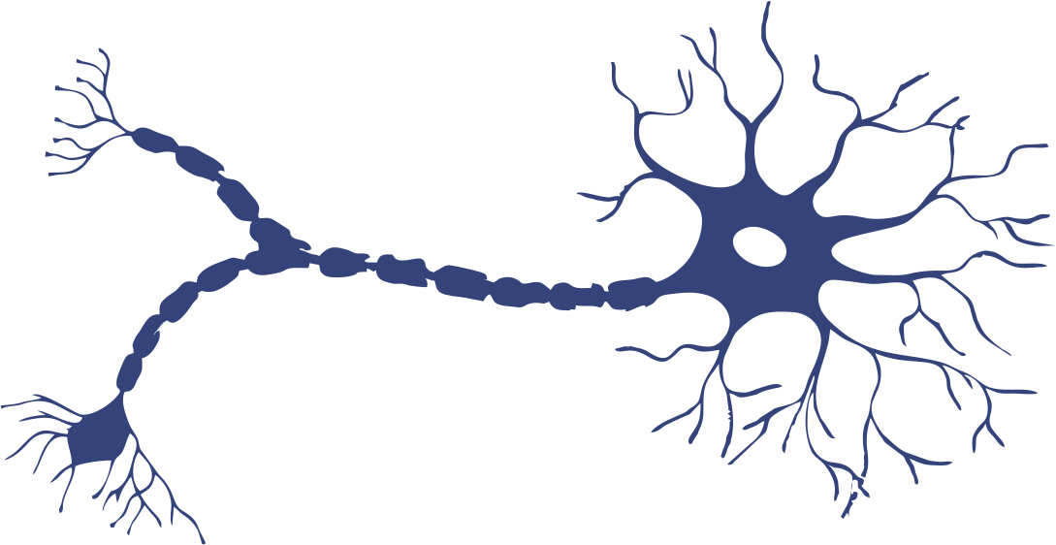
BRAIN RePAIR
BRAIN RePAIR

Slide 2

B
R

Slide 3


Slide 4

b
n
r
i
a
e
p
a
r
i
r

