Slide 1
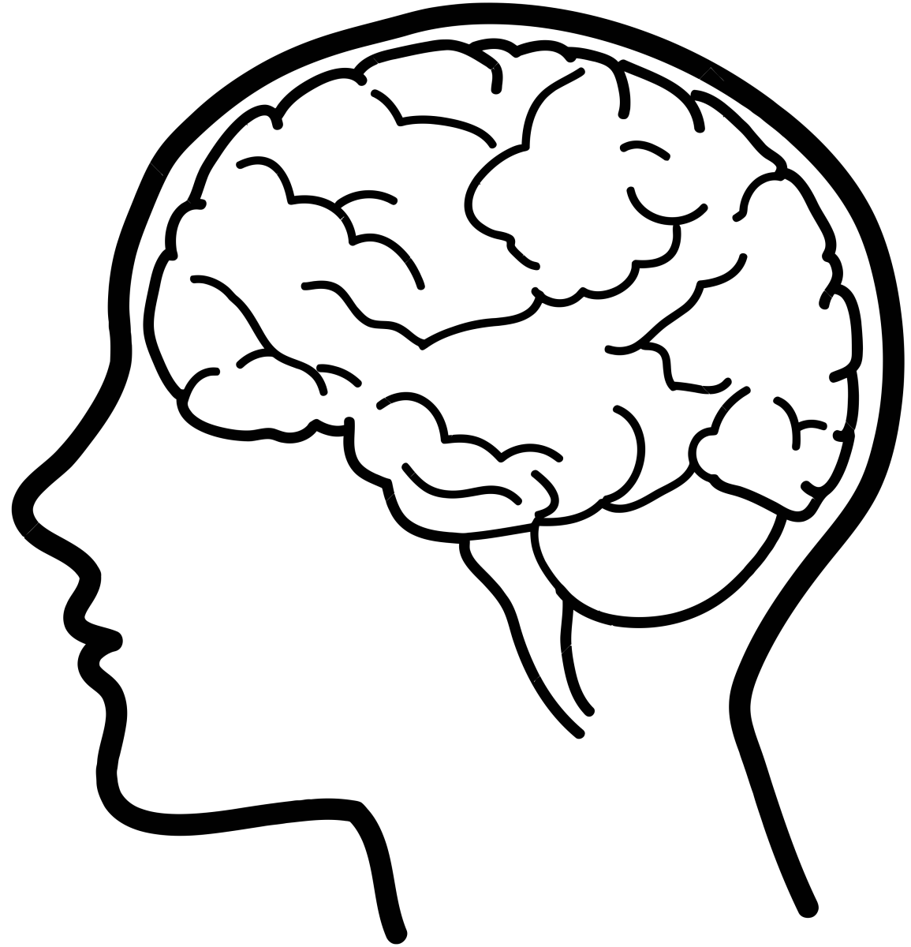
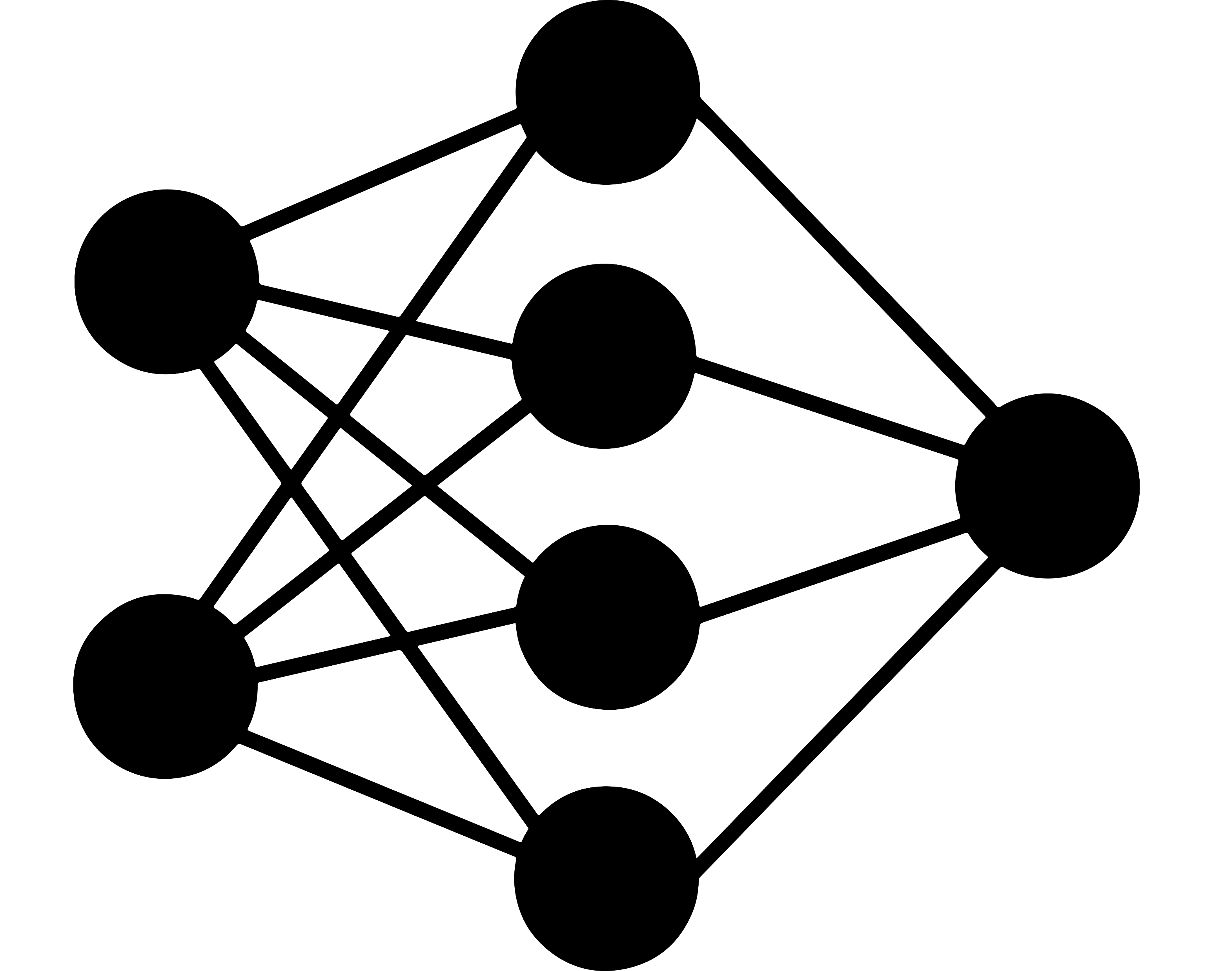

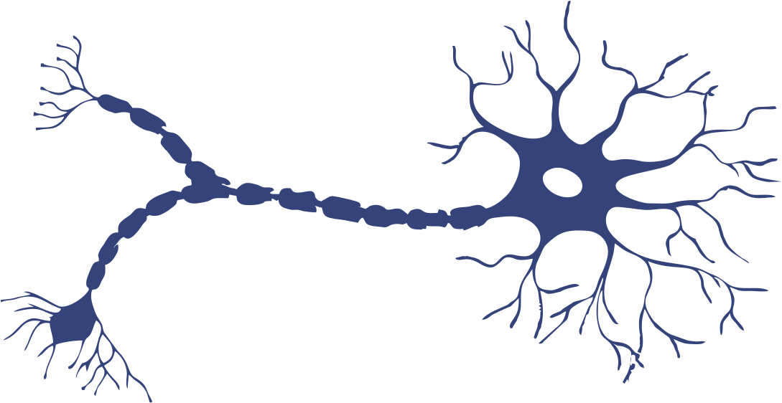
BRAIN RePAIR

Slide 2
B
R

Slide 3
B
R
1
Ø

Slide 4

b
n
r
i
a
e
p
a
r
i
r

