Slide 1
Constructive Investigation with IoT: Case of Smart Parking.
M.M. Nkosi, P. Tarwireyi
Dept. of Computer Science, University of Zululand.

Slide 2
Constructive Investigation with IoT: Case of Smart Parking
Project Based Learning.
It is a very useful method of teaching learners technology (Technical subjects). Teaching with projects quite often turned out to be chaotic in the perception of students. Remarks, based on the results of projects turned out to be highly depended on the subjective point of view of the teacher.
Few main reasons of using project based learning method:
The motivation of students to actually finish the project is a good motive.
Interactions of teachers with students, dependent on factors like specific experience.
Project Based Learning to provide a cumulating experience designed to include a clear focus on: critical thinking and problem solving; collaboration and leadership; verbal and written communications; and independent work.

Slide 3
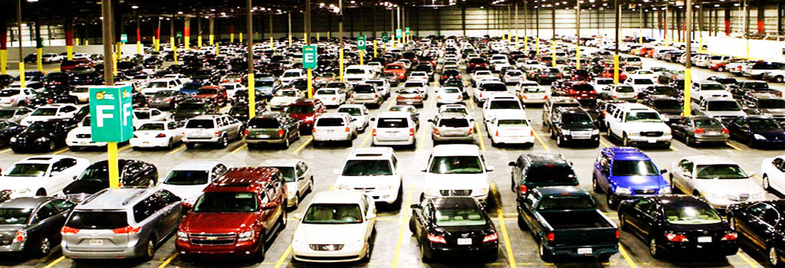
Constructive Investigation with IoT: Case of Smart Parking
With the high percentage of vehicles ownership that seem to keep increasing, parking or finding a parking slot in metropolitan areas has become a conflicting and frustrating situation for a large number of people.

Slide 4
Constructive Investigation with IoT: Case of Smart Parking
Problem
Not enough information for motorists on whether parking is available or not and how costly it is. Vehicle owner always get frustrated by expecting abundant and unoccupied parking slots find limited or expensive parking, or by wasting a lot of time trying to find a parking slot.
Excessive vehicle use creates many problems on society as the number of people owning vehicle increase yearly. The greater number of vehicles the greater the costs of residential parking and increases accident risks. External costs include increased road and parking facility costs, congestion, accident damages, and environmental degradation.
Inefficient use of existing parking capacity. Local zoning ordinances, building codes, and other development practice can create an oversupply of parking spaces.
Low parking turnover rate. This usually occurs when vehicles are parked in the same space/lot for at least 4 hours (on average).
Insufficient parking at event site. Special events can disturb normal traffic flow and require crowd management. Every event can create its own transportation issues.

Slide 5
Constructive Investigation with IoT: Case of Smart Parking
Solution using constructive investigation
This paper describes how a real life problem was used to learn and apply IoT technologies. Which was very challenging as it contains new concept which are not done as a module at the University.
An lot intensive research was done, and a smart parking system was implemented using the following components:
Arduino microcontroller board
Ultrasonic sensors
Wi-Fi module
Servo Motors
The following software's were used:
Arduino IDE
Android Studio
Firebase

Slide 6
Constructive Investigation with IoT: Case of Smart Parking
Solution using constructive investigation..
This project based learning strategy is where students are given responsibility for their learning. Where learning by doing was strongly encouraged as its something rarely done.
This gave students a new perspective not only on what IoT has to offer in terms of technological advancement but also in solving a real live problem with a solution of fourth industrial revolution.
As part of this capstone project module, students have to complete phases of software development which includes requirement analysis, planning, design, coding, prototyping, implementation and testing.
Being able to do this as a 3rd year student in Computer Science is a great privilege hence students were exposed to new ways of solving real world problems and also learn new thing like IoT.

Slide 7
Constructive Investigation with IoT: Case of Smart Parking
Conclusion
This journey had student on their feet with much curiosity. Even though it was very difficult but it was worth doing.
IoT is the future and its vastly growing as the demand for more data is needed to improve peoples lives. Thus having learn this, the students realize it’s a need to learn about such technology.

