Slide 1
Machine Learning with PySpark

Slide 2
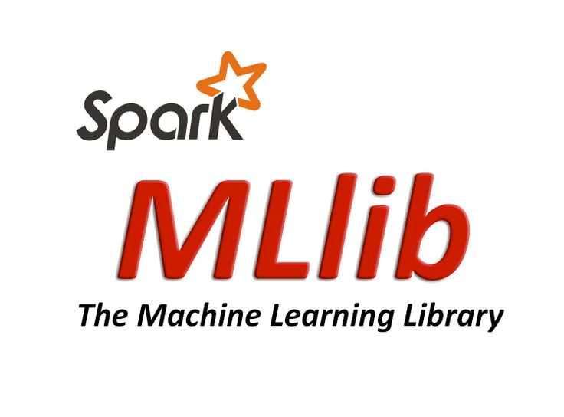
What is MLlib?
Spark’s distributed machine learning (ML) library with the goal of making practical machine learning scalable and easy
It consists of common learning algorithms and utilities, including classification, regression, clustering, collaborative filtering, dimensionality reduction, as well as lower-level optimization primitives and higher-level pipeline APIs.

Slide 3
We will Talk about MLlib later, but first an important tangent:
Not all ML problems have to be solved with a distributed technology like MLlib
Spark has several uses outside of machine learning to prepare data for a fully-functional library like sklearn.
Notes:
Basic statistics
summary statistics
correlations
stratified sampling
hypothesis testing
random data generation
Classification and regression
linear models (SVMs, logistic regression, linear regression)
naive Bayes
decision trees
ensembles of trees (Random Forests and Gradient-Boosted Trees)
isotonic regression
Collaborative filtering
alternating least squares (ALS)
Clustering
k-means
Gaussian mixture
power iteration clustering (PIC)
latent Dirichlet allocation (LDA)
streaming k-means
Dimensionality reduction
singular value decomposition (SVD)
principal component analysis (PCA)

Slide 4

scikit-learn (“sklearn”)
One of the most popular machine learning libraries, across programming languages
Python
Includes all sorts of machine learning and data analysis tools
Open source with a healthy community

Slide 5
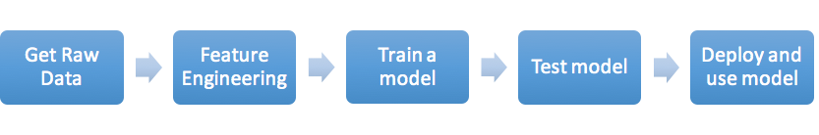
Typical Supervised ML workflow with sk-learn
Notes:
only some of this happen on spark

Slide 6
scikit-learn with Spark
scikit-learn isn’t distributed and can’t be made easily parallelizable, however, it’s completeness and features make it compelling for us to try.
One of the best things of PySpark is being able to naturally work with Python libraries along with doing large-scale data processing.

Slide 7
scikit-learn with Spark workflow
In Spark do feature engineering:
Load large data set
Filter down data at scale
Cleanse data at scale
Summarize at scale (perhaps to build feature vectors as the summarization of several events)
After all this, the data set might be quite small. In scikit-learn do the learning:
Train models
Serialize models and store to HDFS / s3 / wherever
In Spark (or a streaming framework, or something else):
Load the model
Apply the same feature engineering from before
Apply the model at scale

Slide 8
MLlib vs. scikit-learn
MLlib is more scalable and will work on larger data sets.
However, the training data might not be that large after the feature vectors are created.
Also, could sampling lower the size of the data set and yield similar results? In many cases, it can.
scikit-learn has more algorithms, more features, and is more portable so if we can use it, we probably should.

Slide 9
Lab 4: Feature Derivation/Engineering with Spark
Dataset: Amazon reviews
Columns: asin | helpful | overall | reviewText | reviewTime | reviewerID | reviewerName | summary | unixReviewTime
Let’s try to find features that might be indicative of:
whether people react (marked it as helpful/not helpful) to an Amazon review or not
whether an amazon review is more or less helpful
Notes:
This lab is to review/ get us back up to speed with spark api and basic spark stuff. Let’s get creative.

Slide 10
MLlib

Slide 11
Spark MLlib
A library of scalable statistical and machine learning algorithms
Basic statistics
Classification and regression
Collaborative filtering (recommendation engine)
Clustering
Dimensionality reduction
Text mining
Notes:
Basic statistics
summary statistics
correlations
stratified sampling
hypothesis testing
random data generation
Classification and regression
linear models (SVMs, logistic regression, linear regression)
naive Bayes
decision trees
ensembles of trees (Random Forests and Gradient-Boosted Trees)
isotonic regression
Collaborative filtering
alternating least squares (ALS)
Clustering
k-means
Gaussian mixture
power iteration clustering (PIC)
latent Dirichlet allocation (LDA)
streaming k-means
Dimensionality reduction
singular value decomposition (SVD)
principal component analysis (PCA)

Slide 12
Data Types
Dense and Sparse vectors
org.apache.spark.mllib.linalg.{Vector, Vectors}
data type is double
stored on a single machine (local)
Labeled points
org.apache.spark.mllib.regression.LabeledPoint
a dense vector plus a label
for supervised learning (label = class)
Matrices
org.apache.spark.mllib.linalg.{Matrix, Matrices}
dense (local) or distributed
Notes:
MLlib supports local vectors and matrices stored on a single machine, as well as distributed matrices backed by one or more RDDs
Local vectors and local matrices are simple data models that serve as public interfaces

Slide 13
Local Vector
A local vector has integer-typed and 0-based indices and double-typed values, stored on a single machine.
# Create a dense vector (1.0, 0.0, 3.0). v = Vectors.dense([1.0, 2.0])
# Create a SparseVector (2,3,0) by specifying non-zero entries sv1 = Vectors.sparse(3, [0, 2], [1.0, 3.0])
Notes:
A local vector has integer-typed and 0-based indices and double-typed values stored on a single machine
MLlib supports two types of local vectors: dense and sparse

Slide 14
Labeled Point
A labeled point is a local vector, either dense or sparse, associated with a label/response.
In MLlib, labeled points are used in supervised learning algorithms.
from pyspark.mllib.linalg import SparseVector from pyspark.mllib.regression import LabeledPoint
# Create a labeled point with a positive label and a dense feature vector. pos = LabeledPoint(1.0, [1.0, 0.0, 3.0]) # Create a labeled point with a negative label and a sparse feature vector. neg = LabeledPoint(0.0, SparseVector(3, [0, 2], [1.0, 3.0]))
Notes:
A labeled point is a local vector, either dense or sparse, associated with a label/response
In MLlib, labeled points are used in supervised learning algorithms
We use a double to store a label, so we can use labeled points in both regression and classification
For binary classification, a label should be either 0 (negative) or 1(positive)
For multiclass classification, labels should be class indices starting from zero: 0, 1, 2,

Slide 15
Local Matrix
A local matrix has integer-typed row and column indices and double-typed values, stored on a single machine.
from pyspark.mllib.linalg import Matrix, Matrices # Create a dense matrix ((1.0, 2.0), (3.0, 4.0), (5.0, 6.0)) dm2 = Matrices.dense(3, 2, [1, 2, 3, 4, 5, 6]) # Create a sparse matrix ((9.0, 0.0), (0.0, 8.0), (0.0, 6.0)) sm = Matrices.sparse(3, 2, [0, 1, 3], [0, 2, 1], [9, 6, 8])
Notes:
A local matrix has integer-typed row and column indices and double-typed values, stored on a single machine
MLlib supports dense matrices, whose entry values are stored in a single double array in column-major order, and sparse matrices, whose non-zero entry values are stored in the Compressed Sparse Column (CSC) format in column-major order
For example, the following dense matrix

Slide 16
MLlib Basic Statistics
Usually one of the first things you’ll do with new data is some exploratory statistical analysis
MLlib provides many common functions:
Summary statistics (mean, variance, etc.)
Correlation
Stratified Sampling
Hypothesis testing (chi square, Kolmogorov-Smirnov)
Kernel Density Estimation
Also useful: dimensionality reduction
Principle Component Analysis (PCA)
Singular Value Decomposition (SVD)
Notes:
Correlation -
Stratified Sampling - a method of sampling from a population. In statistical surveys, when subpopulations within an overall population vary, it is advantageous to sample each subpopulation (stratum) independently
Hypothesis Teesting - powerful tool in statistics to determine whether a result is statistically significant, whether this result occurred by chance or not
Kernel Density Estimation - In statistics, kernel density estimation (KDE) is a non-parametric way to estimate the probability density function of a random variable. Kernel density estimation is a fundamental data smoothing problem where inferences about the population are made, based on a finite data sample
Principle Component Analysis -
Singular Value Decomposition - In linear algebra, the singular value decomposition (SVD) is afactorization of a real or complexmatrix.

Slide 17
Summary Statistics
A column summary statistics for RDD[Vector]
import numpy as np from pyspark.mllib.stat import Statistics mat = sc.parallelize( [np.array([1.0, 10.0, 100.0]), np.array([2.0, 20.0, 200.0]), np.array([3.0,30.0,300.0])] ) # an RDD of Vectors # Compute column summary statistics. summary = Statistics.colStats(mat) print(summary.mean()) # a dense vector containing the mean value for each column print(summary.variance()) # column-wise variance print(summary.numNonzeros()) # number of nonzeros in each column

Slide 18
Correlations
Statistics provides methods to calculate correlations between series. Depending on the type of input, two RDD[Double]s or an RDD[Vector], the output will be a Double or the correlation Matrix respectively.
from pyspark.mllib.stat import Statistics seriesX = sc.parallelize([1.0, 2.0, 3.0, 3.0, 5.0]) # a series # seriesY must have the same number of partitions and cardinality as seriesX seriesY = sc.parallelize([11.0, 22.0, 33.0, 33.0, 555.0]) # Compute the correlation using Pearson's method. Enter "spearman" for Spearman's method. # If a method is not specified, Pearson's method will be used by default. print("Correlation is: " + str(Statistics.corr(seriesX, seriesY, method="pearson"))) data = sc.parallelize( [np.array([1.0, 10.0, 100.0]), np.array([2.0, 20.0, 200.0]), np.array([5.0, 33.0, 366.0])] ) # an RDD of Vectors # calculate the correlation matrix using Pearson's method. Use "spearman" for Spearman's method. # If a method is not specified, Pearson's method will be used by default. print(Statistics.corr(data, method="pearson"))

Slide 19
Stratified Sampling
Stratified sampling methods, sampleByKey and sampleByKeyExact, can be performed on RDD’s of key-value pairs.
For stratified sampling, the keys can be thought of as a label and the value as a specific attribute.
# an RDD of any key value pairs data = sc.parallelize([(1, 'a'), (1, 'b'), (2, 'c'), (2, 'd'), (2, 'e'), (3, 'f')]) # specify the exact fraction desired from each key as a dictionary fractions = {1: 0.1, 2: 0.6, 3: 0.3} approxSample = data.sampleByKey(False, fractions)

Slide 20
LIBSVM Format
loadLibSVMFile(sc, path, multiclass=False, numFeatures=-1, minPartitions=None)
Loads labeled data in the LIBSVM format into an RDD of LabeledPoint.
The LIBSVM format is a text-based format used by LIBSVM and LIBLINEAR.
Each line represents a labeled sparse feature vector using the following format: label index1:value1 index2:value2 …
where the indices are one-based and in ascending order. This method parses each line into a LabeledPoint.
Notes:
labeled point is used in supervision algorithms
Traditionally 30 and 70 is the split

Slide 21
MLlib: Classification and Regression
A very common task solved by Machine Learning is to predict an unknown value based on a set of observations
Classification predicts a discrete label based on a feature vector
binary (true or false)
SVM, Logistic Regression, Decision Trees, Random Forests, Naive Bayes
multiclass
Logistic Regression, Decision Trees, Random Forests, Naive Bayes
Regression predicts a continuous variable based on a feature input
Linear least squares, Lasso, Regression Tree/Forest, Ridge Regression

Slide 22
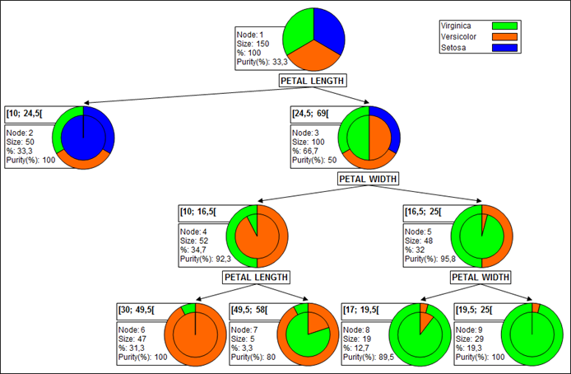
Decision & Regression Trees
Successively partition data by asking questions of its features
When the “leaves” are pure, the algorithm stops
New “test” instances can be parsed by the tree and the data at the leaves are used to make predictions
mode for discrete
mean for continuous

Slide 23
MLlib and Predictive Models - Classification
Load Data and Split into Training and Testing Set from pyspark.mllib.tree import RandomForest, RandomForestModel from pyspark.mllib.util import MLUtils # Load and parse the data file into an RDD of LabeledPoint. data = MLUtils.loadLibSVMFile(sc, 'data/mllib/sample_libsvm_data.txt') # Split the data into training and test sets (30% held out for testing) (trainingData, testData) = data.randomSplit([0.7, 0.3])
Train Model # Train a RandomForest model. # Empty categoricalFeaturesInfo indicates all features are continuous. model = RandomForest.trainClassifier(trainingData, numClasses=2, categoricalFeaturesInfo={}, numTrees=3, featureSubsetStrategy="auto", impurity='gini', maxDepth=4, maxBins=32)
Notes:
Alternatively,

Slide 24
MLlib and Predictive Models - Classification
Make predictions on test instances predictions = model.predict(testData.map(lambda x: x.features)) labelsAndPredictions = testData.map(lambda lp: lp.label).zip(predictions)
Evaluate predictions testErr = labelsAndPredictions.filter( lambda lp: lp[0] != lp[1]).count() / float(testData.count()) print('Test Error = ' + str(testErr)) print('Learned classification forest model:') print(model.toDebugString())
Save and load model model.save(sc, "target/tmp/myRandomForestClassificationModel") sameModel = RandomForestModel.load(sc, "target/tmp/myRandomForestClassificationModel")

Slide 25
Lab 5: Classification with MLLib
Let’s see if we can classify whether people react to an Amazon review or not. React means they review/rate it as helpful or not helpful.

Slide 26
MLlib and Predictive Models - Regression
Load Data and Split into Training and Testing Set from pyspark.mllib.tree import RandomForest, RandomForestModel from pyspark.mllib.util import MLUtils # Load and parse the data file into an RDD of LabeledPoint. data = MLUtils.loadLibSVMFile(sc, 'data/mllib/sample_libsvm_data.txt') # Split the data into training and test sets (30% held out for testing) (trainingData, testData) = data.randomSplit([0.7, 0.3])
Train Model model = RandomForest.trainRegressor(trainingData, categoricalFeaturesInfo={}, numTrees=3, featureSubsetStrategy="auto", impurity='variance', maxDepth=4, maxBins=32)
Notes:
# Train a RandomForest model. # Empty categoricalFeaturesInfo indicates all features are continuous. # Note: Use larger numTrees in practice. # Setting featureSubsetStrategy="auto" lets the algorithm choose.

Slide 27
MLlib and Predictive Models - Regression
Make predictions on test instances predictions = model.predict(testData.map(lambda x: x.features)) labelsAndPredictions = testData.map(lambda lp: lp.label).zip(predictions)
Evaluate predictions testMSE = labelsAndPredictions.map(lambda lp: (lp[0] - lp[1]) * (lp[0] - lp[1])).sum() /\ float(testData.count()) print('Test Mean Squared Error = ' + str(testMSE)) print('Learned regression forest model:') print(model.toDebugString())
Save and load model model.save(sc, "target/tmp/myRandomForestRegressionModel") sameModel = RandomForestModel.load(sc, "target/tmp/myRandomForestRegressionModel")

Slide 28
Lab 6: Regression with MLLib
For the Amazon review that did have a reaction, let’s try to predict try to predict the % 'helpful' reactions.

Slide 29
Clustering
A family of algorithms for grouping data such that objects within a cluster are more similar than those that are not.
Unsupervised (labels are not required)
Requires a measure of similarity/quality, stopping criteria
MLlib provides
k-means/k-means streaming
Gaussian Mixture Models
Power Iteration Clustering (PIC)
Latent Dirichlet Allocation (LDA)

Slide 30
MLlib Clustering
MLlib includes a parallelized variant of the k-means++ method
from pyspark.ml.clustering import KMeans dataset = spark.read.format("libsvm").load("data/mllib/sample_kmeans_data.txt") # Trains a k-means model. kmeans = KMeans().setK(2).setSeed(1) model = kmeans.fit(dataset) # Evaluate clustering by computing Within Set Sum of Squared Errors. wssse = model.computeCost(dataset) print("Within Set Sum of Squared Errors = " + str(wssse)) # Shows the result. centers = model.clusterCenters() print("Cluster Centers: ") for center in centers: print(center)

Slide 31
Collaborative Filtering
Automating predictions about one individual by collecting preference data from many other individuals.
Forms the basis of many recommender systems (Spotify, Reddit, YouTube…)
May be user-based or item-based, or model-based
Model-based: users and products are described by a small set of latent factors that can be used to predict unknown user interests
R = U * V R - ratings matrix, user-item observations matrix U, V
decompose your large user/item matrix into lower dimensional user and item factors through matrix factorization
then can predict user ratings using these user and item factors (learned)
MLlib implements the Alternating Least Squares (ALS) algorithm

Slide 32
Collaborative Filtering - setup & training
from pyspark.ml.evaluation import RegressionEvaluator from pyspark.ml.recommendation import ALS from pyspark.sql import Row
Load Data and Setup Train/Test lines = spark.read.text("data/mllib/als/sample_movielens_ratings.txt").rdd parts = lines.map(lambda row: row.value.split("::")) ratingsRDD = parts.map(lambda p: Row(userId=int(p[0]), movieId=int(p[1]), rating=float(p[2]), timestamp=long(p[3]))) ratings = spark.createDataFrame(ratingsRDD) (training, test) = ratings.randomSplit([0.8, 0.2])

Slide 33
Collaborative Filtering - prediction & evaluation
Build the recommendation model using ALS on the training data als = ALS(maxIter=5, regParam=0.01, userCol="userId", itemCol="movieId", ratingCol="rating", coldStartStrategy="drop") model = als.fit(training)
Evaluate Model predictions = model.transform(test) evaluator = RegressionEvaluator(metricName="rmse", labelCol="rating", predictionCol="prediction") rmse = evaluator.evaluate(predictions) print("Root-mean-square error = " + str(rmse))
Generate Recommendations userRecs = model.recommendForAllUsers(10) # Generate top 10 movie recommendations for each user movieRecs = model.recommendForAllItems(10) # Generate top 10 user recommendations for each movie

Slide 34
Text Mining
MLlib provides some added functionality to support text mining.
Term Frequency-Inverse Document Frequency (TF-IDF)
Reflects the importance of a term to a document in a corpus
Useful in featurizing documents
classification
retrieval/search
Word2Vec
Computes a distributed vector representation of words
Similar words are close in vector space
Useful in Named Entity Recognition, Machine Translation, Tagging ...

Slide 35
Back to Non-MLlib...

Slide 36
Neat Spark package: spark_sklearn
https://spark-packages.org/package/databricks/spark-sklearn
Has functions to make some embarrassingly parallel aspects of sklearn easy parallelized on Spark
Some Capabilities
train and evaluate multiple scikit-learn models in parallel.
convert Spark's Dataframes seamlessly into numpy ndarrays or sparse matrices.
(experimental) distribute Scipy's sparse matrices as a dataset of sparse vectors.
Automatically distributes repetitive tasks like model tuning on a Spark cluster, without impacting the workflow

Slide 37
Neat Spark package: spark_sklearn
from sklearn import grid_search, datasets from sklearn.ensemble import RandomForestClassifier # Use spark_sklearn’s grid search instead: from spark_sklearn import GridSearchCV digits = datasets.load_digits() X, y = digits.data, digits.target param_grid = {"max_depth": [3, None], "max_features": [1, 3, 10], "min_samples_split": [1, 3, 10], "min_samples_leaf": [1, 3, 10], "bootstrap": [True, False], "criterion": ["gini", "entropy"], "n_estimators": [10, 20, 40, 80]} gs = grid_search.GridSearchCV(RandomForestClassifier(), param_grid=param_grid) gs.fit(X, y)

