Slide 1
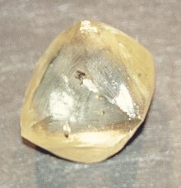
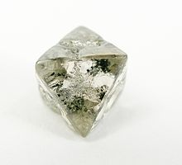

Slide 2
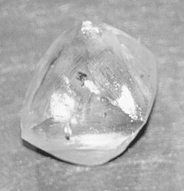
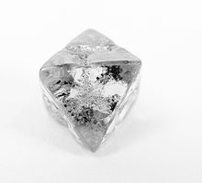

Slide 3
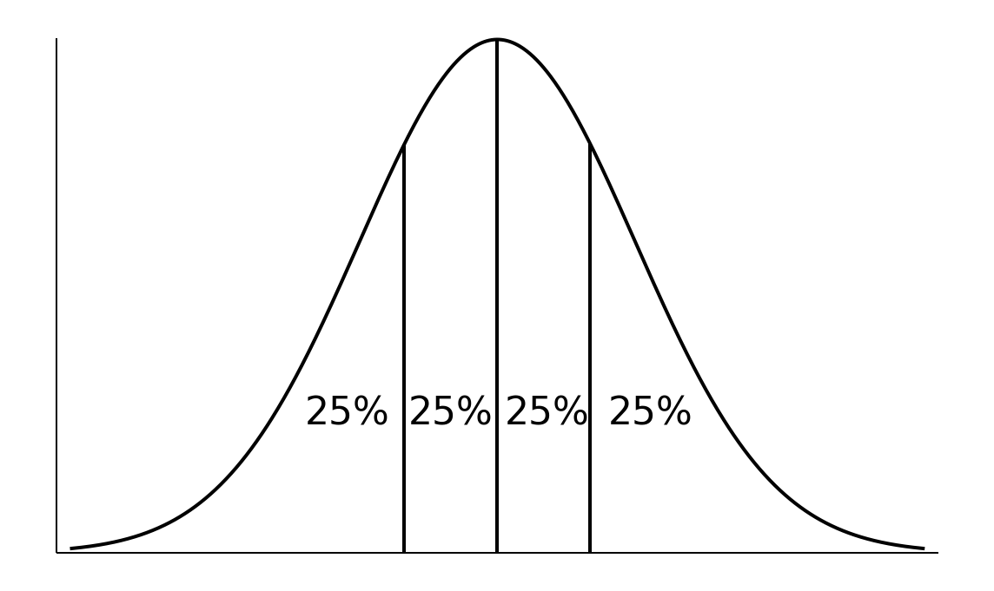

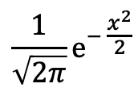
$${\frac{1}{\sqrt{2π}}e}^{− \frac{x^{2}}{2}}$$
$$x$$
What’s the value of $x$ here?
It is the 25% quantile of the standard Gaussian model

Slide 4

Unit = 200 km,
Length = 2400 km (approx.)
Unit = 100 km,
Length = 2800 km (approx.)
Unit = 50 km,
Length = 3400 km (approx.)

