Slide 1
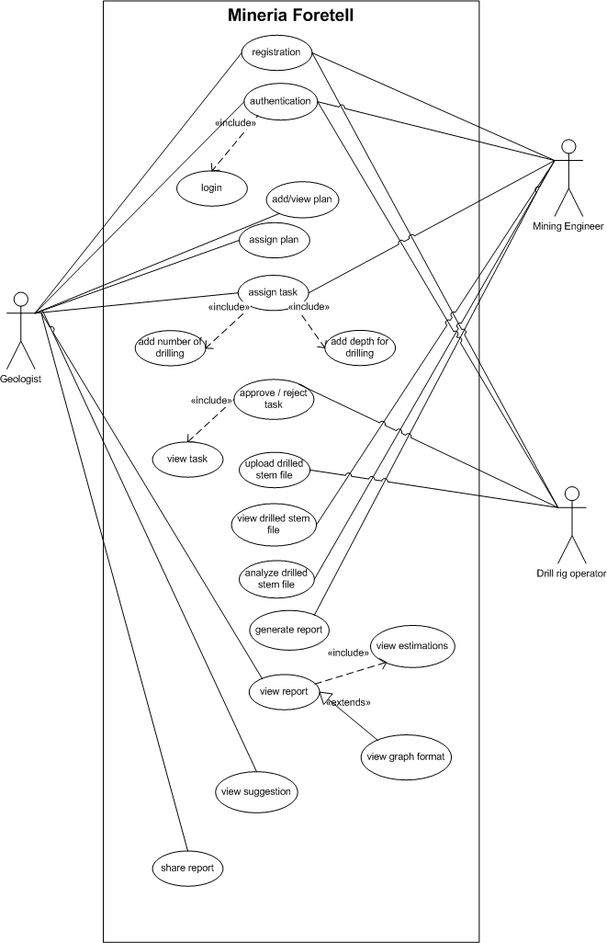
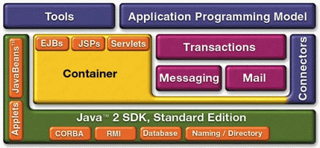
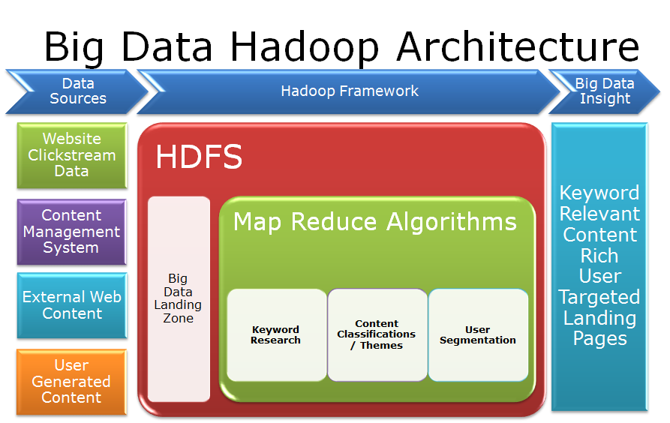
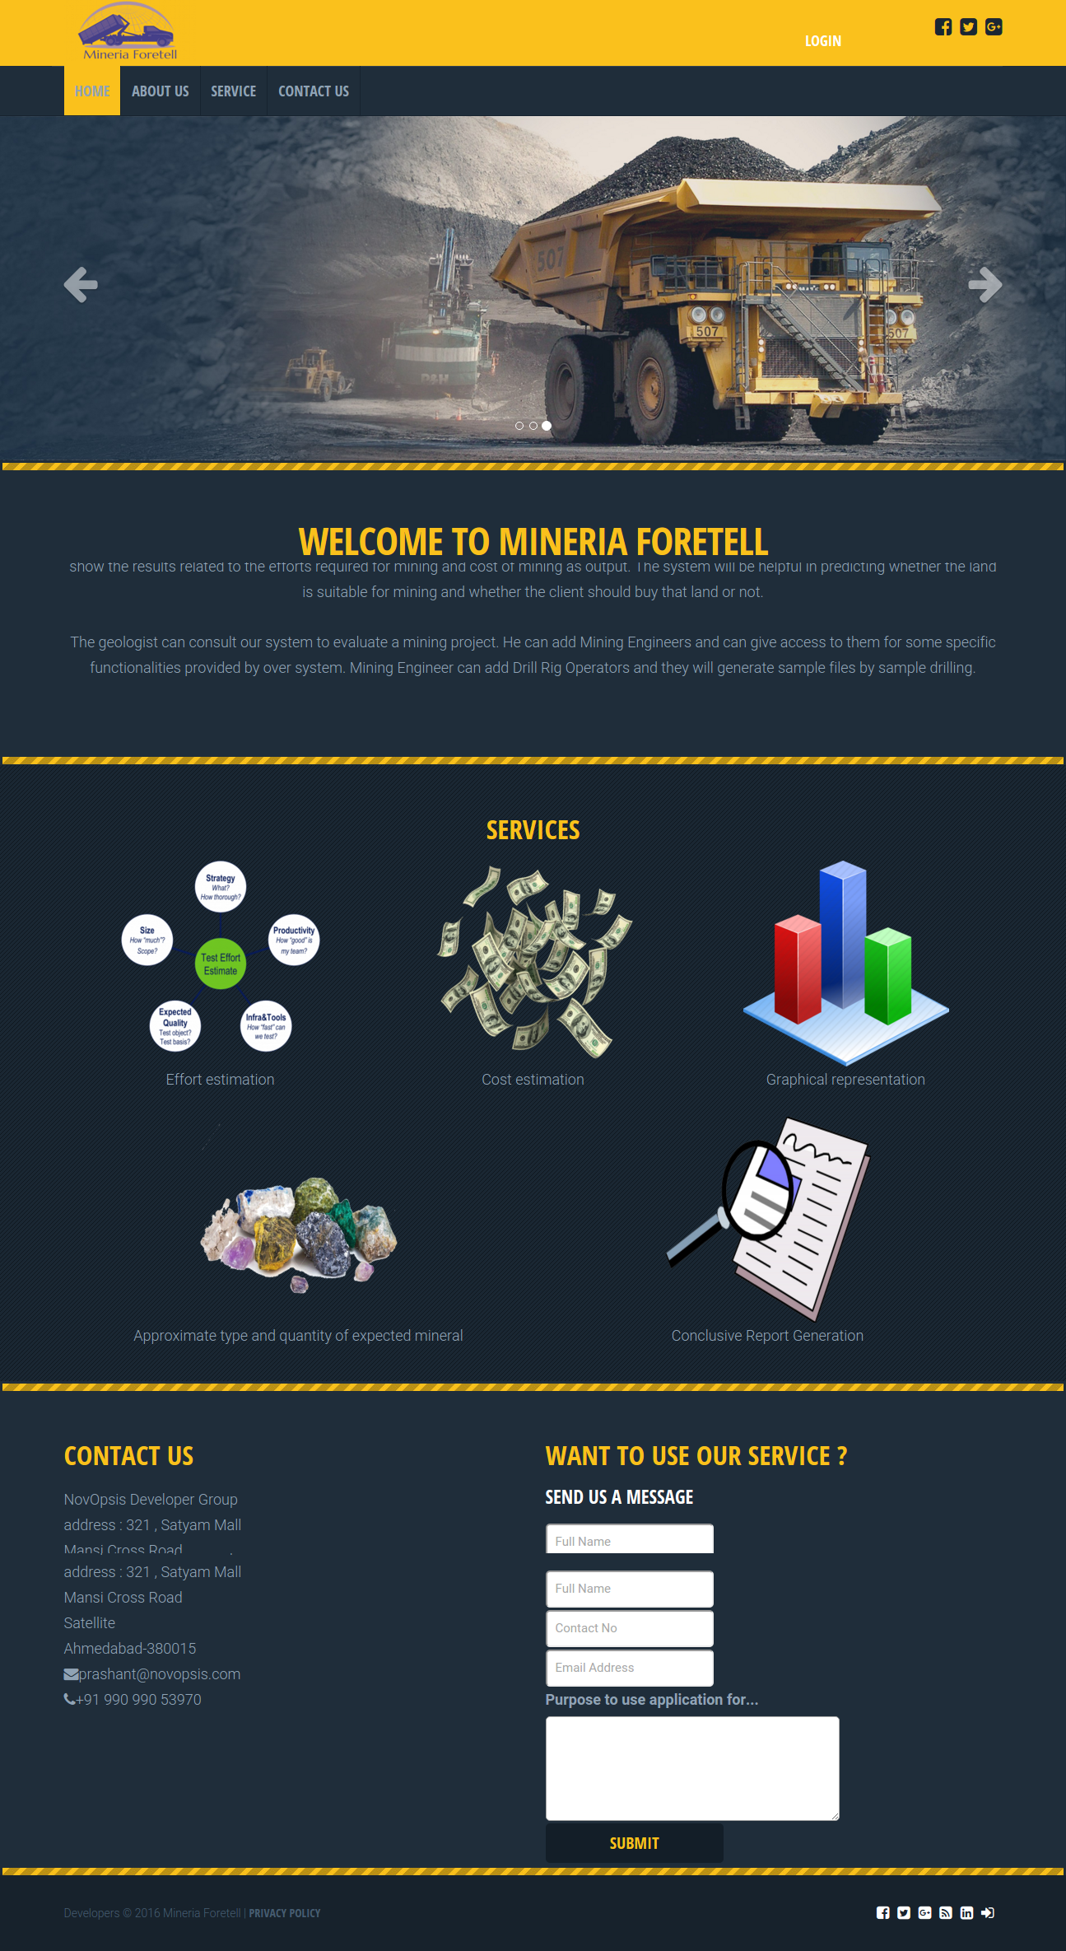
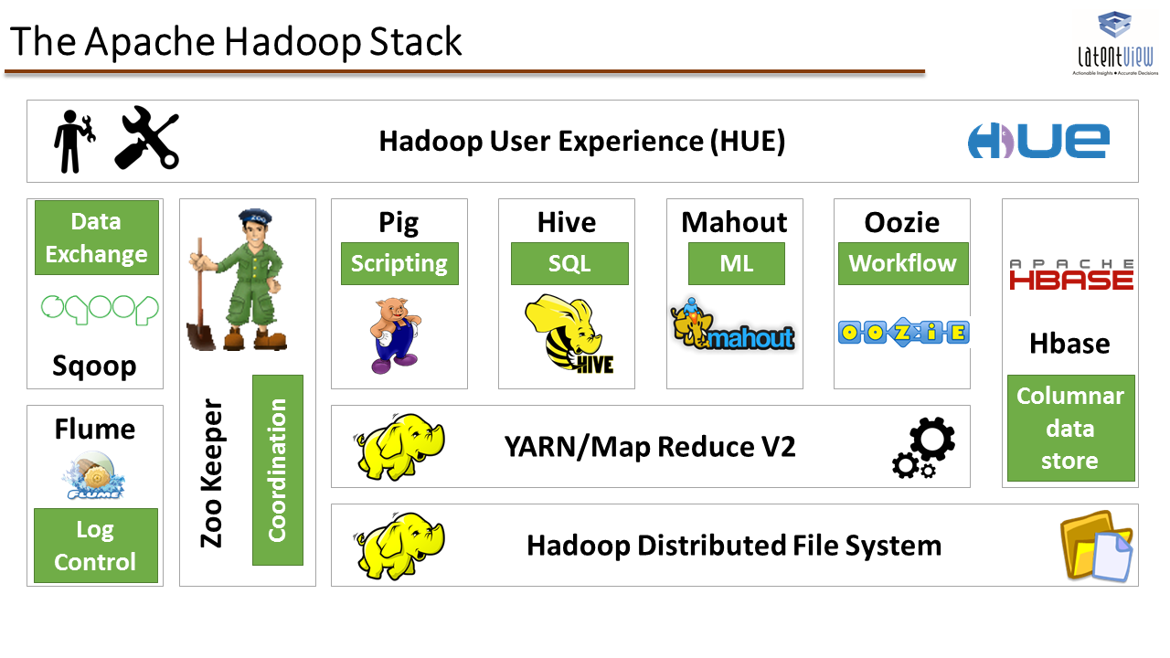
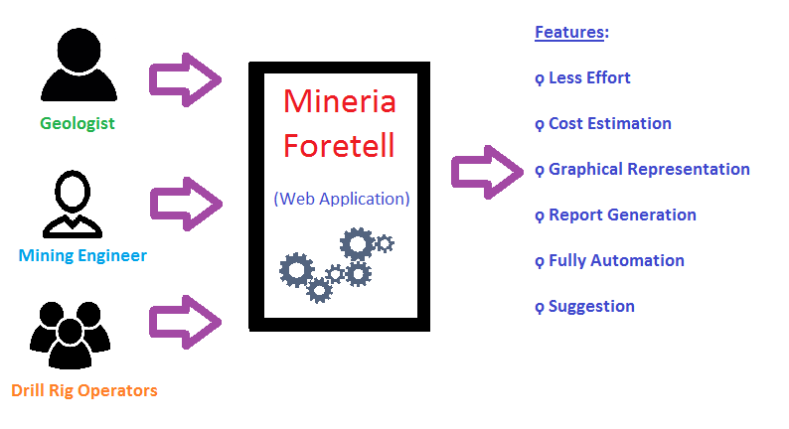
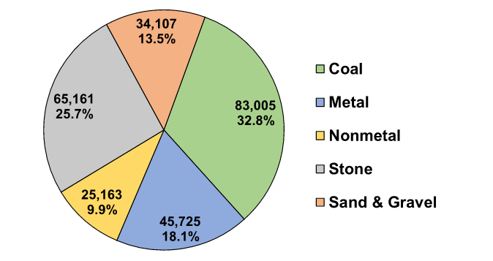
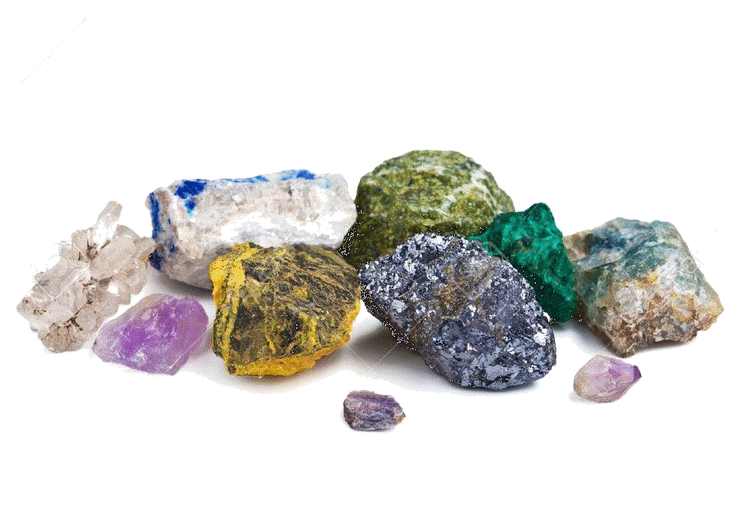


Mineria Foretell
Problem
Diagrams
Technology
Previously, forecasting regarding mining work is used to be done manually but was not introduced through any application. There was no prediction regarding the efforts or the cost estimation of mining. All of these processes were very time consuming and even after these much exhaustive work the predictions are not guaranteed.
Abstract
-Forecasting related to type and quantity of minerals like iron ore, coal, bauxite etc. can be done before mining by the geologist. Forecasting regarding mining work was used to be done manually. This forecasting was generally the approximation and expectation of geologist which was solely based on his experience. Also the cost required for mining cannot be predicted. There was no automation that can forecast the type and quantity of minerals and the cost required for mining. Moreover, the whole mining process was very time consuming and costly. To decrease those efforts in terms of time and money we have developed Mineria Foretell.
-Mineria Foretell will be more precise in determining the type and quantity of minerals than previous forecasting. First we gathered requirements for mining forecasting by the effective communication with some mining industries and geologists. We referred some research papers and registered patents related to our project. Then we defined the scope of our project Mineria Foretell.
-Hence, Mineria Foretell is an effective web application to precisely forecast the type and quantity of minerals. This application will be very helpful to the mining industries and government sectors to decide whether to invest or purchase for the MIne/Land or not.
Figure 5 : Java - J2EE Architecture
Figure 1 : Usecase Diagram
IMPLEMENTATION AND RESULT
Figure 6 : BigData Hadoop Architecture
INTRODUCTION
-Mineria Foretell is a system that takes the drilled data as input, processes it and forecasts the quantity of iron ore, coal & other minerals.
-It also shows the results related to the efforts required for mining, schedule and cost of mining as output.
-The system is helpful in predicting whether the land is suitable for mining and the client should buy that land or not.
OBJECTIVE
Figure 7 : Apache Hadoop Stack
Mineria Foretell is a system that forecasts the quantity of minerals like iron ore, coal, bauxite and many others available in a mine. The system works as follows:
- The system firstly takes sample drilled file as input which is an unstructured format.
- It analyses the input data, parses it and converts the data into structured format.
- It uses the parsed data and prepares the graphs for density and cost.
- It displays the efforts and schedule required for mining.
-Finally it generates the report and gives suggestion whether the land is suitable for
mining and the client should buy that land or not according to his budget.
Figure 8 : Working Flow OF Mineria foretell and itsFeatures
Figure 2 : Interface to user Mineria Foretell
[1] MMSD-Mining, Minerals and Sustainable Development.URL: http://www.iied.org/mining-minerals-sustainable-development-mmsd [2] Methodology and Equations of Mineral Production Forecast Available from URL: : https://file.scirp.org/Html/3-1210145_38656.htm
[3] A multidimensional grey metabolism Markov forecasting method is proposed based on the theories of Grey forecast and Stochastic process. Available from URL: http://link.springer.com/chapter/10.1007%2F978-3-642-30976-2_37
REFERENCES
LITERATURE SURVEY
Title
Mining, Minerals and Sustainable Development (MMSD) ^{[1]}
Methodology and Equations of Mineral Production Forecast ^{[2]}
Forecasting Mineral Commodity Prices with Multidimensional Grey Metabolism Markov Chain. ^{[3]}
Figure 3 : Graphical Representation
Figure 4 : Mineral Quantity
Figure 9 : Cost Estimation
Figure 10 : Report Generation

