Slide 1
Mineria Foretell

Slide 2
Introduction
Mineria Foretell is a system that forecasts the quantity of minerals like iron ore, coal, bauxite and many others available in a mine.
The system shows the results related to the efforts required for mining, schedule and cost of mining as output.
The system is helpful in predicting whether the land is suitable for mining and the client should buy that land or not.

Slide 3
Literature Review
Forecasting Mineral Commodity Prices with Multidimensional Grey Metabolism Markov Chain
The price with large random fluctuation in mineral market has made it very difficult to do an accurate forecast. To overcome this problem, a multidimensional grey metabolism Markov forecasting method is proposed based on the theories of Grey forecast and Stochastic process. The forecasting effect of the model is tested through a case study and analysis with MATLAB software. The research results indicate that the forecasting precision of the proposed method is high and not limited to forecasting step length. So the method can be used to do a long term forecasting for mineral commodity prices without considering economic crisis.
Link : http://link.springer.com/chapter/10.1007%2F978-3-642-30976-2_37

Slide 4
Mining, Minerals and Sustainable Development (MMSD)
The Mining, Minerals and Sustainable Development Project (MMSD) was a research project looking at how the mining and minerals sector could contribute to the global transition to sustainable development. Between 2000 and 2002, MMSD project carried out research, analysis and consultation. This introduction describes what the project set out to do and the process that evolved to accomplish those goals. The report found that the mining and minerals industry has made major advances towards sustainability but the sector faces new challenges, as governments in the global South reassert control over their natural resources, while at the same time lacking the capacity to ensure mining can contribute to sustainable development.
Link : http://www.iied.org/mining-minerals-sustainable-development-mmsd

Slide 5
Methodology and Equations of Mineral Production Forecast
The equations of mineral production forecast link the change in time of mineral reserves with the production and the ratio of reserves to production. These equations allow us to model the development of the mineral resources evaluated at any scale. Probabilistic bidimensional charts made from montecarlo simulations provide intervals of confidence for the forecasts. The set of equations is devised and presented for a variety of applications to the oil and gas industry, as well to the production of any other mineral resource, either metals or non metals, whose ore deposit volumes and production might be quantified.
Link:
http://www.scirp.org/journal/PaperInformation.aspx?PaperID=36620#.VbE0YPmqqko

Slide 6
Modules and Functionalities
1) User Authentication
Registration
Login
2) Mine planning
Add/View Plan
Add/View minerals expected from the ground
Add/View due date of each assignment
Assign plan to mining engineer
Decide number of drillings needed for the plan
Add the depth for drilling
Decide locations for drilling
Assign the drilling process to drill rig Operator

Slide 7
Cont…
3) Drilled file generation
View task assigned by mining engineer
Upload drilled stem file
4) Historical data insertion
Add historical information regarding mining
5) Drilled file analysis
View the file sent by drill rig Operator
Analyze the file

Slide 8
Cont…
6) Report generation
Convert Unstructured data into structured format
Integrate the data
Add the types and quantity of expected minerals
Generate report including graphical representation
7) Conclusion
Calculate the profit or loss that may incur in buying the land
Provide a suggestion

Slide 9



Technology

Slide 10
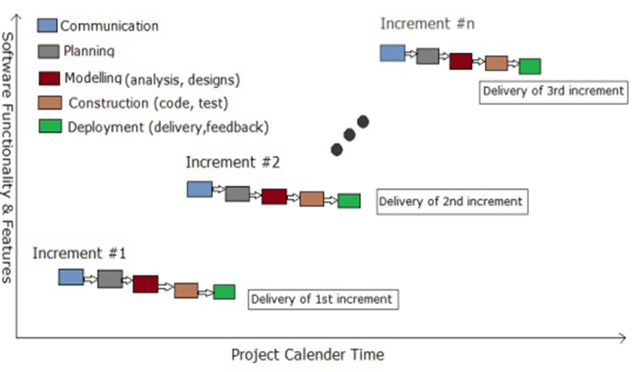
Software Development Model
Fig 1: Incremental model

Slide 11
Why we choose Incremental Model
In incremental model the whole requirement is divided into various modules.
Each module passes through the requirements, design, implementation and testing phases.
This model suits better for our system because working version of software is produced during the first module, so you have working software early on during the software life cycle.
Also we can easily add functions to the existing system with the subsequent release.

Slide 12
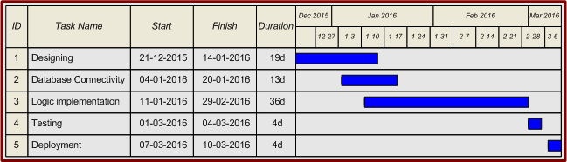
Project Planning
Fig 2: Gantt chart

Slide 13
Analysis of System
Use case Diagram
Sequence Diagram
Activity Diagram
Data Flow Diagram
E-R Diagram
Class Diagram

Slide 14
Use Case
A use case diagram illustrates a unit of high level functionality provided by the system.
The main purpose of the use-case diagram is to help development teams visualize the functional requirements of a system, including the relationship of "actors" (human beings who will interact with the system) to essential processes, as well as the relationships among different use cases.

Slide 15
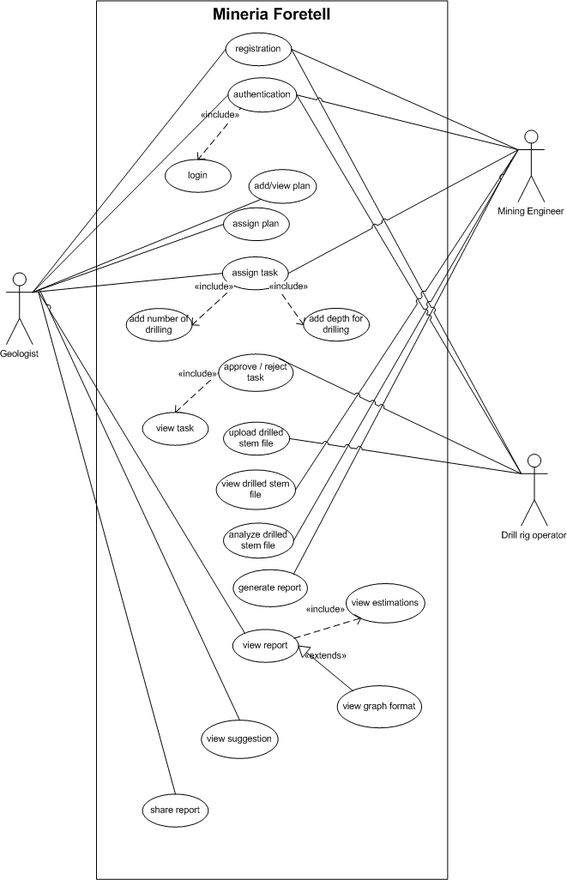
Fig 3:Use Case

Slide 16
Sequence Diagram
A sequence diagram shows the participants in an interaction and the sequence of messages among them.
A sequence diagram shows the interaction of a system with its actors to perform all or part of a use case.
A sequence diagram has two dimensions: The vertical dimension shows the sequence of messages/calls in the time order that they occur; the horizontal dimension shows the object instances to which the messages are sent.

Slide 17
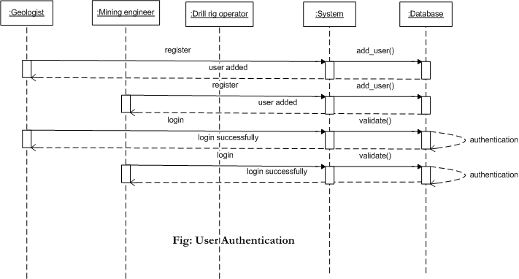

Slide 18
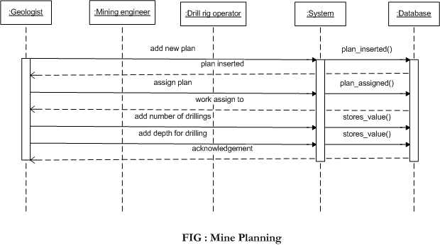

Slide 19
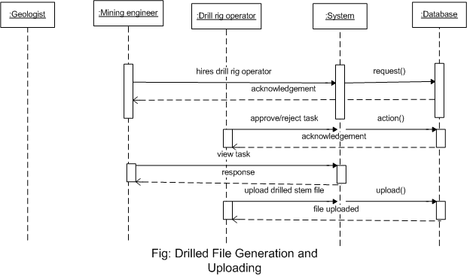

Slide 20
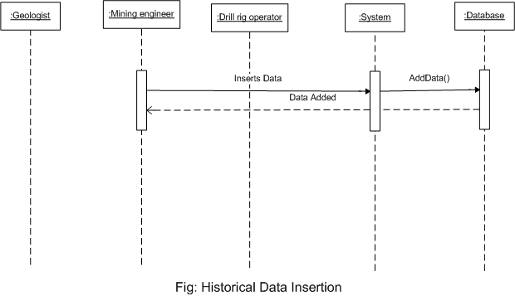

Slide 21
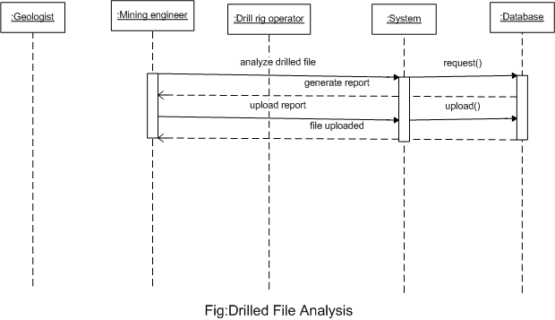

Slide 22
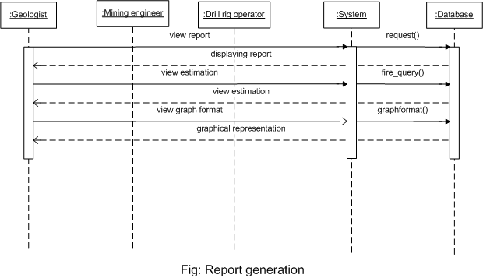

Slide 23
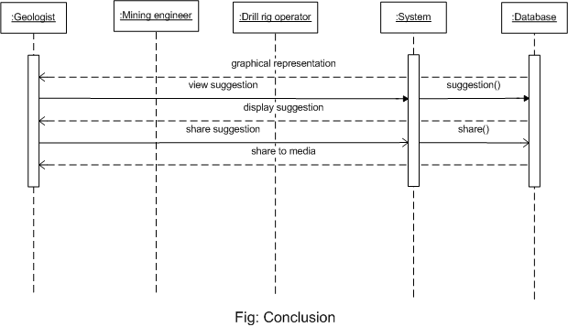

Slide 24
Activity Diagram
An activity diagram shows a sequence of steps that make up a complex process, such as an algorithm or workflow.
An activity diagram shows flow of control, similar to a sequence diagram, but focuses on operations rather than on objects.
An activity diagram is like a traditional flowchart, however, an activity diagram can show both sequential and concurrent flow of control.

Slide 25
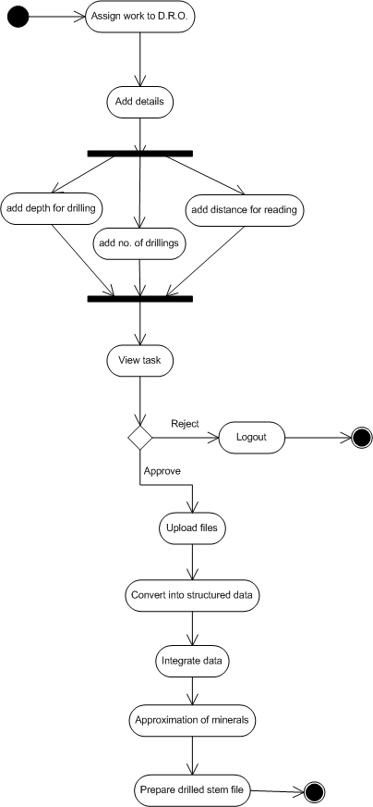
Fig 4: Activity Diagram

Slide 26
Data Flow Diagram
A Data Flow Diagram (DFD) is a graphical representation of the "flow" of data through an information system, modelling its process aspects.
A DFD is often used as a preliminary step to create an overview of the system, which can later be elaborated.
A DFD shows what kind of information will be input to and output from the system, where the data will come from and go to, and where the data will be stored.

Slide 27
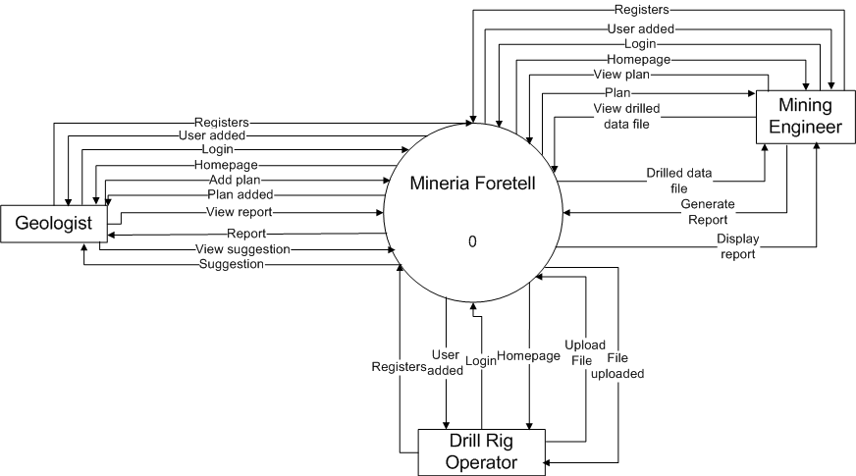
Fig 5: Context Level Diagram

Slide 28
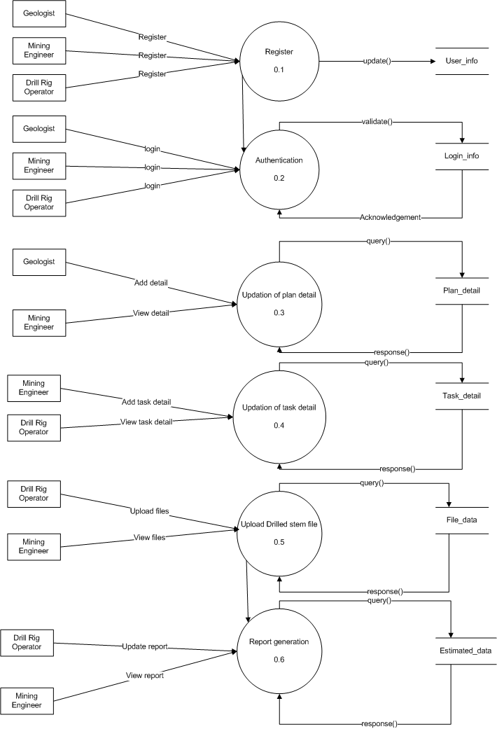
Fig 6: Level 1 Diagram

Slide 29
E-R Diagram
An entity–relationship model (ER model) is a data model for describing the data or information aspects of a business domain or its process requirements, in an abstract way that lends itself to ultimately being implemented in a database such as a relational database.
The main components of ER models are entities (things) and the relationships that can exist among them.

Slide 30
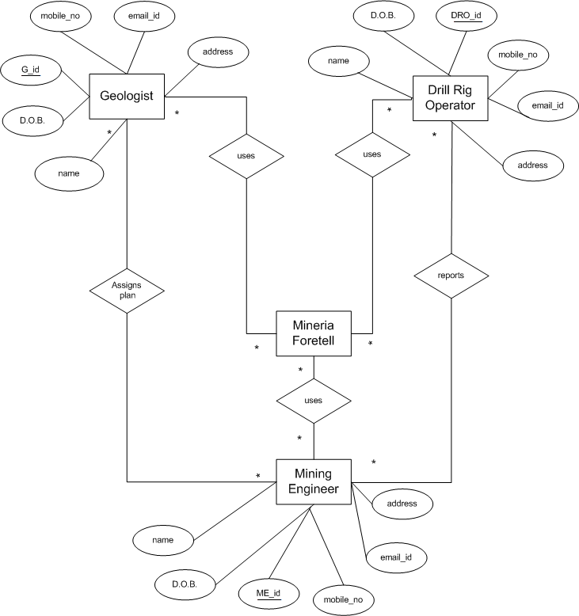
Fig 7: E-R Diagram

Slide 31
Class Diagram
The class diagram shows how the different entities (people, things, and data) relate to each other; in other words, it shows the static structures of the system.
Class diagrams can also be used to show implementation classes, which are the things that programmers typically deal with.

Slide 32
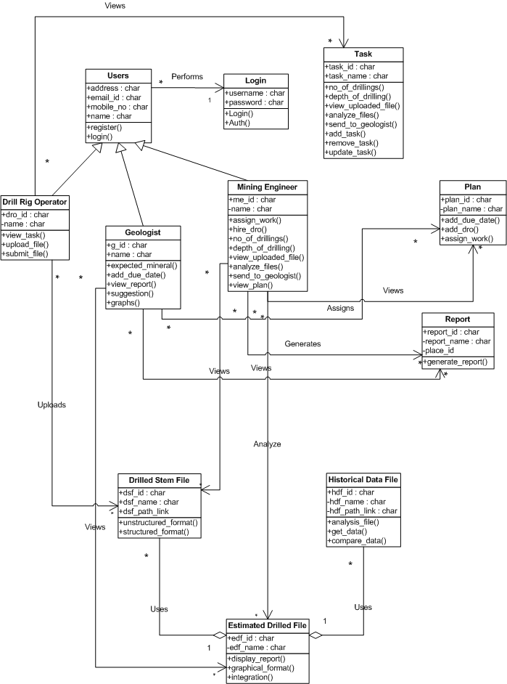
Fig 8: Class Diagram

Slide 33
Data Dictionary
Table 1 : user_info
Name | Data Type | Constraint | Key | Description
user_login_id | int(11) | Auto | PK | To fetch data for login info
user_id | int(11) |  | FK | user id
user_first_name | varchar(50) |  |  | Stores First Name
user_last_name | varchar(50) |  |  | Stores Last Name
user_contact_number | varchar(50) |  |  | Contact Number
Table 2 : login_info
Name | Data Type | Constraint | Key | Description
user_id | int(11) | Auto | PK | user id
username | varchar(255) |  |  | username
password | Varchar(255) |  |  | password
role | varchar(45) |  |  | user role

Slide 34
Table 3 : project_details
Name | Data Type | Constraint | Key | Description
mine_id | int(11) | Auto | PK | mine id
mine_area | varchar(50) |  |  | mine area
due_date | date |  |  | due date to complete plan
mine_location | varchar(255) |  |  | location of mine
user_id_from | int(11) |  | FK | user who uploaded the plan details
company_name | varchar(50) |  |  | name of company
points | int(11) |  |  | No. of points to be drilled
tasks | int(11) |  |  | No. of tasks
project_name | varchar(50) |  |  | name of project
Table 4 : project_user_details
Name | Data Type | Constraint | Key | Description
project_user_id | int(11) | Auto | PK | to fetch data from project_details
mine_id | int(11) |  | FK | mine id
user_id_to | int(11) |  | FK | user to whom the plan is assigned

Slide 35
Table 5 : mineral_details
Name | Data Type | Constraint | Key | Description
mineral_id | int(11) | Auto | PK | Mineral id
mine_id | int(11) |  | FK | mine id
expected_mineral | int(11) |  |  | user who is assigned the task
quantity | int(11) |  |  | quantity of minerals
cost | float |  |  | depth of drilling
Table 6 : task_details
Name | Data Type | Constraint | Key | Description
task_id | int(11) | Auto | PK | task id
user_id_from | int(11) |  | FK | user who assigned the task
user_id_to | int(11) |  | FK | user who is assigned the task
mine_id | int(11) |  | FK | mine id
due_date | date |  |  | completion date
depth | float |  |  | depth of drilling

Slide 36
Table 7 : point_details
Name | Data Type | Constraint | Key | Description
task_point_id | int(11) | Auto | PK | task point id
task_id | int(11) |  | FK | task id
point_id | int(11) |  | FK | point id
Table 8 : point_readings
Name | Data Type | Constraint | Key | Description
reading_id | int(11) | Auto | PK | reading id
point_id | int(11) |  | FK | point id
depth | float |  |  | depth of drilling
expected_mineral | varchar(150) |  |  | mineral expected from point
back_force | float |  |  | back force of mineral

Slide 37
Table 9 : file_details
Name | Data Type | Constraint | Key | Description
file_id | int(11) | auto increment by 1 | PK | file id
point_id | int(11) |  | FK | point id
file_path | varchar(255) |  |  | file location path
status | varchar(50) |  |  | status to check processing in hadoop
Table 10 : reading_report_details
Name | Data Type | Constraint | Key | Description
report_id | int(11) | Auto | PK | report id
mine_id | int(11) |  | FK | mine id
report_path | varchar(255) |  |  | path where the report is stored
upload_date | date |  |  | date when report was generated
Table 11 : estimated_profit
Name | Data Type | Constraint | Key | Description
e_id | int(11) | Auto | PK | estimated profit id
mine_id | int(11) |  | FK | mine id
mining_cost | varchar(55) |  |  | total cost of mining
expected_profit | varchar(45) |  |  | total profit expected

Slide 38
Test Cases
Table 1 : Login_TC
Test Case ID | Test Case Name | Test Case Description | Test Step | Expected Result | Actual Result | Test Status
TCID01_1 | Login with correct credentials | To verify login functionality works properly | Click on login button | User should get logged in properly. System should redirect the user to his respective dashboard | As expected | Pass

Slide 39
TCID01_2 | Login without username and password | To verify login functionality works properly | Click on login button | By leaving both fields empty, the message “Please fill out this field” should be displayed | As expected | Pass
TCID01_3 | Login with username and password only | To verify login functionality works properly | Click on login button | By leaving either of the fields empty, the message “Please fill out this field” should be displayed | As expected | Pass
TCID01_4 | Login with incorrect credentials | To verify login functionality works properly | Click on login button | User should not get logged in. System should redirect the user to enter login credentials again | As expected | Pass

Slide 40
Table 2 : Forgot_Password_TC
Test Case ID | Test Case Name | Test Case Description | Test Step | Expected Result | Actual Result | Test Status
TCID02_1 | Forgot password | To verify forgot password functionality works properly | Click on forgot password | When user clicks on forgot password then user will have to enter existing email id and the new password will be sent to the user on that id | As expected | Pass
TCID02_2 | Wrong email id | To verify the email id of the user during forgot password | Click on send button | User should get error message displaying “Please enter an existing email” | As expected | Pass

Slide 41
Table 3 : Add_Project_TC
Test Case ID | Test Case Name | Test Case Description | Test Step | Expected Result | Actual Result | Test Status
TCID03_1 | Add project with appropriate details | To verify project is added successfully | Click on add project button | The project should be added System should redirect to success page. | As expected | Pass
TCID03_2 | Add project with inappropriate details | To verify project is added successfully | Click on add project button | The project should not be added. System should redirect to failure page. | As expected | Pass

Slide 42
Table 4 : Assign_Task_TC
Test Case ID | Test Case Name | Test Case Description | Test Step | Expected Result | Actual Result | Test Status
TCID04_1 | Assign task with appropriate details | To verify task is assigned successfully | Click on assign task button | The task should be assigned to D.R.O. System should redirect to success page. | As expected | Pass
TCID04_2 | Assign task with inappropriate details | To verify task is assigned successfully | Click on assign task button | The task should not be assigned to D.R.O. System should redirect to failure page. | As expected | Pass

Slide 43
Table 5 : Validation_TC
Test Case ID | Test Case Name | Test Case Description | Test Step | Expected Result | Actual Result | Test Status
TCID05_1 | Validate the email id of M.E/D.R.O | The standard format of email id should be followed i.e abc@g.com | Click on submit button | User should get alert displaying “Please enter valid email id”. System should redirect to same page. | As expected | Pass
TCID05_2 | Validate the contact number of M.E/D.R.O | The length of contact number should be 10 | Click on submit button | User should get alert displaying “Please enter valid contact number”. System should redirect to same page. | As expected | Pass

Slide 44
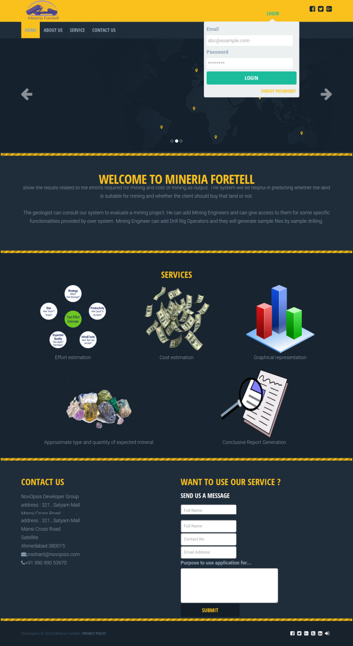
Implementation Screenshots
Landing Page

Slide 45
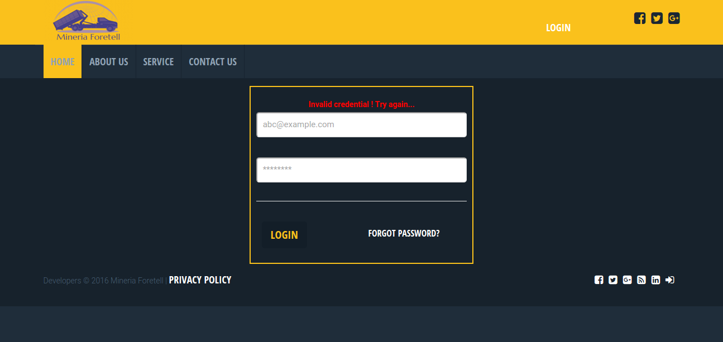
Invalid Credentials

Slide 46
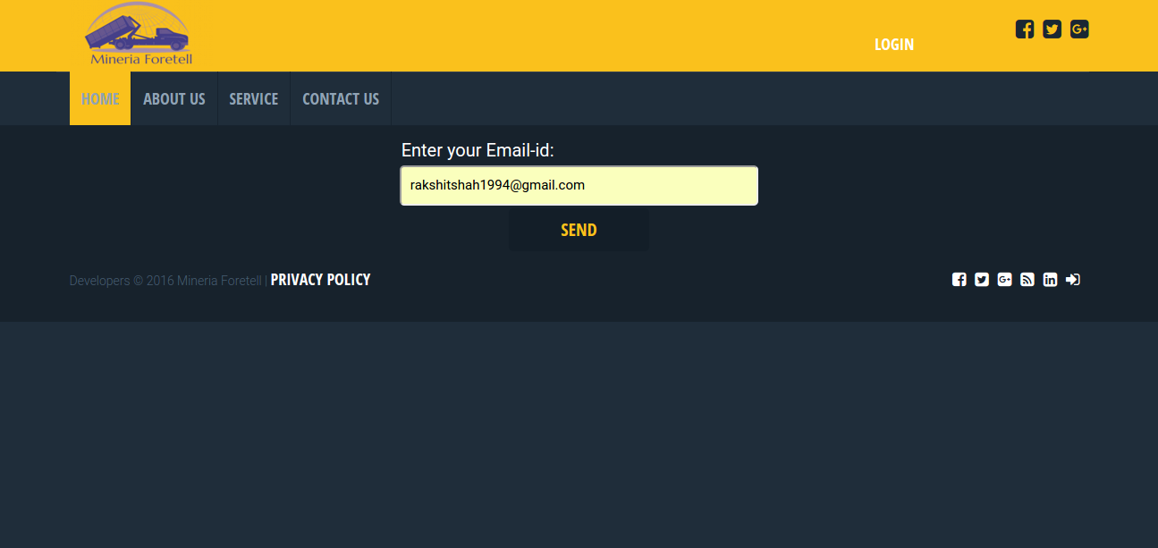

Forgot Password

Slide 47
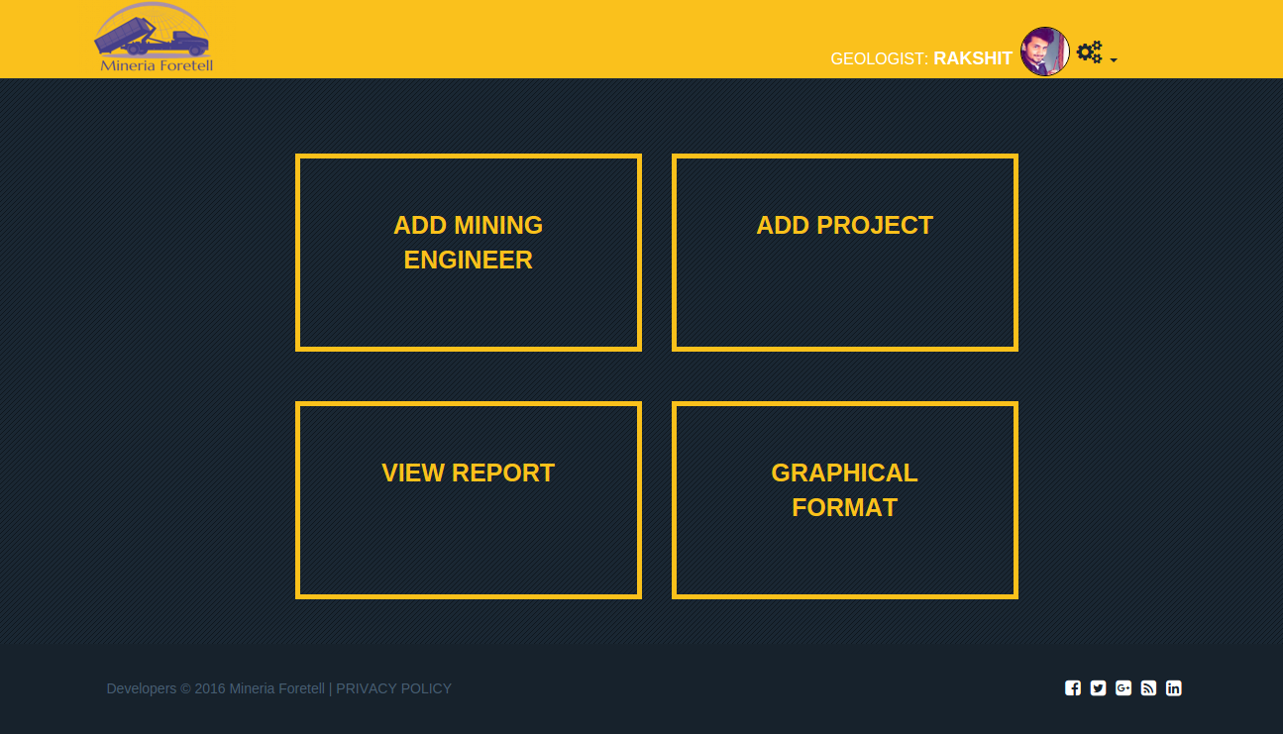
Geologist Dashboard

Slide 48
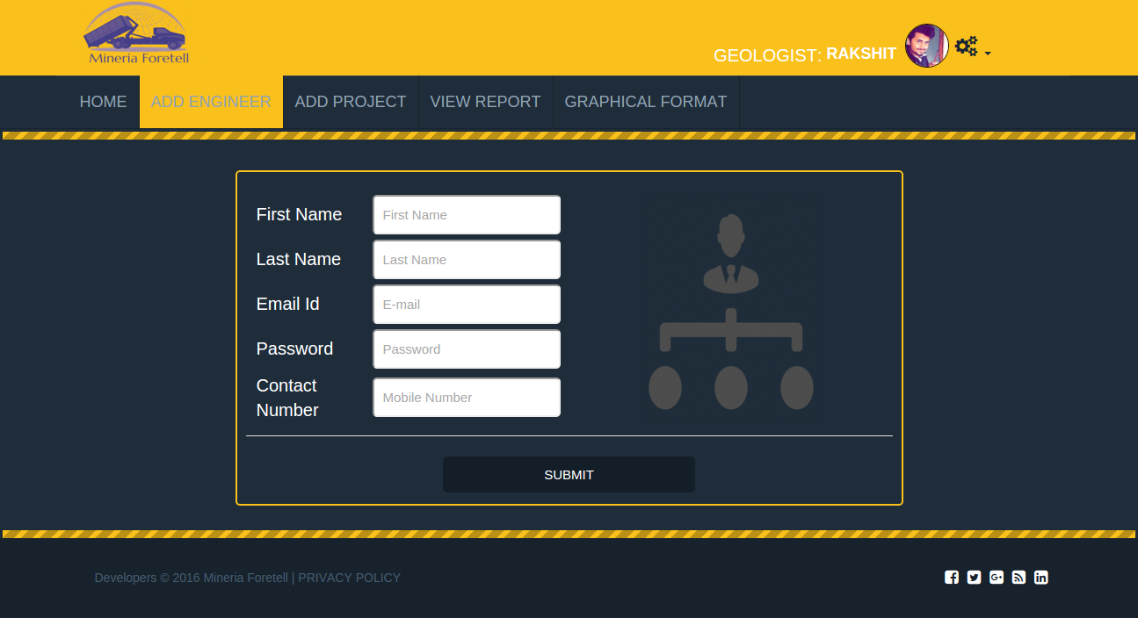
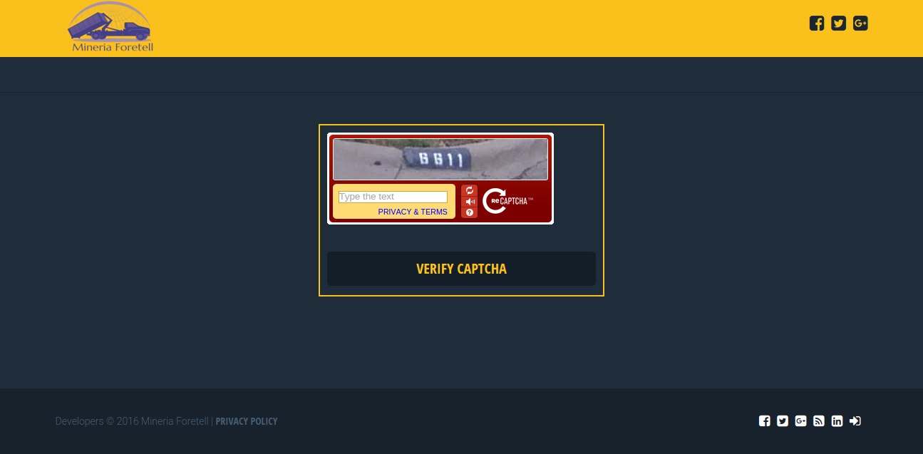
Add Mining Engineer/D.R.O

Slide 49
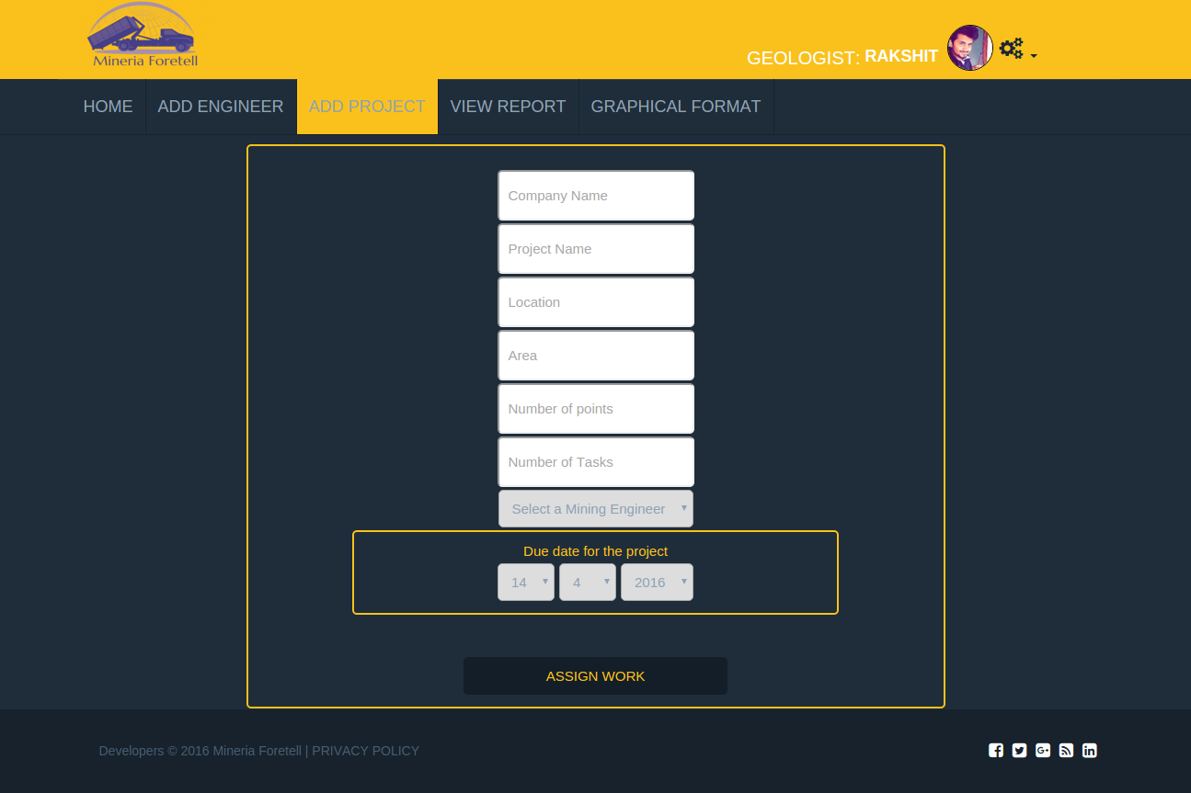
Add Project

Slide 50
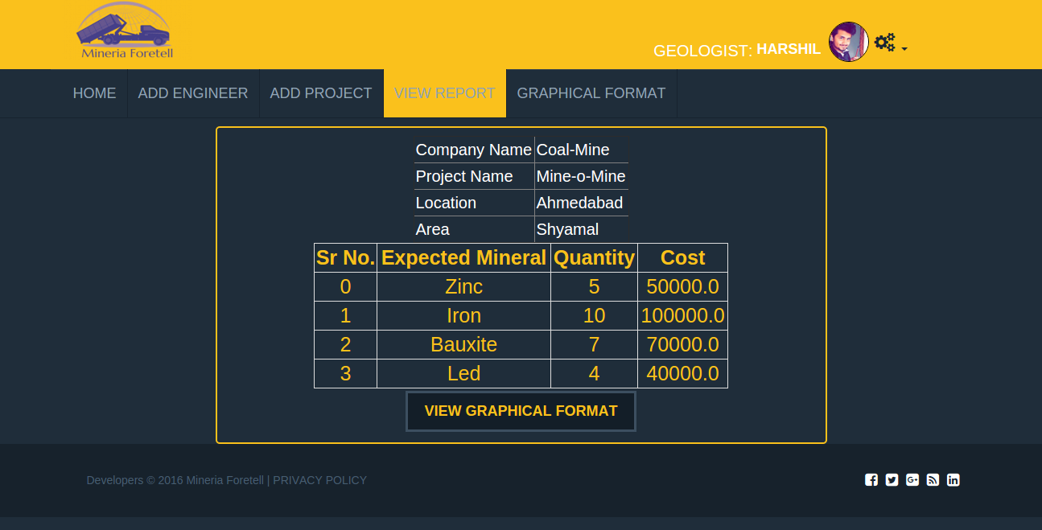
View Report

Slide 51
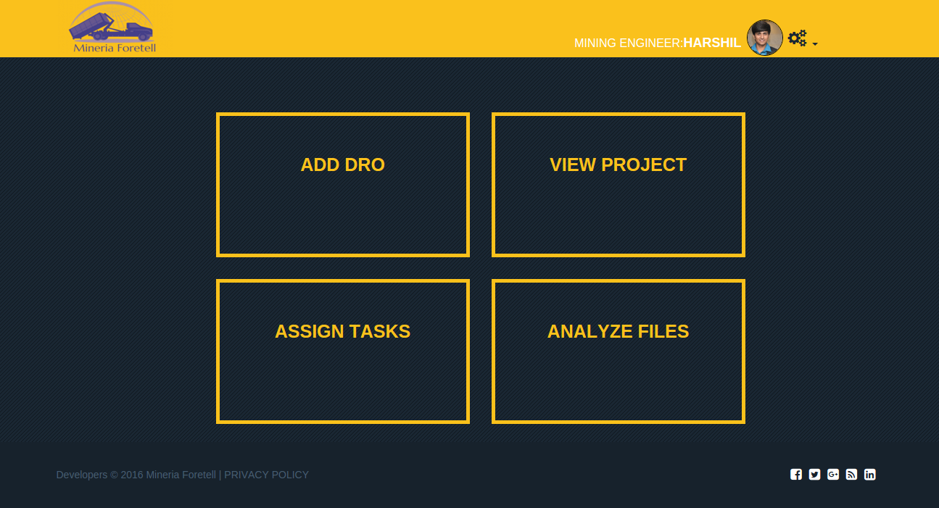
Mining Engineer Dashboard

Slide 52
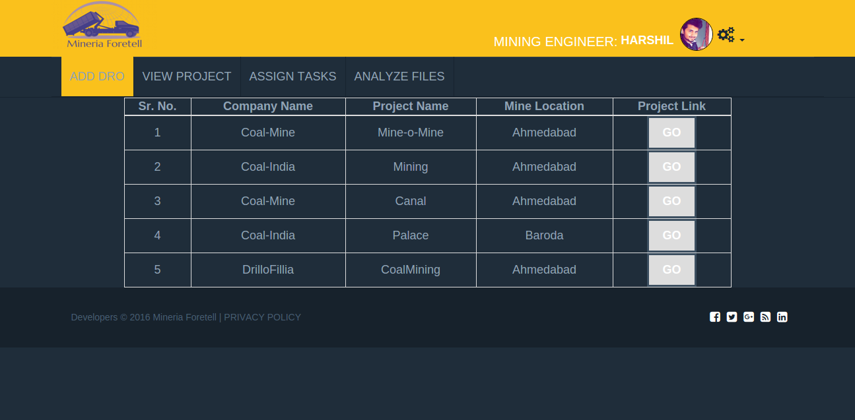
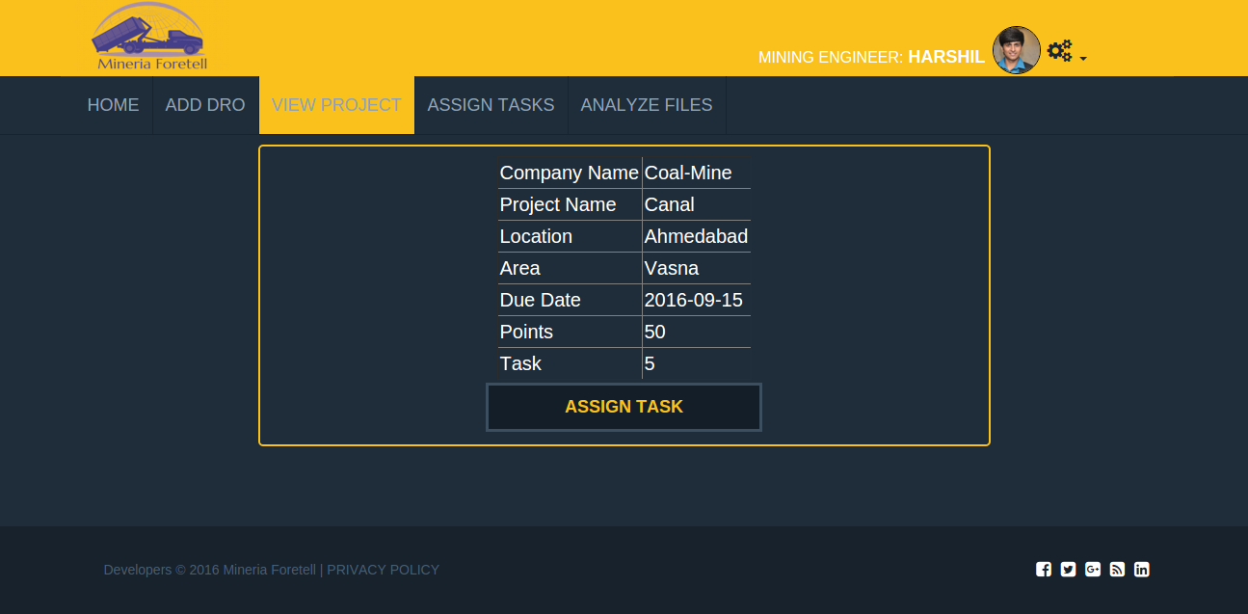
View Project

Slide 53
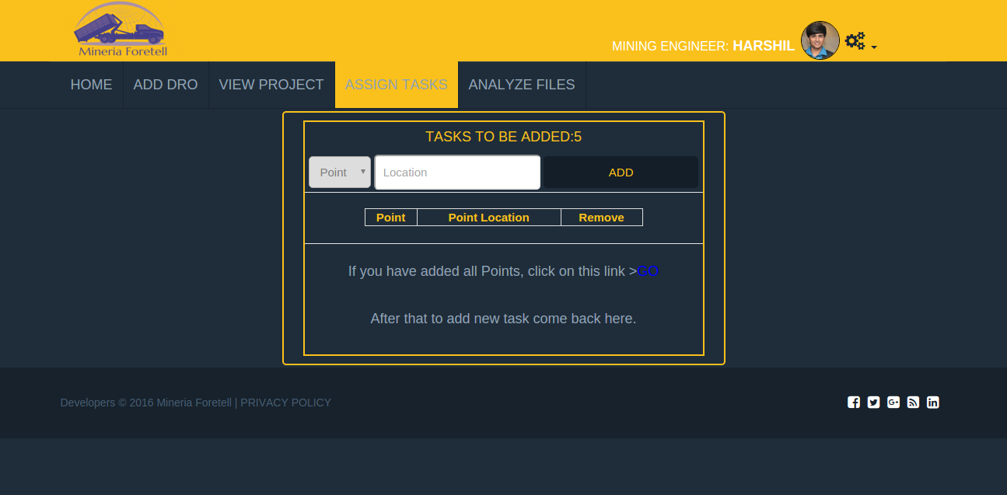
Assign Tasks

Slide 54
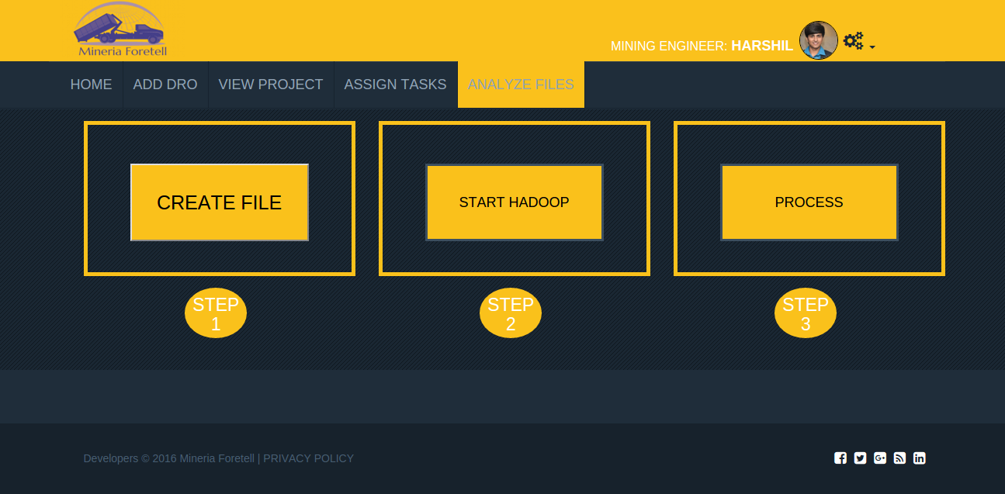
Analyze Files

Slide 55
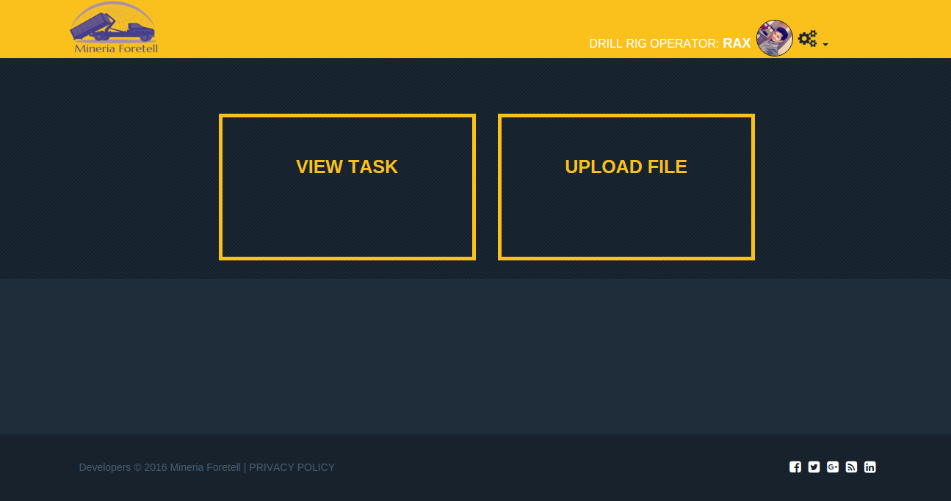
D.R.O Dashboard

Slide 56
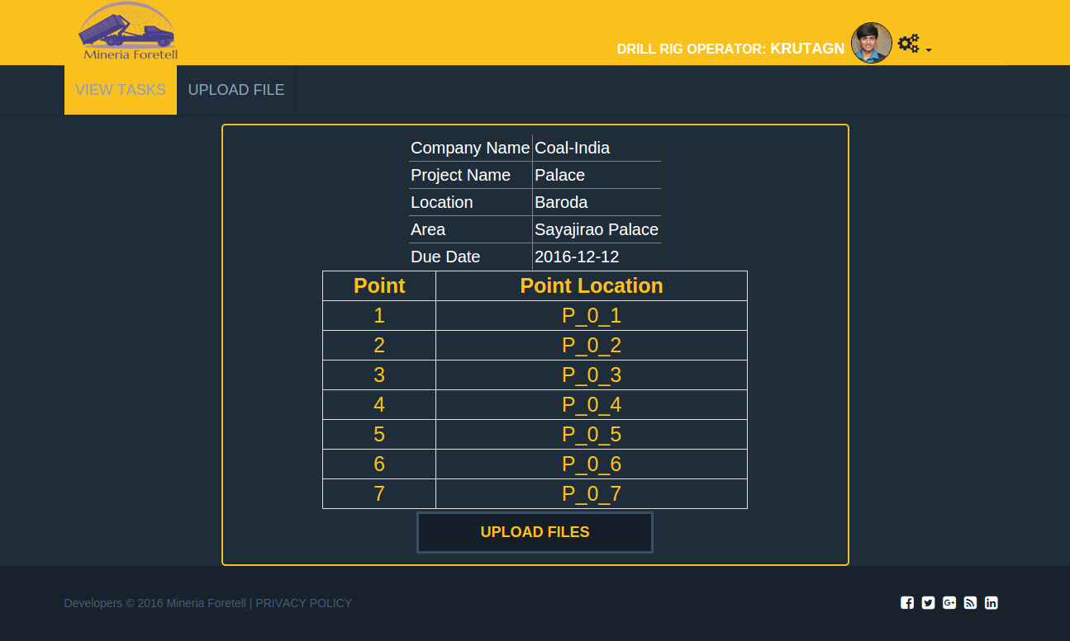
View Tasks

Slide 57
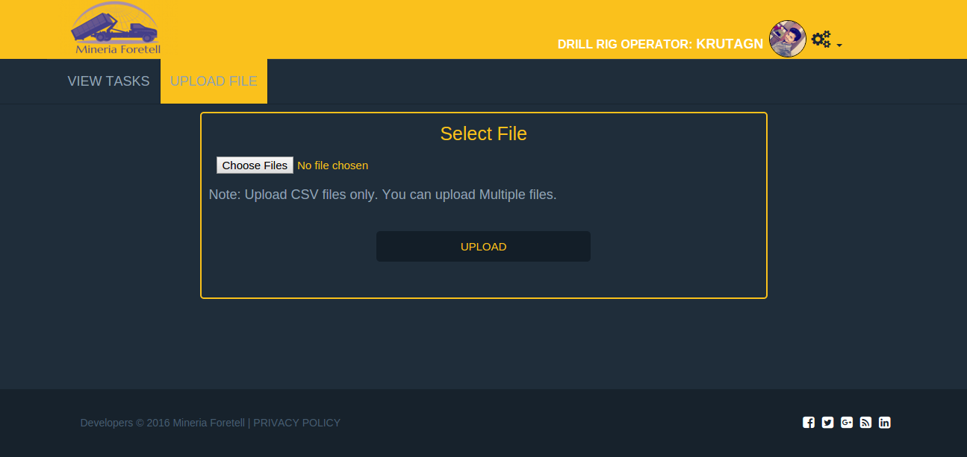
Upload File

Slide 58
References
[1] Robin J. Hickson, Terry L. Owen .Project Management for Mining: Handbook for Delivering Project Success
[2] Unified Modeling Language (UML) Standard Diagram. Available from URL: http://www.tutorialspoint.com/uml/uml_standard_diagrams.htm
[3] A multidimensional grey metabolism Markov forecasting method is proposed based on the theories of Grey forecast and Stochastic process. Available from URL:
http://link.springer.com/chapter/10.1007%2F978-3-642-30976-2_37
[4] Big Data Tutorials -Simple and Easy Learning for Big Data. Tutorials point provides free tutorials and reference manuals with examples for various topics. Available from URL : http://www.tutorialspoint.com/big_data_tutorials.htm
[5] MMSD-Mining, Minerals and Sustainable Development. Available from URL: http://www.iied.org/mining-minerals-sustainable-development-mmsd

Slide 59
THANK YOU

