Slide 1
Production Report
Thant Min Htet
(One-page website/ Simplicity and Informative/ 7-days weather forecast/ detail weather forecast for a day/ Hourly updated data/ Fluid animation and Colorful screen background/ Customization features/ Items suggestion accordance with weather.)
Production process
Tools and Library (Bootstrap, Adobe Illustrator/ XD/ Google Font/ )
API (Open Weather Map/ Google Map API)
Geo-coding function is applied, and weather location can be changed by map search.
Wireframes (adjustments)
Development(HTML/CSS/JS)
Production (1) > some research > production(2)
Screen transitions
API Data Handling.
Drawings images and icons
Implement image, icons and Animation.

Slide 2
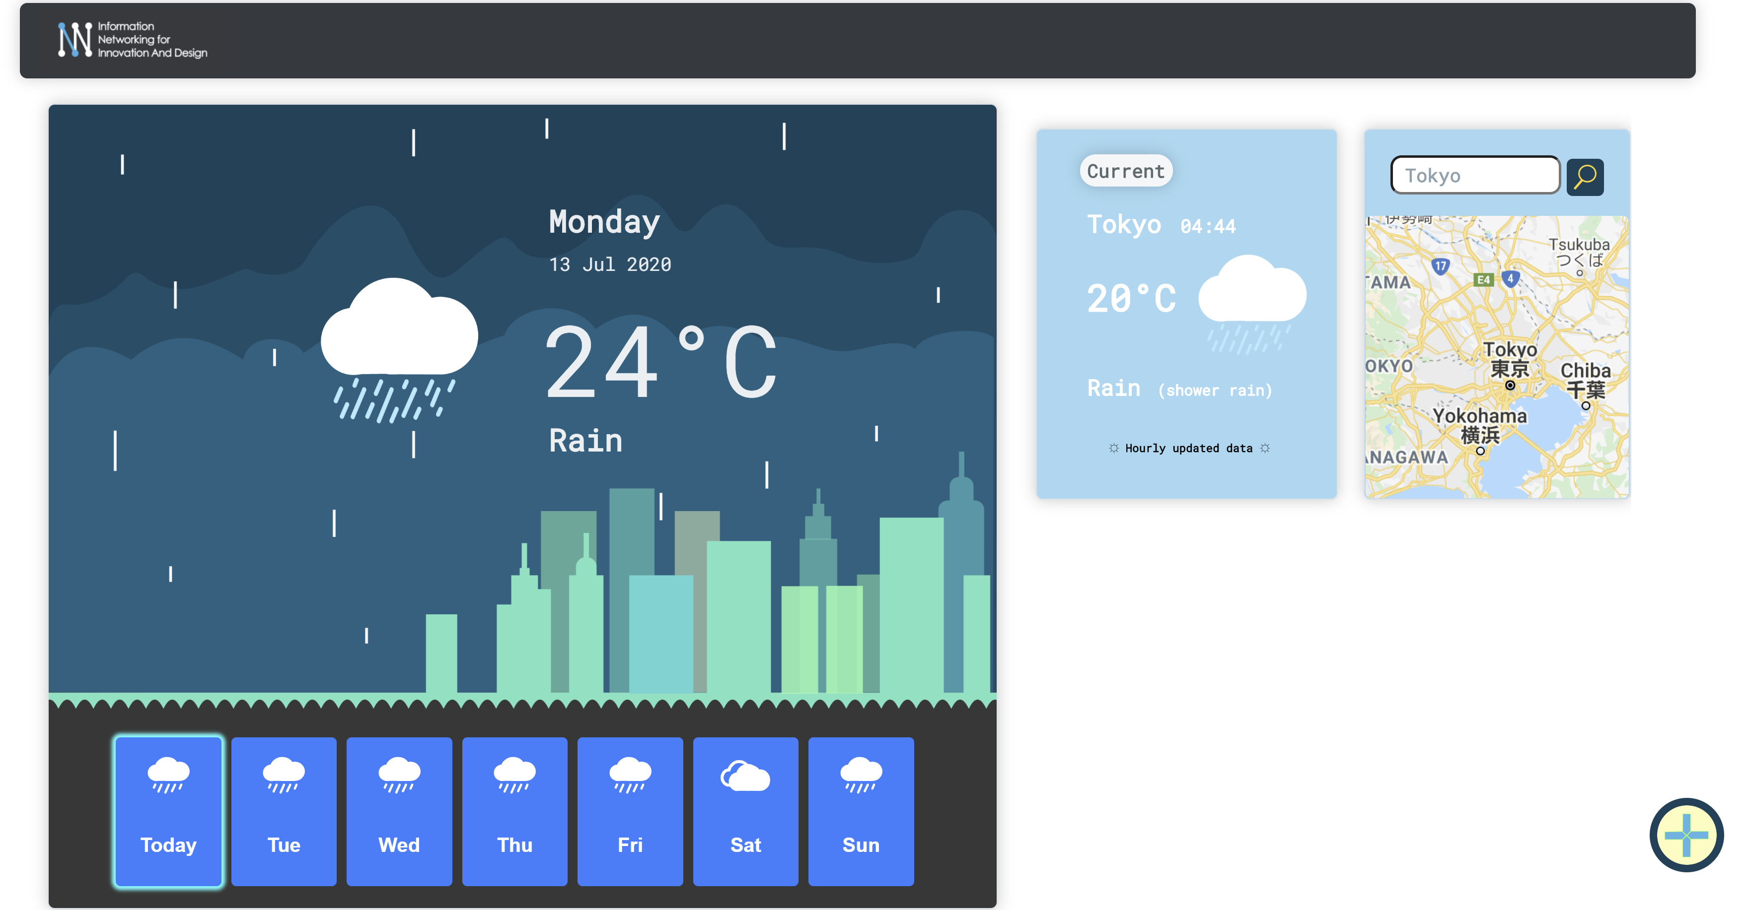
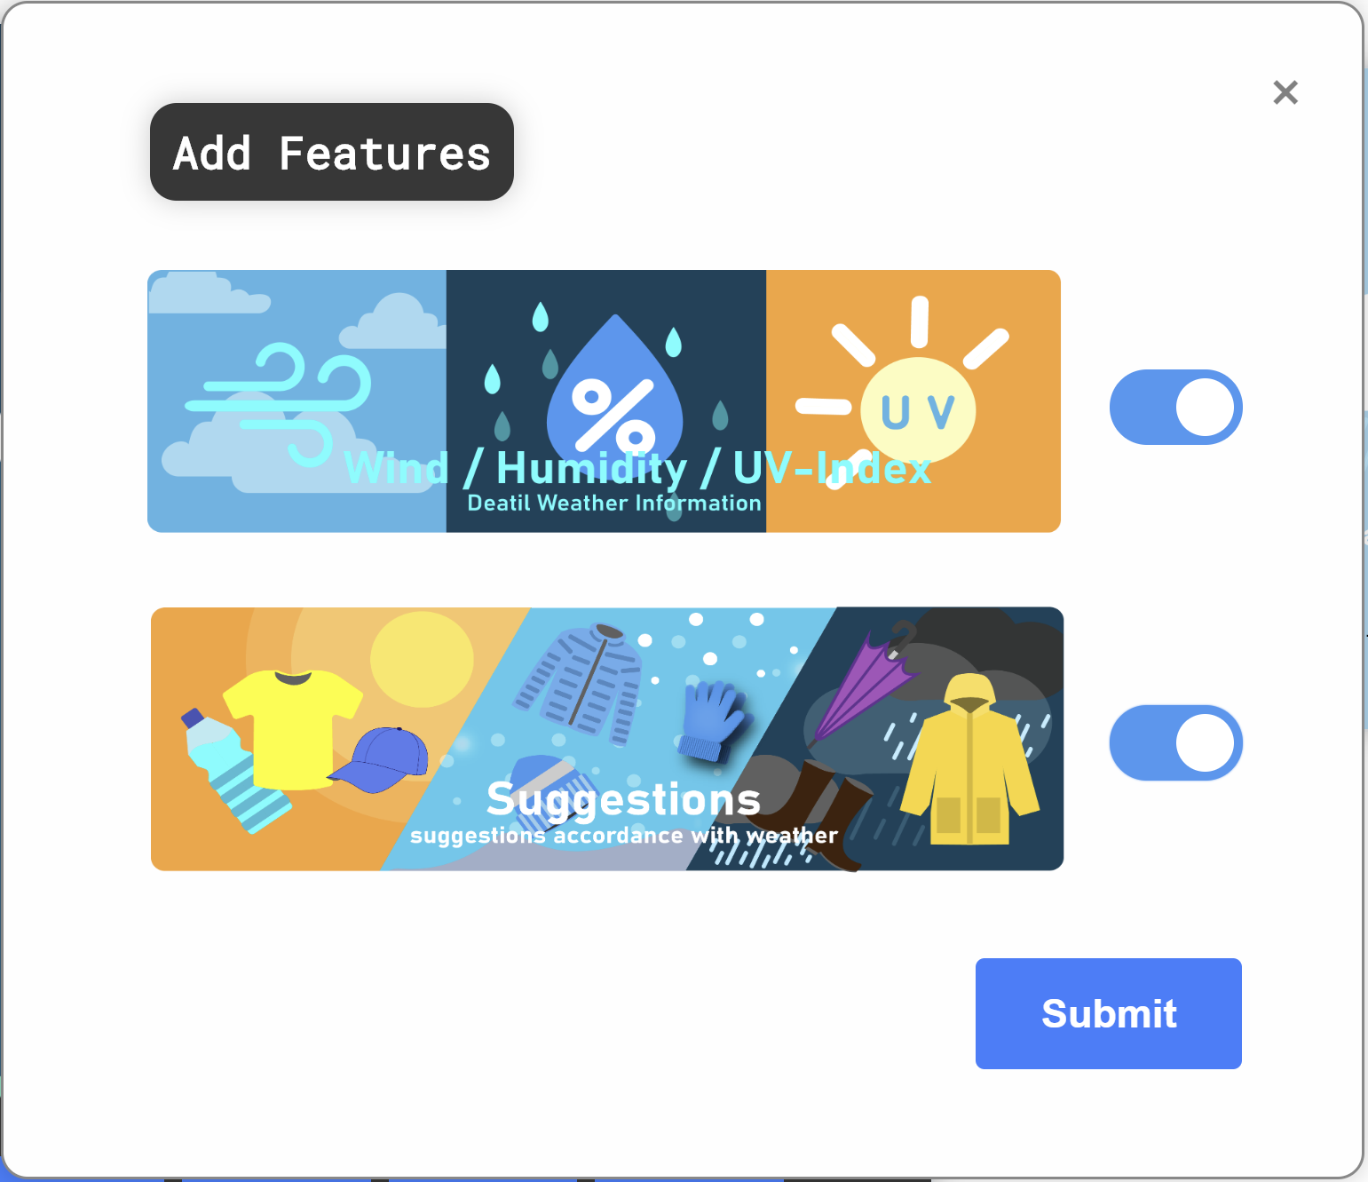
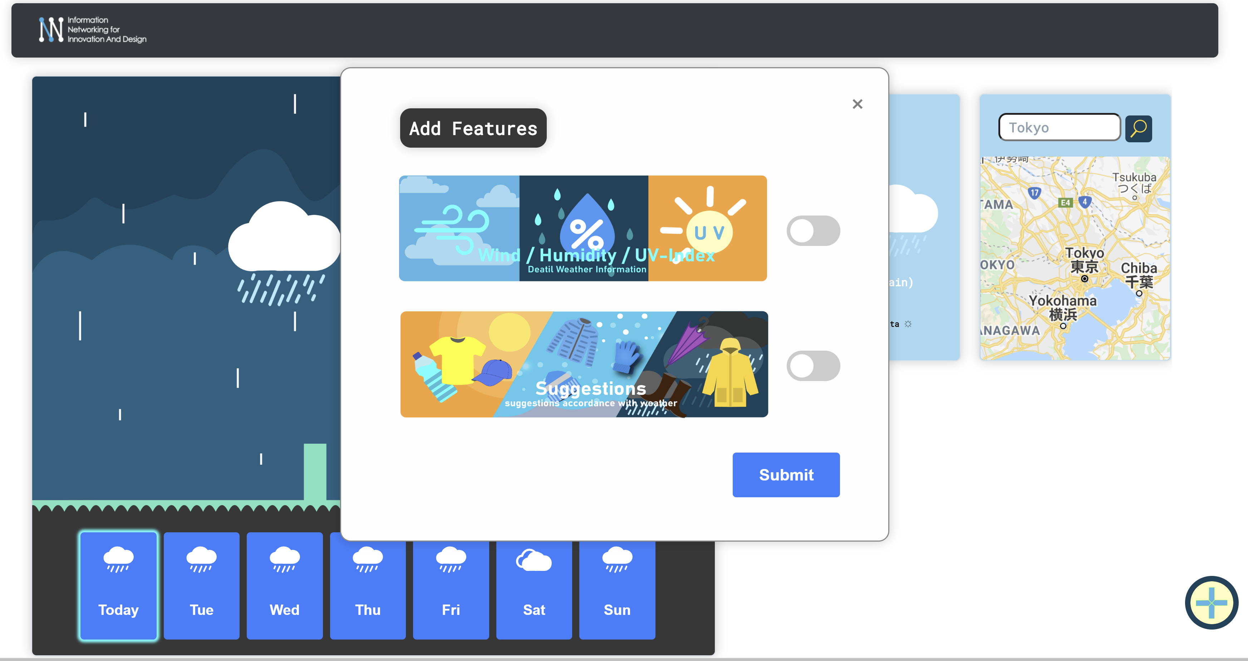
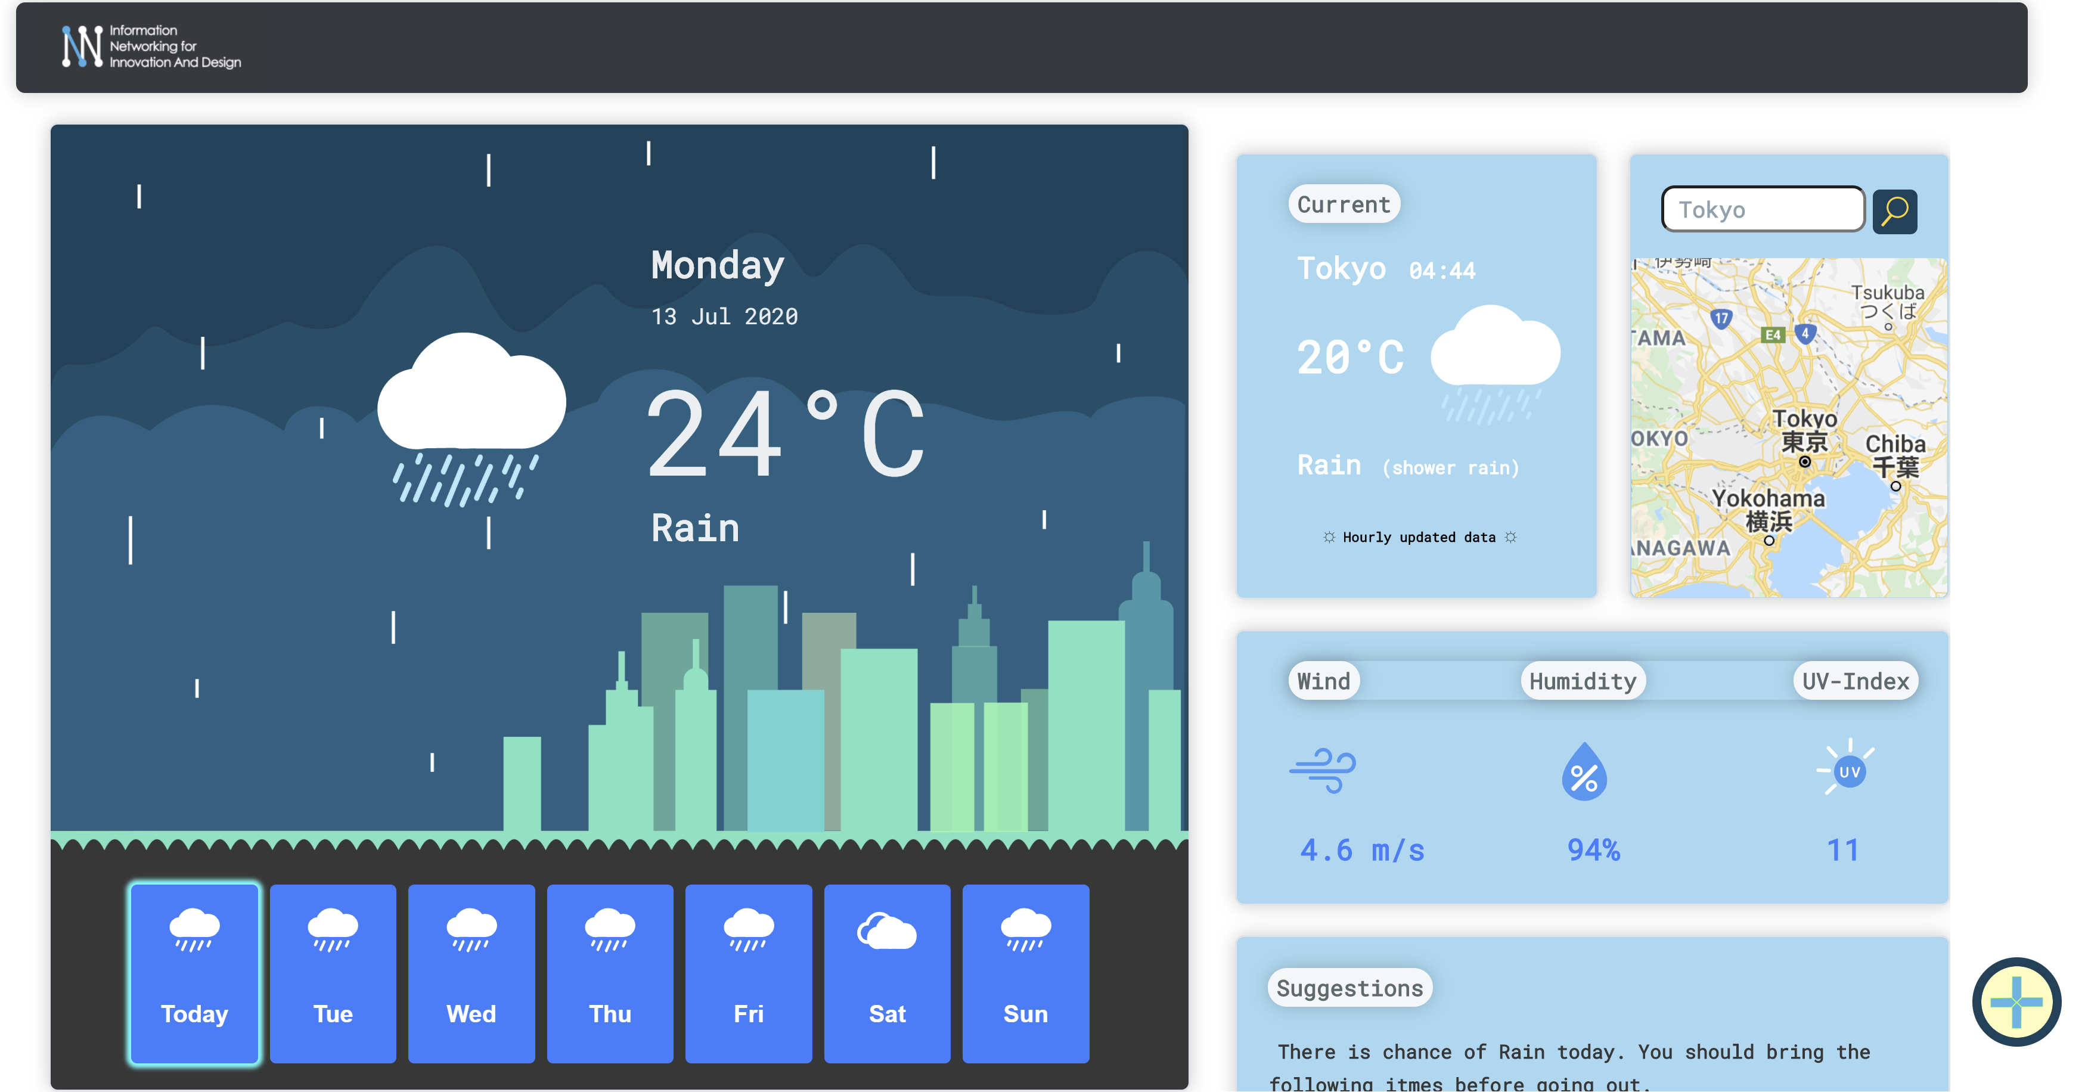
Wire-FrAME
Default Features
Add Features Button
Logo and navigation Bar
General (one grasp) Information of daily weather
Suitable Image background will be displayed accordance with weather
Hourly Updated Weather info
Map and Location change
Wind/ Humid/ UVI
Suggestions
Customizable Features
Customizable
features
Add Customizable features Button
Buttons for 7 days weathers
Left: 7 days weather forecast and one grasp info display.
Right: Detail weather Info of a day such as current weather condition, location change map, and Customizable Features.
Default features : Current weather condition (data update hourly)
Customizable features: Wind/Temperature/UVI-Index, Suggestions (accordance with weather)

Slide 3
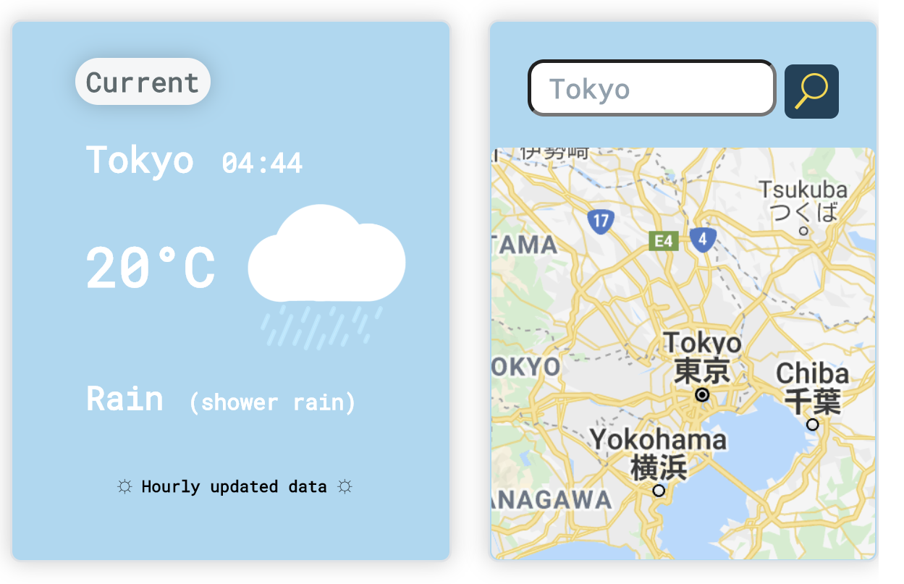
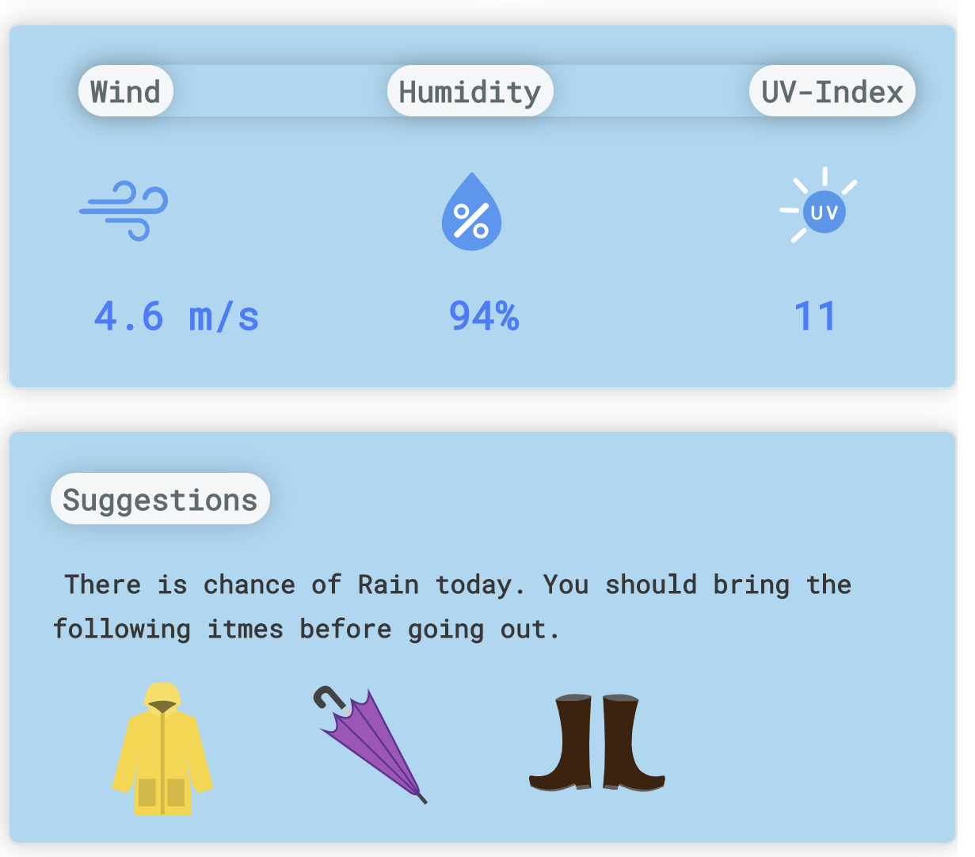
References
Default Features
Customizable features
This features can be added or remove according to the user preferences.
These features are default and will display on the top-right of the website.
Currently two customizable features is available. This website design is easily addible more features in the further developments.
Location can be change here by typing City name.
After typing City name,
Press Enter or Search Button and
The Weather data of the city will be updated automatically.
This feature show Wind, Humidity and UVI, currently. This data also update hourly.
The left feature is current weather condition.
The data is updated hourly.
The Suggestions feature will suggest some necessary items and provide suggestions accordance with the weather conditions.
www.weather.com
https://www.meetcarrot.com/weather/
https://emojipedia.org/apple/
Note: Some of the designs and concepts are referred from above sites. Some design concept are referenced, and all the icons and background images are drawn with Adobe Illustrator on my own.

