Slide 1
LDAP - Lightweight Directory Access Protocol

Slide 2
Topics to be covered
What is LDAP and Active Directory
LDAP Terminology
LDAP Tree
LDAP Authentication
LDAP Query

Slide 3
What is LDAP and Active Directory
LDAP - Light Weight Directory Access Protocol is a protocol for querying and modifying items in directory service providers like Active Directory.
Active Directory is a directory service implemented by Microsoft, and it supports Lightweight Directory Access Protocol (LDAP).
Directory Service is a software system that stores, organises, and provides access to information in a computer operating system's directory.
Microsoft implemented a modern directory service for Windows, originating from the X.500 directory, created for use in Exchange Server. And this implementation is called Active Directory.
LDAP defines how clients should access data on the server, not how that data is stored on the server.

Slide 4
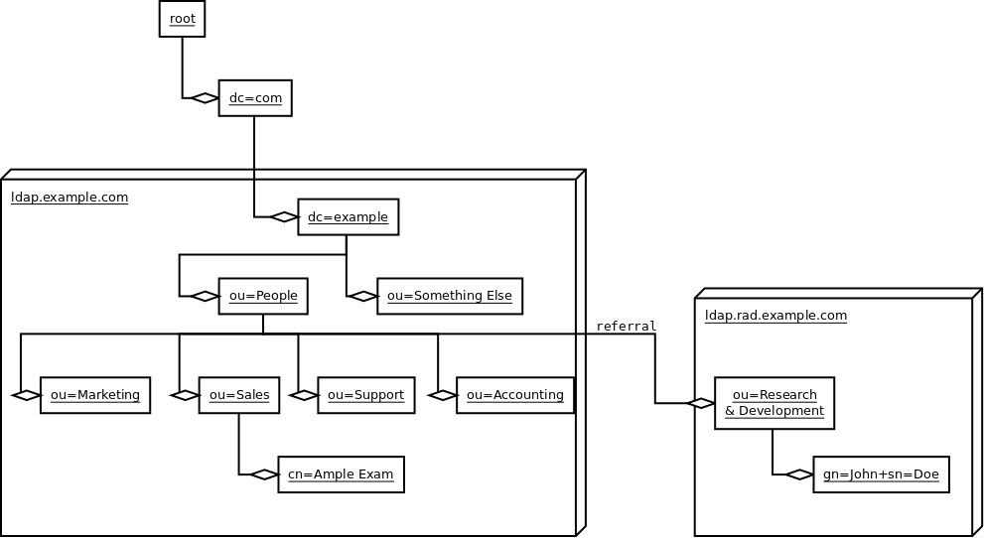
Active Directory Tree Example
Directory Information Tree (DIT)

Slide 5
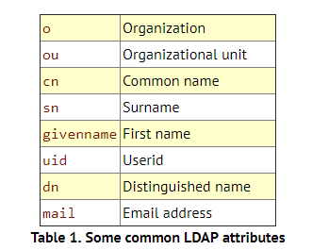
LDAP Terminology
LDAP's basic structure is based on a simple information tree metaphor called a directory information tree (DIT).
Each leaf in the tree is an entry; the first or top-level entry is the root entry.
The DN, which is the name of an entry, must be unique.
cn=Minerva,ou=Trainees,ou=Users,dc=Yash,dc=com
dc-Domain Component

Slide 6
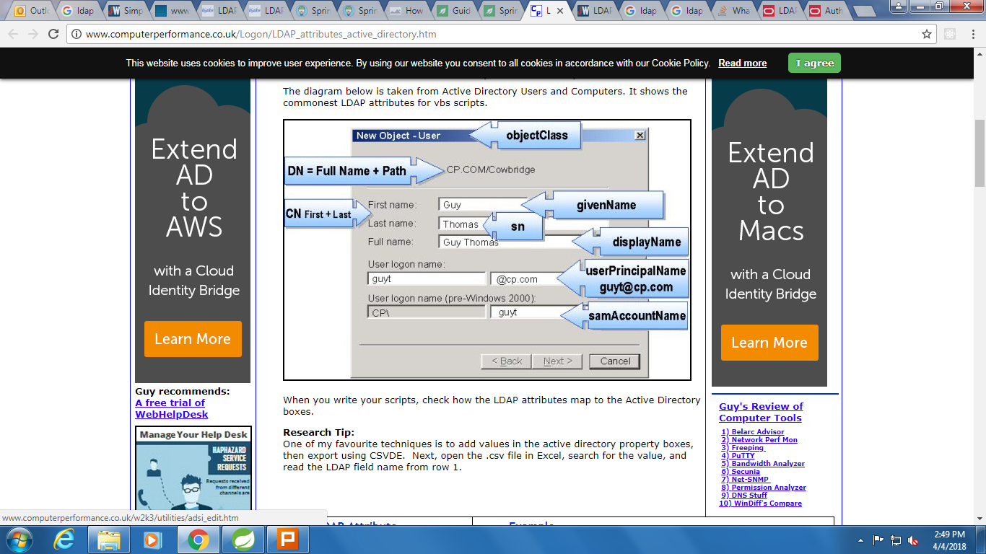

Slide 7
Steps for LDAP Authentication:
LDAP Authentication is first step while accessing data from LDAP. Active directory (AD) stores resources, which can be users, systems (computers) or any other resources in object form.
This storage is hierarchal and not relational.
Steps :
Create a java.util.HashTable of environment attributes required to connect to AD.
Create LdapContext object using environment attributes .
LDAP_INITIAL_CONTEXT_FACTORY =com.sun.jndi.ldap.LdapCtxFactory
LDAP_SECURITY_AUTHENTICATION =simple
LDAP_PROVIDER_URL =ldap://inidradc01.yash.com/
LDAP_SEARCH_BASE =DC=yash,DC=com

Slide 8
Steps for LDAP Query:
Create AD connection (i.e. context) using LDAP (as discussed in previous article).
Define search base
Prepare search query
Define search controls
Search AD using context object from step 1 and the search parameters in steps 2, 3 and 4.
Process resultset to retrieve the desired basic user attributes.

