Slide 1
CAPSTONE SUBMISSION
End-to-End DevSecOps Pipeline
Infrastructure as Code, Continuous Integration, and Observability.

Slide 2



Pipeline Architecture
Infrastructure
CI/CD
DevSecOps
Terraform provisioning AWS EKS 1.31.
GitHub Actions workflow automation.
Trivy, Checkov, and Bandit security gates.

Slide 3

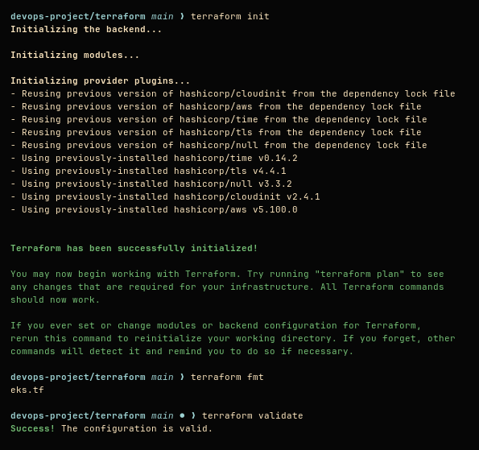
IaC Initialization
Terraform workspace successfully initialized, formatted, and syntax validated prior to provisioning.

Slide 4

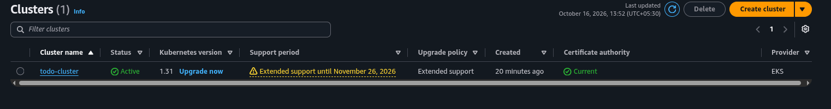
STEP 01
Infrastructure Provisioning
VPC Reuse: Data sources bypass network creation blocks.
IAM Workarounds: IRSA and KMS disabled for SCP compliance.
Access Granted: Creator admin permissions explicitly enabled.

Slide 5

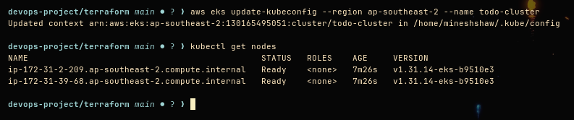
Active Worker Nodes
T3.small instances successfully registered to the EKS control plane.

Slide 6

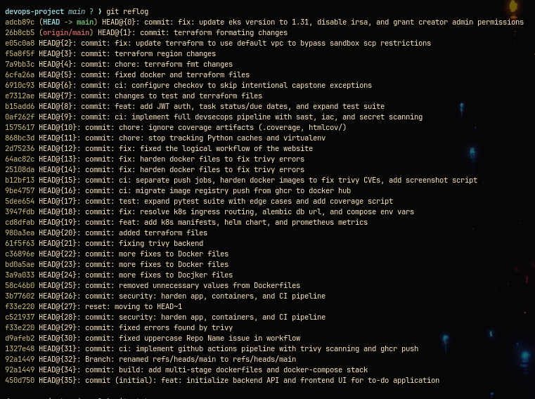
Version Control
Structured Git commit history tracking all DevSecOps pipeline integrations and infrastructure updates.

Slide 7

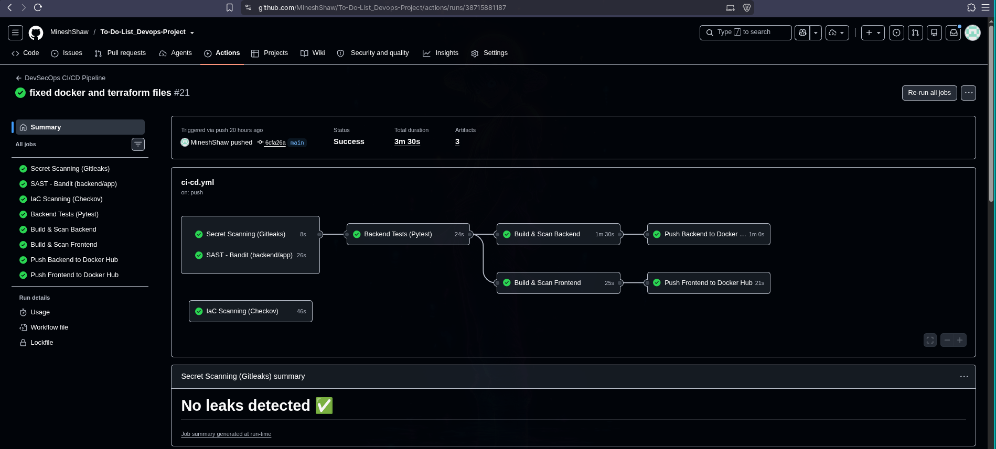
Automated CI/CD Workflow
1. Pre-Build Security
Gitleaks, Checkov, and Bandit scans.
2. Application Testing
Pytest execution.
3. Image Build & Push
Trivy SCA followed by Docker Hub publish.

Slide 8
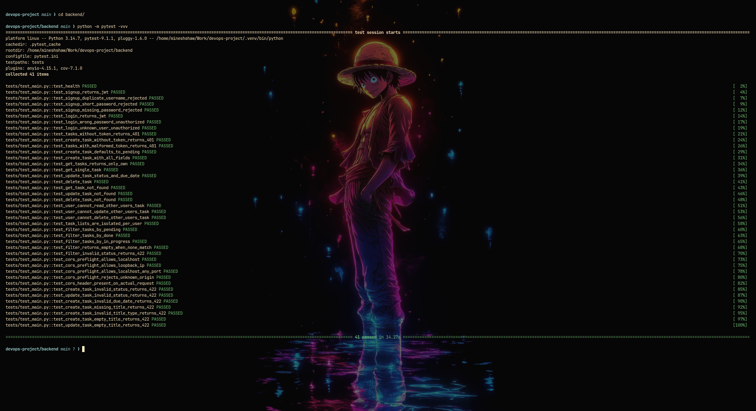
QUALITY GATES
Testing & Security
Hard failure criteria prevents vulnerable code from building.
Pytest
Trivy
Checkov

Slide 9
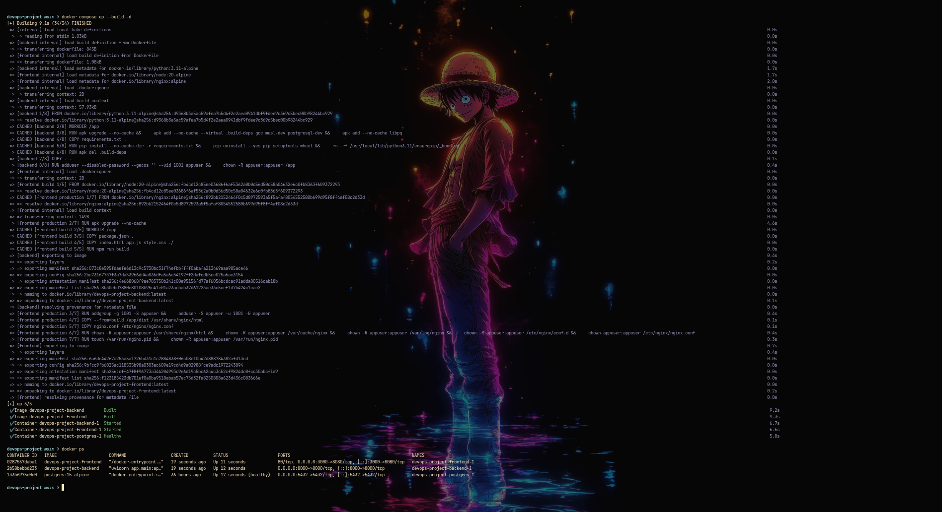
Local Container Stack
Multi-stage Docker builds running locally via Docker Compose before deployment.

Slide 10
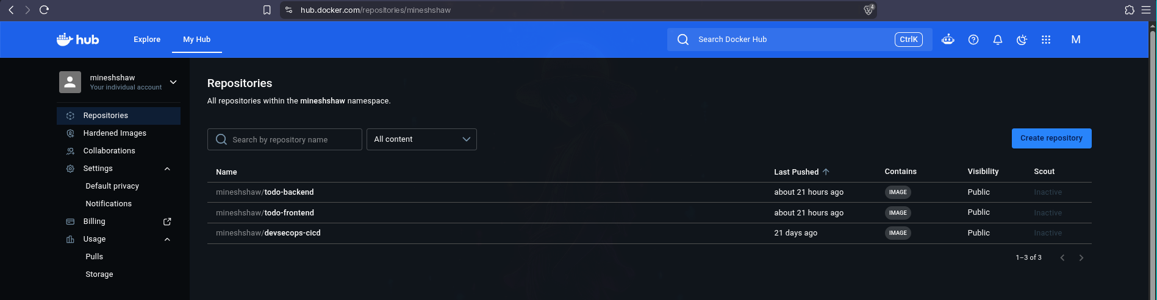
Immutable Artifacts
Clean container images pushed to Docker Hub.
Tagged strictly with Git commit SHAs.

Slide 11
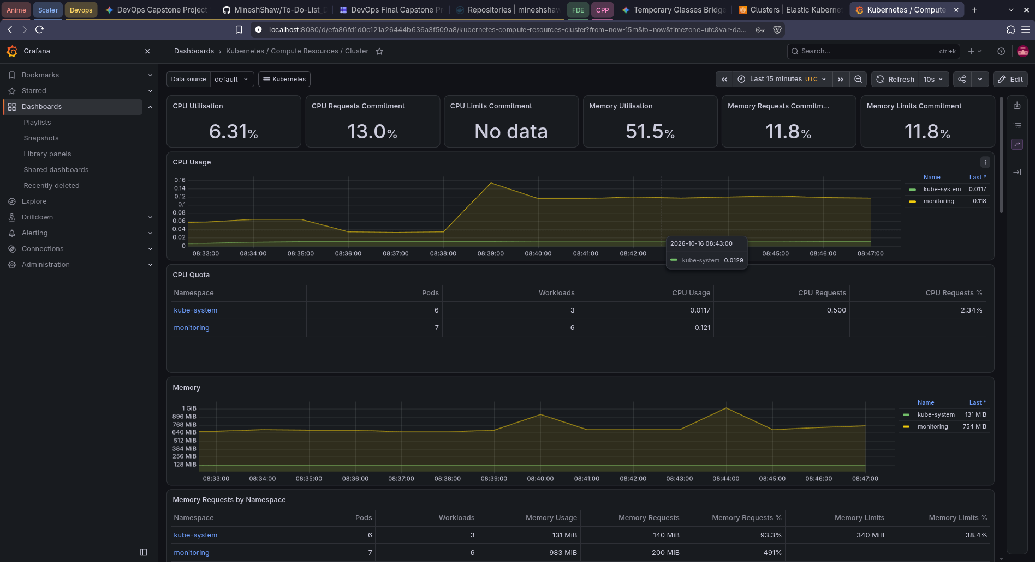
Cluster Observability
Prometheus & Grafana monitoring compute resources.

Slide 12

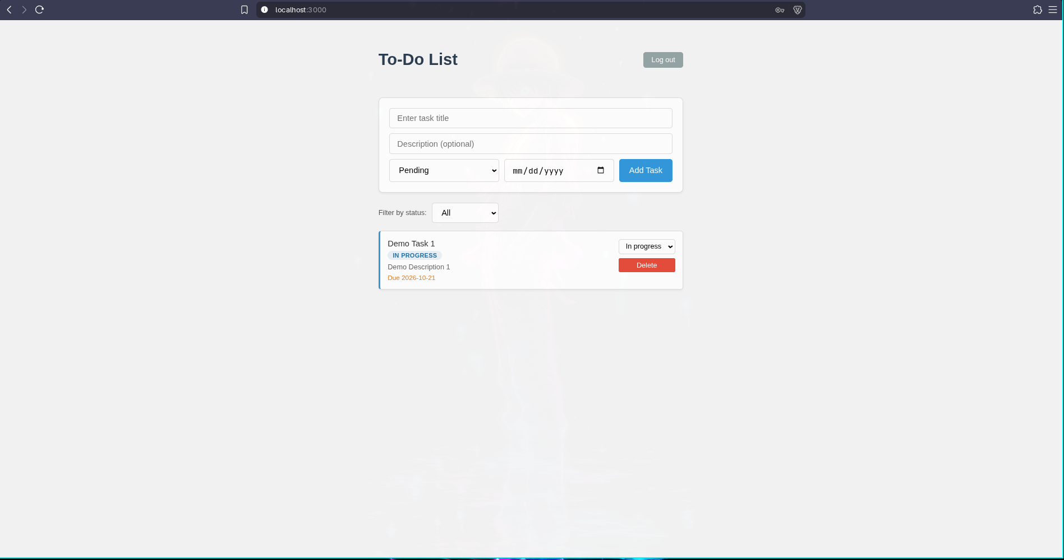
Application Deployed
FastAPI backend and frontend running via Helm.
Exposed securely on EKS nodes.

Slide 13

Project Complete
A fully automated, secure, and observable infrastructure lifecycle.

