Slide 1
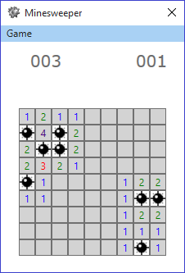
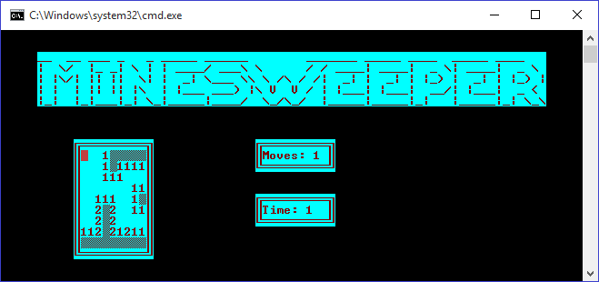
Minesweeper-6 Team Project

Slide 2
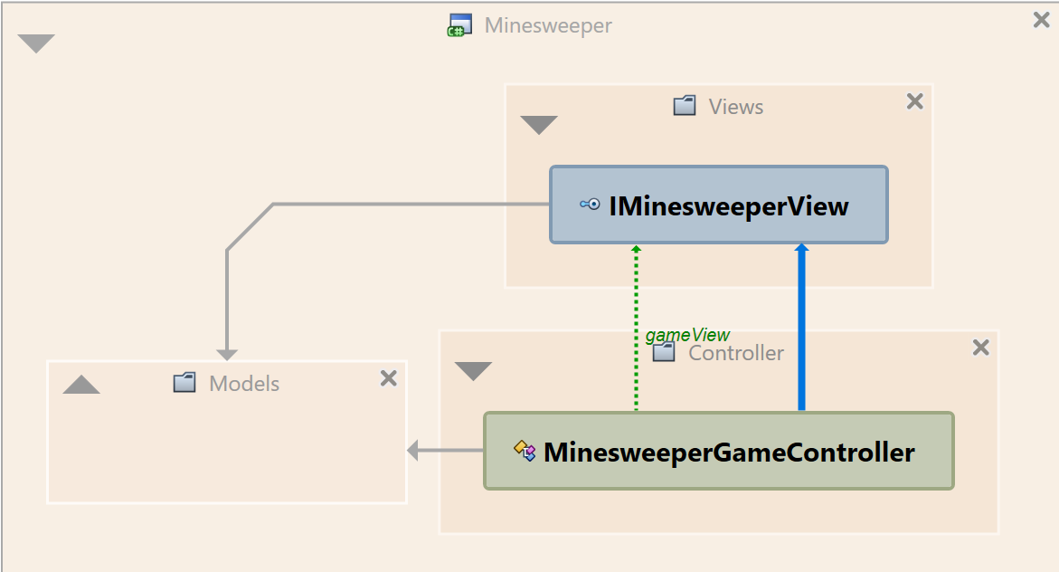
Architecture
Implemented using Model-View-Controller architecture pattern
Models and controller implemented in separate assembly, together with view interface (Minesweeper.dll)

Slide 3
Minesweeper models
MinesweeperCell – implement reveal, protect and bomb logic
MinesweeperGrid – keep cell collection, random bombs generation, boom event
MinesweeperGridFactory – initialize easy, medium, hard grids
MinesweeperDifficultyType – enum for different game levels
MinesweeperPlayer – game player data
MinesweeperGameData – logic for store/load players, easy to change input/output. Currently uses XML serialization of players
Player and click event arguments
Grid/cell/player exceptions

Slide 4
Minesweeper controller
Controls all game logic
Works with abstract grid, view, timer, players and game level types
Handle all view events and reacts on their change
Stores game data using data model

Slide 5
IMinesweeper view
No implementation, only interface definition
Any view should be able to display:
DisplayGrid
DisplayScoreBoard
DisplayMoves
DisplayTime
And handle user inputs:
OpenCellEvent
ProtectCellEvent
ShowScoreBoardEvent
AddPlayerEvent
Two views implemented – console and WPF

Slide 6
Console view and game
Uses minesweeper.dll
Implements own ConsoleView : IMinesweeperView
ConsoleBox – console box with grid and text
ConsoleButton : ConsoleBox – implements console button with click event
ConsoleMenu : ConsoleBox – implements complete menu with buttons
ConsolePrinter – print console boxes
ConsoleWrapper – wraps CLR console class (for testing)
ConsoleTimer – timer functionality
Demo

Slide 7
WPF view and game
Uses minesweeper.dll
Implements own WpfView : IMinesweeperView
XAML based implementation
WpfMinesweeperButton : Button – extenstion of WPF button, containing rows and cols for the grid
MainWindow : Window – main window in the game
ScoresWindow : Window – scoreboard window
InputBox : Window – add player box
Demo

Slide 8
Used SOLID principles
SRP – Separate class for each object in minesweeper models, separate controller and views. Console and WPF classes implement only what they need. All class components that are not needed are private or protected. Easy reusing of classes.
OCP – mainly implemented in minesweeper.dll. New game view (ex. Mobile or Web) can be easily created without changing anything in the library.
LSP – used in console view. ConsolePrinter prints any console box using IConsoleBox interface. Inherited buttons and menus do not change the print behavior.
ISP – small interfaces created in the librarty. Cell/Grid/Player. All of them can be reused.
DIP – all needed data for classes are used as input parameters. The only constructed new objects are StringBuilder and EventArgs. Objects are created only in controllers. Easy to test implementation.

Slide 9
Used SOLID principles
DRY – no code clones in the project. Checked by Visual Studio.
YAGNI – all code clones that cannot be tested are removed.

Slide 10
Design Patters
Simple factory – Minesweeper grid creation (easy, medium, hard)
Composite – for console user interface
Adaptor – used for CLR console for easy interface testing
Strategy – used for different views
Iterator – used for cells iteration in the grid
Observer – CLR events for different views
Memento – use to save/load user data

Slide 11
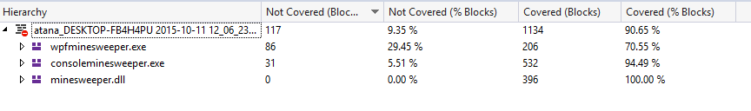
UnitTests & StyleCop
69 Unit test written using Visual Studio Team Test (90.65% coverage of the complete code)
Used moq framework (for interfaces IMinesweeperView, IMinesweeperGrid, IMinesweeperTimer, IConsoleWrapper)
No StyleCop warnings (including documentation)

Slide 12
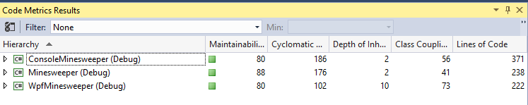
Code quality
Class/method/variables naming according to best practices
High Maintainability index in all projects
Low cyclomatic complexity in methods for easy testing
Low class coupling

Slide 13
Documentation
All code objects documented with XML format documentation (classes, methods, properties, events, fields)
CHM documentation created (MinesweeperDocumentation.chm)
Refactoring documentation provided (README.md)

Slide 14
Organization and participants
Used Git as source code repository and GitHub as project hosting https://github.com/Minesweeper-6-Team-Project-Telerik/Minesweeper-6.git
Participants:
Atanas Georgiev (ageorgiev) – project architecture, minesweeper and console implementation, unit tests
Stefan Yovchev (stefan.yovchev) – Wpf implementation and unit testing
Tatyana Rangelova (TanyaRan) – code documentation, stylecop fixing, CHM documentation creation

