Slide 1

Ming
Every “done” comes with proof
Automatic acceptance for
features built with AI
IBM Bob 2.0 Hackathon
Notes:
Ming helps developers check the features that coding AI says are complete. The welcome illustration is concept artwork, not execution evidence. Source artwork: apps/web/public/welcome/inspection-room.png; provenance: docs/WELCOME_ART_ASSETS.md. Product sources: README.md and docs/UPLOADED_PROJECTS.md.

Slide 2
The work left after “done”
AI says the feature
is finished.
01
Open the app and repeat the steps
02
Find the failure and capture it
The developer still has
a second job: checking it.
03
Explain the problem to the AI
04
Check everything again after the edit
Ming
02 / 08
Notes:
Problem supplied by the project owner: after AI announces completion, the developer manually opens the page, clicks through requirements, captures failures, explains them to AI, and repeats after each edit. No measured percentage or time saving is claimed. Source: docs/submission/problem-solution.md.

Slide 3
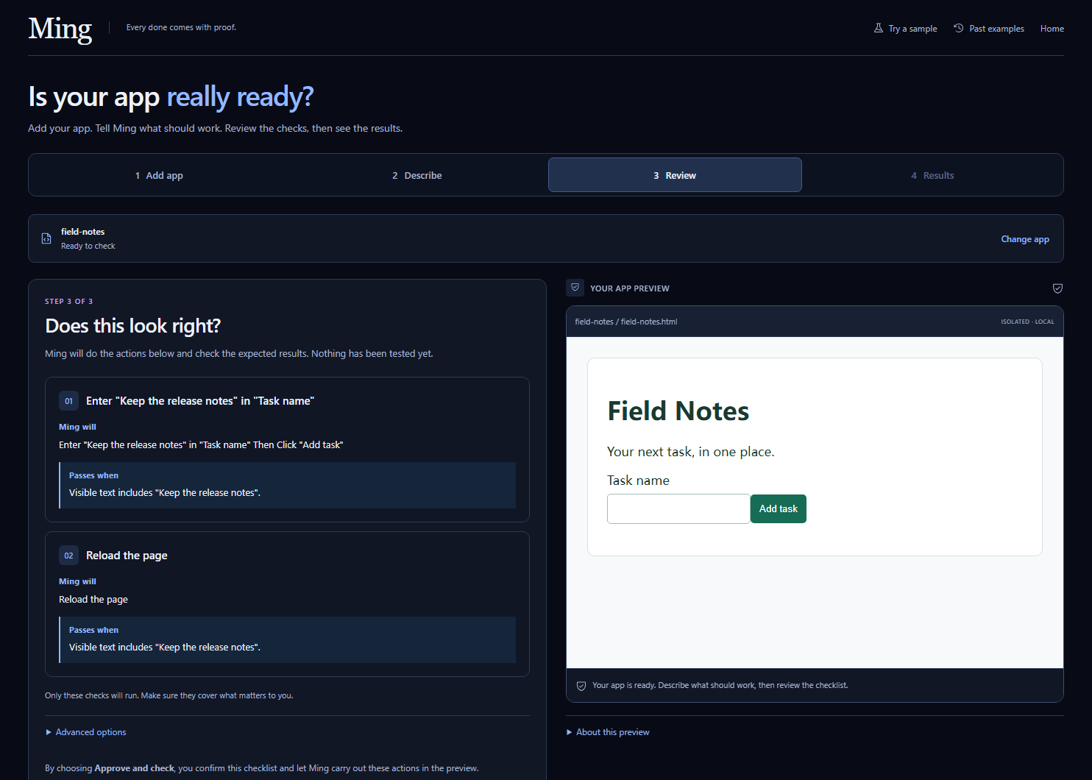
A checklist you approve once per run
Add app
Open your HTML, static ZIP
or public GitHub website.
Describe
Say what should work.
Ask AI for a checklist.
Review
Read the actions and outcomes.
Choose Approve and check.
Results
See the observed failure
and its recorded evidence.
Ming
03 / 08
Notes:
Current Add app / Describe / Review / Results workflow. Screenshot: docs/evidence/simple-workflow/2026-09-27T04-03-10-108Z-after-4187825e/03-draft-review-desktop.png, latest redesigned interface. Its planner response was a local test fixture; it illustrates the UI, not live generation proof. The separate actual provider evidence is on slide 4. Supported HTML/static ZIP/public static GitHub folders; human reviews draft before explicit approval and execution. Source: docs/SIMPLE_WORKFLOW_REVIEW.md and docs/DOUBAO_PLANNING.md.

Slide 4
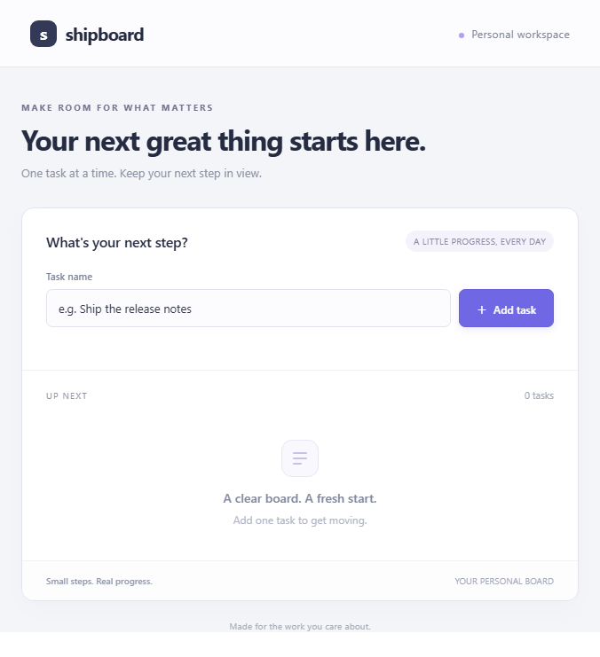
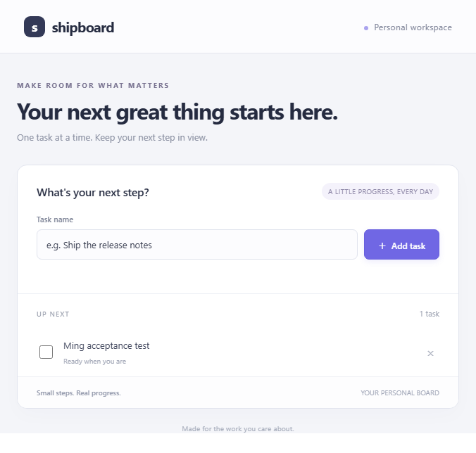
A real failure, then a passing revision
After reload: task lost
After correction: task remains
9
unchanged steps
One real AI draft.
Two source versions.
Original failure preserved.
Actual DOM captures. The corrected sample was prepared in advance.
Ming
04 / 08
Notes:
Source: docs/evidence/shipboard-doubao/2026-09-26T17-49-25-055Z-0db01f40/production-report.json, buggy-evidence.json and corrected-evidence.json. One actual Doubao Seed 2.0 Pro call proposed nine steps covering blank-name validation, task creation and persistence. The browser executed the buggy upload and failed after reload. A prepared corrected source then passed all nine unchanged steps. These images are original DOM-rendered captures, not native screenshots. This hosted case uses a prepared correction and does not demonstrate autonomous AI repair. The separate local coding-agent MCP repair is documented in docs/judge-evidence/manifest.json.

Slide 5
Evidence your coding AI can act on
The handoff keeps the context
Online workflow
Copy the repair instructions.
Paste them into your coding AI.
Bring back the updated app.
What the user expected
What actually happened
Which actions led to the failure
Which source and checks produced it
Local MCP workflow
An authorized coding agent reads
the evidence, edits the source
and reruns the original checks.
Ming
05 / 08
Notes:
Sources: docs/UPLOADED_PROJECTS.md, docs/GITHUB_IMPORT.md, docs/evidence/shipboard-doubao/2026-09-26T17-49-25-055Z-0db01f40/repair-brief.txt, apps/web/src/upload/runtime.ts, README.md section Connect a coding agent, docs/judge-evidence/manifest.json. The hosted path copies a brief for the user to paste into their coding AI; it does not wake an editor or modify a repository. The local 12-tool MCP adapter supports authorized coding agents reading evidence and rerunning the confirmed standard. The actual local source repair used an additional coding tool after Bob helped build the initial foundations.

Slide 6
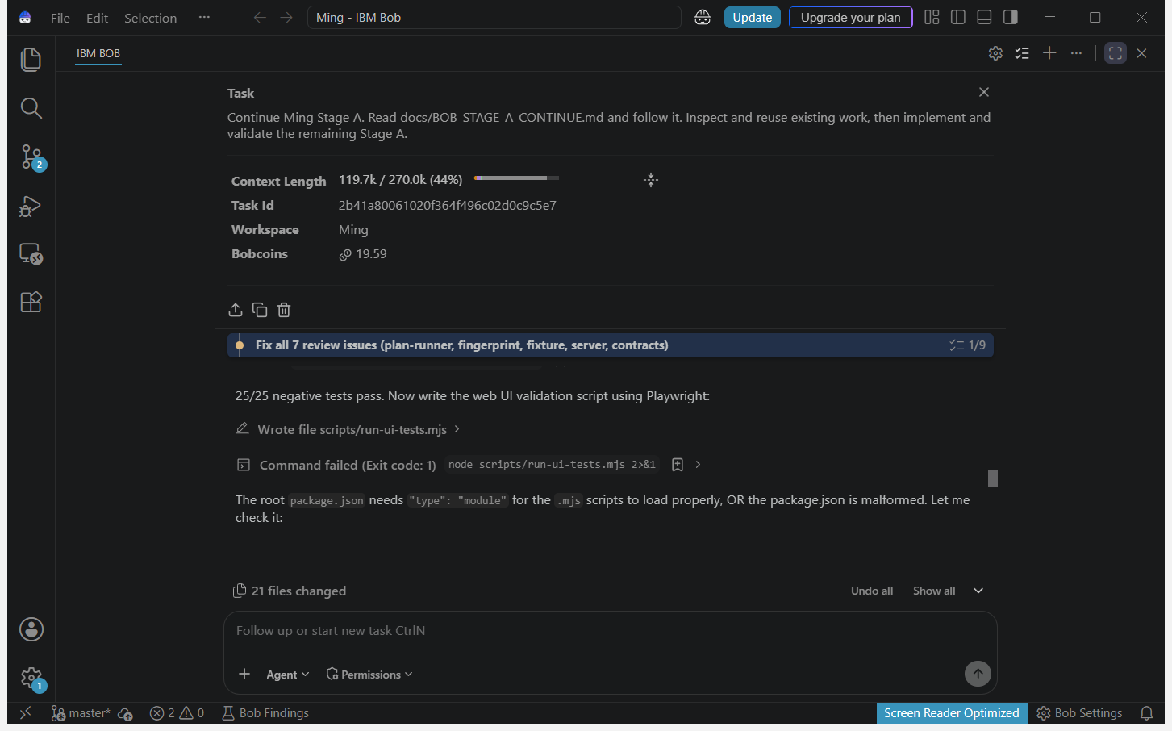
IBM Bob built the initial foundation
Browser execution
and evidence
Model drafts
and confirmation
Repair and MCP
foundations
Additional tools supported
completion and refinements.
Ming
06 / 08
Notes:
Original unaltered image: bob_sessions/ming_task02_stage_a_final_summary.png. Task ID 2b41a80061020f364f496c02d0c9c5e7. This Stage A task-consumption summary records real development activity and includes a failed command. It does not independently prove that every check passed. Bob contribution details and independent verification: docs/STAGE_B_RESULTS.md, docs/STAGE_C_STATUS.md, bob_sessions/README.md, bob_sessions/manifest.json. Bob implemented the initial Stage A runner/service/UI, Stage B provider draft validation/confirmation, and partial Stage C repair/MCP foundations. Subsequent development with additional tools completed and extended the product after the trial quota ended. No watsonx.ai or watsonx Orchestrate was used.

Slide 7
Reusable checks replace repeated manual work
Ming repeats the browser actions,
records the failure and keeps
the same standard for the next run.
Online
Local
HTML, built static ZIPs and public
GitHub website folders.
AI drafts require an explicit request.
Running development apps with
the local runner and MCP connection.
The app handles its own dependencies.
Passing means the approved checks passed. It does not certify every possible behavior.
Ming
07 / 08
Notes:
Sources: docs/UPLOADED_PROJECTS.md, docs/DOUBAO_PLANNING.md, docs/SIMPLE_WORKFLOW_REVIEW.md and README.md supported targets. Impact is described as operations performed and reusable evidence, not an unmeasured speedup. Hosted flow supports built static websites; it does not install packages, start backends or allow external-network calls in the preview. Local execution supports same-origin development applications with browser evidence. Every result covers only the approved checks.

Slide 8
Ming
Every “done” comes with proof
Project links
ming-acceptance-proof.amosming.chatgpt.site
github.com/Ming-Amos/Ming
Application, source code and original Bob session records
Notes:
Project links: https://ming-acceptance-proof.amosming.chatgpt.site and https://github.com/Ming-Amos/Ming. Bob task screenshots: https://github.com/Ming-Amos/Ming/tree/main/bob_sessions. Access remains owner-private at deck preparation; the owner must enable and verify judge access before submitting. No formal competition submission is claimed.

