Slide 1
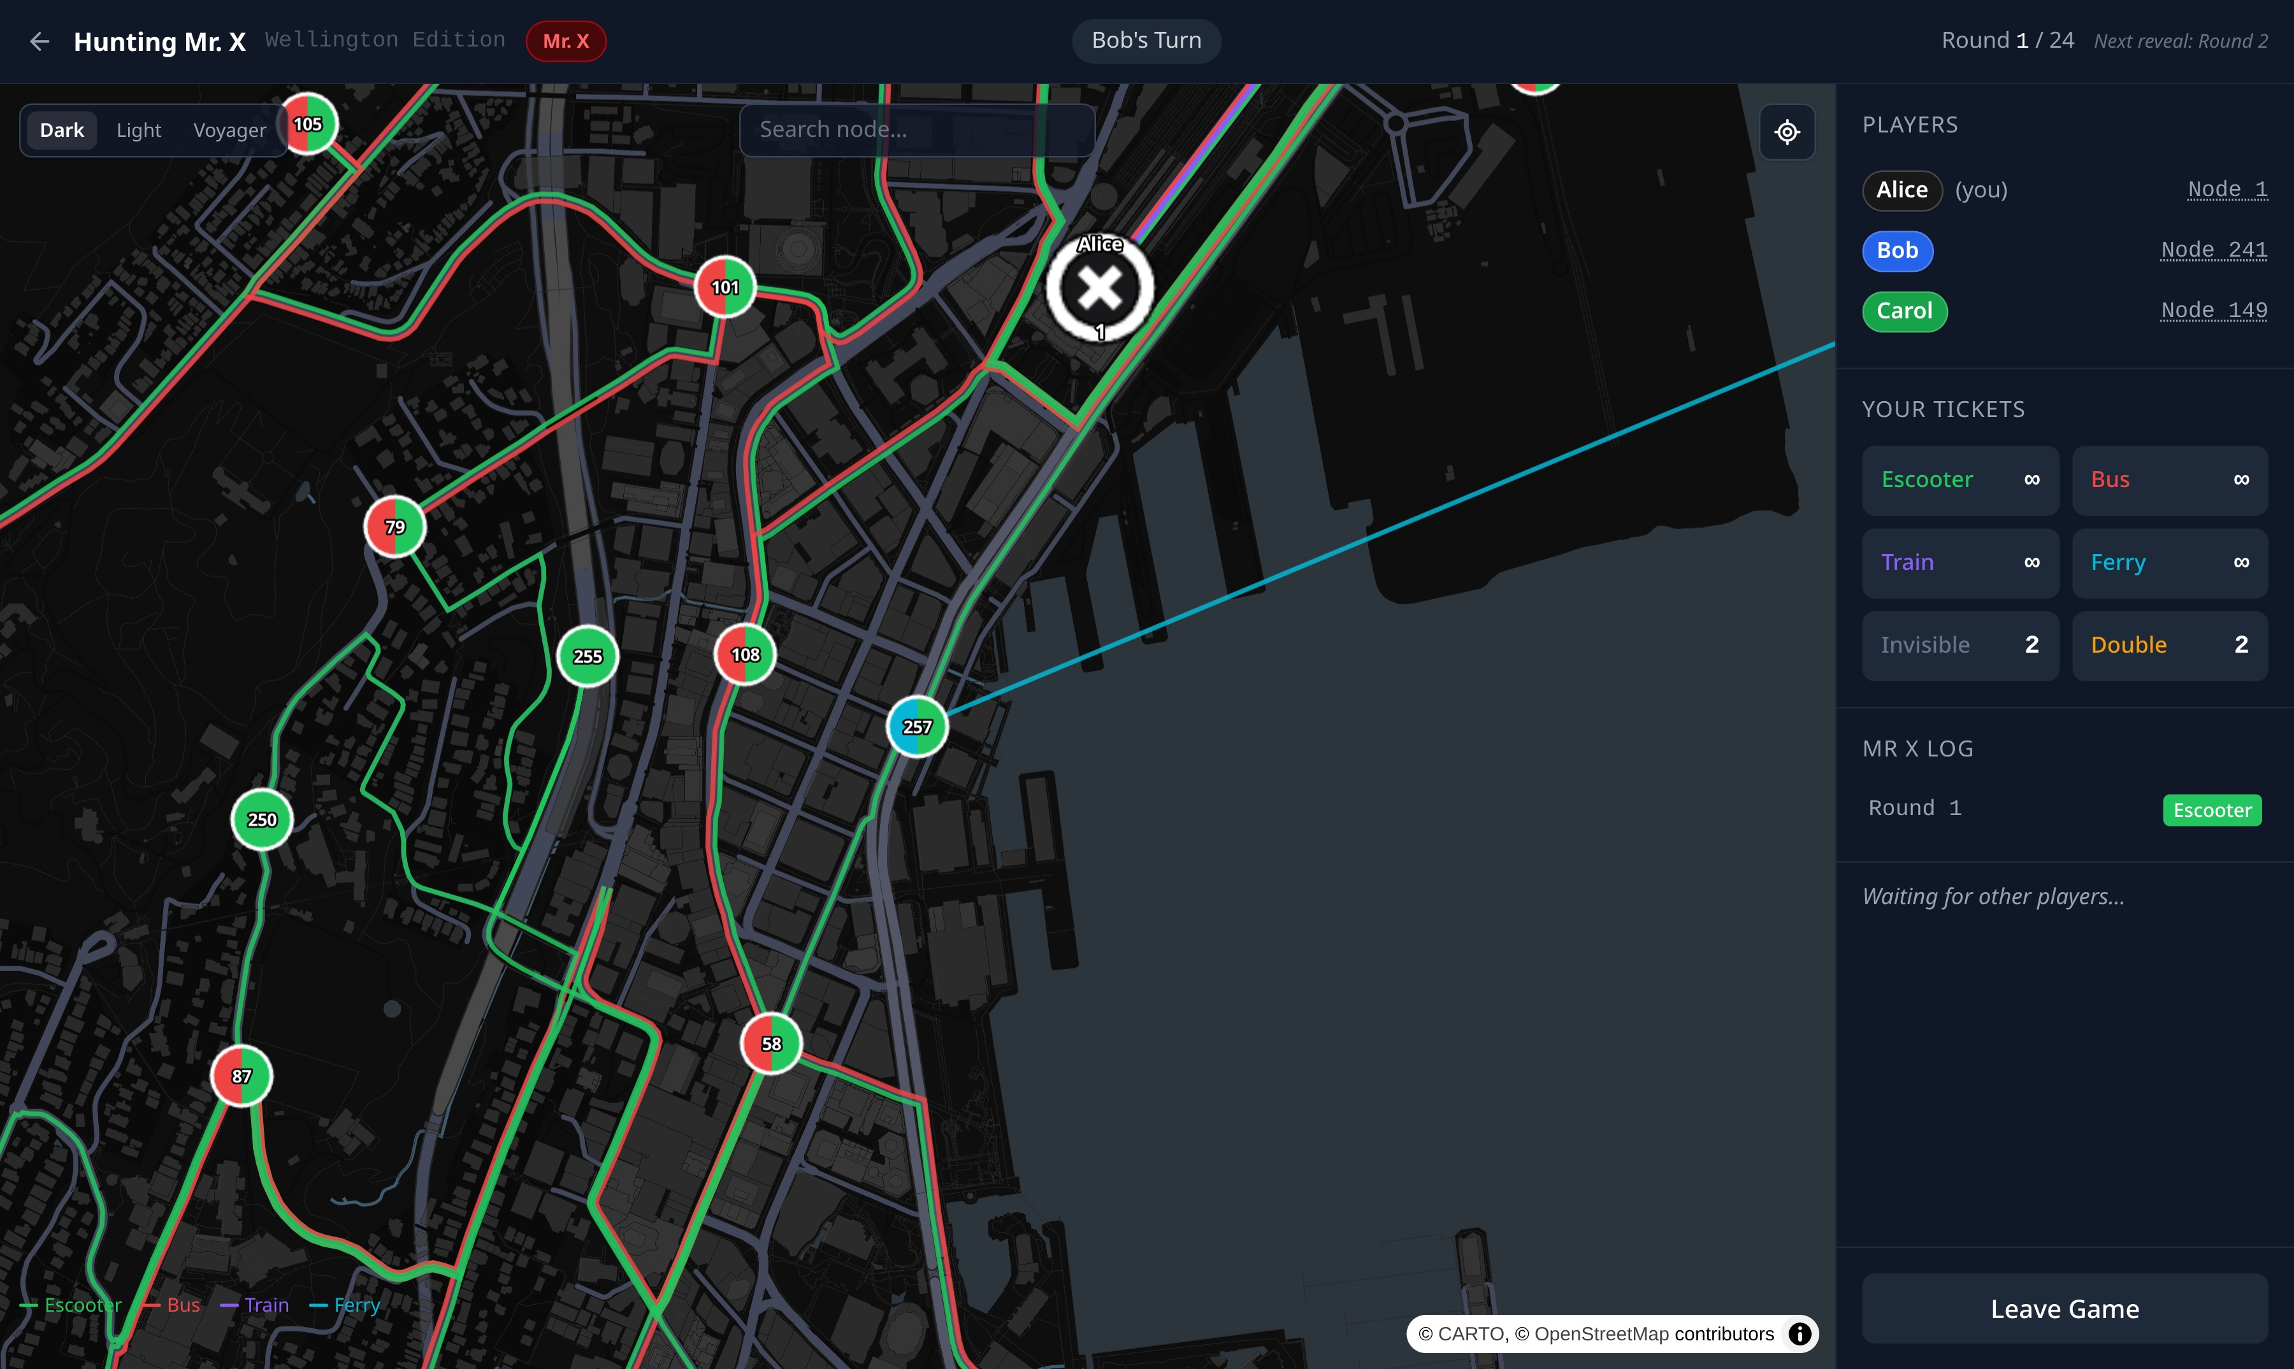
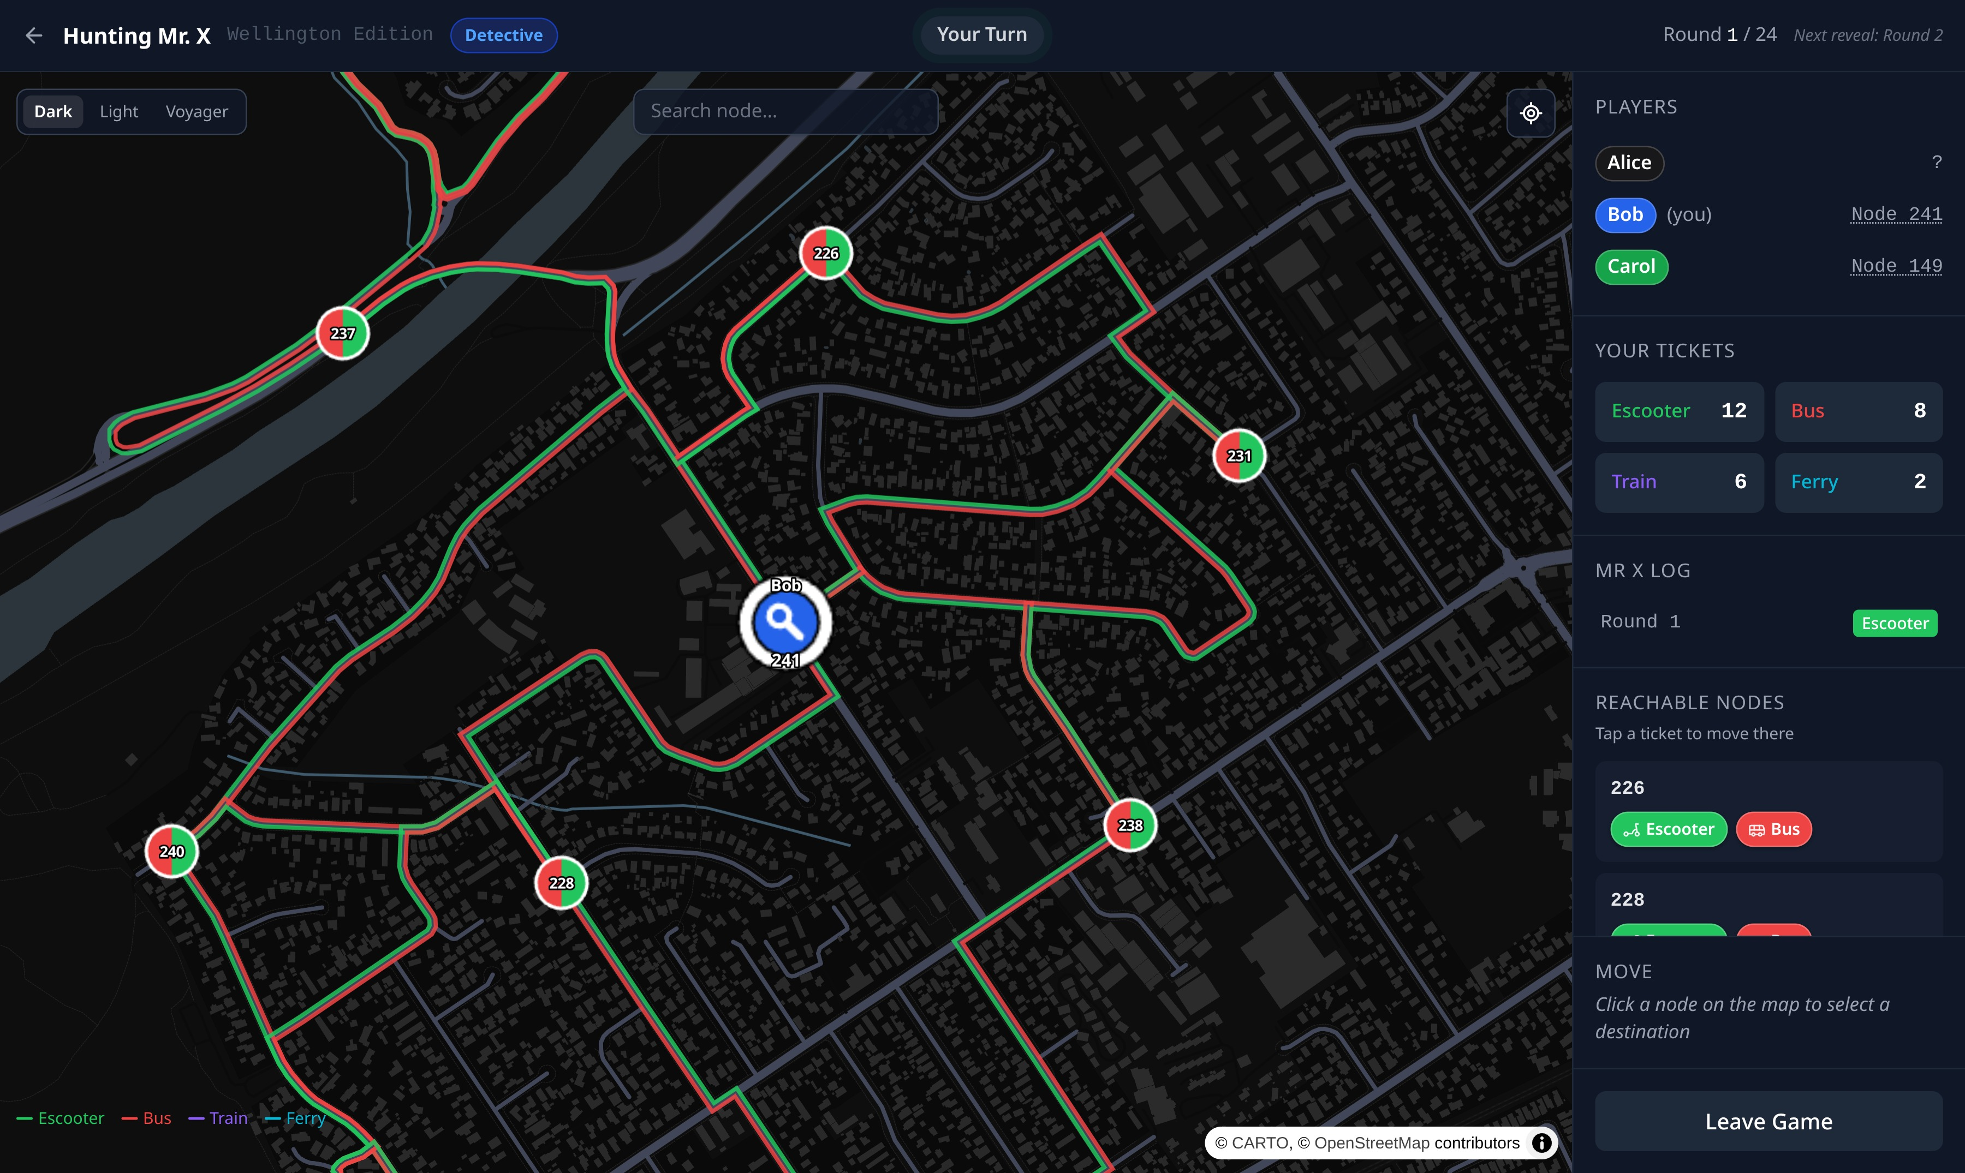
HUNTING MR. X
WELLINGTON EDITION
A new Open Day demo: a classic board game, rebuilt to play online on a real map of Wellington
MING BAO
Supervisors: Jens Dietrich, Stuart Marshall
ENGR489, Victoria University of Wellington
KEY FINDINGS
Open Day
216 places
No install
played live by visitors
on the stand's laptops
on a real map of Wellington
by bus, train, ferry and e-scooter
join from a web browser
with a link or a six-letter code
WHY OPEN DAY?
HOW TO PLAY
The old software demo was over five years old
Visitors need something to try in a few minutes
A game set in their own city starts conversations
One player is Mr X; up to five detectives hunt him
Everyone travels by bus, train, ferry or e-scooter
Mr X stays hidden, shown only every few rounds
Catch him within 24 rounds to win
SAME GAME, DIFFERENT SECRETS
He sees where he is
They see “?”
Mr. X
moves in secret across the city.
Detective
sees him only in rounds 2, 8, 13, 18 and 24.
TECHNICAL CHALLENGES
KEEPING A SECRET
STAYING IN SYNC
A FREE REAL MAP
PROVING IT WORKS
Each player is sent their own view, so Mr X's position never reaches a detective's screen.
Every move is pushed live to every screen. A dropped connection catches up by itself.
Routes along real roads are worked out once, not paid for on every move.
135 automated tests, including 300 random games. Every planted bug was caught.
TECH STACK
OUTCOME
Game screens | Vue 3, TypeScript, Tailwind CSS
Map | MapLibre GL, OpenStreetMap
Game server | Java 21, Spring Boot
Live updates | WebSockets (STOMP)
Testing | JUnit 5, Mockito, PIT
Hosting | Docker, Cloudflare Tunnel
Played live at Open Day
Anyone can join over the internet
Ready for future Open Days
NEXT STEPS
The board: 216 places
A big-screen view for the stand
A phone-friendly layout
Computer players for solo games

