Slide 1
Scotland Yard
Wellington Edition
Ming Bao · ENGR489 · Victoria University of Wellington · June 2026

Slide 2
The Problem
• Scotland Yard is a classic hidden-movement deduction game - physical board only
• Existing digital versions (Board Game Arena, Steam) use fictional maps and are not fully online and automatic
• SWEN capstone projects at VUW are rarely suitable for open days
• Gap:** No web-based platform for Scotland Yard on a real city map, in real time, in a browser
Goal: Build a multiplayer Scotland Yard game on Wellington's real transport network — playable in a browser, and visually striking enough to be a department showpiece

Slide 3
Background Research: Related Work
• Existing website: https://ssy.pvx.sk/
- played through QR codes
• Tabletop Simulator from steam
- requires TT sim: $29
- not automated
• Scotland yard game on steam
- mostly negative reviews
-bad AI
-not fully online
-$22

Slide 4
Tech Stack
Layer | Options | Selection | Why
Backend | Java, JS, Unity | Java 21 + Spring Boot | Familiarity, works well with graphs, no need for complex engines
Frontend | Vue, React, JS game engine | Vue + TypeScript | Reactive, typed, composable, familiarity
Map API | Next slide | MapLibre GL | Next slide
Communication | Websocket | Websocket | Built in compatibility with js and sprintboot
Deployment | Cloud (AWS, Azure), university | Docker, home server, cloudflare (planned T2) | Reproducible deploys, free

Slide 5
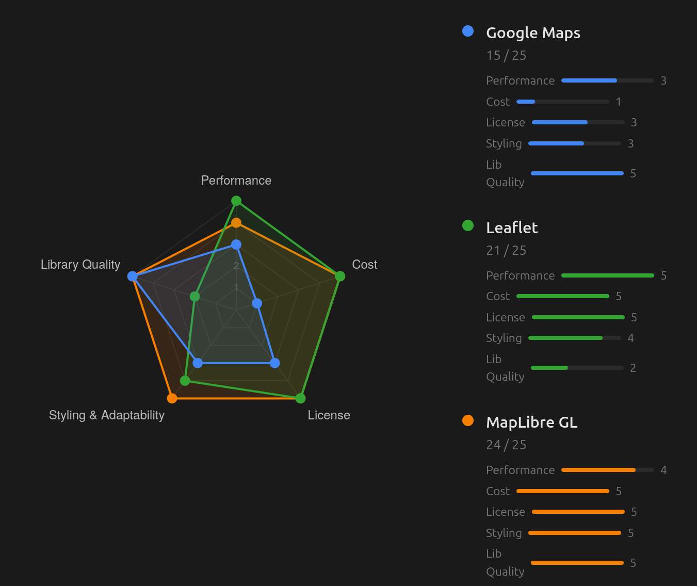
Map Library Evaluation

Slide 6
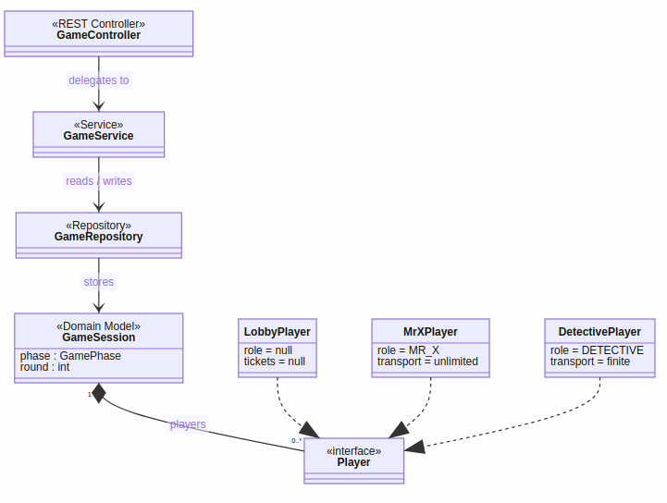
System Architecture

Slide 7
What's Been Built: Backend
Sprint 1–2 complete — Lobby + Role Assignment
Method | Path | Purpose
POST | /api/games/create | create game, return join code
POST | /api/games/join | join by code
GET | /api/games/{id} | get current state
POST | /api/games/{id}/start | host starts, assigns roles
DEL | /api/games/{id}/players/{pid} | leave/kick
• WebSocket: server broadcasts to /topic/games/{id} after every state change
• link to swaggerhub https://app.swaggerhub.com/apis/aaaa-df0/scotland-yard-wellington-api/0.1.4

Slide 8
What's Been Built: Frontend + Demo
Working lobby flow (live demo or video)
1
Player creates game → lands on lobby with 6-char join code
2
Second player joins by code → both lobbies update instantly via WebSocket
3
Host can kick players → kicked player sees notification and is redirected
4
Host starts game → all players transition together to the game board

Slide 9
Trade-offs & Limitations
Decision | Trade-off | Mitigation
No Persistency | Players and games are temporary but security can be ignored to an extent | Good enough for what the game is designed for
No authentication | Anyone with a join code can join | By design — for open days and play with friends
WebSocket (STOMP) | More complex than REST polling | Standard Spring support; already working
Pre-computed GeoJSON | Must build Wellington graph manually | One-time effort; no per-request API cost
Current limitations:
• Game engine (move validation, catch detection, win conditions) not yet implemented
• Wellington graph data not yet populated
• Deployment planned for T2

Slide 10
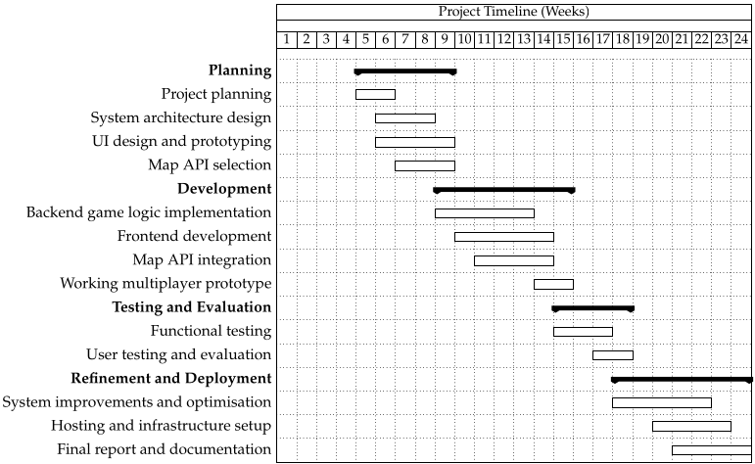
Progress
Slide 11 / 13 · ~45 s

Slide 11
Next steps
Sprint 3 — Map + Wellington Graph
Sprint 4 — Game Engine
Sprint 5 — Deploy
• Build Wellington node/edge graph
• Move validation against graph edges
• Docker containerisation (backend + frontend)
• MapLibre GL rendering of nodes and edges on real map
• Ticket decrement on move
• Host on home server
• Node selection and ticket picker UI
• Turn rotation (MrX → each detective → repeat)
• Milestone: full game playable end-to-end by external users
• Milestone: player selects and submits a move on the real map
• Catch detection and win conditions
• Reveal rounds (3, 8, 13, 18, 24)
• Milestone: two players complete a full round

Slide 12
Summary
Where we are at end of Trimester 1
• ✅ Full specification written
• ✅ Map library evaluated with benchmark data — MapLibre GL selected
• ✅ System architecture designed (state machine, player hierarchy, WebSocket)
• ✅ Working backend: 6 endpoints, WebSocket, role assignment, 104 tests passing
• ✅ Working frontend: create / join / lobby with real-time updates + light/dark mode
• ✅ OpenAPI spec in sync, enforced by pre-commit hook
Next: Game engine (move validation · catch detection · win conditions) + real Wellington map
Slide 13 / 13 · ~15 s

