Slide 1



PMBIO Module 04 Germline. Germline WGS and Exome Variant Analysis
Malachi Griffith, Obi Griffith, Zachary Skidmore, Huiming Xia
Introduction to bioinformatics for DNA and RNA sequence analysis (IBDR01)
29 October – 2 November, 2018
Glasgow

Slide 2
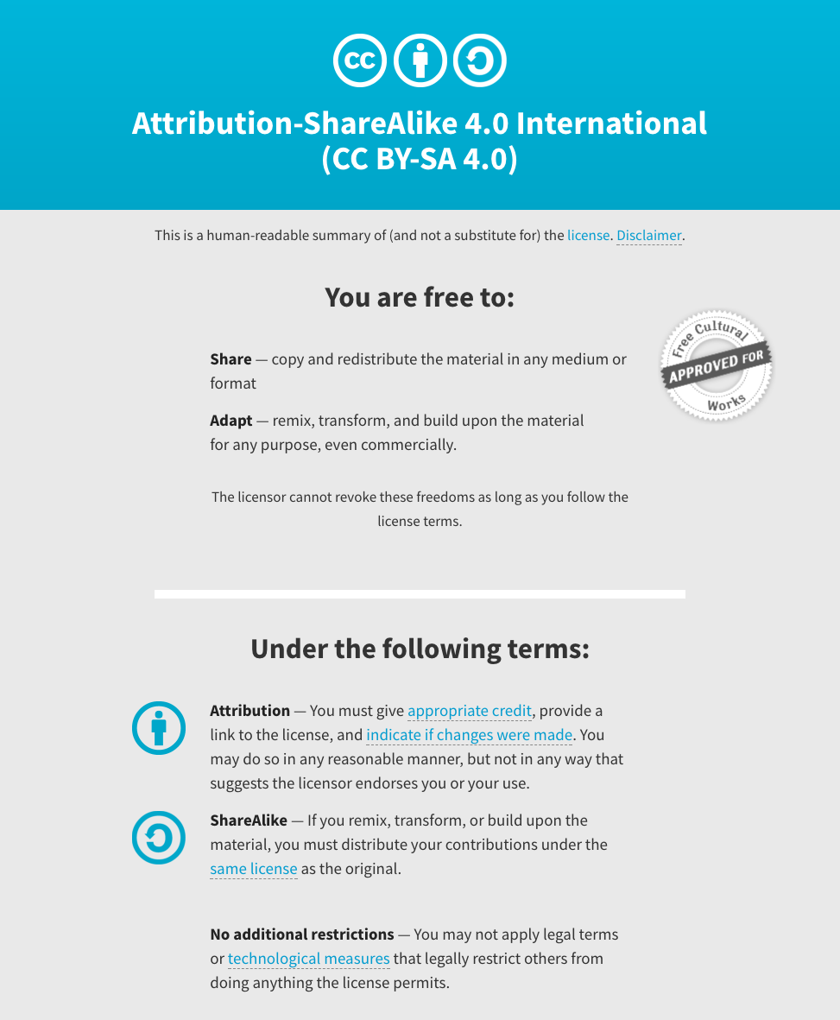
Notes:
Note there are two licenses if effect for this course.
All *content* (lectures, written materials, etc.) are made available under the Creative Commons Attribution-ShareAlike 4.0 International (CC BY-SA 4.0). (https://creativecommons.org/licenses/by-sa/4.0/).
All *code* (R scripts the website code itself) are made available under the MIT License (https://opensource.org/licenses/MIT).

Slide 3
Learning objectives of module 04: Germline
Key concepts: Variation, germline mutation, polymorphism, SNPs, variant databases, germline variant calling
Use of the GATK tool kit for variant calling
Perform basic germline variant filtering
Compare single sample germline variant calling to cohort based calling

