Slide 1



PMBIO Module 05 Somatic. Somatic WGS and Exome Variant Analysis
Malachi Griffith, Obi Griffith, Zachary Skidmore, Huiming Xia
Introduction to bioinformatics for DNA and RNA sequence analysis (IBDR01)
29 October – 2 November, 2018
Glasgow

Slide 2
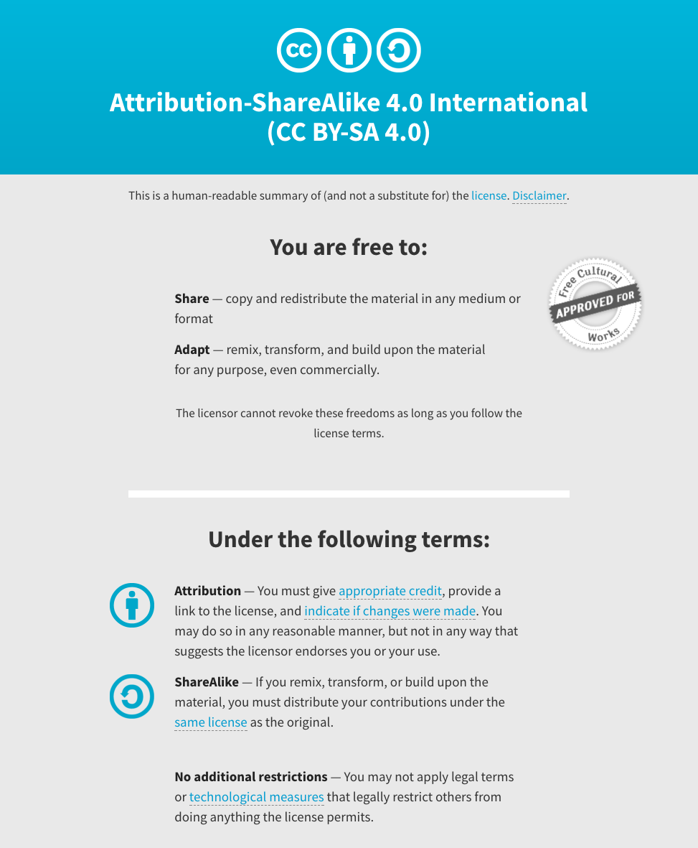
Notes:
Note there are two licenses if effect for this course.
All *content* (lectures, written materials, etc.) are made available under the Creative Commons Attribution-ShareAlike 4.0 International (CC BY-SA 4.0). (https://creativecommons.org/licenses/by-sa/4.0/).
All *code* (R scripts the website code itself) are made available under the MIT License (https://opensource.org/licenses/MIT).

Slide 3
Learning objectives of module 05: Somatic
Key concepts: Somatic variation, variant types (SNVs, small indels, CNVs, SVs, LOH), VCFs, variant allele fraction (VAF), purity estimation and tumor clonality
Compare and contrast the merits of exome and WGS data for variant calling
Compare germline and somatic variant calling strategies
Consider the features of major variant types detected in NGS data
Perform somatic variant calling of various types using tools specific to each type
Understand the basic features of the VCF format
Merge multiple VCFs into a single combined VCF
Perform variant filtering to identify a high quality set of variants
Annotate variants with respect to transcript annotations, population frequency, predicted function, etc.
Manually review variants of each type to better understand how variant callers use read alignment data to identify variants

