Slide 1

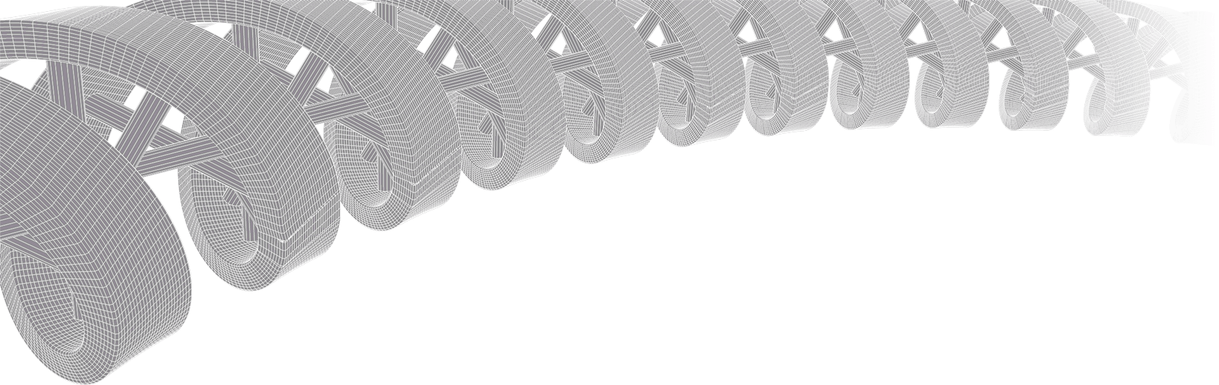

PMBIO Module 06 RNAseq. RNA-sequence analysis
Malachi Griffith, Obi Griffith, Zachary Skidmore, Huiming Xia
Introduction to bioinformatics for DNA and RNA sequence analysis (IBDR01)
29 October – 2 November, 2018
Glasgow

Slide 2
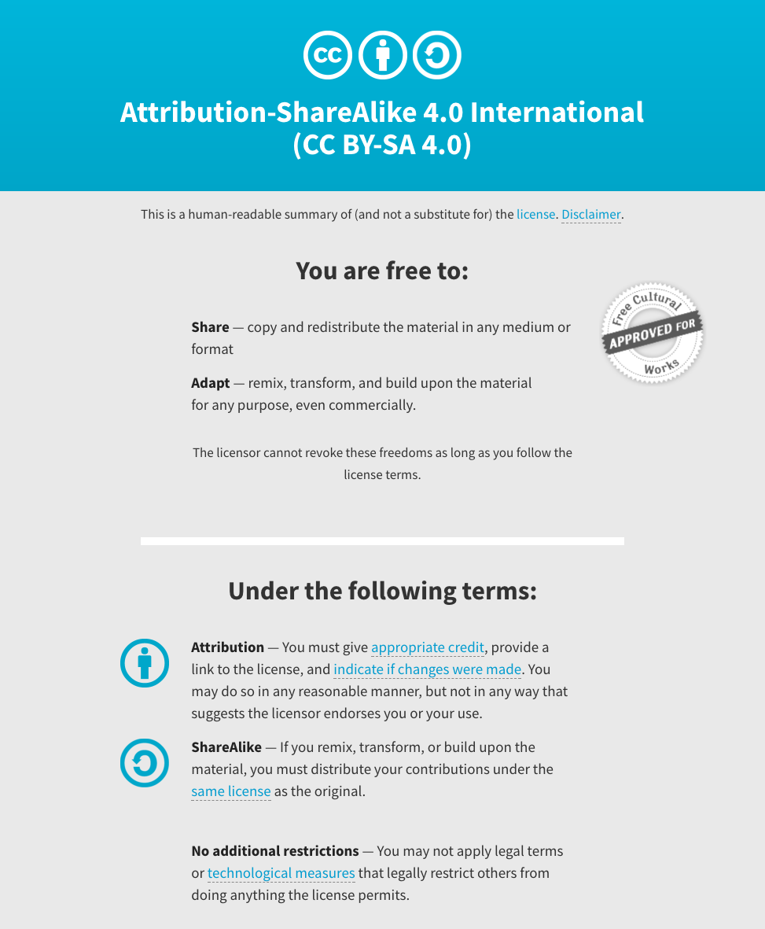
Notes:
Note there are two licenses if effect for this course.
All *content* (lectures, written materials, etc.) are made available under the Creative Commons Attribution-ShareAlike 4.0 International (CC BY-SA 4.0). (https://creativecommons.org/licenses/by-sa/4.0/).
All *code* (R scripts the website code itself) are made available under the MIT License (https://opensource.org/licenses/MIT).

Slide 3
Learning objectives of module 06: RNAseq
Key concepts: RNA-seq, library strategies, RNA splicing, genes and transcripts, transcription strand, gene/transcript abundance estimation, FPKM and TPM, differential expression (DE) analysis, normalization, batch effects
Perform alignment of RNA-seq data and a basic QC analysis of the resulting alignments
Obtain gene and transcript abundance estimates
Perform a reference-free alignment and abundance estimation and contrast the results with the reference based approach
Basic differential expression analysis
Perform an expression outlier analysis
Run an RNA fusion detection tool and parse the results for interesting candidates
Assess expression of specific gene markers of relevance (e.g. HER2, ER, PR)
Assess the expression of specific variants identified in previous sections.
Identify an example of allele specific expression

