Slide 1



PMBIO Module 07 Clinical. Clinical Applications
Malachi Griffith, Obi Griffith, Zachary Skidmore, Huiming Xia
Introduction to bioinformatics for DNA and RNA sequence analysis (IBDR01)
29 October – 2 November, 2018
Glasgow

Slide 2
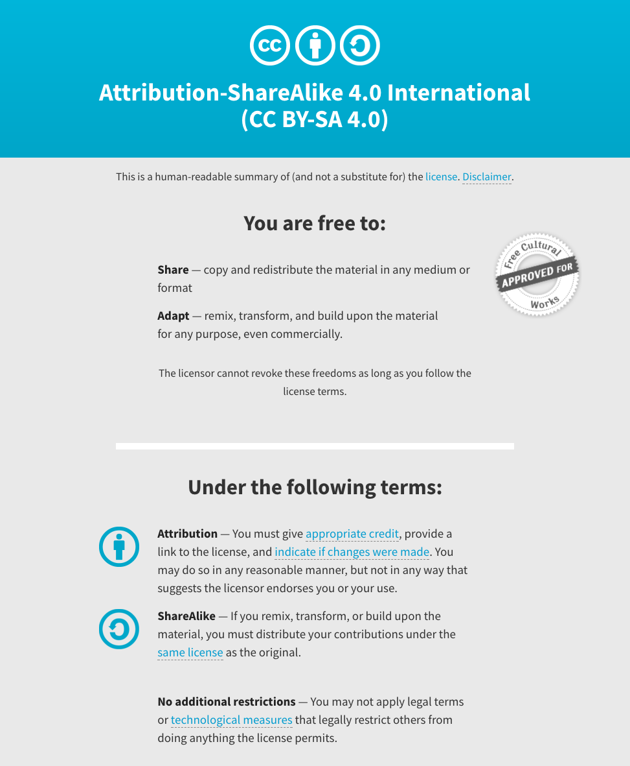
Notes:
Note there are two licenses if effect for this course.
All *content* (lectures, written materials, etc.) are made available under the Creative Commons Attribution-ShareAlike 4.0 International (CC BY-SA 4.0). (https://creativecommons.org/licenses/by-sa/4.0/).
All *code* (R scripts the website code itself) are made available under the MIT License (https://opensource.org/licenses/MIT).

Slide 3
Learning objectives of module 07: Clinical
Key concepts: Clinical interpretation of variants, variant interpretation types (predisposing, predictive, predisposing, diagnostic), variant interpretation guidelines, clinical applications of passenger somatic variants (early detection, minimal residual disease tracking, personalized vaccines).
Prioritize germline variants to identify putative de novo and clinically relevant mutations
Germline pathogenicity assessment (demonstrate concepts with some example variants using ClinGen Variant Curation Interface)
Biological function or oncogenicity (demonstrate concepts by uploading a filtered VCF into CRAVAT)
Somatic clinical actionability (demonstrate concepts with some example variants using CIViC)

