Slide 1



PMBIO Module 08 Immune. Immunogenomics analysis
Malachi Griffith, Obi Griffith, Zachary Skidmore, Huiming Xia
Introduction to bioinformatics for DNA and RNA sequence analysis (IBDR01)
29 October – 2 November, 2018
Glasgow

Slide 2
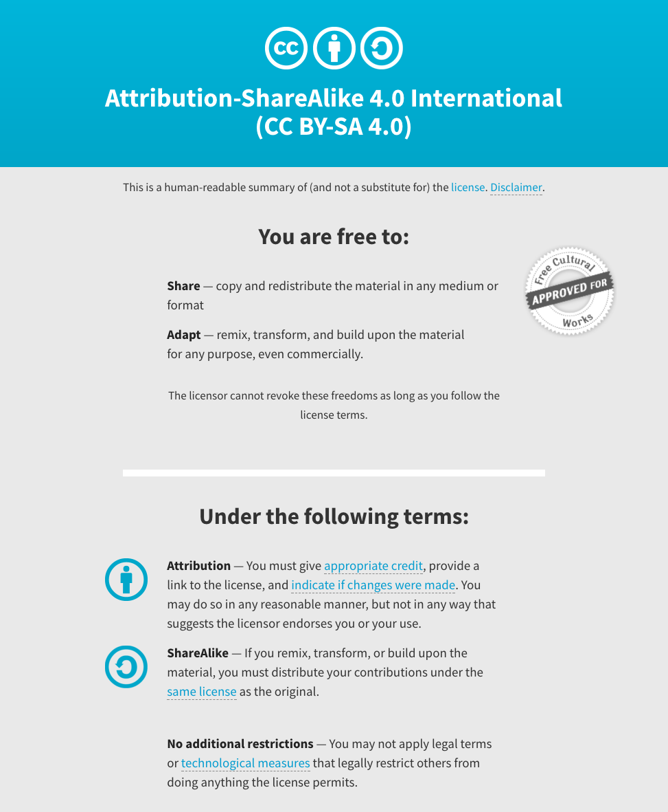
Notes:
Note there are two licenses if effect for this course.
All *content* (lectures, written materials, etc.) are made available under the Creative Commons Attribution-ShareAlike 4.0 International (CC BY-SA 4.0). (https://creativecommons.org/licenses/by-sa/4.0/).
All *code* (R scripts the website code itself) are made available under the MIT License (https://opensource.org/licenses/MIT).

Slide 3
Learning objectives of module 08: Immune
Key concepts: Immunogenomics, adaptive immunity, immunotherapies, personalized cancer vaccines, MHC binding prediction, neoantigen identification and prioritization
Use results from the previous sections (germline variants, somatic variants, gene/transcript expression estimates, variant allele fractions, clonality estimates, etc.) to design a personalized cancer vaccine for our hypothetical patient
Become familiar with the pvactools software for neoantigen identification, prioritization, selection, and DNA vector design

