Slide 1



PMBIO Module XX: MODULE TITLE
Malachi Griffith, Obi Griffith, Zachary Skidmore, Huiming Xia
Introduction to bioinformatics for DNA and RNA sequence analysis (IBDR01)
29 October – 2 November, 2018
Glasgow

Slide 2
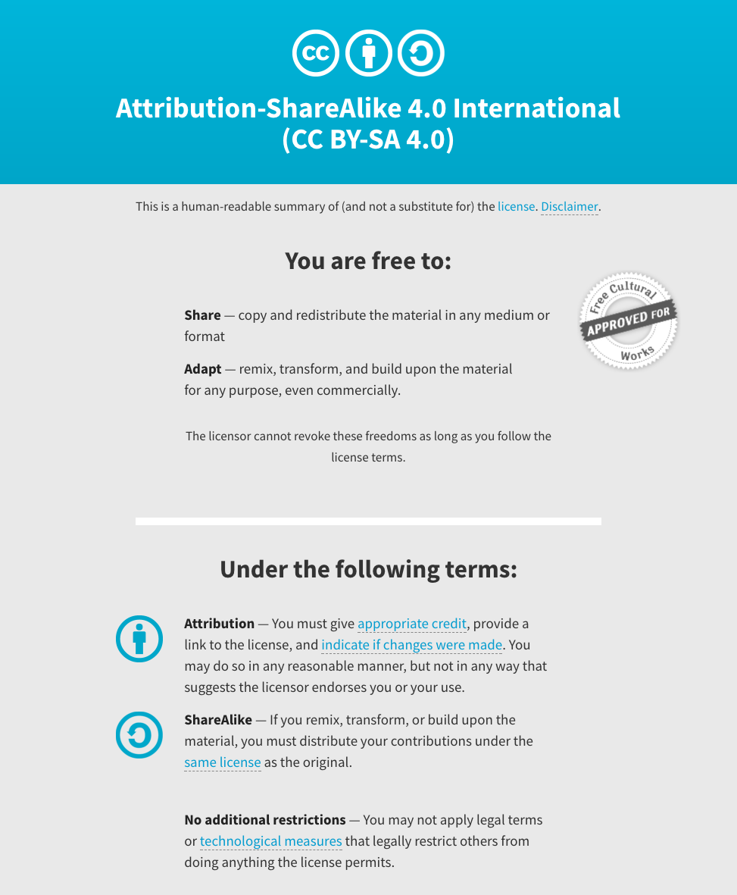
Notes:
Note there are two licenses if effect for this course.
All *content* (lectures, written materials, etc.) are made available under the Creative Commons Attribution-ShareAlike 4.0 International (CC BY-SA 4.0). (https://creativecommons.org/licenses/by-sa/4.0/).
All *code* (R scripts the website code itself) are made available under the MIT License (https://opensource.org/licenses/MIT).

Slide 3
Learning objectives of the course
Module 1: …
Module 2: …
Tutorials
Provide working examples of data visualization and interpretation
Self contained, self explanatory, portable

Slide 4
Learning objectives of module 1
MODULE TITLE
…

