Slide 1

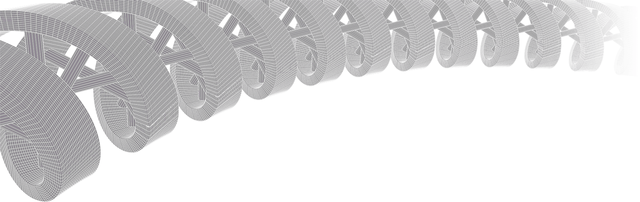

PMBIO Module 02 Inputs. References, Annotations, and Raw Data
Malachi Griffith, Obi Griffith, Zachary Skidmore, Huiming Xia
Introduction to bioinformatics for DNA and RNA sequence analysis (IBDR01)
29 October – 2 November, 2018
Glasgow

Slide 2
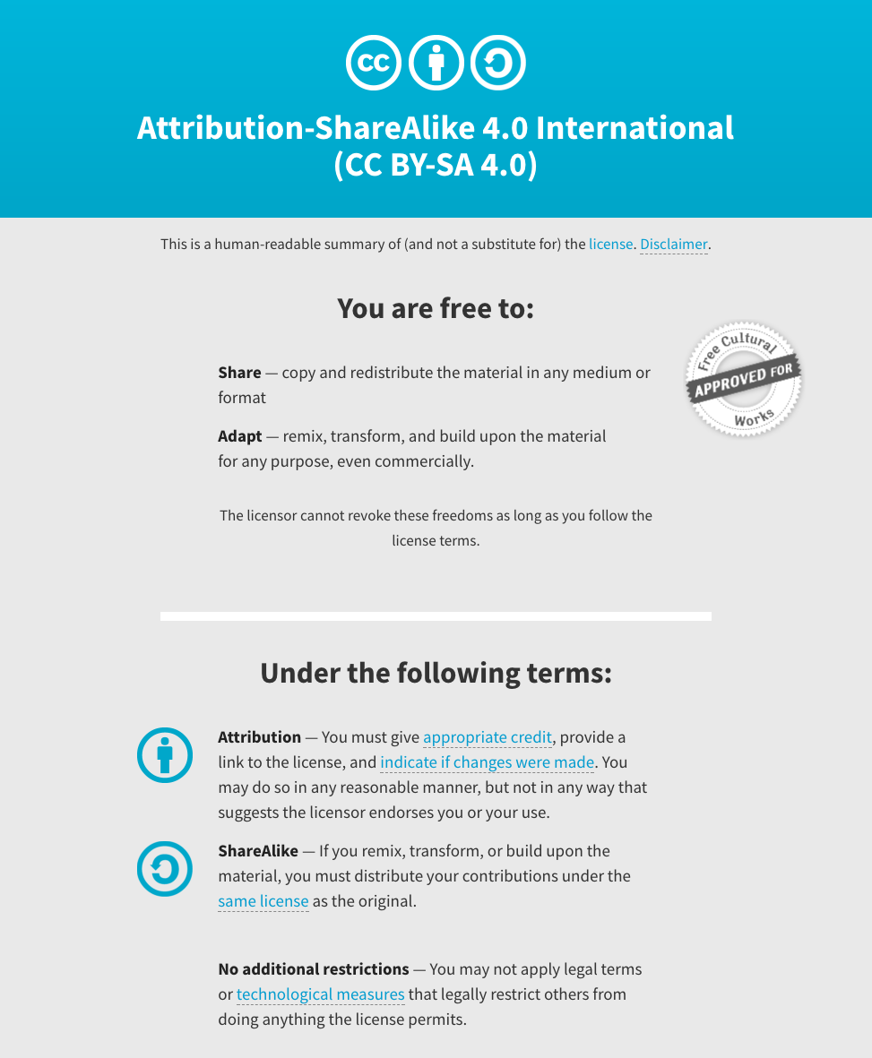
Notes:
Note there are two licenses if effect for this course.
All *content* (lectures, written materials, etc.) are made available under the Creative Commons Attribution-ShareAlike 4.0 International (CC BY-SA 4.0). (https://creativecommons.org/licenses/by-sa/4.0/).
All *code* (R scripts the website code itself) are made available under the MIT License (https://opensource.org/licenses/MIT).

Slide 3
Learning objectives of module 02: Inputs
Key concepts: Central dogma (chromosomes, genes, transcripts, proteins), reference genome assemblies, reference genome versions, FASTA file format, gene/transcript annotation pipelines (Refseq, Ensembl, UCSC, Gencode), GTF file format, sequence data generation, NGS reads, FASTQ file format, raw data QC.
Obtain reference genome and annotation files and understand the standard formats used to represent them
Index large files for more efficient access/analysis
Download and explore raw data files
Review experimental details for a proof-of-principle personalized genomics exercise
Perform a raw data quality assessment and discuss any data quality issues that are observed. What are their implications for interpretation of the results?

Slide 4
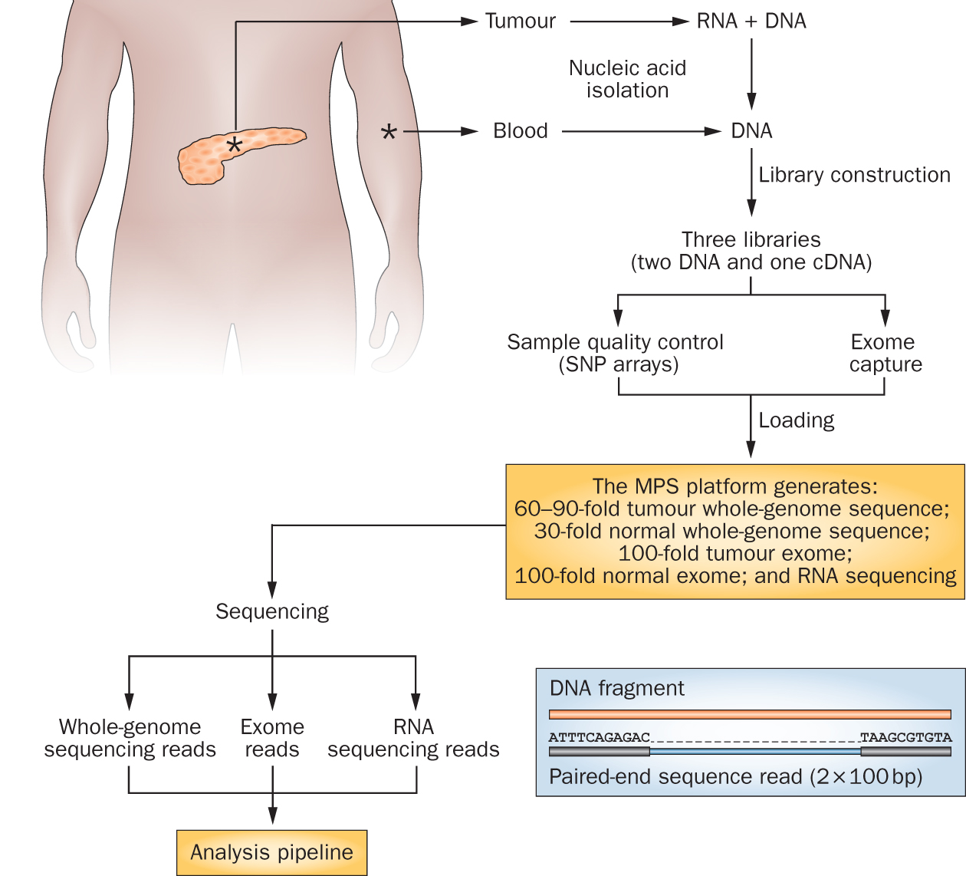
Cancer genomics data has exploded with rapid advances in sequencing technologies
Notes:
We sequence a lot of things at the Genome Institute. But my research interest is fairly focused on clinical cancer sequencing. The idea here is that we start with a patient, sometimes starting at diagnosis but often starting at the point where they have exhausted standard of care options.
From these patients we get a tumor sample and a reference normal sample (usually blood). From the tumor we isolate DNA and RNA and from the normal we isolated DNA. This trio of samples is subjected to library construction followed by whole genome, exome, and transcriptome sequencing. This data flows into our analysis systems and we attempt to detect somatic events that might be relevant to cancer biology or treatment. This involves detecting single nucleotide variants, small insertions and deletions, large copy number amplifications and deletions, gene and isoform expression levels, structural rearrangements, gene fusions, and detection of tumor associated viruses.

Slide 5
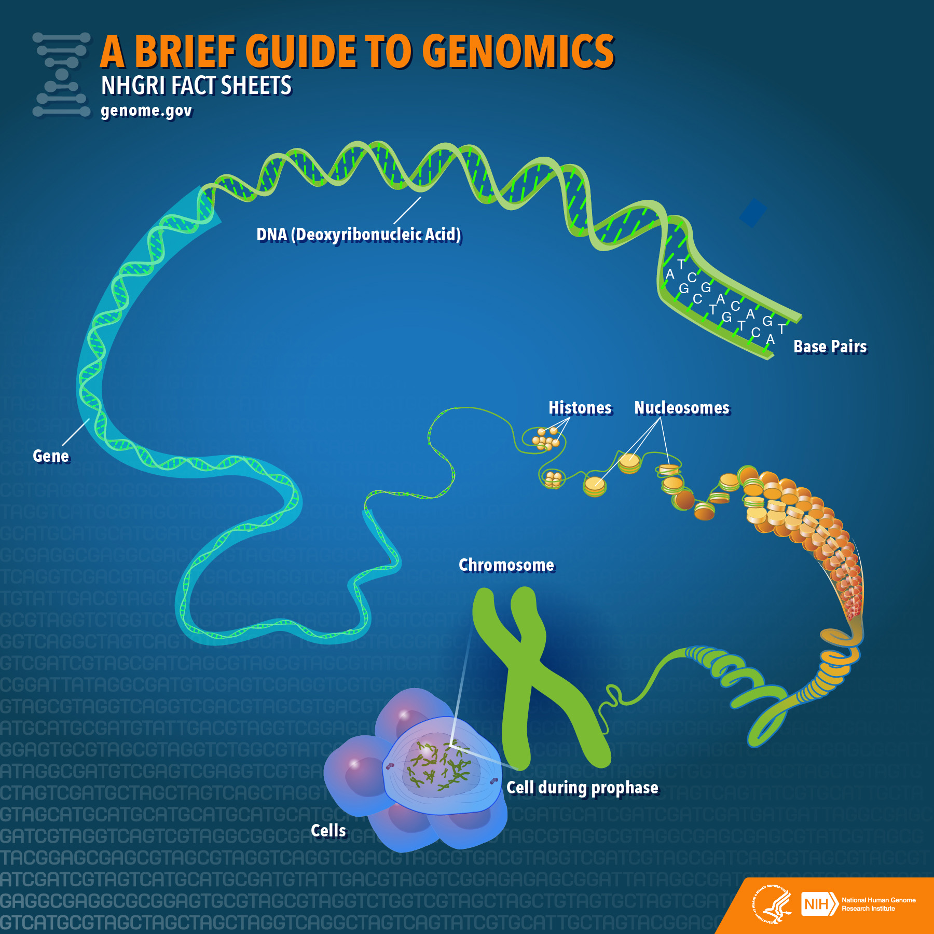
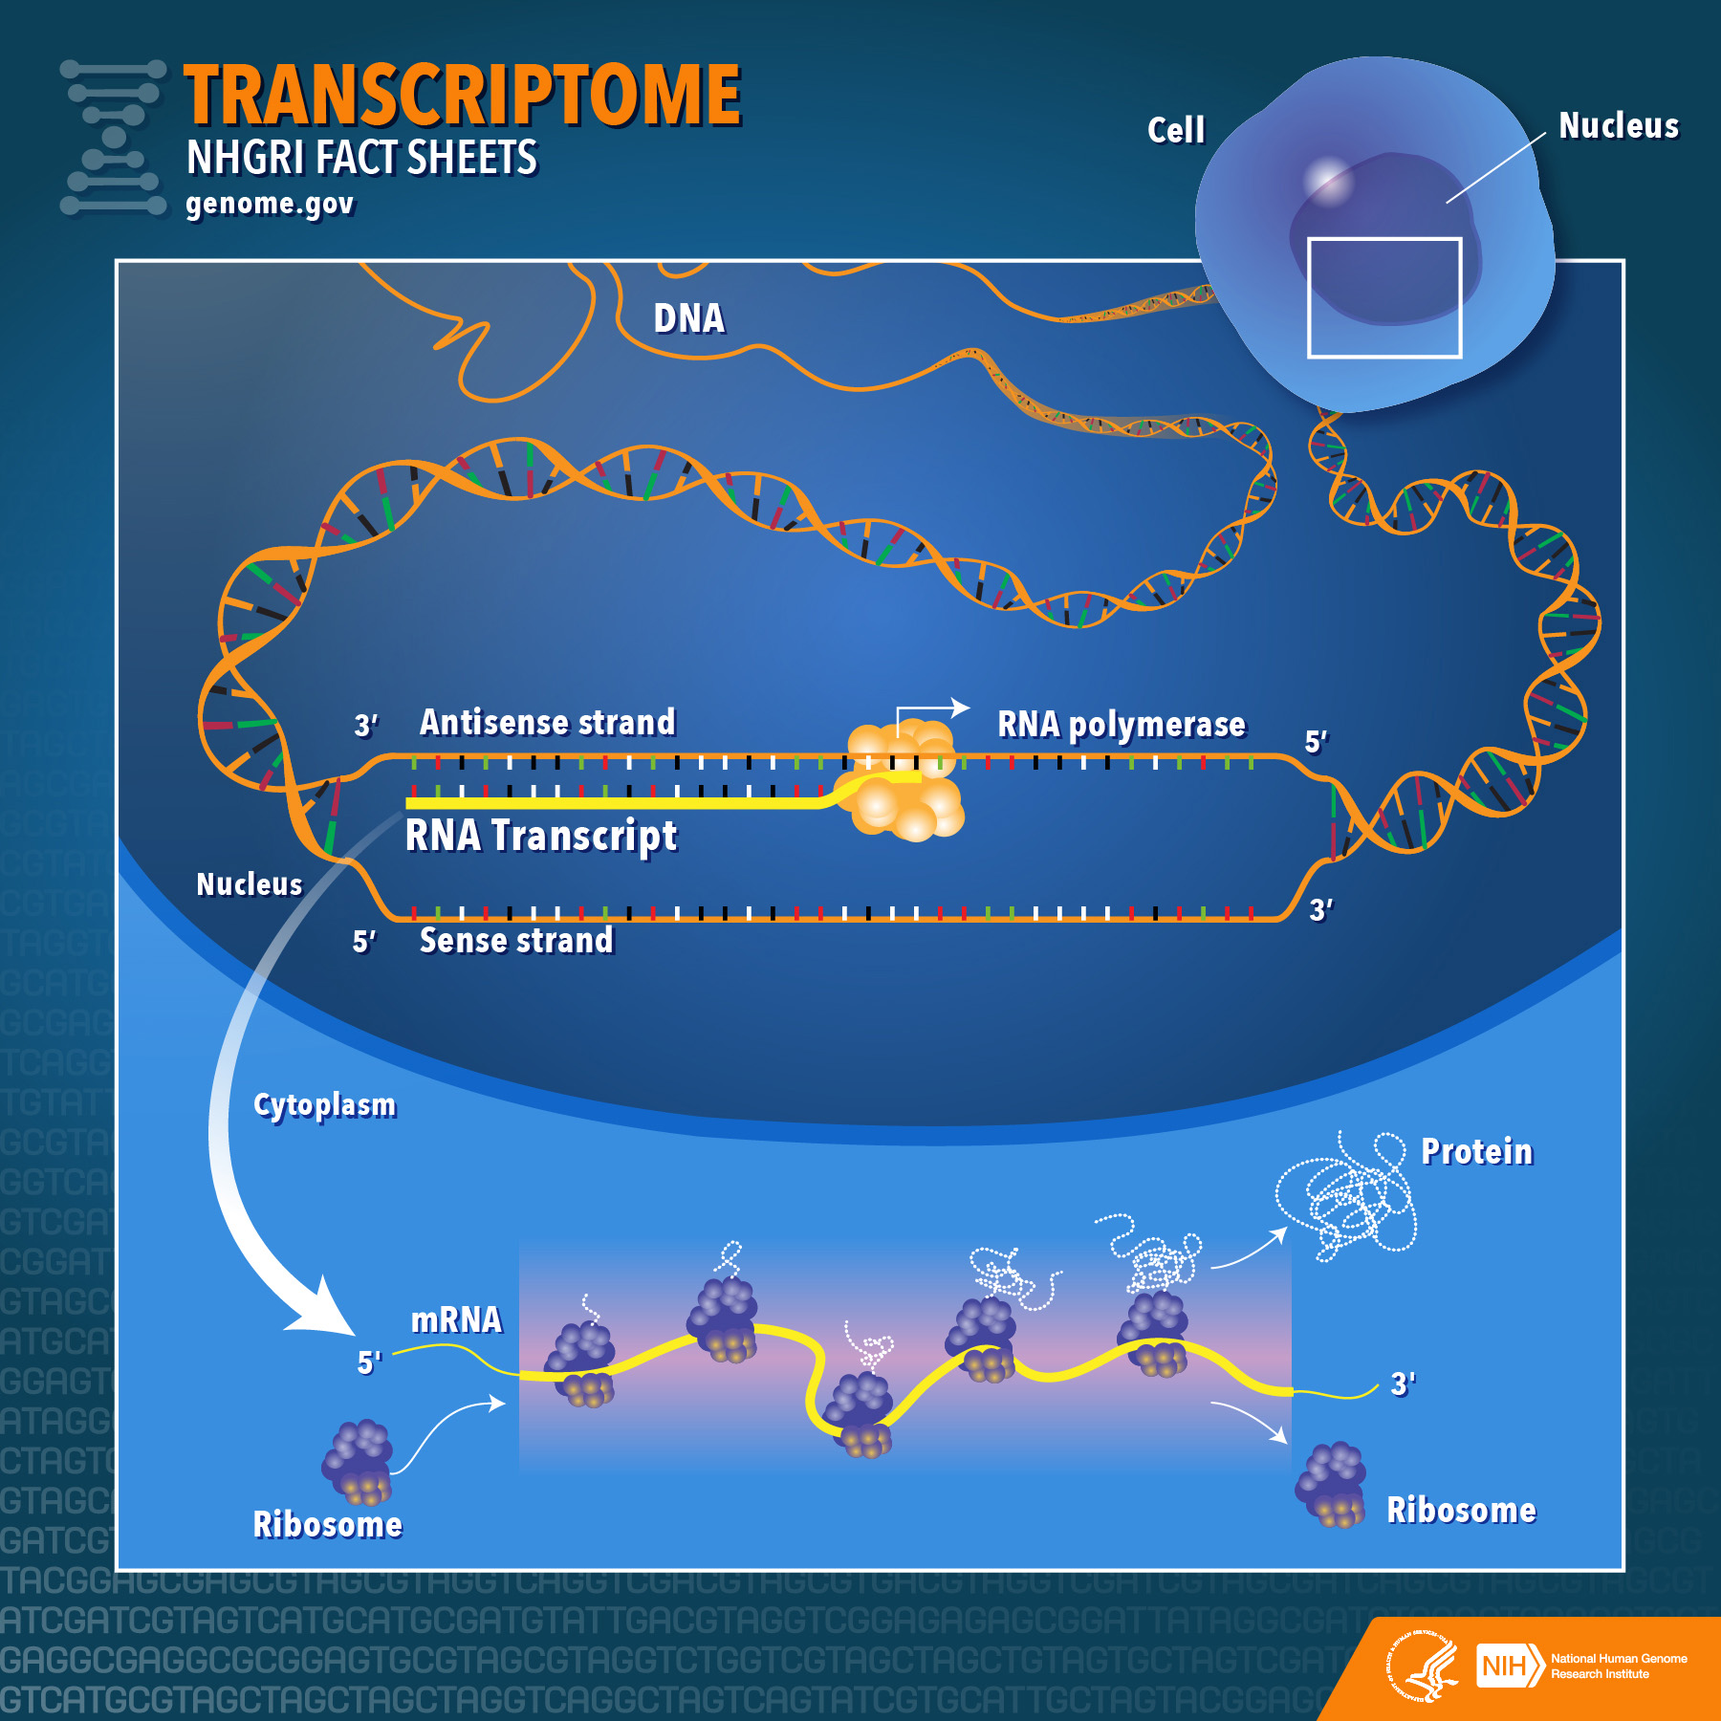
Genomes and transcriptomes

Slide 6
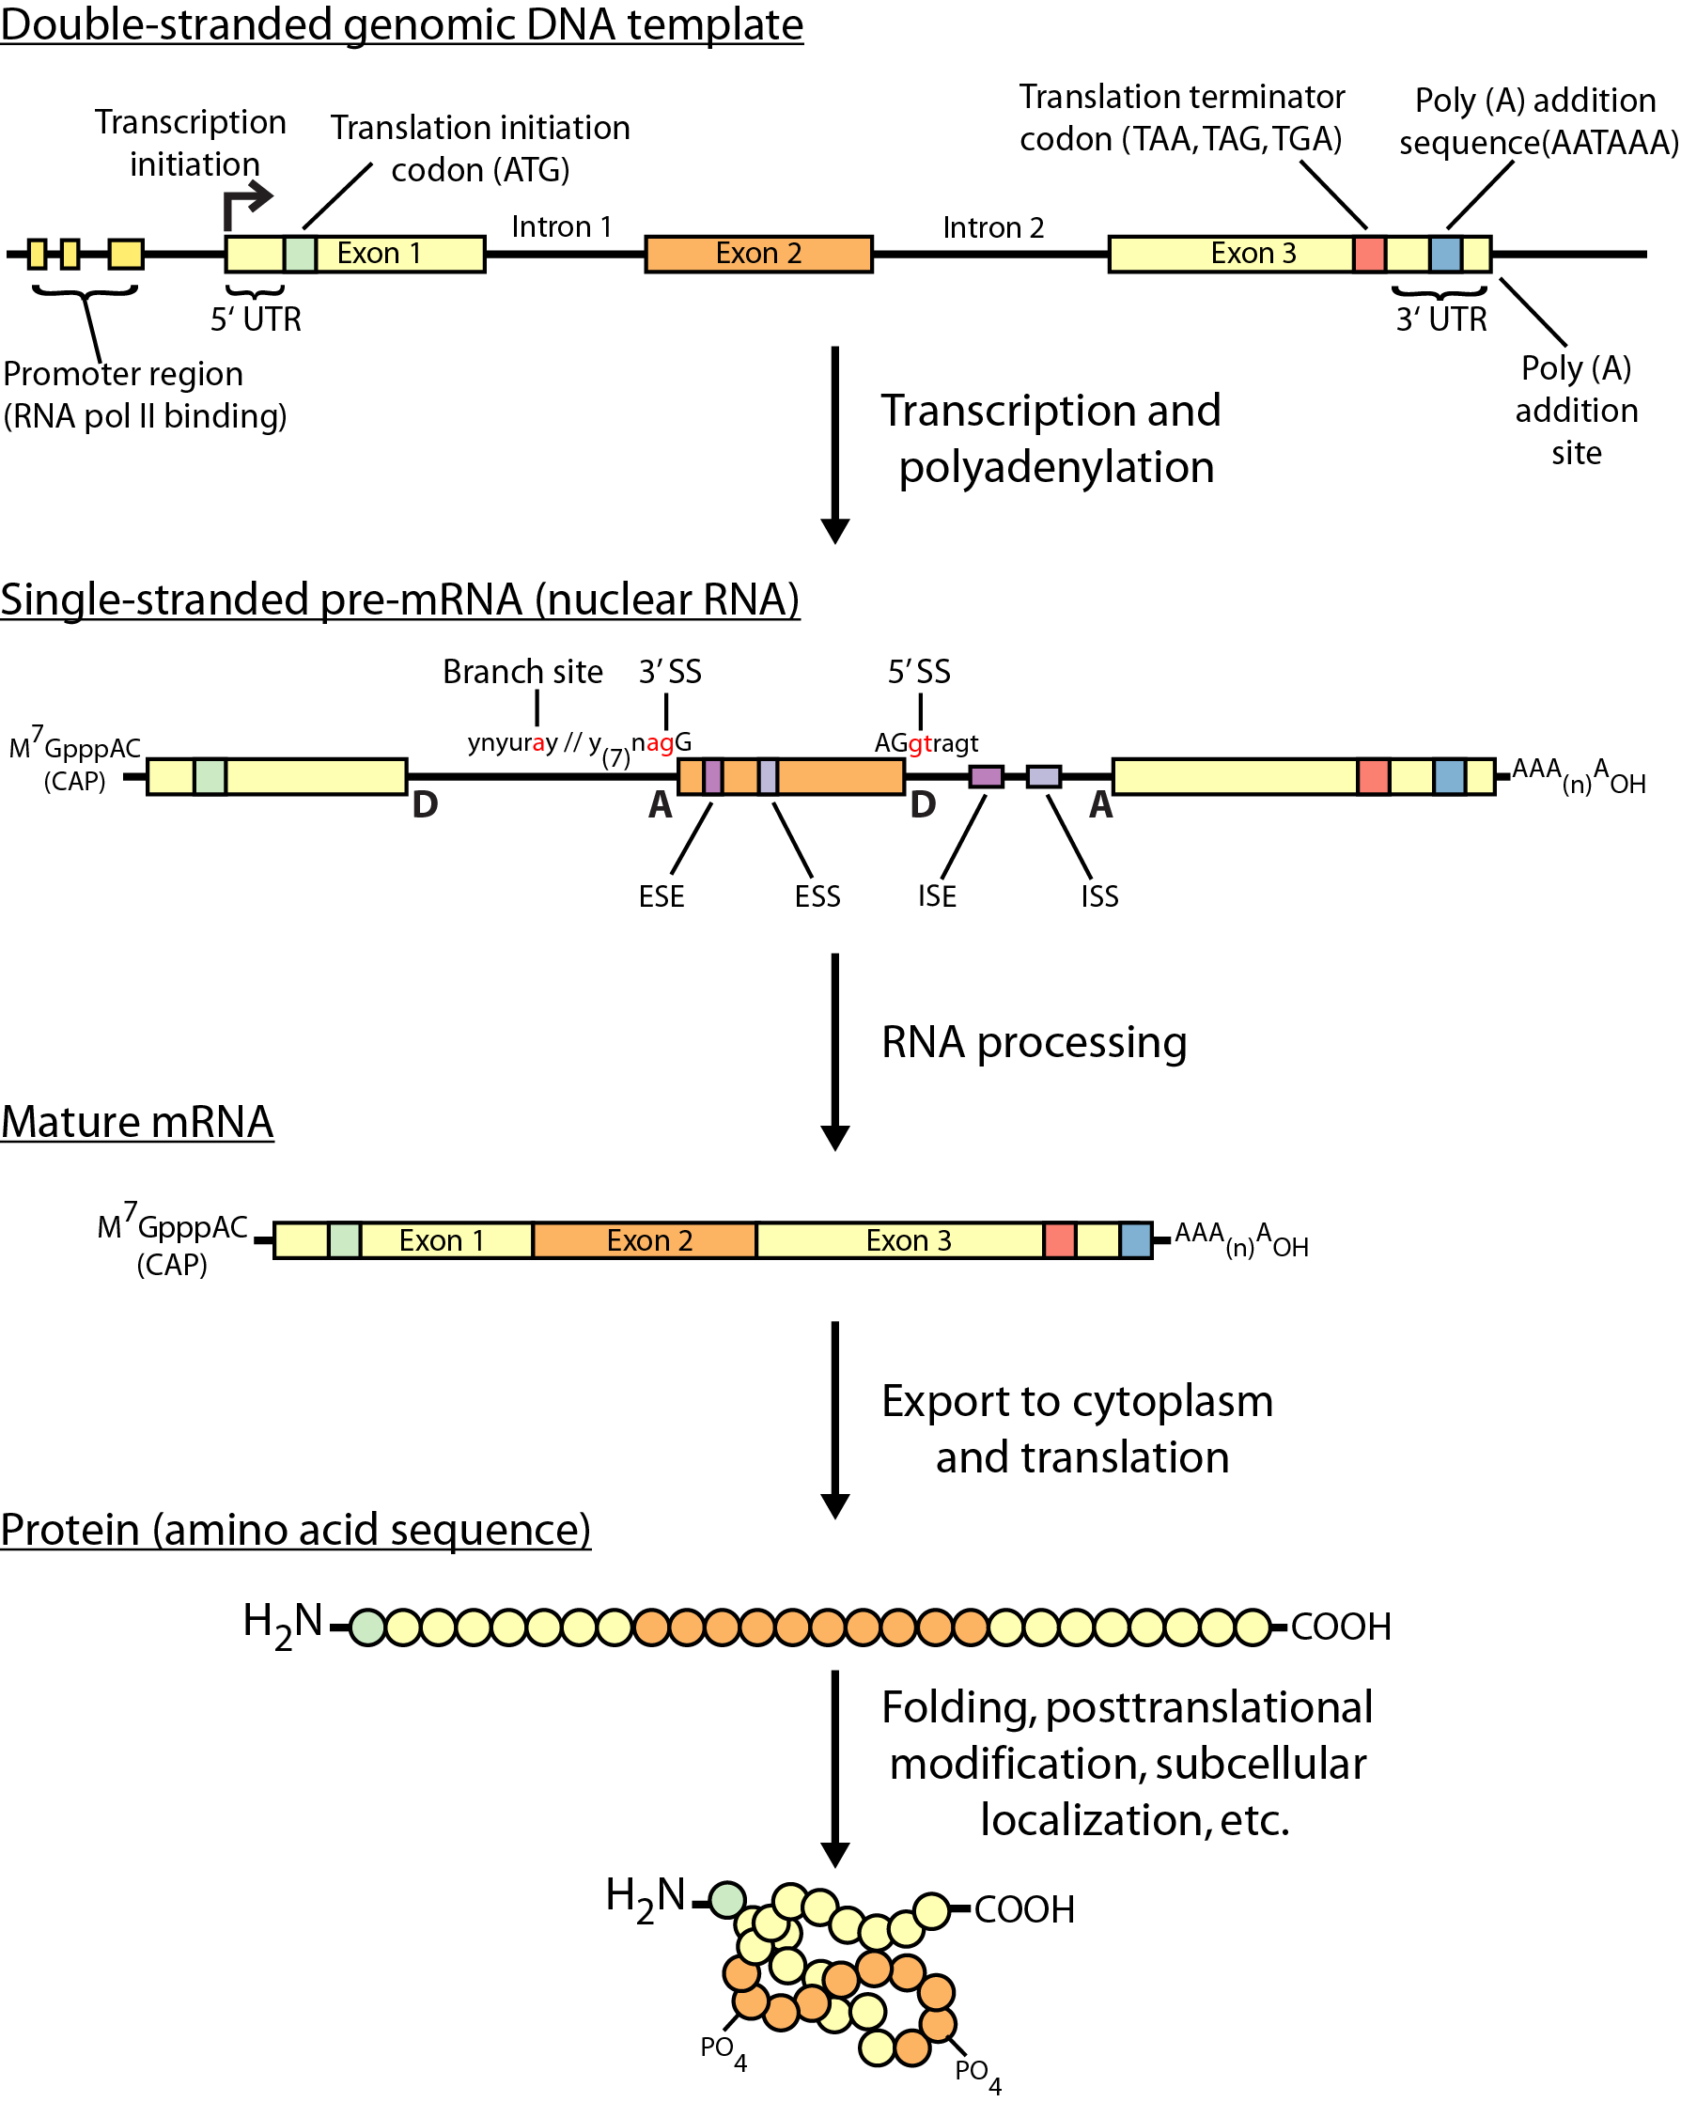
The Central Dogma

Slide 7
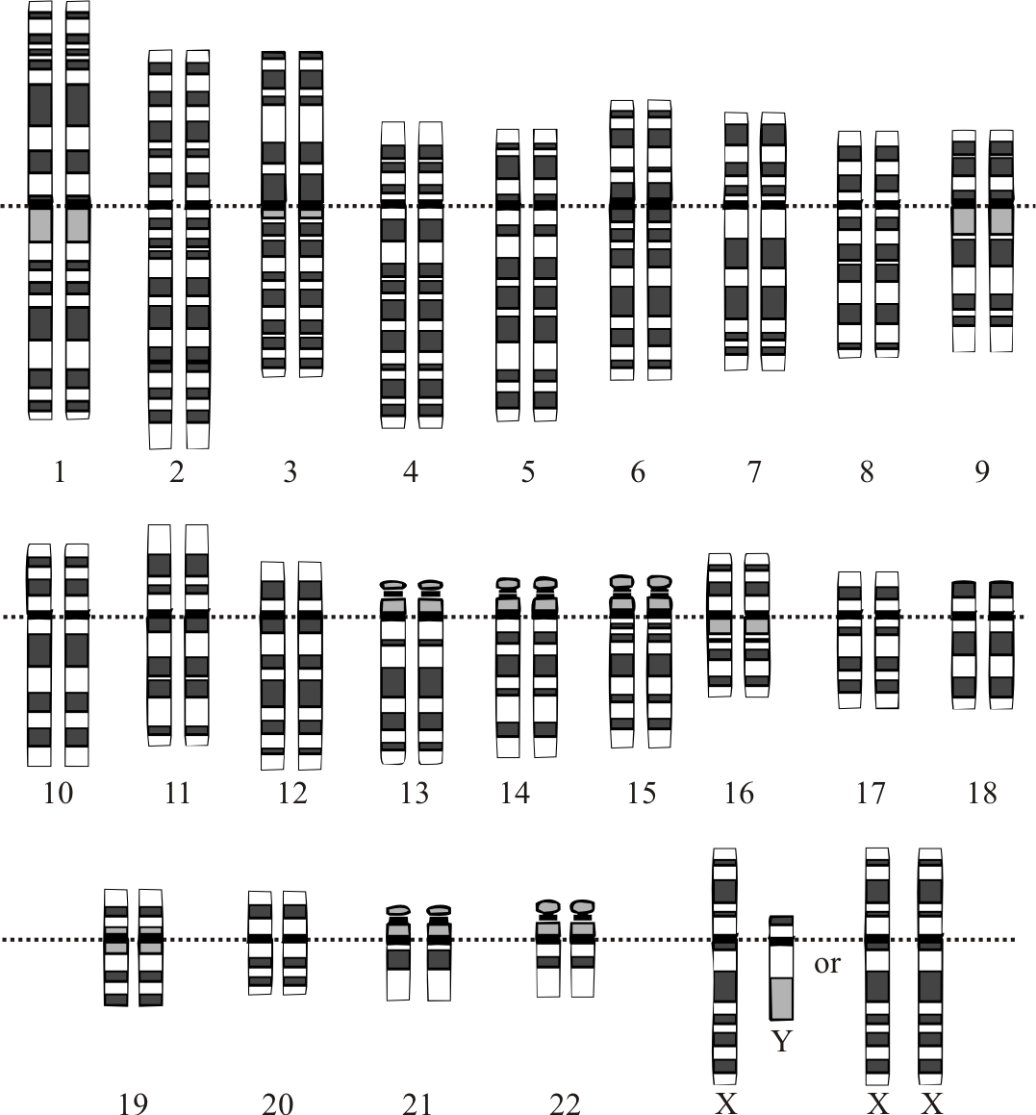
Human chromosomes (karyotype)

Slide 8
Our reference genome
All reference files were obtained from the 1000 genomes project
The GRCh38 build of the human genome is used
This is the latest version of the human reference
For the tutorial, two chromosomes are used (chr. 6 and chr. 17)
The reason for this is to reduce run time for the tutorial
Performing this analysis on the complete genome reference would require only minor modification of the commands
Would also require more storage, compute resources, and time

Slide 9
Reference genome assemblies/versions/builds
NOTE!: Probably ~50% of all bioinformatics results problems where something unexpected is happening involve genome coordinate build incompatibility
e.g. reads were aligned to build 37 but you are using transcript annotations based on build 38 coordinates
Learn to use ‘lift-over’ tools
https://www.biostars.org/p/65558/

Slide 10
1- versus 0-based coordinates
NOTE!: The other ~50% relate to 1 versus 0 based coordinates or conceptually similar data parsing issues
Learn the basics of these two coordinate systems that are both used ubiquitously in genomics
https://www.biostars.org/p/84686/

Slide 11
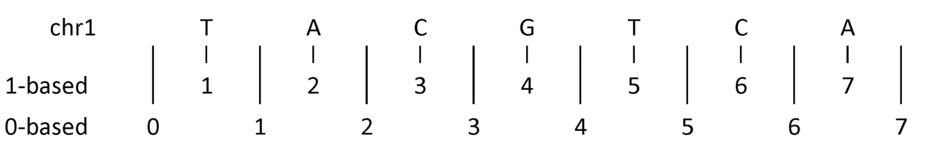
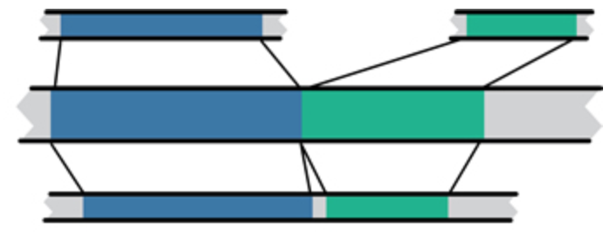
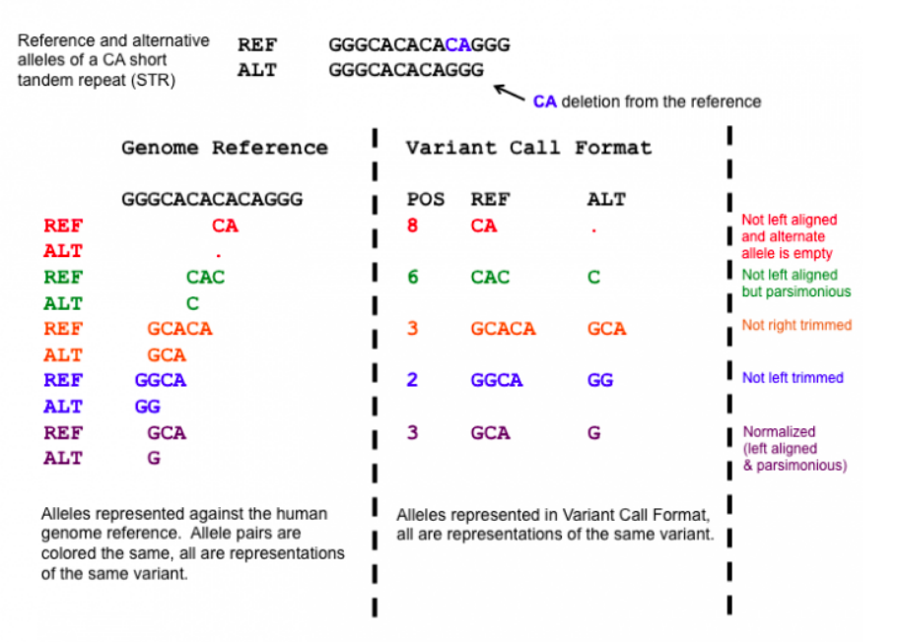
Common sources of confusion
Genomic coordinate systems
1-based vs. 0-based
Genome builds
And annotation builds
“Liftover” tools
Left-shifted vs right-shifted
Mouse mm10
Human hg19
Human GRCh37

Slide 12
0-based vs 1-based method to indicate a single nucleotide or variant
chr1 |  | T |  | A |  | C |  | G |  | T |  | C |  | A
1-based |  | 1 |  | 2 |  | 3 |  | 4 |  | 5 |  | 6 |  | 7
0-based | 0 |  | 1 |  | 2 |  | 3 |  | 4 |  | 5 |  | 6 |  | 7
 | 1-based | 0-based
Indicate a single nucleotide | chr1:4-4 G | chr1:3-4 G
Indicate a range of nucleotides | chr1:2-4 ACG | chr1:1-4 ACG
Indicate a single nucleotide variant | chr1:5-5 T/A | chr1:4-5 T/A
1-based coordinate system
Single nucleotides, variant positions, or ranges are specified directly by their corresponding nucleotide numbers
GFF, SAM, VCF, Ensembl browser, …
0-based coordinate system
Single nucleotides, variant positions, or ranges are specified by the coordinates that flank them
BED, BAM, UCSC browser, …

Slide 13
Common genomic data file formats
FASTA – sequences (DNA, RNA, protein)
FASTQ – raw sequence data (with qualities)
SAM/BAM/CRAM – aligned sequence data
GTF – gene/transcript annotations
BED – other genome features
VCF – variant calls (individual, multi-individual)
MAF – aggregated variant information (project, population)
Many, many custom data formats output by specialized tools … often in TSV format

Slide 14
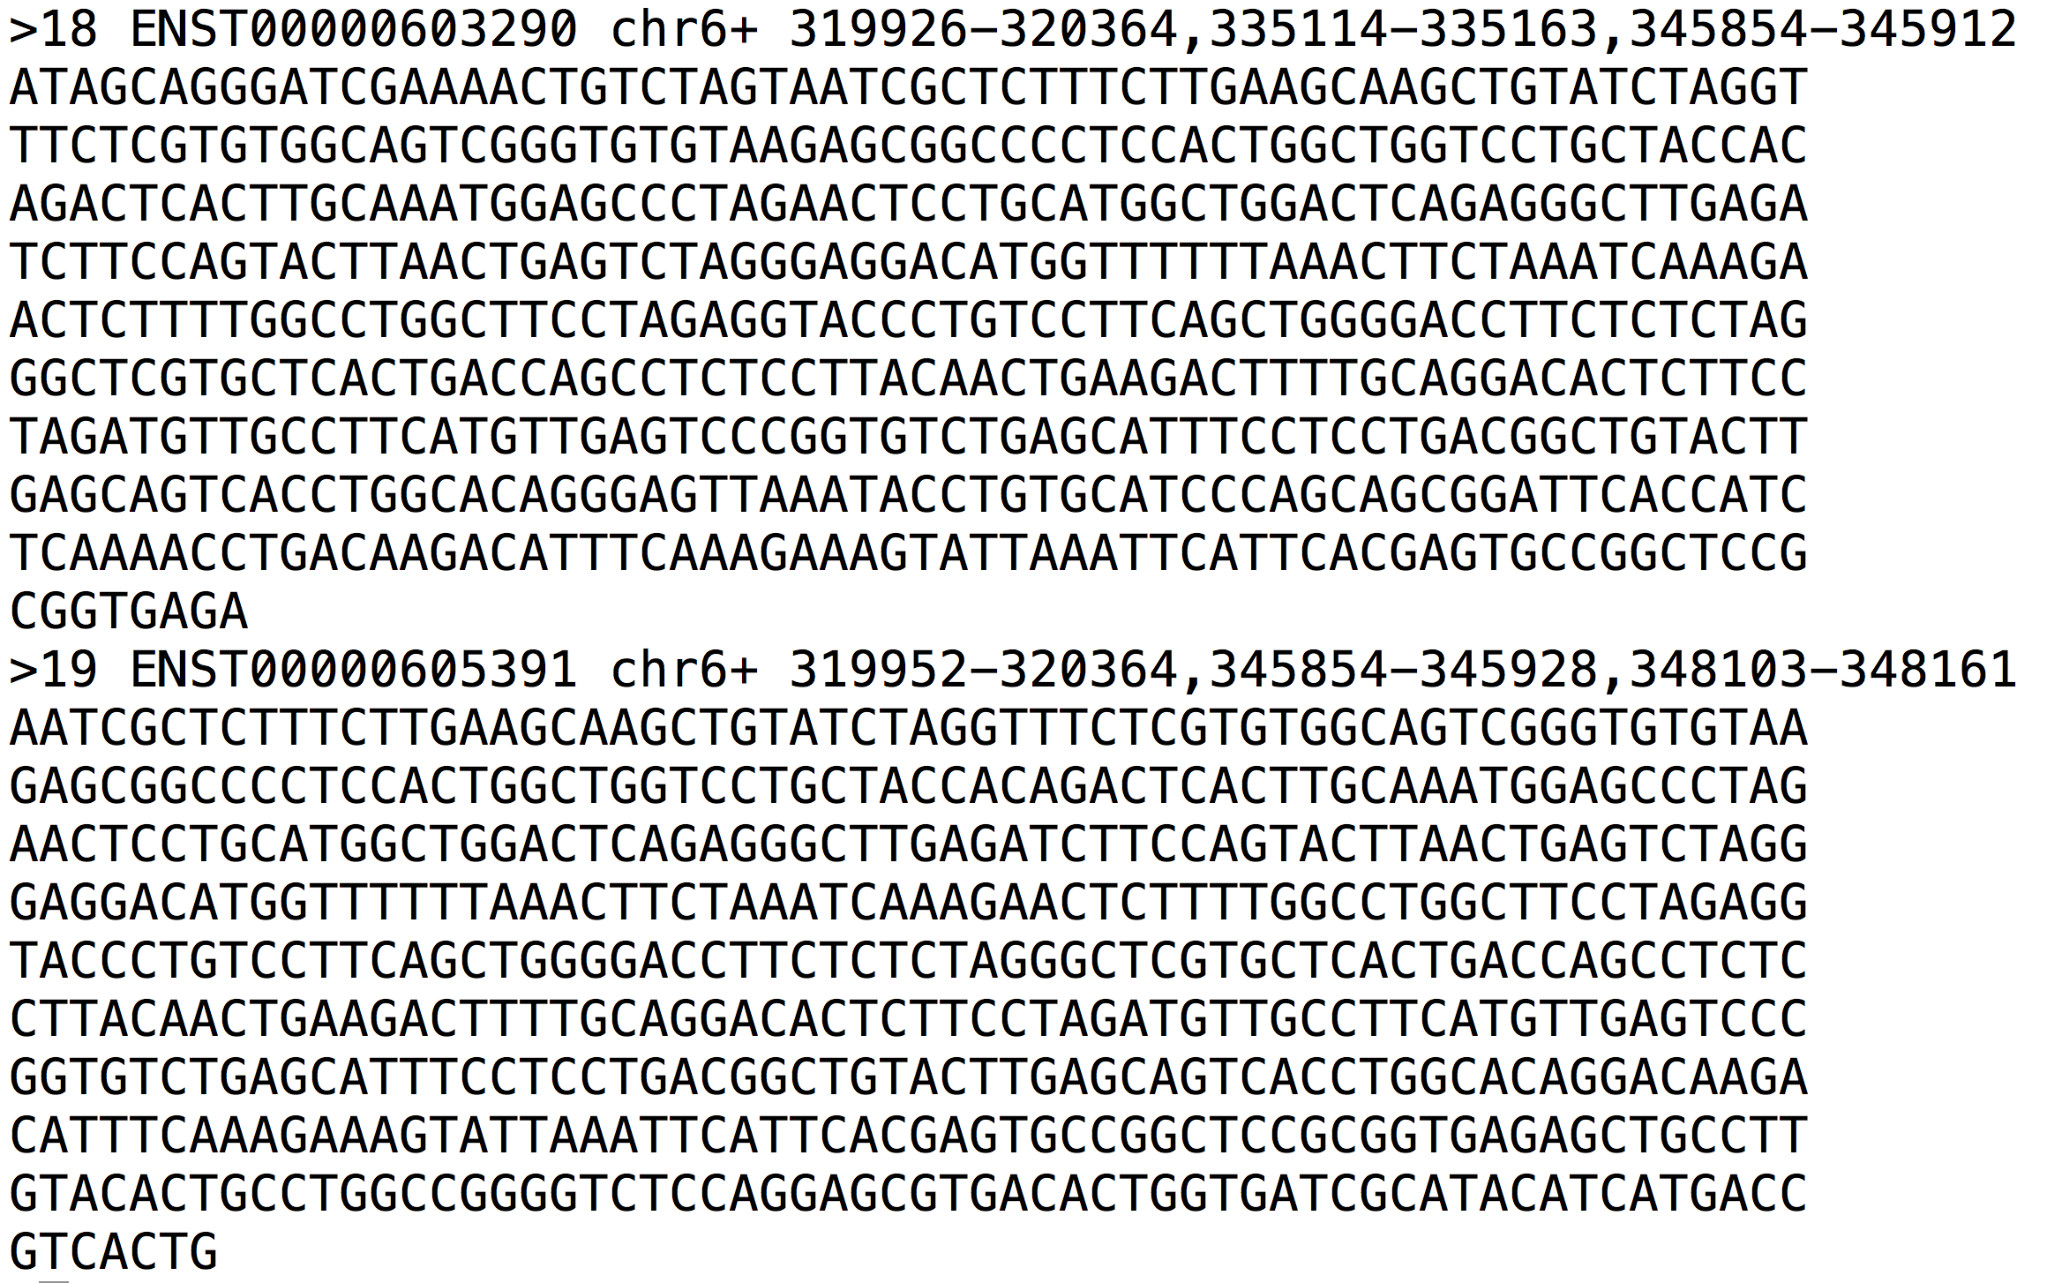
FASTA file format example

Slide 15
Raw data
For purposes of the tutorial, the test data has been pre-filtered
Identified reads that appear to match transcripts on the selected chromosomes
The test data corresponds to a single hypothetical human breast cancer patient (cell lines)
HCC1395 and HCC1395/BL
Genomic DNA and RNA were isolated
The RNA samples also included one of two ERCC RNA “spike-in” mixes (Mix1 or Mix2)
The input data is provided in ‘fastq’ format:
http://en.wikipedia.org/wiki/FASTQ_format

Slide 16
FASTQ file format example
Fastq files represent raw sequence – base calls and qualities
@HWI-ST718_146963544:6:1213:8996:10047/1
CTTTTTTATTTTTGTCTGACTGGGTTGATTCAAAA
+
CCCFFFFFHHHHGJHIIJHIHIIIFHIJJJJIJJGIBBFGE
@HWI-ST718_146963544:5:2303:11793:37095/1
ATGAATTATAGGGCTGTATTTTAATTTTGCATTTTAA
+
@@??BDDFFF<FHEGFFGGIEBGHIIIIIBEHIIGIH<FHE

Slide 17
Phred scores and ASCII glyphs
Phred Q | Probability (P) of Wrong Base | Base Call Accuracy | Sanger “Q + 33” Shift | Sanger “Q + 33” Shift ASCII glyph
0 | 1 | 0 | 33 | !
1 | 0.794 | 0.206 | 34 | “
2 | 0.631 | 0.369 | 35 | #
10 | 0.1 | 0.90 | 43 | +
20 | 0.01 | 0.99 | 53 | 5
30 | 0.001 | 0.999 | 63 | ?
Encoding History:
Sanger Format (shown above): Q of 0 to 93 using ASCII 33 to 126
Sanger data, SAM format, Illumina 1.8+
Solexa/Illumina 1.0: Q of -5 to 62 using ASCII 59 to 126
Illumina 1.3 to 1.8: Q of 0 to 62 using ASCII 64 to 126
Illumina 1.5 to 1.8: Phred scores 0 to 2 have a slightly different meaning
Notes:
http://www.somewhereville.com/2011/12/16/sanger-and-illumina-1-3-and-solexa-phred-score-q-ascii-glyph-base-error-conversion-tables/
https://en.wikipedia.org/wiki/FASTQ_format#Quality

Slide 18
Known transcript annotations
All annotation files are obtained from Ensembl
http://useast.ensembl.org/info/data/ftp/index.html
There are many other ways to obtain gene annotation files. For example:
UCSC Genome Browser, Ensembl API, BioMart, Entrez, Galaxy, etc. could also be used
You will download GTF files describing human transcripts (exon coordinates, gene ids, gene symbols, etc.)
Descriptions of the GTF file format can be found here:
http://genome.ucsc.edu/FAQ/FAQformat.html#format4

Slide 19
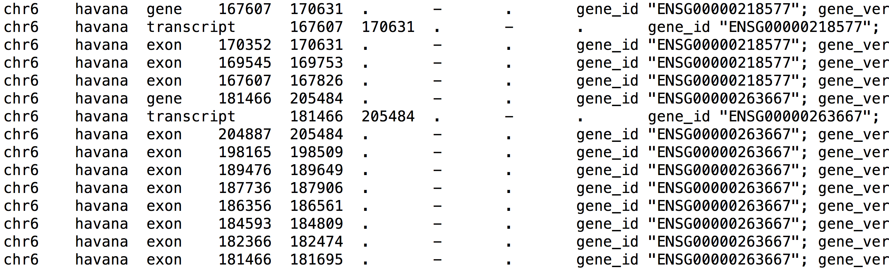
GTF file format example

Slide 20
Indexing reference genomes
Before sequences can be mapped to the genome, the reference genome files must be ‘indexed’ in a way that is compatible with the aligner being used
Each alignment algorithm generally requires a custom index to be built for that purpose
Do not use an index created for another aligner
In general we will encounter the concept of “indexing” many times throughout the course
Reference genomes (FASTA files), reference transcriptomes (GTF files), alignments (BAM files), variants (VCF files), etc.

Slide 21
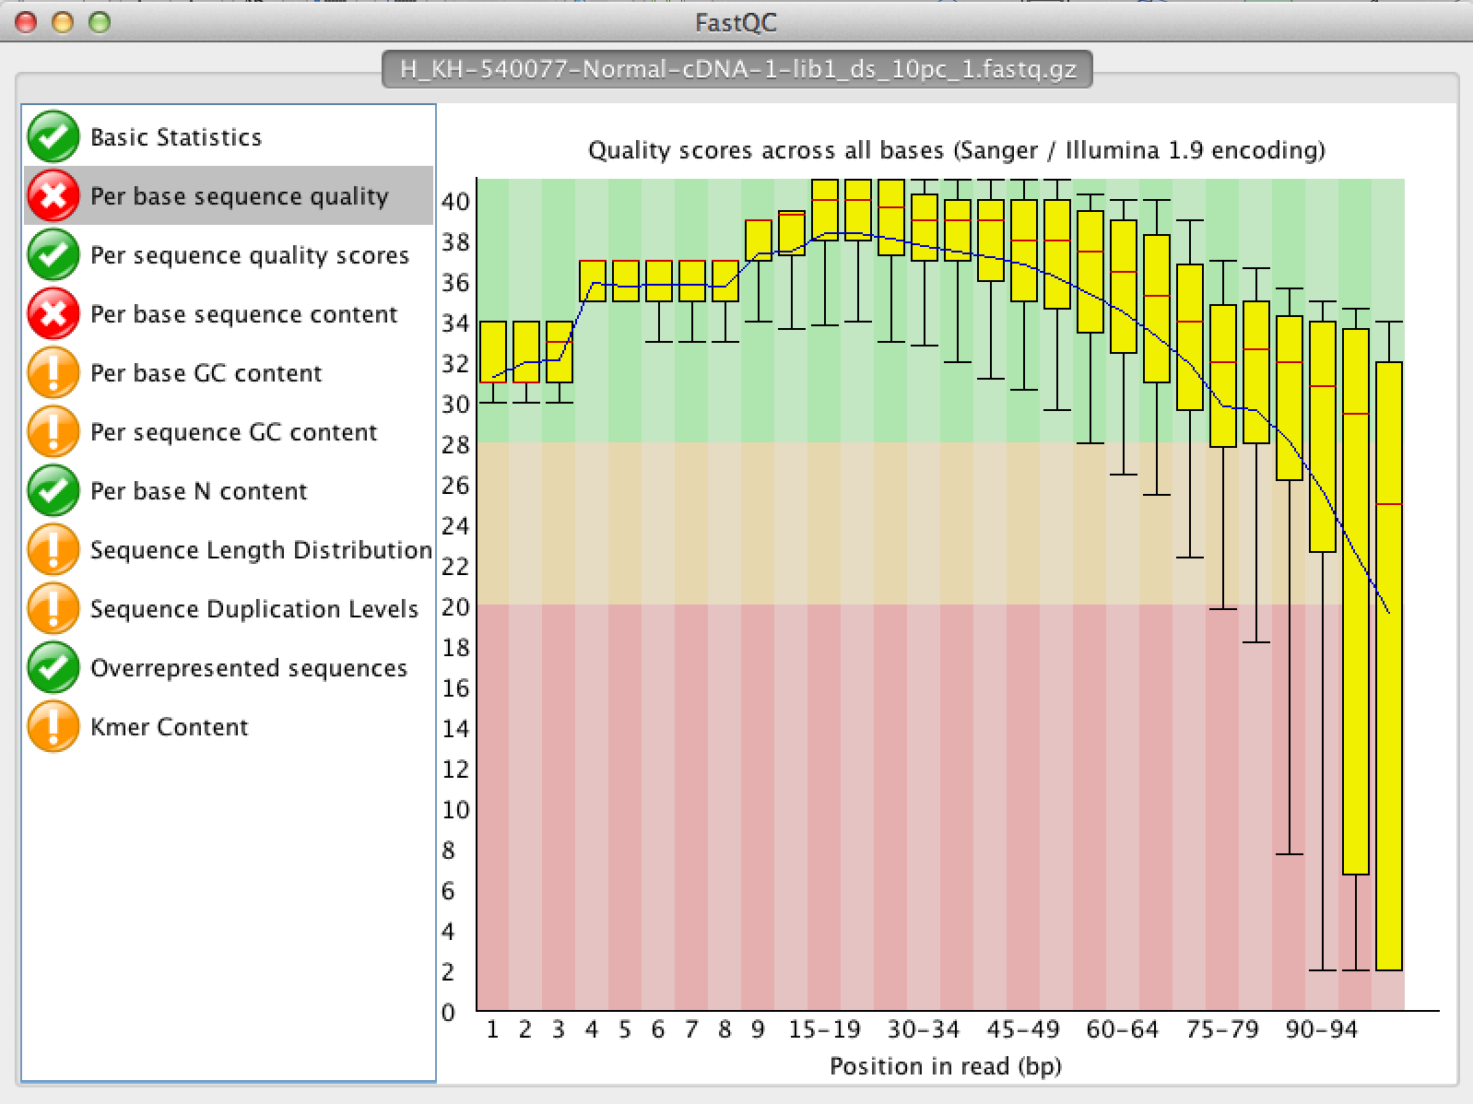
Pre-Alignment QC

