Slide 1

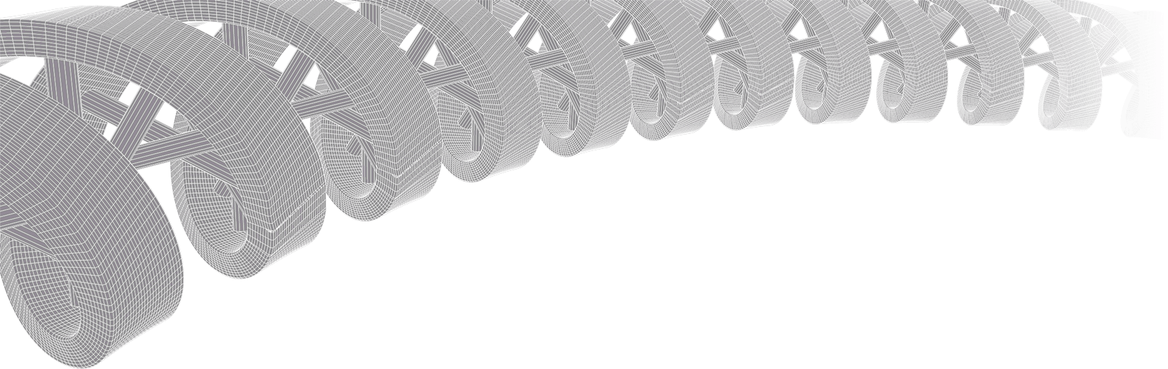

PMBIO Module 03 Align. Alignment algorithms, visualization, and QC
Malachi Griffith, Obi Griffith, Zachary Skidmore, Huiming Xia
Introduction to bioinformatics for DNA and RNA sequence analysis (IBDR01)
29 October – 2 November, 2018
Glasgow

Slide 2
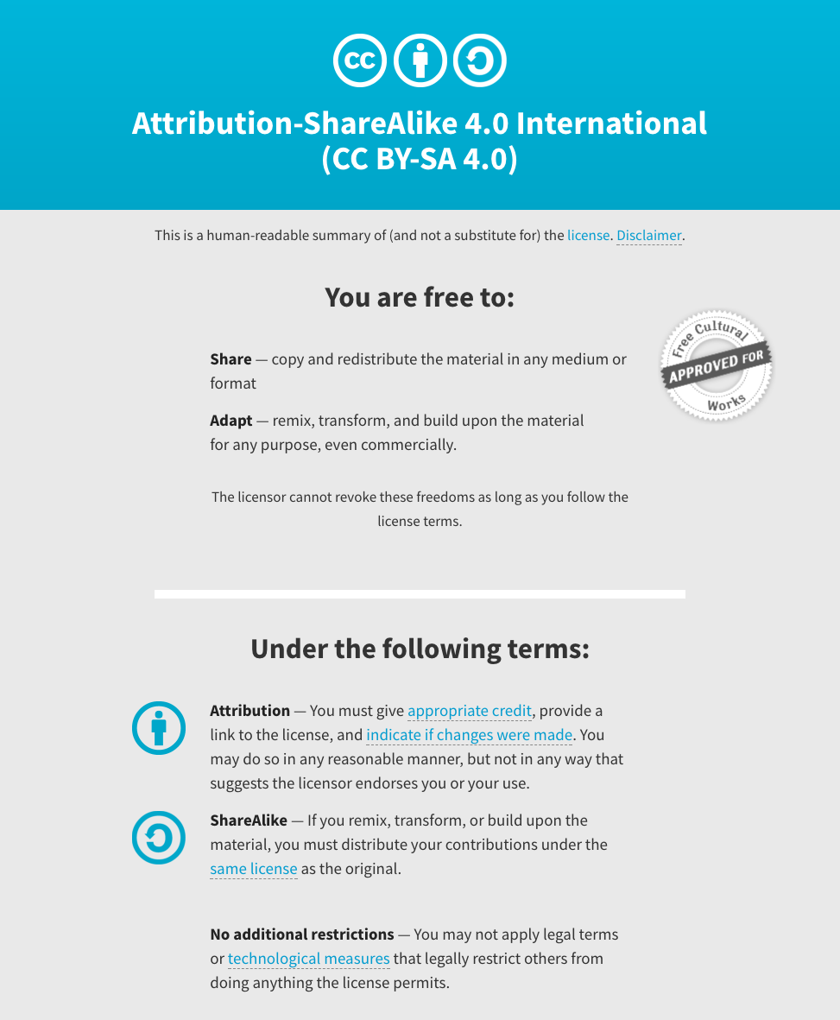
Notes:
Note there are two licenses if effect for this course.
All *content* (lectures, written materials, etc.) are made available under the Creative Commons Attribution-ShareAlike 4.0 International (CC BY-SA 4.0). (https://creativecommons.org/licenses/by-sa/4.0/).
All *code* (R scripts the website code itself) are made available under the MIT License (https://opensource.org/licenses/MIT).

Slide 3
Learning objectives of module 03: Align
Key concepts: Sequence alignment algorithms, BAM files, genome viewers, alignment quality assessment
Compare and contrast DNA vs. RNA sequence alignment strategies
Perform alignment of sequence data using a few popular alignment algorithms
Explore the BAM file format and learn approaches for summarizing, filtering, and otherwise manipulating BAM files
Learn to use a genome viewer
Perform a quality assessment using the aligned data

Slide 4
Alignment algorithms…

Slide 5
SAM/BAM/CRAM files represent sequence alignments
The specification
http://samtools.sourceforge.net/SAM1.pdf
The SAM format consists of two sections:
Header section
Used to describe source of data, reference sequence, method of alignment, etc.
Alignment section
Used to describe the read, quality of the read, and nature alignment of the read to a region of the genome
BAM/CRAM are compressed versions of SAM.
BAM compressed using lossless BGZF format
CRAM compressed further using knowledge of reference. May or may not be lossless
BAM/CRAM files are usually ‘indexed’
A ‘.bai’ file will be found beside the ‘.bam’ file
Indexing aims to achieve fast retrieval of alignments

Slide 6
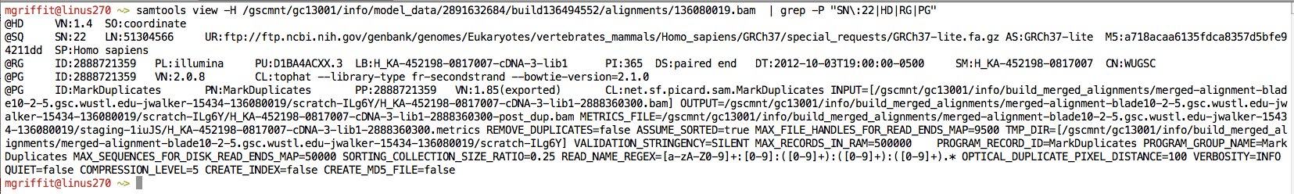
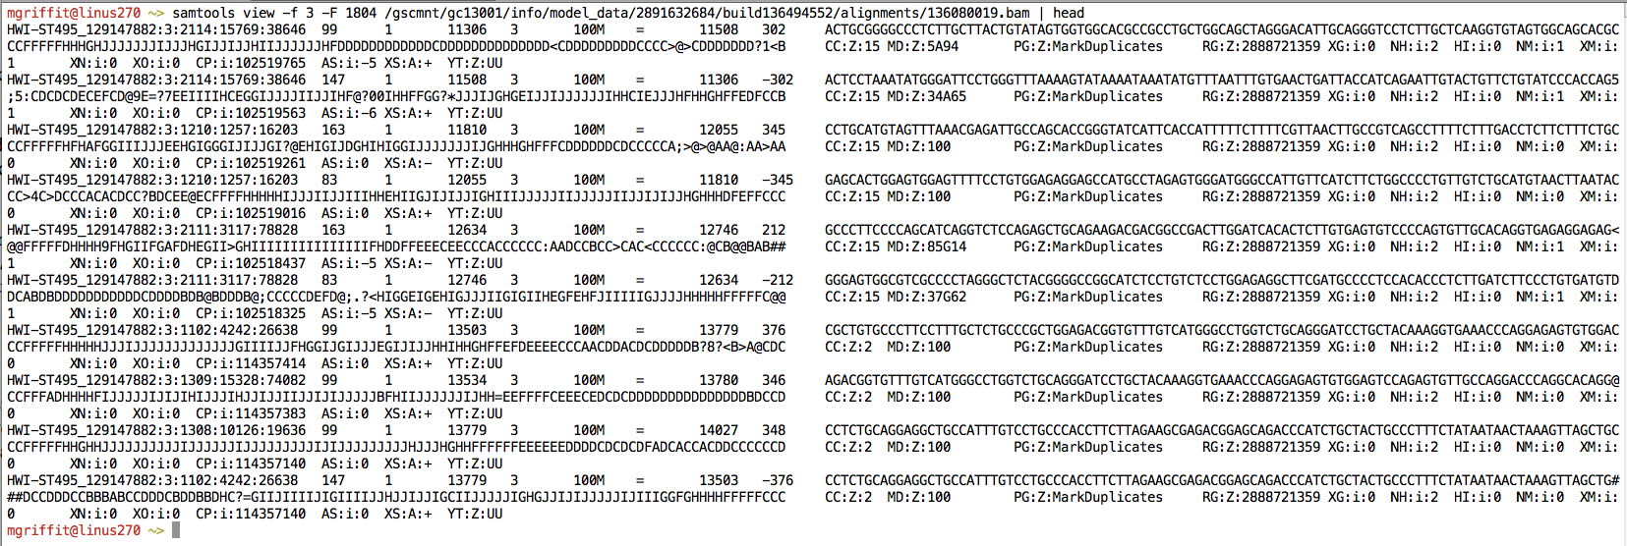
A BAM file is divided in header and alignment sections
Example SAM/BAM header section (abbreviated)
Example SAM/BAM alignment section (only 10 alignments shown)

Slide 7
BAM header section provides general information about alignment strategy
Used to describe source of data, reference sequence, method of alignment, etc.
Each section begins with character ‘@’ followed by a two-letter record type code. These are followed by two-letter tags and values
@HD The header line
VN: format version
SO: Sorting order of alignments
@SQ Reference sequence dictionary
SN: reference sequence name
LN: reference sequence length
SP: species
@RG Read group
ID: read group identifier
CN: name of sequencing center
SM: sample name
@PG Program
PN: program name
VN: program version

Slide 8
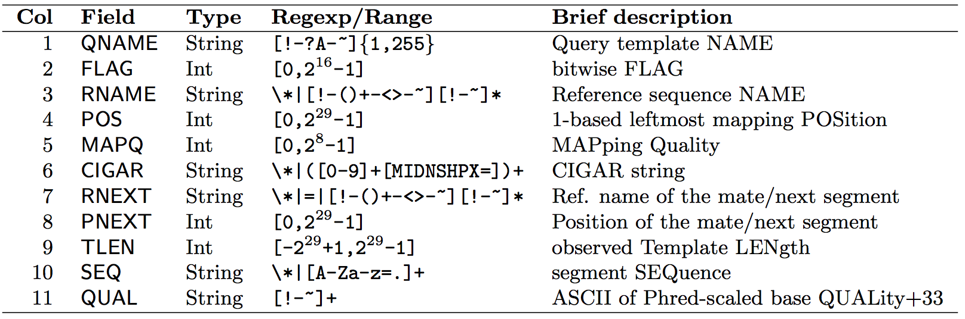
BAM alignment section provides details for each read alignment
QNAME e.g. HWI-ST495_129147882:1:2302:10269:12362 (QNAME)
FLAG e.g. 99
RNAME e.g. 1
POS e.g. 11623
MAPQ e.g. 3
CIGAR e.g. 100M
RNEXT e.g. =
PNEXT e.g. 11740
TLEN e.g. 217
SEQ e.g. CCTGTTTCTCCACAAAGTGTTTACTTTTGGATTTTTGCCAGTCTAACAGGTGAAGCCCTGGAGATTCTTATTAGTGATTTGGGCTGGGGCCTGGCCATGT
QUAL e.g. CCCFFFFFHHHHHJJIJFIJJJJJJJJJJJHIJJJJJJJIJJJJJGGHIJHIJJJJJJJJJGHGGIJJJJJJIJEEHHHHFFFFCDCDDDDDDDB@ACDD

Slide 9
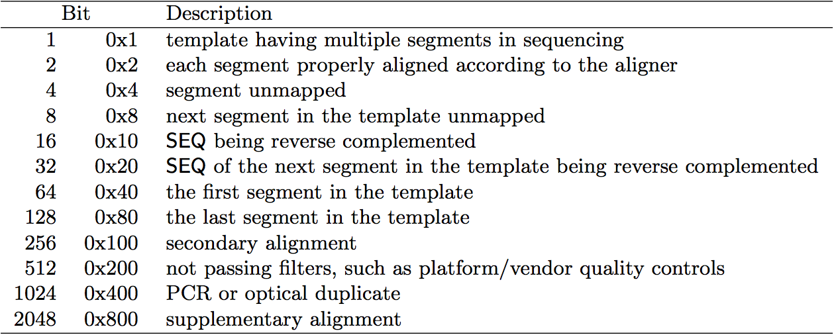
BAM flags describe several alignment properties in a single number
http://broadinstitute.github.io/picard/explain-flags.html
12 bitwise flags describing the alignment
These flags are stored as a binary string of length 11 instead of 11 columns of data
Value of ‘1’ indicates the flag is set. e.g. 00100000000
All combinations can be represented as a number from 1 to 2048 (i.e. 2¹¹-1). This number is used in the BAM/SAM file. You can specify ‘required’ or ‘filter’ flags in samtools view using the ‘-f’ and ‘-F’ options respectively
Note that to maximize confusion, each bit is described in the SAM specification using its hexadecimal representation (i.e., '0x10' = 16 and '0x40' = 64).

Slide 10
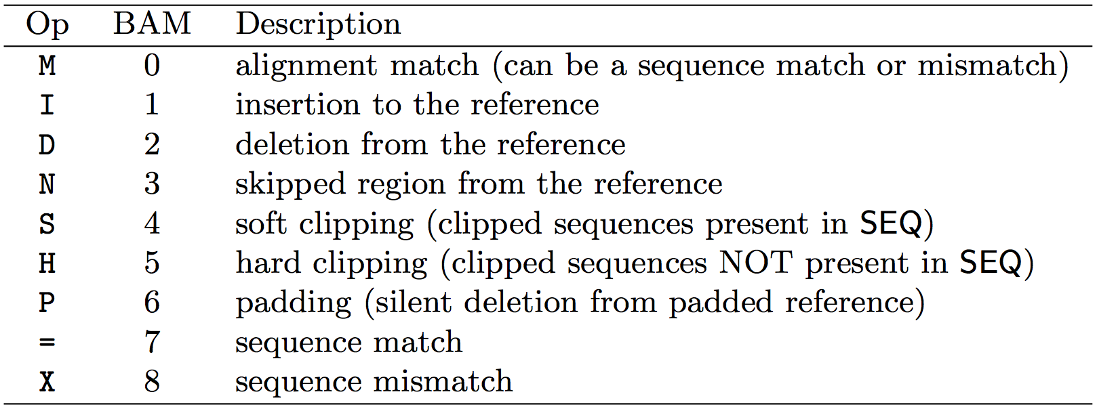
CIGAR strings similarly describe the entire alignment in as few characters as possible
The CIGAR string is a sequence of base lengths and associated ‘operations’ that are used to indicate which bases align to the reference (either a match or mismatch), are deleted, are inserted, represent introns, etc.
e.g. 81M859N19M
A 100 bp read consists of: 81 bases of alignment to reference, 859 bases skipped (an intron), 19 bases of alignment

Slide 11
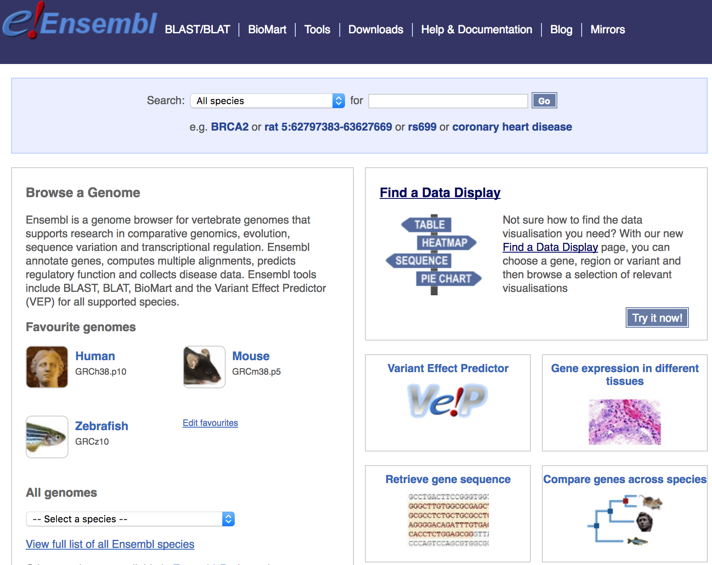
Genome browsers - Ensembl

Slide 12
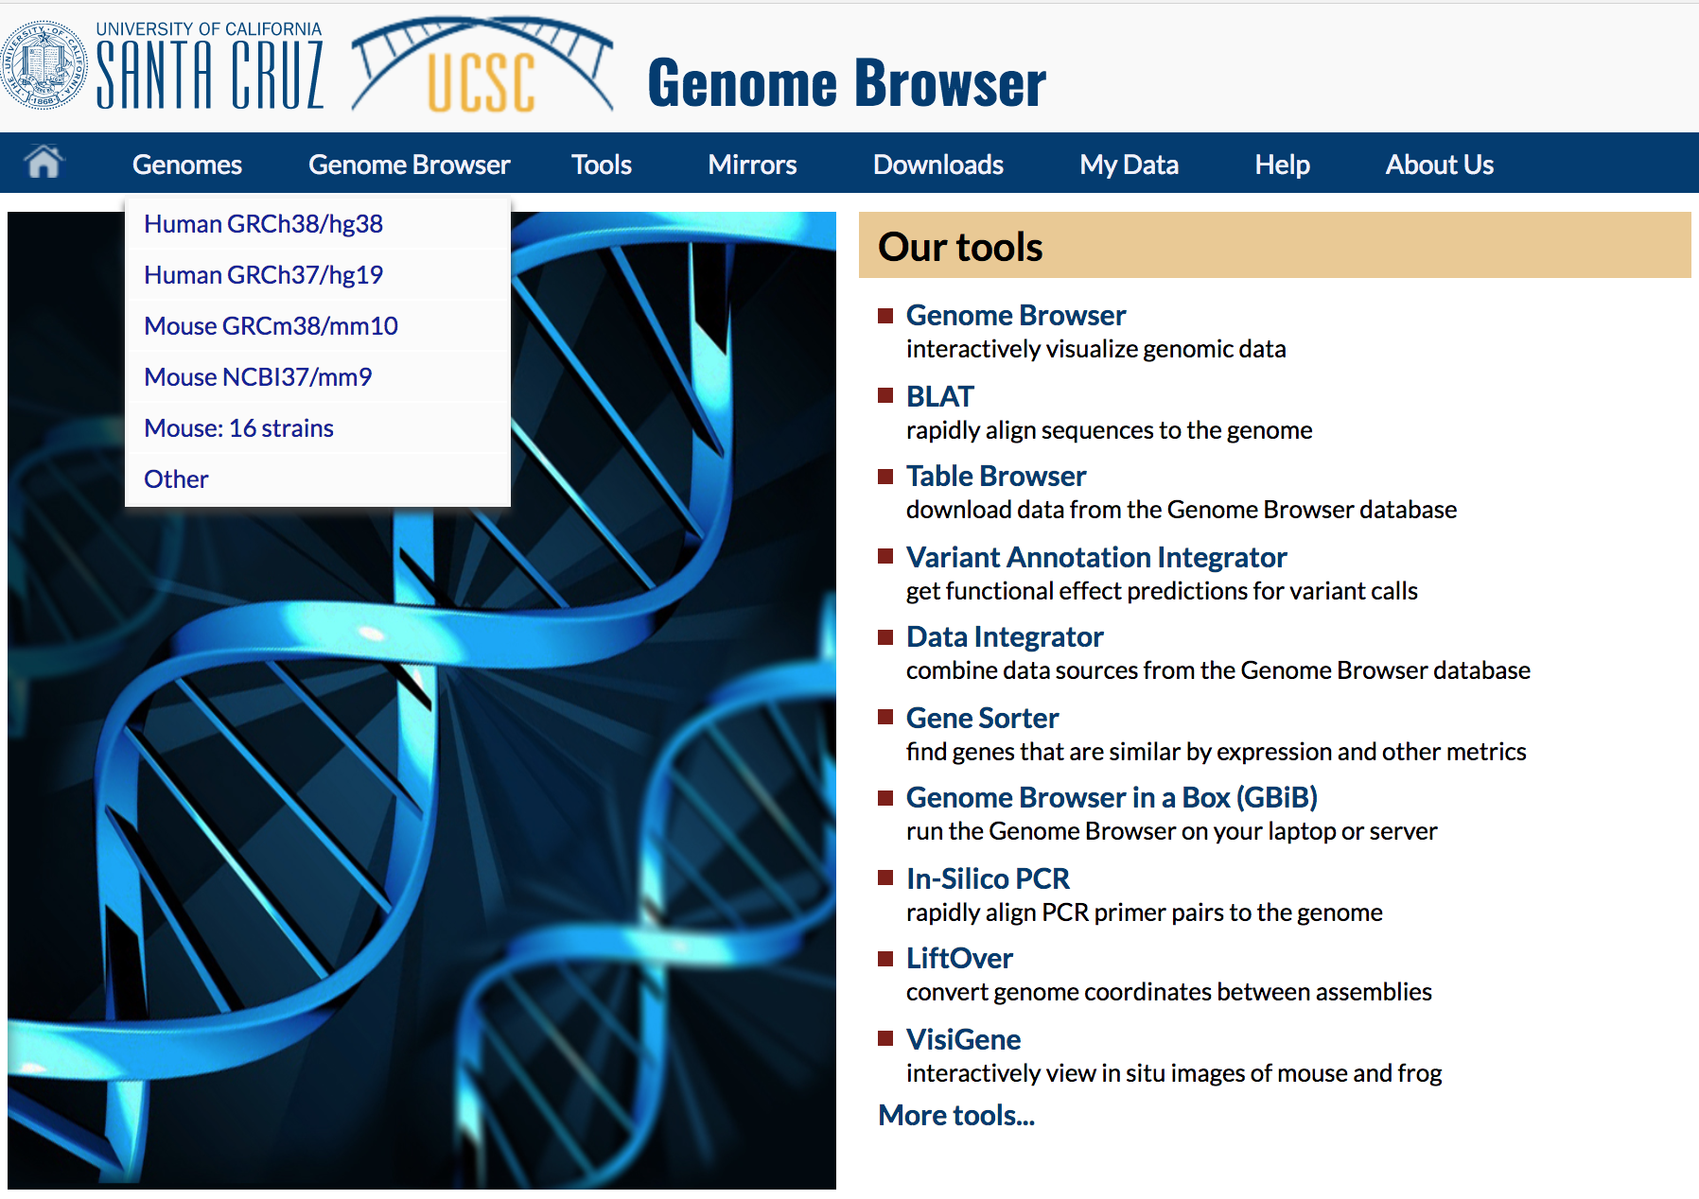
Genome browsers - UCSC

Slide 13
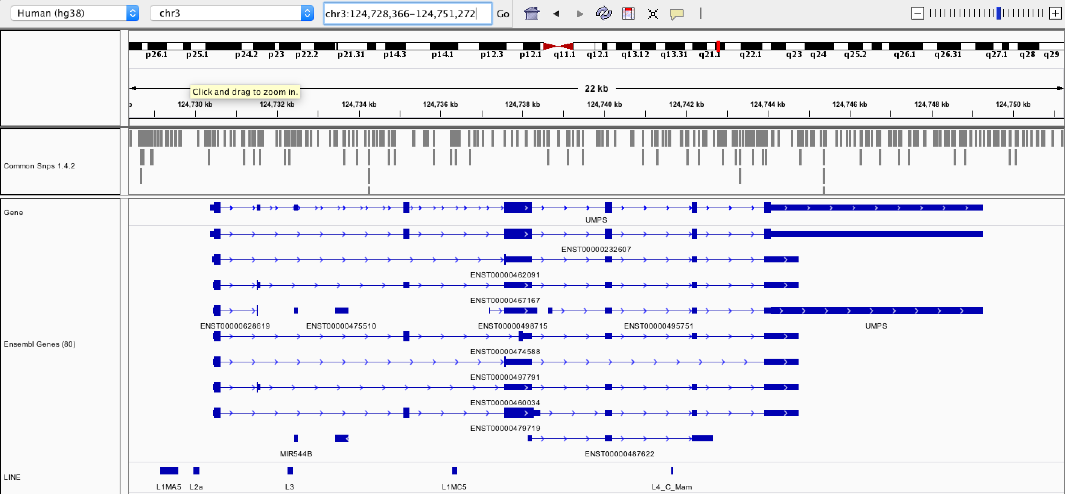
Genome browsers - IGV

Slide 14
Alignment QC …

