Slide 1
COMPUTER VISION Digit Recognizer

Slide 2
TABLE OF CONTENTS
01
目的
02
資料來源
03
資料說明

Slide 3
01
目的

Slide 4

9
Goal
The goal in this competition is to take an image of a handwritten single digit, and determine what that digit is. For every in the test set, you should predict the correct label.

Slide 5
02
資料來源

Slide 6
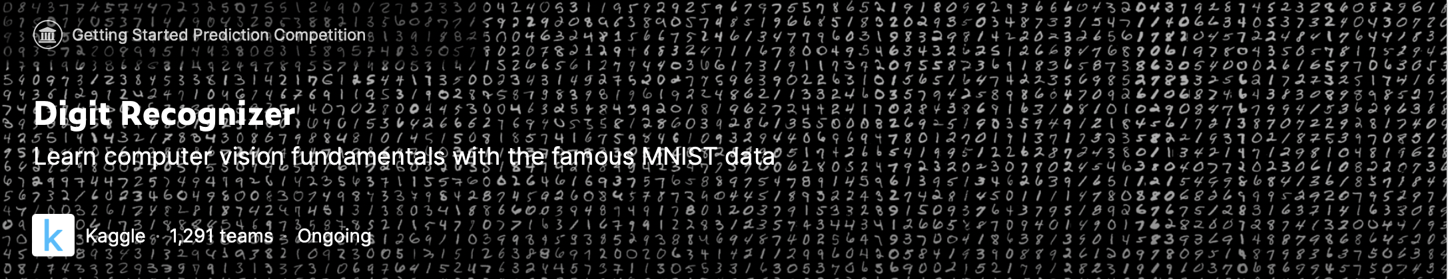
Kaggle
https://www.kaggle.com/competitions/digit-recognizer

Slide 7
Recognizing Handwritten Digits with CNN
Loading the Data Set
Normalization, Reshape and Label Encoding
Train Test Split
Convolution Neural Network
Convolution
Max Pooling
Dropout
Full Connection
Implement with Keras
Create Model
Define Optimizer
Compile Model
Epochs and Batch Size
Data Augmentation
Fit the Model
Evaluate the model
https://www.kaggle.com/code/turhancankargin/recognizing-handwritten-digits-with-cnn

Slide 8
03
資料說明
train.csv, test.csv, sample_submission.csv

Slide 9
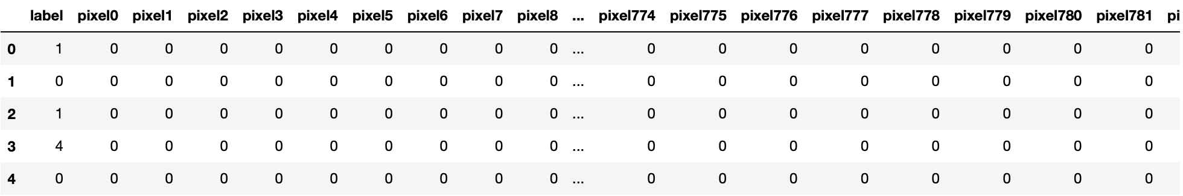
train.csv
shape = (42000, 785)
42000筆資料, 784(28 * 28)pixels + label
Range: (1) pixel: 0~255
(2) label: 0~9

Slide 10
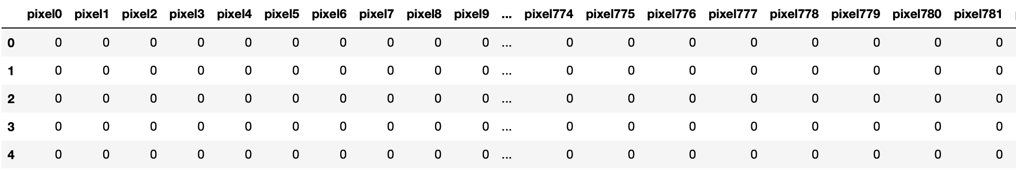
test.csv
shape = (28000, 784)
28000筆資料, 784(28 * 28)pixels
Range: (1) pixel: 0~255

Slide 11
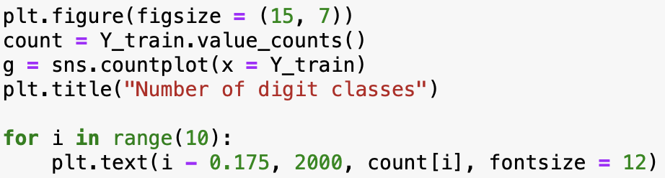
Data distribution

Slide 12
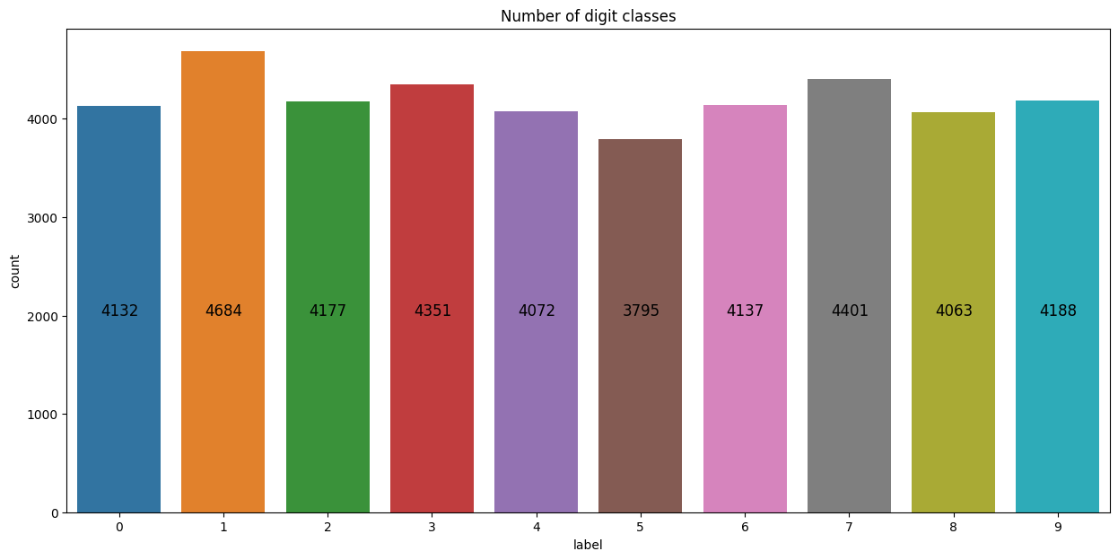
Data distribution

Slide 13
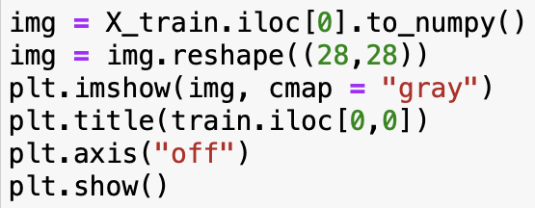
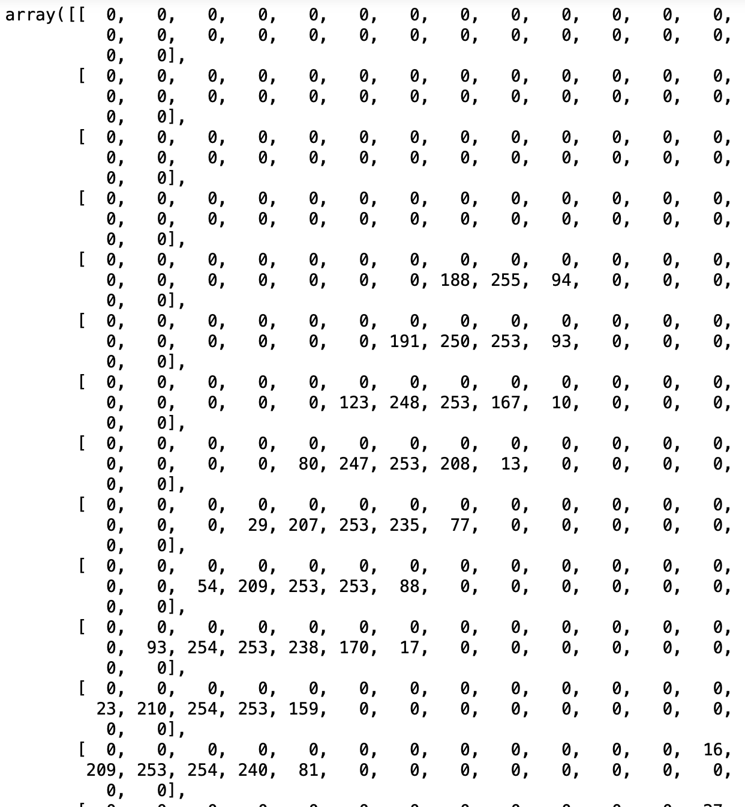
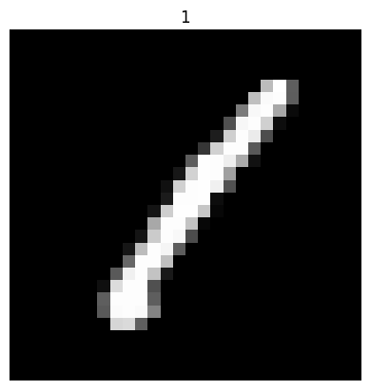
Display the data

Slide 14
Different from MNIST
MNIST
Kaggle
(1) Distribution
Training set: 60000筆資料
Testing set: 10000筆資料
(2) Data type
Image: jpg/png, numpy.ndarray
(1) Distribution
Training set: 42000筆資料
Testing set: 28000筆資料
(2) Data type
pandas dataframe -> numpy.ndarray -> pandas Series

Slide 15
THANKS!

