Slide 1
Computer Vision: Sudoku Solver

Slide 2
Table of contents
01
簡介
02
資料來源
03
預期目標
04
目前進度

Slide 3
01
簡介

Slide 4
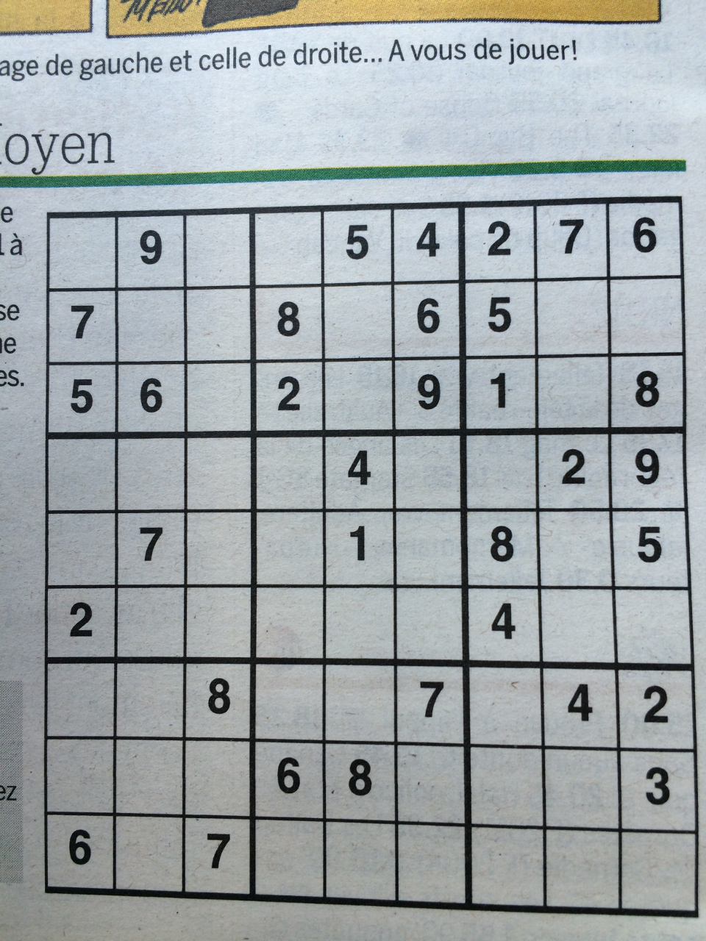
Sudoku
8 | 9 | 3 | 1 | 5 | 4 | 2 | 7 | 6
7 | 2 | 1 | 8 | 3 | 6 | 5 | 9 | 4
5 | 6 | 4 | 2 | 7 | 9 | 1 | 3 | 8
1 | 8 | 6 | 7 | 4 | 5 | 3 | 2 | 9
4 | 7 | 9 | 3 | 1 | 2 | 8 | 6 | 5
2 | 3 | 5 | 9 | 6 | 8 | 4 | 1 | 2
3 | 1 | 8 | 5 | 9 | 7 | 6 | 4 | 2
9 | 4 | 2 | 6 | 8 | 1 | 7 | 5 | 3
6 | 5 | 7 | 4 | 2 | 3 | 9 | 8 | 1

Slide 5
02
資料來源

Slide 6
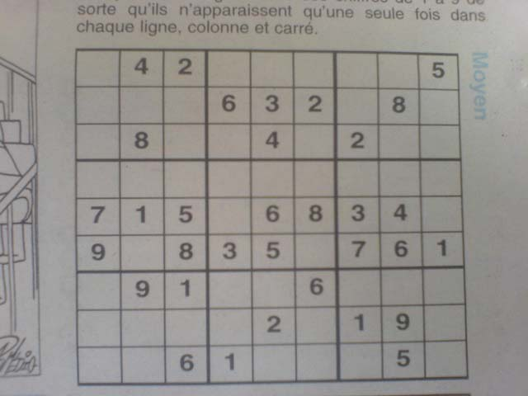
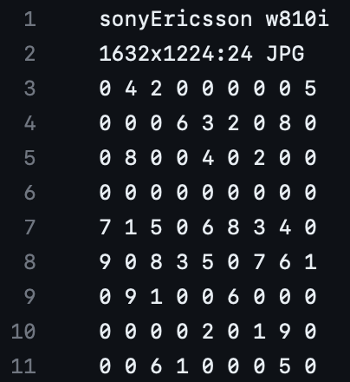
Data
203 jpg檔、203 dat檔
https://github.com/wichtounet/sudoku_dataset/tree/master/images

Slide 7
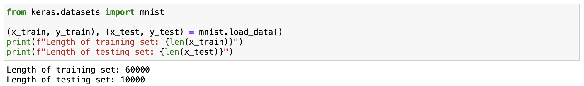
Training Data

Slide 8
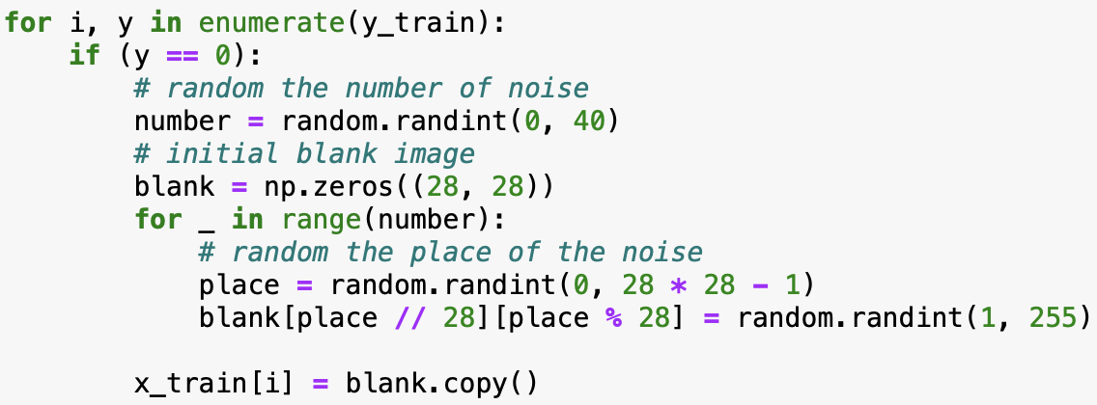
Training Data

Slide 9
03
規劃作法

Slide 10
Step 1: Extract

Slide 11
Step 2: Computer Vision
 | 9 |  |  | 5 | 4 | 2 | 7 | 6
7 |  |  | 8 |  | 6 | 5
5 | 6 |  | 2 |  | 9 | 1 |  | 8
 |  |  |  | 4 |  |  | 2 | 9
 | 7 |  |  | 1 |  | 8 |  | 5
2 |  |  |  |  |  | 4
 |  | 8 |  |  | 7 |  | 4 | 2
 |  |  | 6 | 8 |  |  |  | 3
6 |  | 7

Slide 12
Step 3: Algorithm
 | 9 |  |  | 5 | 4 | 2 | 7 | 6
7 |  |  | 8 |  | 6 | 5
5 | 6 |  | 2 |  | 9 | 1 |  | 8
 |  |  |  | 4 |  |  | 2 | 9
 | 7 |  |  | 1 |  | 8 |  | 5
2 |  |  |  |  |  | 4
 |  | 8 |  |  | 7 |  | 4 | 2
 |  |  | 6 | 8 |  |  |  | 3
6 |  | 7
8 | 9 | 3 | 1 | 5 | 4 | 2 | 7 | 6
7 | 2 | 1 | 8 | 3 | 6 | 5 | 9 | 4
5 | 6 | 4 | 2 | 7 | 9 | 1 | 3 | 8
1 | 8 | 6 | 7 | 4 | 5 | 3 | 2 | 9
4 | 7 | 9 | 3 | 1 | 2 | 8 | 6 | 5
2 | 3 | 5 | 9 | 6 | 8 | 4 | 1 | 2
3 | 1 | 8 | 5 | 9 | 7 | 6 | 4 | 2
9 | 4 | 2 | 6 | 8 | 1 | 7 | 5 | 3
6 | 5 | 7 | 4 | 2 | 3 | 9 | 8 | 1

Slide 13
04
目前進度

Slide 14
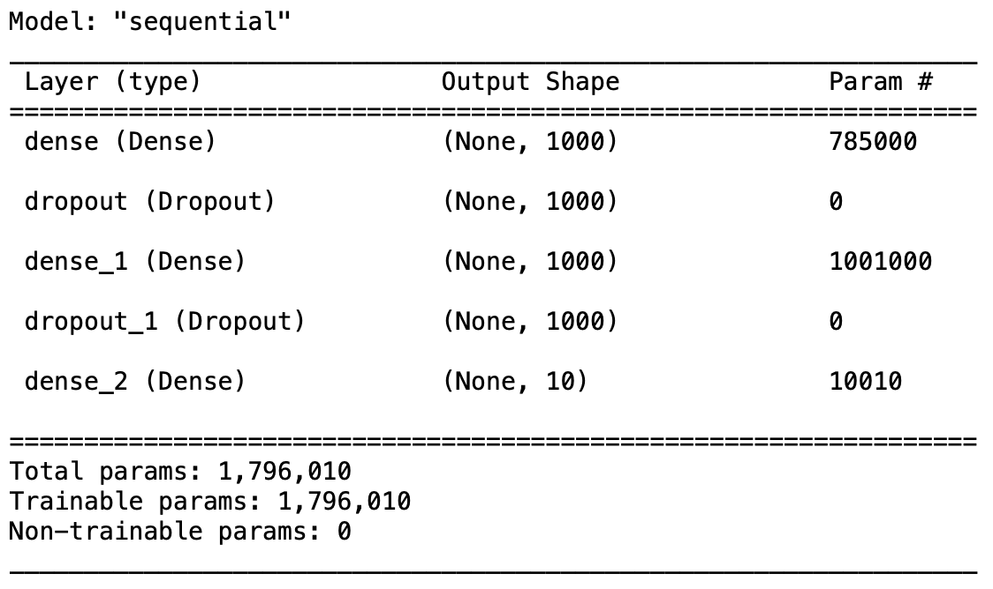
Model Summary

Slide 15
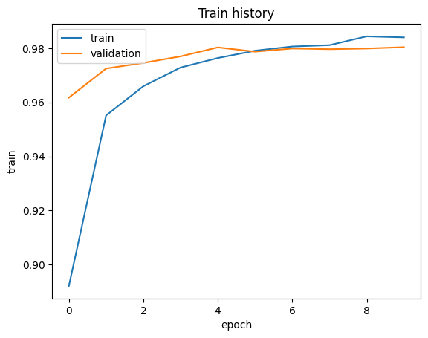
Model Training
Validation split: 0.2, epoch: 10
Accuracy: 0.983

Slide 16
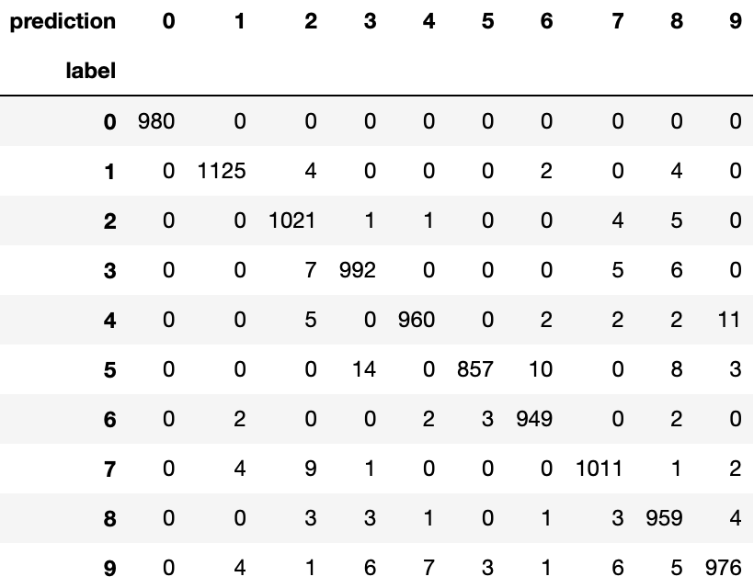
Confusion matrix

Slide 17
Thanks!

