Slide 1

SPEAKER RECOGNITION
?

Slide 2
Problem Statement
Aiming at building an automatic text-independent speaker recognition system.
I have used the Chain Speech Corpus for the project.
The corpus has 36 speakers ( 16 females, 20 males).
Each speaker provided recording in three speaking styles : Solo, Whispering, Fast.
Each speaker has 39 speech samples (avg length: 1 min) in each speaking style.
Aim to design a system such that any speaker in corpus can be recognized when provided with his speech sample in any of the three speaking styles with good accuracy.

Slide 3
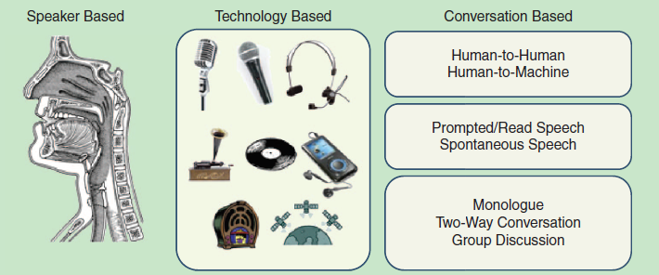
CHALLENGES

Slide 4
BLOCK DIAGRAM
FEATURE EXTRACTION
MODELING
Training Speech
{S₁,S₂,….S_{M}}
FEATURE EXTRACTION
MATCHING
Speaker Identified
Testing Speech
S?
S_{k}

Slide 5
FEATURE EXTRACTION
Speech sounds are the product of an air stream passed through the glottis, producing resonances in the vocal tract and nasal cavities.
To produce different sounds, the vocal tract moves into different configurations that change its resonance structure. Following figure shows how vocal-tract configurations produce different spectra for two steady state vowel sounds.
Note that for any particular sound, the relative location of the formants within each speaker's spectrum is similar, since the same sound is being produced.
By comparing the speaker's spectra, however, we see that corresponding formants occur at different frequencies and with different intensities-a direct result of the different vocal-tract structures.
Most automatic speaker-recognition systems rely upon these spectral differences to discriminate speakers.

Slide 6
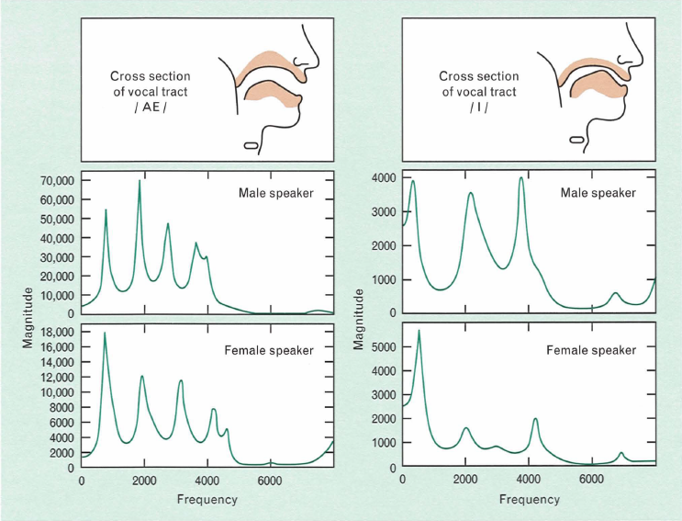

Slide 7
FEATURE EXTRACTION
A signal coming out from a system is due to the input excitation and also the response of the system. Similarly speech signal is composed of excitation source and vocal tract system components.
Vocal tract structure is a predominant physiological factor that distinguishes one person’s voice from others. So, for speaker recognition we would like to extract the vocal tract system components from the speech signals.
The objective of cepstral analysis is to separate the speech into its source and system components without any a priori knowledge about source or system.

Slide 8

CEPSTRAL ANALYSIS: Theory
If e(n) is the excitation sequence and h(n) is the vocal tract filter sequence, then the speech sequence s(n) can be expressed as follows:
The speech sequence has to be de-convolved into the excitation and vocal tract components in the time domain. For this, multiplication of the two components in the frequency domain has to be converted to a linear combination of the two components.
IDFT of log spectra transforms to quefrency domain. In the quefrency domain the vocal tract components are represented by the slowly varying components concentrated near the lower quefrency region and excitation components are represented by the fast varying components at the higher quefrency region.
Fourier Transform
Log

Slide 9
CEPSTRAL ANALYSIS: Block Diagram
DFT
X[k]
log
C[k]
IDFT
x[n]
c[n]
Time Domain
Quefrency Domain

Slide 10



Linear Prediction Cepstral Coefficients
For calculating the cepstrum, we can also use the periodogram based estimate of Power Spectrum which is DFT squared. This would just give a scaling factor of 2.
So now as we can use the power spectrum for cepstral analysis, we can also use the Auto Regressive Power Spectrum estimate for cepstrum evaluation.
According to AR model:
The error is assumed to be zero mean White Noise.
Fourier Transform

Slide 11



Linear Prediction Cepstral Coefficients
e[n]
s[n]
|S(z)|² = $\frac{\text{σ}\text{2}}{|1+\sum_{k=1}^{P}{akz_k|2}}$

Slide 12

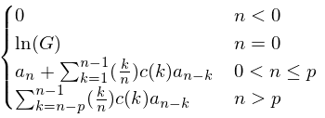
Linear Prediction Cepstral Coefficients
There is a computationally less intensive procedure to find the LPCC from LPC.
I have used LPCC coefficients from m = 1 to m = 15.
c(m) =
where
h(n) =

Slide 13

Mel-Frequency Cepstral Coefficients
The procedure to find the MFCC involves the following steps:
Preemphasis: Boost the amount of energy in the high frequencies. Energy in the high frequencies is low in general. Preemphasis makes information from these higher frequencies more available to the acoustic model. (alpha = 0.97)
Framing and Windowing: We divide the speech signal into frames with a certain overlap. Then Hamming Window is applied to these frames ,which shrinks the values of the signal toward zero at the window boundaries, avoiding discontinuities. (f_size = 10ms, f_ovlp = 4ms, fs=44100Hz)

Slide 14


Mel-Frequency Cepstral Coefficients
Finding the Periodogram- based Power Spectrum estimate.
Human ears cannot discern the difference between two closely spaced frequencies. This effect becomes more pronounced as the frequencies increase. Modeling this property of human hearing during feature extraction improves the performance. This is performed by our Mel filterbank: the first filter is very narrow and gives an indication of how much energy exists near 0 Hertz. As the frequencies get higher our filters get wider as we become less concerned about variations. (f_min = 0, f_max = Fs/2, mel_n = 40)

Slide 15
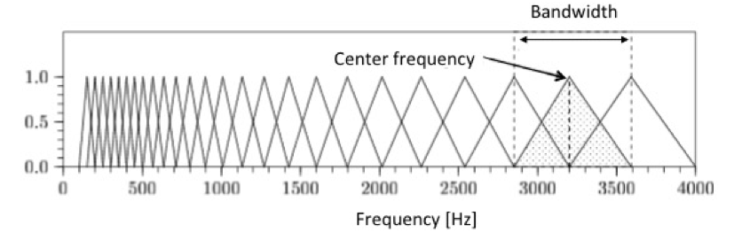
Mel-Frequency Cepstral Coefficients
Now we pass the power spectrum of each frame through these mel filter banks. We get 40 filter bank energies, one corresponding to each filter bank for each frame.
We take the log of these energy and perform DCT on these values for each frame to get our MFCC. This process is similar to cepstral analysis (DCT done instead of IDFT). So we take the lower indexed coefficients as our features. (coeff_n = 13)
So we get 100 feature vectors every second and the dimension of each vector is 13.

Slide 16


MODELLING : GMM
We will fit the feature vectors of each speaker into a Mixed Gaussian pdf.
Each speaker model is represented by
To estimate these speaker models we use EM Algorithm.
where b_{i}(x) is a gaussian pdf with parameters µ_{i} and ∑_{i}
Algorithmic Issues:
Numerical Underflow: Since the dimensionality of the vectors is high (10-20) the code must take care of numerical underflows.
Variance Limiting: When the number of component densities is high, the variance values could go very low due to some noisy outliers. So to avoid this we apply a variance limiting (σ² >= 10⁻⁶).

Slide 17

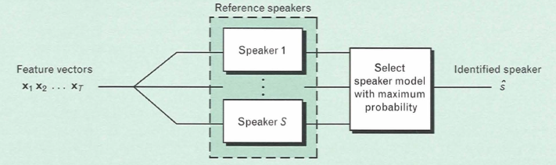


MATCHING: ML Classifier
The identification system is a straightforward maximum likelihood classifier.
Given the s speaker models { λ₁, λ₂,….,λ_{S}} and the input feature vector sequence {x₁,x₂….x_{T}} we will choose the model which has the maximum posterior probability given the feature vectors.

Slide 18
PERFORMANCE EVALUATION
Feature vectors {x₁,x₂,……x_{t}} were extracted from the input test speech.
To evaluate the performance for different test utterance lengths(T), the feature vectors were divided into overlapping segments of T feature vectors. ( T_time(sec) = [0.1,0.5,0.8,1,2] )
The identified speaker for each segment was compared with correct speaker and the number of correct recognitions were recorded.
For each test utterance length a final performance percentage was calculated using
% correct identification = number of correctly identified segments x 100
total number of segments

Slide 19
RESULTS: LPCC
The following are the results for 10 speakers and both training and testing speech corresponding to solo speaking style.
Amount of training Speech | Model Order | Test Length
 |  | 0.1 sec | 0.5 sec | 0. 8 sec | 1 sec | 2 sec | 5 sec
15 Seconds | M = 8 | 44.6% | 68.2% | 75.5% | 78.3% | 86.5% | 96.8%
 | M = 12 | 42.5% | 63.8% | 71.0% | 74.8% | 85.3% | 93.5%
 | M = 16 | 43.7% | 66.1% | 72.6% | 76.3% | 85.4% | 92.9%
30 Seconds | M = 8 | 49.0% | 76.5% | 84.1% | 87.3% | 95.05 | 96.1%
 | M = 12 | 51.0% | 78.9% | 86.2% | 89.3% | 97.0% | 97.8%
 | M = 16 | 51.5% | 79.5% | 86.3% | 89.5% | 97.4% | 99.8%
60 seconds | M = 8 | 51.0% | 78.6% | 86.9% | 90.4% | 97.6% | 99.6%
 | M = 12 | 53.4% | 82.3% | 89.3% | 92.2% | 98.3% | 99.6%
 | M = 16 | 54.6% | 84.0% | 91.4% | 93.5% | 98.1% | 100%

Slide 20
CONCLUSION
The best model order is M = 16.
The best percentage performance is 100%.
The training length for best performance is 60 sec.
The test length for best performance is 5 sec.

Slide 21
RESULTS: MFCC
The following are the results for 10 speakers and both training and testing speech corresponding to solo speaking style.
Amount of training Speech | Model Order | Test Length
 |  | 0.1 sec | 0.5 sec | 0. 8 sec | 1 sec | 2 sec
15 Seconds | M = 8 | 59.1% | 82.9% | 87.0% | 89.1% | 95.3%
 | M = 12 | 61.7% | 85.5% | 91.2% | 93.8% | 99.6%
 | M = 16 | 59.9% | 92.1% | 89.3% | 91.5% | 98.7%
30 Seconds | M = 8 | 70.6% | 92.1% | 96.1% | 96.7% | 97.8%
 | M = 12 | 71.8% | 92.3% | 96.9% | 98.0% | 100%
 | M = 16 | 71.8% | 92.1% | 96.2% | 97.0% | 99.6%
60 seconds | M = 8 | 47.6% | 56.9% | 58.4% | 58.8% | 60.0%
 | M = 12 | 75.5% | 95.4% | 98.8% | 99.6% | 100%
 | M = 16 | 75.8% | 94.4% | 98.2% | 99.0% | 99.7%

Slide 22
CONCLUSION
The best model order is M = 12.
The best performance is 100%.
The training length for best performance is 30 sec.
The test length for best performance is 2 sec.
MFCC performs better than LPCC.

Slide 23
RESULTS : Varying Speaking Style
When the same training models were used to recognize the testing speech in whisper and fast speaking styles, the best possible recognition happened when M=4. For all greater values of M the correct recognition percentage was less than 50%.
This implies that this model did not work well on recognizing different speaking styles when trained on one of the speaking styles.
Speaking Style | Test Length
 | 0.1 sec | 0.5 sec | 0.8 sec | 1 sec | 2 sec
Whisper | 32.1556% | 42.0833% | 46.4389% | 54.7500% | 61.8111%
Fast | 35.1000% | 41.4500% | 44.0667% | 51.8333% | 61.9333%

Slide 24
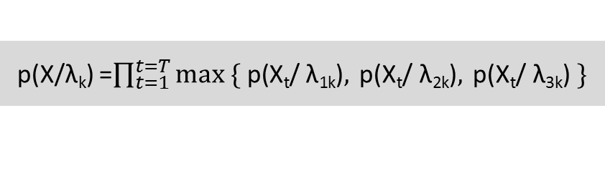
Incorporating Different Speaking Styles
We can train three GMM models for each speaker with each one in one speaking style. However, the lengths of whispering and fast training speech where less than the length of the solo training speech.
This was done because in a realistic situation, we have enough amount of solo speech samples but small amounts of whispered and fast speech samples.
As an output of the modeling stage we get three GMM models for each speaker.
Frame based score competition (FSC) approach is used to compute the likelihood of an observation given the three GMM models. In FSC, we compare a feature vector of each frame to three GMMs in the speaker model. We pick the highest score amongst the three GMM for the given frame.
λ_{k} = {λ_{1k}, λ_{2k}, λ_{3k}} k = 1,2…,s
p(X/λ_{k}) =$\prod_{t=1}^{t=T}{max \{ \text{p}\text{(}\text{Xt}\text{/} \text{λ}\text{1}\text{k}\text{)}, \text{p}\text{(}\text{Xt}\text{/} \text{λ}\text{2}\text{k}\text{)}, \text{p}\text{(}\text{Xt}\text{/} \text{λ}\text{3}\text{k}\text{)} \}}$

Slide 25
RESULTS
The following are the results for 10 speakers and model order M = 12. The feature vectors used are MFCC. 30 sec of solo speech , 15 sec of whispered speech and 15 sec of fast speech.
Speech Style | Test Length
 | 0.1 sec | 0.5 sec | 1 sec | 2 sec
SOLO | 67.7% | 89.8% | 96.8% | 99.2%
WHISPER | 55.4% | 81.9% | 92.8% | 98.7%
FAST | 63.8% | 88.9% | 94.5% | 98.9%

Slide 26
RESULTS : Varying Number of Speakers
The following are the results for 12 Gaussian components and 60 seconds of training speech for solo testing speech.
Number of speakers | Test Length
 | 0.1 sec | 0.5 sec | 0.8 sec | 1 sec | 2 sec
6 | 83.1% | 96.6% | 98.7% | 99.4% | 100%
10 | 77.0% | 95.2% | 98.0% | 98.9% | 100%
15 | 69.8% | 93.1% | 97.1% | 98.1% | 99.2%
20 | 64.3% | 91.4% | 96.2% | 97.6% | 99.0%
25 | 51.0% | 82.9% | 86.9% | 88.0% | 90.1%
30 | 42.5% | 60.7% | 65.1% | 69.0% | 76.6%
36 | 35.4% | 50.6% | 53.4% | 54.1% | 65.5%

Slide 27

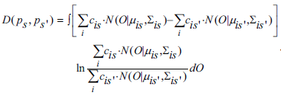
Maximizing Divergence
Divergence measure between two random variables can be expressed as
These two distributions can be thought of as the GMM models of two speakers. In such a case, the divergence measure becomes
To simplify the above measure, we use a common component GMM models. So our speaker model now becomes

Slide 28
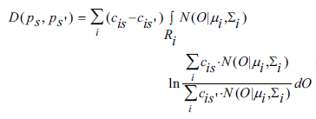


Maximizing Divergence
The divergence measure simplifies to
We approximate the Gaussian Mixture distribution in the region of a single Gaussian by
Now the divergence measure further simplifies to
Here, R_{i} is the region of the i^{th} mixture component.

Slide 29
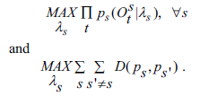
Maximizing Divergence
We further assume a global covariance matrix for all components.
So now we need to find speaker models which simultaneously maximizes the likelihood of each speaker’s speech data and the inter-speaker divergence.

Slide 30
Further Work
Implement the Common Component GMM based method for higher number of speakers.
Model selection is a monotonous job. Model selection should be made automatic. This can be done by using Bayesian Inference Models.
Different feature extraction techniques can be explored which work well for different speaking styles by modelling for a single style.
Channel and noise effects must also be considered in the speaker recognition process.

Slide 31
REFERENCES
D.Reynolds, “Speaker Identiﬁcation and Veriﬁcation Using Gaussian Mixture Speaker Models,” Speech Communication, Vol. 17, No. 1-2, p. 91-108, August 1995.
John H.L. Hansen and Taufiq Hasan, “Speaker Recognition by Machines and Humans”, Tutorial Review, IEEE Signal Processing Magazine, November 2015.
Douglas A. Reynolds, “Automatic Speaker Recognition Using Gaussian Mixture Speaker Models”, The Lincon Laboratory Journal, Volume 8. Number 2, 1995.
Qin Jin, Szu-Chen Stan Jou, and Tanja Schultz, “Whispering Speaker Identification”, Interactive Systems Laboratories, LTI SCS, Carnegie Mellon University,2007.
Yih-Ru Wang and Chen-Yu Chiang, “A New Common Component GMM-Based Speaker Recognition Method”, Department of Communications Engineering, National Chiao Tung University, Taiwan, Republic of China ,2005.

Slide 32
REFERENCES: Web Pages
http://iitg.vlab.co.in/?sub=59&brch=164&sim=616&cnt=1108
http://practicalcryptography.com/miscellaneous/machine-learning/
http://apexpg.jimdo.com/matlab-file/mel-frequency-cepstral-coefficients/
http://iitg.vlab.co.in/?sub=59&brch=164&sim=615&cnt=1
http://www2.cmpe.boun.edu.tr/courses/cmpe362/spring2014/files/projects/MFCC%20Feature%20Extraction.pdf
http://www3.cs.stonybrook.edu/~skiena/jaialai/excerpts/node16.html
http://www.ifp.illinois.edu/~hasegawa/notes/chap5.pdf

Slide 33
THANK YOU

