Slide 1

Home IoT Automation through
Speaker Recognition
Project Advisor
Prof. Hyeran Jeon
Submitted By
Vishv Brahmbhatt
Mitul Patel
Piyush Patil
Nishank Singla

Slide 2
INTRODUCTION
In this project, we have developed a Speaker Recognition system for Smart Home Automation.
Current home automation systems does not offer user authentication and are not personalized.
Our Speaker Recognition system along with Speech Recognition system provides a natural and secure way of interaction to smart home devices.
Speaker Recognition is a biometric system to recognize user based on their voice.
We have used deep learning convolutional neural network to achieve this goal.

Slide 3
BACKGROUND
Internet of Things has brought changes in many aspects of human life.
Home automation is the most prominent and emerging technology for the next 5-10 years.
With the advancement of such technologies we also need a secure way to access these systems.
Amazon Echo and Google home are the example of such systems which can control smart home devices using voice commands.
But these systems do not provide authenticated access to the smart home devices and also are not personalized.

Slide 4
TECHNOLOGIES
We have used the state-of-the-art approach i.e. Convolutional Neural Network.
ConvNet is a very deep feed-forward neural network architecture for pattern recognition mostly in images.
Every deep neural networks is a two-staged process: Training and Inference.
For Training process, we have used GPU servers provided by our advisor.
For Inference process, we have used Jetson Tx1 board which is a GPU embedded board thus best hardware for inference.
Python programming language is used for every purpose like recording audios, generating spectrogram, developing end-to-end pipeline.
Notes:
Can explain about inference.

Slide 5
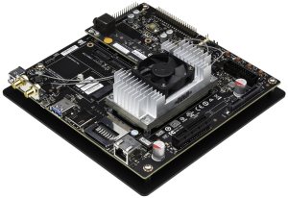


ARCHITECTURE
Our project has very simple architecture, we have trained the models on GPU server and then has deployed the trained models on the Jetson Tx1 GPU board.
Below is the architecture of the inference part in a big picture.
Nvidia Jetson TX1 Board
Deep Learning model on the GPU Board will perform the speaker recognition
Voice Command through
microphone
Project Architecture Overview
Notes:
Can explain about inference.

Slide 6
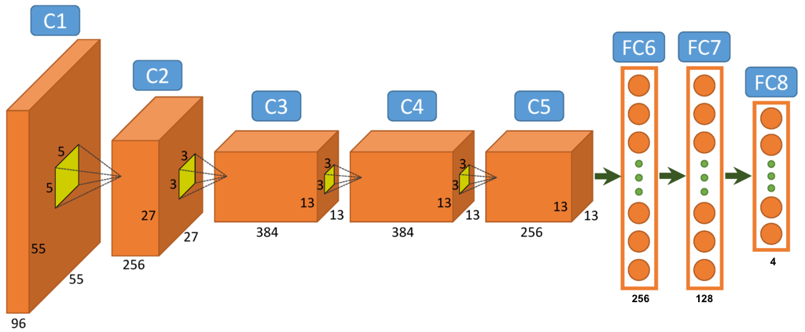
CNN ARCHITECTURE
We have used the AlexNet convolutional neural network for both speaker recognition as well speech recognition.
For both recognition systems, we have trained the models with different values of hyper-parameters and has come up with the values that are giving us the most accurate results.
Below is the one CNN architecture of the speaker recognition model.
Input Image Size
256 * 256
CNN architecture for Speaker Recognition
Notes:
Can explain about inference.

Slide 7
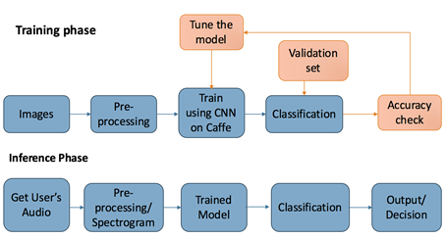
Training Vs Inference
Training Phase: In this phase, we train the model on a big dataset which has been divided into train, validation and test set.
Inference Phase: In this phase, trained model take single input sample, perform classification using trained weights and output the class of the input sample.
Below is the image that explains the two stages in any deep neural network.
Notes:
Can explain about inference.

Slide 8
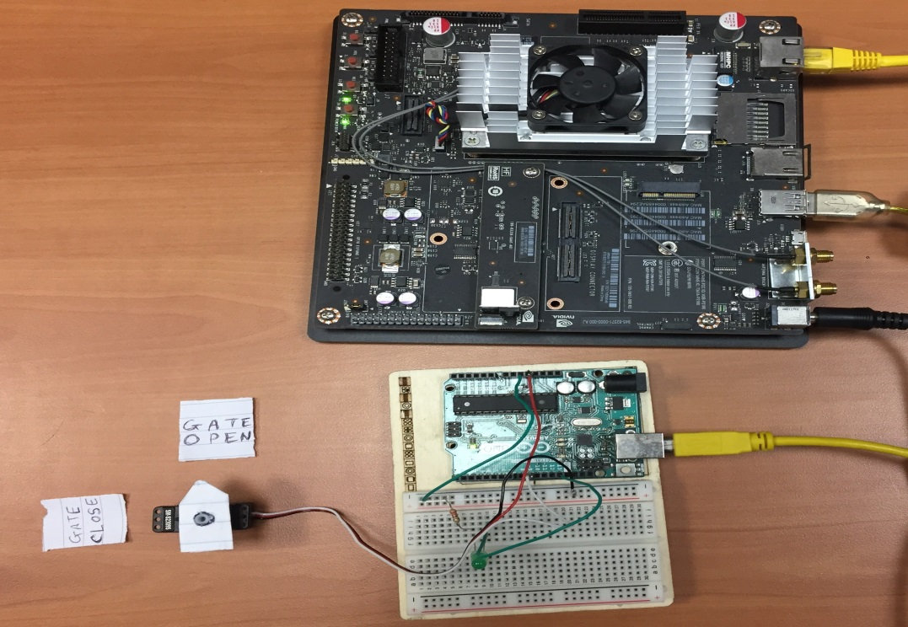
END-TO-END SYSTEM
Below is the image of Jetson Tx1 Board connected to Arduino Uno.
Arduino Uno controls the IoT devices connected to it.
We are demonstrating ”Open/Close the gate” by a servo motor and “Turn on/Off the light” by a LED light.
Notes:
Can explain about inference.

Slide 9
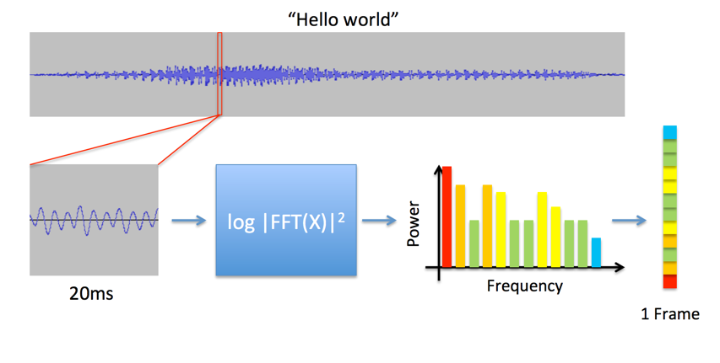
SPECTROGRAM
Spectrogram is the building block of our system. Every audio wav signal has been converted to a spectrogram image which then has been feed into the CNN for training as well inference.
Below are the spectrogram generation steps:
Take 20ms sliding window with 10ms shift of audio waveform.
Compute FFT and take magnitude of it.
Figure 8 Spectrogram generation from audio [4]
Notes:
Can explain about inference.

Slide 10
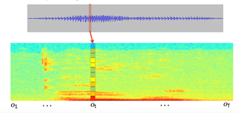
Continued…
Concatenate each frame from adjacent windows to form “Spectrogram”.

Slide 11
RESULTS
After training a lot number of models with different values of hyper parameter, we have achieved the following results.
94-95% accuracy in Speaker Recognition.
84-85% accuracy in Speech Recognition.
Speaker Recognition Model Configurations | Speech Recognition Model Configurations
Train Set: 1600 spectrogram images Validation Set: 400 Learning rate: 0.001 Momentum: 0.5 Batch Size: 40 Drop-out: 0.6 Max- Iterations: 3000 Number of neurons in FC 6 is 256 and FC 7: 128 Learning Policy: Step | Train Set: 500 Validation Set: 100 Learning rate: 0.001 Momentum: 0.5 Batch Size: 25 Drop-out: 0.6 Max-Iterations: 3000 Number of neurons in FC 6 and FC 7: 256 and 128 Learning Policy: Inv
Notes:
Can explain about inference.

Slide 12
DEMONSTRATION VIDEO
Introductory Video Link
  https://drive.google.com/file/d/0B6pxb6O5OWfeSWJnWWhnRG1mN0k/view?usp=sharing
Demo Video Links
  The first demo is the complete demo, demonstrating me(Nishank) as un-authorized user and Mitul(my team mate) as authorized user who will control smart home devices(in this case a stepper motor) using his voice.
  https://drive.google.com/file/d/0B6pxb6O5OWfeT201QnNYWk1nMzQ/view?usp=sharing
  The second demo is the recording of the end-to-end pipeline using python socket programming demonstrating me and my other 2 teammates Vishv and Mitul inputting our voice commands for the speaker as well speech recognition.
  https://drive.google.com/file/d/0B6pxb6O5OWfeWTdTQ3d1aUpUdFE/view?usp=sharing
Notes:
Can explain about inference.

Slide 13
CONCLUSIONS
Currently deep learning algorithms are used for speech recognition only, but after working on this project we can say that it can be used for speaker recognition as well.
Changing hyper-parameters makes significant difference to the accuracy of the model. Fine-tuning hyper-parameters such as momentum, learning rate, and dropout gave us good accuracy and also solves the problem of over-fitting.
For deep learning problem, the bigger size of dataset gives the better generalized model. If the dataset is too small, there is a chance of over-fitting.
Notes:
Can explain about inference.

Slide 14
FUTURE SCOPE
The project covers certain scenarios and implementation of the common use cases. The future scope will involve following improvements and enhancements:
Classifying more speakers using the speaker recognition model. Verifying the accuracy of the model by adding more number of commands to the training dataset.
Deploying the home automation unit in real life environment. There are several challenges associated with it, such as classifying different voices, train the model.
We are using text based speech recognition which can be enhanced by text independent speech recognition and Natural Language Processing.
Currently, we generate the spectrogram from user’s voice without filtering, the future enhancements would involve removing the background noise, filtering out other noises. This is especially important for generating the training data set.
Notes:
Can explain about inference.

Slide 15
Thank You…

