Slide 1
UCAR project: Speaker Identification
Els van Dijk – 0749866
Sridhar Jagannathan – 0786488
Deyang Wang– 0758165

Slide 2
Speaker Identification: Why?
Video

Slide 3
Speaker Identification: How?
For a complete system, we need to:
Record samples of speech
Extract defining features
Define speaker models to classify new samples
Basics for 2 & 3 provided by existing Matlab system¹
¹ Can be found on http://www.mathworks.com/matlabcentral/fileexchange/27059

Slide 4
How: Recordings
For a complete system, we need to:
Record samples of speech
7 participants (+ 1 ‘unknown’)
15 samples each: 3 sentences * 5 conditions
Extract defining features
Define speaker models to classify new samples

Slide 5
How: feature extraction
For a complete system, we need to:
Record samples of speech
Extract defining features
Basic system provides two:
MFCC
wavelet SBC
Define speaker models to classify new samples

Slide 6
How: Speaker Modelling & Classification
For a complete system, we need to:
Record samples of speech
Extract defining features
Define speaker models to classify new samples
Basic system uses GMM
Our addition: a hybrid model & multiple Gaussian models

Slide 7
How: the Hybrid Model
Two models are trained:
MFCC-based
Wavelet SBC-based
Three possible results:
If MFCC model has the best match, use that
If wavelet SBC model has the best match, use that
If neither has a good match, sample is ‘unknown’

Slide 8
How: Multiple Gaussians models
Initial results showed that just ‘averaging’ over different conditions did not work very well
the speech patterns are probably very different
→ we should model different conditions with different Gaussian models

Slide 9
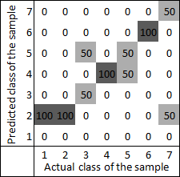
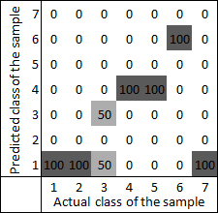
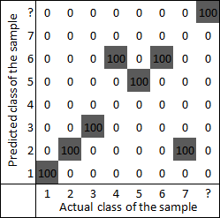
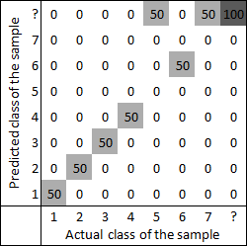
Results
Basic MFCC Basic SBC
Hybrid Model Final System
Overall RR has improved,
RR of ‘normal samples’ is better
New system on multiple Gaussians seems to work!
‘unknown’ class detection is robust
‘Normal’ Samples
Recognition Rate: 64%
Recognition Rate: 33%
Recognition Rate: 80%
Recognition Rate: 80%
Notes:
We see confusion matrices of the basic system, using MFCC, on the left. The overall recognition rate is 58%, for ‘normal’ samples – that is, normal speed, English – the recognition rate is 64%. In our altered system – seen on the right – the overall recognition rate has improved: 62% versus 58% in the basic system. On ‘normal’ samples, recognition is improved: a recognition rate of 80% versus 64% in the basic system.
Remember that, in a confusion matrix, an optimal system would show a nice diagonal line with only 100’s. Anything outside that diagonal is a misclassification. In the top-left graph, there are quite a few high numbers outside the diagonal. In the bottom-right graph, there are fewer. It looks like this is because of our ‘unknown speaker’ class: a lot of the samples that would otherwise simply be misclassified are now classified as being ‘unknown’ (we see this as a number of darker cells in the top row). This addition, then, seems to be working.
The altered system on the left is the approach where a single Gaussian is trained multiple times for different samples. The system on the right is where the system is trained on multiple Gaussians depending on the speech pattern.

Slide 10
Demonstration
Refer to Application_Demo in the subfolder for flash demo

Slide 11
Limitations & Future Work
The recognition rate achieved for multiple Gaussians when used across different patterns of speech is encouraging.
Future work should focus on producing a weighted probability model, which selects the best Gaussian chosen for the speech automatically. For e.g.) if the probability of a person having nasal congestion is 0.2 hence the model would have a relative weight of 0.2 versus normal sample model in the matching algorithm.
Notes:
So we’ve shown you what does work about our system, let’s talk briefly about some of the limitations of our work. As I showed before, the system needs to be trained under different conditions of speech variability, normally a real world application would train on only few samples and would have only a generic model to base on.
To improve this, one may consider a model where different Gaussians are attached with weights wherein the probability of each condition occur would determine the relative weight.

Slide 12
Limitations & Future Work
The sampling frequency can be increased from 8 KHz to 16 KHz to improve the accuracy.
The time duration of the samples can also be increased to model the speaker in a better fashion
Notes:
The increase in frequency may allow us to capture complete information in the speech spectrum.
When the time duration of the samples increases the model is better represented.

Slide 13
Q&A, Suggestions?
?

