Slide 1



AVC LAB / TECHNICAL SEMINAR
Wan2.1 & Wan2.2
Video generation foundations and world-model adaptations
Architectures, training objectives, evidence, and recent research examples
10 September 2026
Notes:
This talk explains Wan2.1 and Wan2.2 as reusable video-generation foundations. We first build a mental model of the latent video pipeline, then examine the changes introduced by Wan2.2. The final section follows four recent research projects that reuse Wan for interactive world generation or robot visual planning. The emphasis is on the mechanisms that are inherited, the mechanisms that downstream work adds, and the evidence available for each claim. Sources were checked on 10 September 2026. The world-model examples are representative case studies, not an exhaustive usage ranking.
PRIMARY SOURCES
Presentation framing and research synthesis.
Checked on 10 September 2026. Original source figures retain their own typography. Editable slide text, tables, charts and speaker notes use Microsoft YaHei.

Slide 2
01 / PROBLEM AND MODEL FAMILY
The problem: generate coherent change over time
A video generator must solve four coupled problems within a finite compute budget.
01
Appearance
Preserve objects, textures and identity across many frames.
02
Motion
Represent temporal evolution, camera movement and interactions.
03
Conditioning
Translate language and reference images into specific visual changes.
04
Cost
Train and sample long sequences without exhausting memory or compute.
Wan combines compressed video latents, a video DiT, and large-scale data curation.
Wan Team, 2025 | Sections 3–4
02 / 38
Notes:
A single attractive frame is insufficient for video generation. The model must maintain identity while the scene changes, follow text describing events, and represent camera motion without producing inconsistent geometry. These requirements interact with compute: more frames and higher resolution produce longer token sequences. Wan addresses the problem as an integrated system. A causal video VAE reduces the visual representation; a diffusion transformer learns its conditional evolution; and the data pipeline supplies coverage and detailed supervision. This organization also explains why later world models often retain the pretrained video backbone while adding task-specific control and memory.
PRIMARY SOURCES
Wan: Open and Advanced Large-Scale Video Generative Models
https://arxiv.org/abs/2503.20314
FIGURE / DATA PROVENANCE
Sections 3–4
Checked on 10 September 2026. Original source figures retain their own typography. Editable slide text, tables, charts and speaker notes use Microsoft YaHei.

Slide 3
01 / PROBLEM AND MODEL FAMILY
Three questions organize this report
Read the architecture through the problems each component is intended to solve.
01
Wan2.1
How do the VAE, DiT, text encoder and flow objective work together?
02
Wan2.2
Why specialize denoisers by noise level, and why build a separate dense 5B model?
03
World models
What must be added to a video prior for control, memory and useful rollouts?
The central distinction is between a pretrained video prior and the system built around it.
Wan Team, 2025; Wan2.2 official release
03 / 38
Notes:
The first part establishes the common machinery: latent compression, patchification, spatiotemporal attention, text conditioning, and flow matching. The second part separates two different developments inside Wan2.2. A14B introduces high-noise and low-noise experts, while TI2V-5B uses a dense transformer and a more compressed VAE representation. The third part examines concrete downstream adaptations. It is useful to ask the same question for each example: which checkpoint supplies the video prior, what new training or architecture is added, and which experiment actually evaluates the resulting world-model capability?
PRIMARY SOURCES
Wan: Open and Advanced Large-Scale Video Generative Models
https://arxiv.org/abs/2503.20314
Wan2.2 — architecture, evaluation and deployment
https://github.com/Wan-Video/Wan2.2
Checked on 10 September 2026. Original source figures retain their own typography. Editable slide text, tables, charts and speaker notes use Microsoft YaHei.

Slide 4
01 / PROBLEM AND MODEL FAMILY
The core releases form two distinct branches
Model names describe the generator; text encoders and VAEs add further parameters.
Release / model | Generator | Main role
Wan2.1 T2V-1.3B | Dense 1.3B | Accessible text-to-video baseline
Wan2.1 14B family | Dense 14B | T2V and separate I2V checkpoints
Wan2.2 T2V / I2V-A14B | 2 × ≈14B experts | 14B active per denoising step
Wan2.2 TI2V-5B | Dense 5B | Unified T2V / I2V; new video VAE
Wan2.2-TI2V-5B is not a smaller A14B MoE.
Wan2.1 official code; Wan2.2 official release | Core checkpoint families; Wan2.2 release: 28 Jul 2025
04 / 38
Notes:
This table scopes the talk to the core Wan2.1 and Wan2.2 generation models, rather than every editing, animation, speech, or community derivative. Wan2.1 exposes a small 1.3B T2V model and a larger 14B family. Wan2.2 has two directions: A14B contains two denoisers of approximately 14B parameters each, while only one is active at a given noise level; TI2V-5B is a separate dense model. The 27B total versus 14B active interpretation refers to the diffusion-transformer experts, not the complete end-to-end system. Keeping this distinction explicit is necessary when reading world-model papers, many of which use the dense 5B checkpoint.
PRIMARY SOURCES
Wan2.1 — official implementation and checkpoints
https://github.com/Wan-Video/Wan2.1
Wan2.2 — architecture, evaluation and deployment
https://github.com/Wan-Video/Wan2.2
FIGURE / DATA PROVENANCE
Core checkpoint families; Wan2.2 release: 28 Jul 2025
Checked on 10 September 2026. Original source figures retain their own typography. Editable slide text, tables, charts and speaker notes use Microsoft YaHei.

Slide 5
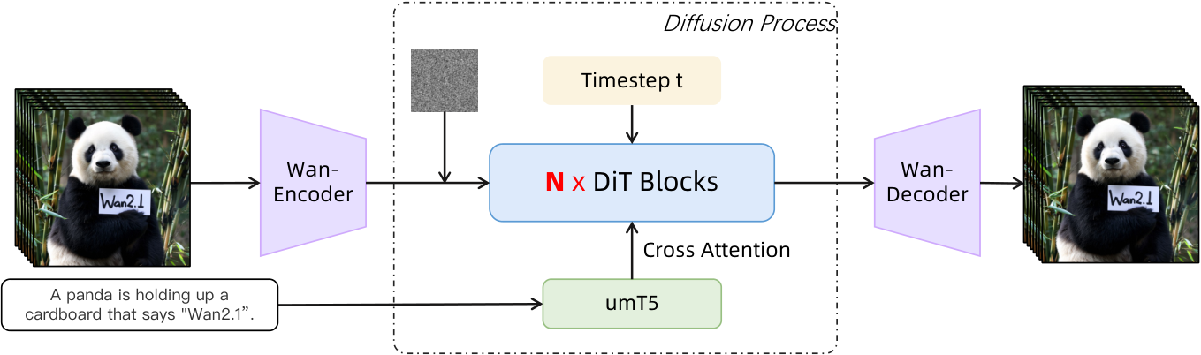
02 / WAN2.1: ARCHITECTURE
A latent video pipeline separates three jobs
The VAE compresses pixels, UMT5 encodes text, and the DiT predicts latent flow velocity.
Training
Inference
Encode real video, mix with noise, predict the flow velocity.
Start from noise, integrate the learned flow, decode the video.
The generation backbone is a video diffusion transformer; UMT5 supplies text conditions.
Wan Team, 2025 | Figure 9; Sections 4.1–4.2
05 / 38
Notes:
The original architecture figure shows an encoder on the left because it includes the training path. At inference in text-to-video generation, there is no target video to encode: the latent sequence starts as random noise. The DiT repeatedly predicts how the latent should change under the prompt and current time condition, and the VAE decoder converts the final latent into pixels. UMT5 provides a sequence of language embeddings through cross-attention. This is different from using Qwen as the video generator. Qwen can appear elsewhere in the data-captioning or prompt-extension pipeline, but it is not the main diffusion-transformer backbone in this diagram.
PRIMARY SOURCES
Wan: Open and Advanced Large-Scale Video Generative Models
https://arxiv.org/abs/2503.20314
FIGURE / DATA PROVENANCE
Figure 9; Sections 4.1–4.2
Checked on 10 September 2026. Original source figures retain their own typography. Editable slide text, tables, charts and speaker notes use Microsoft YaHei.

Slide 6
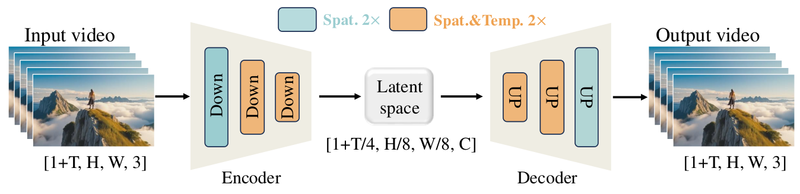
02 / WAN2.1: ARCHITECTURE
Wan-VAE reduces the spatiotemporal grid
Causal 3D compression: 4 × 8 × 8, with 16 latent channels.
Frame convention
Architecture
1 + T input frames become 1 + T/4 latent frames.
RMSNorm preserves causality; the VAE has 127M parameters.
The first frame is compressed only in space, so one architecture handles images and videos.
Wan Team, 2025 | Figure 5; Section 4.1.1
06 / 38
Notes:
The compression ratio is temporal by height by width. A video with 81 frames has T equal to 80, so it becomes 21 latent time steps. The spatial dimensions are divided by eight, and each latent cell has 16 channels. The special first-frame treatment allows an image to be handled without requiring a temporal group of four frames. Causal convolutions ensure that future frames do not influence an earlier representation. Wan also replaces normalization that could mix temporal information with RMSNorm and reduces channels in spatial upsampling to lower memory use. These choices make the VAE a reusable component independently of the DiT.
PRIMARY SOURCES
Wan: Open and Advanced Large-Scale Video Generative Models
https://arxiv.org/abs/2503.20314
FIGURE / DATA PROVENANCE
Figure 5; Section 4.1.1
Checked on 10 September 2026. Original source figures retain their own typography. Editable slide text, tables, charts and speaker notes use Microsoft YaHei.

Slide 7
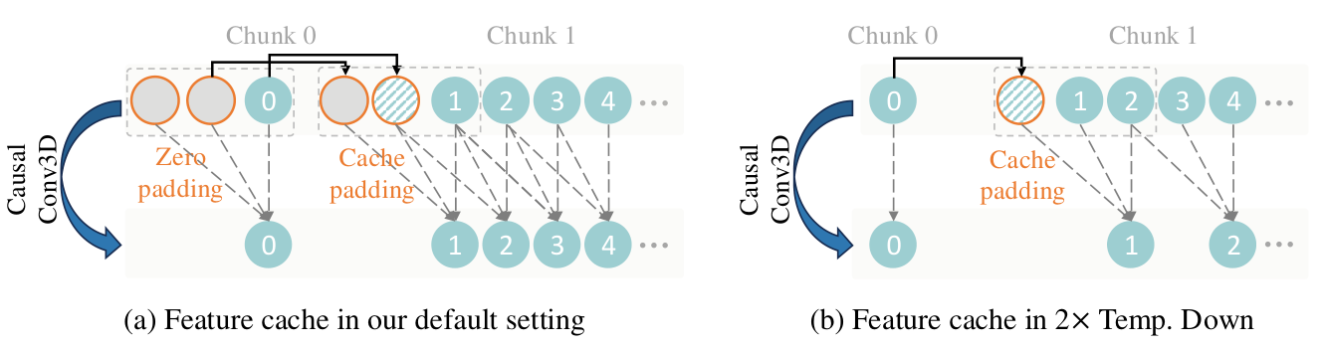
02 / WAN2.1: ARCHITECTURE
Feature caching makes VAE processing chunkable
Reuse boundary features so each chunk sees the required causal context.
Regular causal convolution
Temporal downsampling
Reuse preceding features instead of re-encoding all history.
Adjust cache padding to preserve the intended output length.
Streaming the VAE controls memory; it does not by itself make the DiT a streaming world model.
Wan Team, 2025 | Figure 6; Section 4.1.3
07 / 38
Notes:
Read the figure from left to right. A convolution requires a short temporal neighborhood. For the first chunk, missing earlier frames are represented by padding. Later chunks can reuse cached features from the previous chunk, preserving continuity without processing the entire video again. The cache management differs when temporal downsampling uses stride two. The authors use this mechanism to support long-video encoding and decoding with bounded chunk memory. This is a property of the representation module. The standard video DiT still processes a finite denoising window, so the VAE feature cache should not be confused with the recurrent state, attention cache, or memory bank used by an interactive world model.
PRIMARY SOURCES
Wan: Open and Advanced Large-Scale Video Generative Models
https://arxiv.org/abs/2503.20314
FIGURE / DATA PROVENANCE
Figure 6; Section 4.1.3
Checked on 10 September 2026. Original source figures retain their own typography. Editable slide text, tables, charts and speaker notes use Microsoft YaHei.

Slide 8
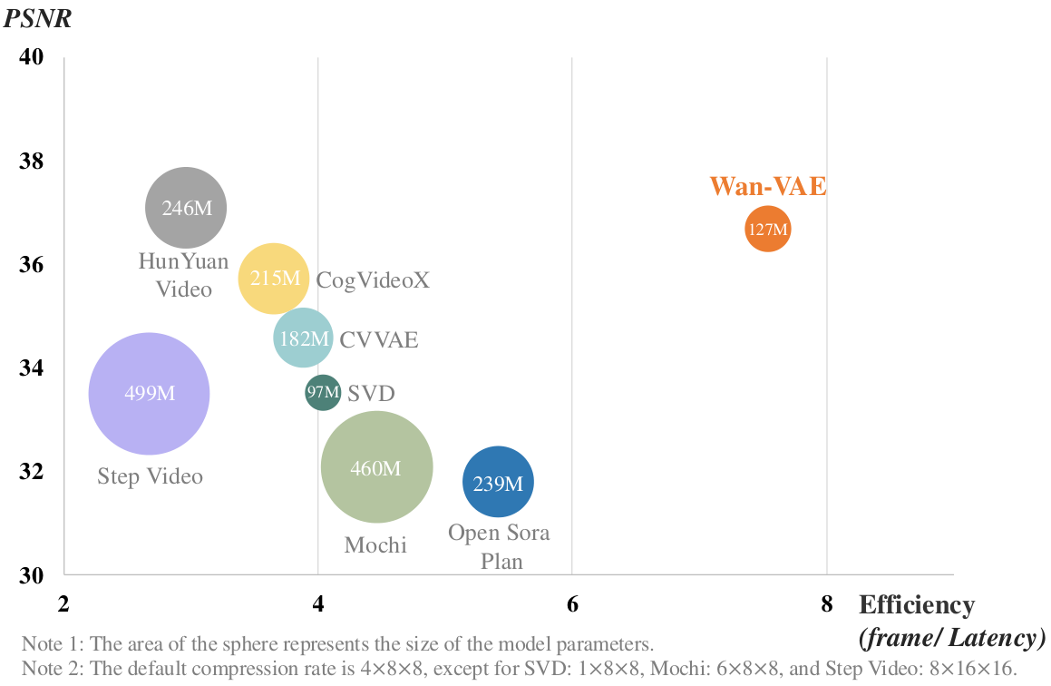
02 / WAN2.1: EVIDENCE
VAE evidence: reconstruction quality versus speed
The useful comparison is a quality–efficiency tradeoff, not PSNR alone.
Protocol
200 videos; 25 frames at 720 × 720.
Observation
Wan-VAE combines competitive PSNR with higher throughput.
Boundary
Compression ratios and latent channels differ for some baselines.
The reported 2.5× reconstruction speedup is specific to the Hunyuan comparison and test setup.
Wan Team, 2025 | Figure 7; Section 4.1.4
08 / 38
Notes:
The claim is that a compact causal VAE can reconstruct videos efficiently without sacrificing too much fidelity. The expected evidence is a favorable position on the PSNR-versus-throughput plot. The figure places Wan-VAE toward the high-throughput side while retaining competitive reconstruction quality. Circle size represents parameter count. The paper reports a 2.5-times reconstruction speed advantage over HunyuanVideo under the same hardware environment. This should not be converted into a 2.5-times end-to-end generation claim because the DiT dominates a different portion of the workload. Several baselines also use different compression ratios or latent dimensions, which limits a perfectly controlled architectural comparison.
PRIMARY SOURCES
Wan: Open and Advanced Large-Scale Video Generative Models
https://arxiv.org/abs/2503.20314
FIGURE / DATA PROVENANCE
Figure 7; Section 4.1.4
Checked on 10 September 2026. Original source figures retain their own typography. Editable slide text, tables, charts and speaker notes use Microsoft YaHei.

Slide 9
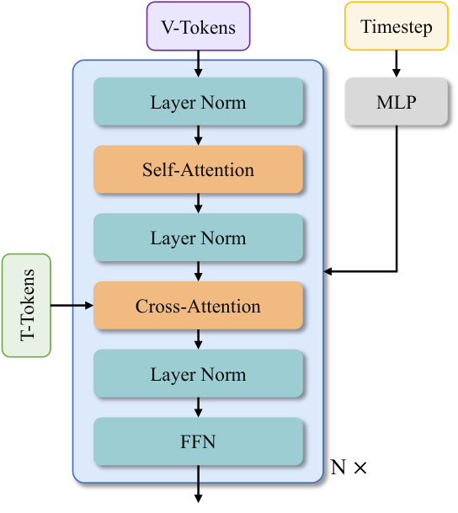
02 / WAN2.1: ARCHITECTURE
Inside the DiT: space, time and language
Video tokens attend across the clip; language enters through cross-attention.
Video self-attention
Model spatial and temporal relations with 3D positional encoding.
Text cross-attention
Read up to 512 UMT5 condition tokens.
Time modulation
Share the modulation MLP, with learned biases for individual blocks.
Wan2.1 keeps a familiar DiT structure and concentrates capacity in the video transformer.
Wan Team, 2025; Wan2.1 official code | Figure 10; Section 4.2.1
09 / 38
Notes:
The block alternates video self-attention, text cross-attention, and a feed-forward network, with normalization and residual modulation. Self-attention lets information move across spatial positions and frames, while three-dimensional rotary position encoding represents temporal and spatial coordinates in the implementation. Cross-attention lets video tokens query the text embeddings instead of simply appending language to the video sequence. The diffusion time controls how the block behaves at a particular noise level. Wan shares the MLP that predicts time-modulation parameters across blocks, while retaining block-specific biases. We will later inspect the ablation that supports this parameter-allocation choice.
PRIMARY SOURCES
Wan: Open and Advanced Large-Scale Video Generative Models
https://arxiv.org/abs/2503.20314
Wan2.1 — official implementation and checkpoints
https://github.com/Wan-Video/Wan2.1
FIGURE / DATA PROVENANCE
Figure 10; Section 4.2.1
Checked on 10 September 2026. Original source figures retain their own typography. Editable slide text, tables, charts and speaker notes use Microsoft YaHei.

Slide 10
02 / WAN2.1: ARCHITECTURE
Patchification still leaves a long token sequence
A 1 × 2 × 2 latent patch corresponds to a 16 × 16 pixel region in Wan2.1.
Configuration | T2V-1.3B | T2V-14B
Transformer blocks | 30 | 40
Hidden width | 1,536 | 5,120
Attention heads | 12 | 40
Feed-forward width | 8,960 | 13,824
81 frames at 720 × 1,280 | 75,600 tokens | 75,600 tokens
Resolution and duration drive token count; parameter size does not change this tokenization.
Wan2.1 official code; Wan Team, 2025 | Official model configs; sequence length derived from Section 4.2.1
10 / 38
Notes:
The configuration rows come from the released model definitions. The final row is a calculation, not a measured benchmark or a recommendation to run the 1.3B model at 720p. An 81-frame video becomes 21 latent frames. At 720 by 1280 pixels, the VAE produces a 90 by 160 spatial grid. Patchification groups each two-by-two latent region, giving 45 by 80 spatial tokens per time step. Therefore, 21 times 45 times 80 equals 75,600 tokens. Full attention over such a sequence is expensive, which motivates sequence parallelism during training and stronger compression or restricted context in downstream systems.
PRIMARY SOURCES
Wan2.1 — official implementation and checkpoints
https://github.com/Wan-Video/Wan2.1
Wan: Open and Advanced Large-Scale Video Generative Models
https://arxiv.org/abs/2503.20314
FIGURE / DATA PROVENANCE
Official model configs; sequence length derived from Section 4.2.1
Checked on 10 September 2026. Original source figures retain their own typography. Editable slide text, tables, charts and speaker notes use Microsoft YaHei.

Slide 11
02 / WAN2.1: TRAINING
Flow matching learns a direction from noise to data
Use the paper's convention: x₀ is noise, x₁ is a clean video latent.
Interpolation
xₜ = t x₁ + (1 − t) x₀
Construct a training input at a sampled time t.
Target velocity
vₜ = x₁ − x₀
The straight path has a constant target direction.
Training loss
L = E[‖u(xₜ, c, t; θ) − vₜ‖²]
Predict velocity from the noisy latent, text condition and time.
Training fits a velocity field; inference numerically integrates it to synthesize a video.
Wan Team, 2025 | Equations 1–3; c abbreviates the text-embedding sequence
11 / 38
Notes:
The source paper defines x zero as Gaussian noise and x one as the clean latent. Time runs from zero at noise to one at data in this mathematical convention. An intermediate sample is a linear interpolation of these endpoints, and its target velocity is the clean latent minus the noise. The network learns this vector field with a mean-squared error objective. The text condition c denotes the UMT5 embedding sequence; time is sampled from a logit-normal distribution during training. At inference the unknown clean latent is not available, so a numerical solver follows the network-predicted field. Some sampler code uses the opposite noise-time direction; that notation change should not be mistaken for a different objective.
PRIMARY SOURCES
Wan: Open and Advanced Large-Scale Video Generative Models
https://arxiv.org/abs/2503.20314
FIGURE / DATA PROVENANCE
Equations 1–3; c abbreviates the text-embedding sequence
Checked on 10 September 2026. Original source figures retain their own typography. Editable slide text, tables, charts and speaker notes use Microsoft YaHei.

Slide 12
02 / WAN2.1: TRAINING
A curriculum builds semantics before expensive video
The 14B training recipe progressively raises spatial and temporal complexity.
01
Image stage
Start with 256-pixel image pretraining to learn semantic and spatial structure.
02
Joint stage 1
Mix images with 5-second videos at low resolution: 192-pixel video, 16 FPS.
03
Joint stages 2–3
Raise image/video resolution to 480 pixels, then 720 pixels.
04
Post-training
Continue with curated high-quality video at 480 and 720 pixels.
The curriculum increases data throughput early and spends high-resolution compute later.
Wan Team, 2025 | Sections 4.2.2–4.2.3; resolution labels follow the report
12 / 38
Notes:
The motivation for a curriculum is computational as well as statistical. Directly training on long, high-resolution clips reduces examples processed per GPU-hour and can force smaller batches. Wan first learns broad semantic and spatial alignment from lower-resolution images, then introduces video and raises resolution. The report describes a first joint stage with 256-pixel images and approximately five-second, 192-pixel videos at 16 frames per second, followed by 480-pixel and 720-pixel stages. Post-training uses a more selective dataset without changing the main architecture. The report also specifies mixed-precision training and AdamW, but those standard optimizer choices are less central than the curriculum and data distribution.
PRIMARY SOURCES
Wan: Open and Advanced Large-Scale Video Generative Models
https://arxiv.org/abs/2503.20314
FIGURE / DATA PROVENANCE
Sections 4.2.2–4.2.3; resolution labels follow the report
Checked on 10 September 2026. Original source figures retain their own typography. Editable slide text, tables, charts and speaker notes use Microsoft YaHei.

Slide 13
02 / WAN2.1: DATA
The data pipeline teaches more than visual quality
Coverage, motion filtering and dense descriptions determine what the generator can learn.
01
Filter
Remove poor technical quality, weak aesthetics, unwanted text and unsuitable motion.
02
Balance
Adjust motion, quality and category proportions across training phases.
03
Describe
Produce dense captions covering events, objects, camera motion and relationships.
04
Refine
Curate high-quality images/videos; refine captions with human annotations.
Qwen appears in the captioning pipeline; UMT5 remains the generator's text encoder.
Wan Team, 2025 | Sections 3.1–3.3; Figure 3
13 / 38
Notes:
Wan treats data preparation as a major part of the system. The pretraining pipeline filters multiple quality dimensions, and the sampling distribution changes as training progresses. Detailed captions make otherwise ambiguous motion easier to associate with language. The report describes a LLaVA-style captioning model with a vision encoder, a two-layer projection, and a Qwen language model. It also uses a slow-fast video representation to limit captioning cost. These models generate supervision for the video model; they are not the diffusion backbone used to synthesize video. This distinction is especially useful when reading model-family diagrams where the same language-model name can appear in several different roles.
PRIMARY SOURCES
Wan: Open and Advanced Large-Scale Video Generative Models
https://arxiv.org/abs/2503.20314
FIGURE / DATA PROVENANCE
Sections 3.1–3.3; Figure 3
Checked on 10 September 2026. Original source figures retain their own typography. Editable slide text, tables, charts and speaker notes use Microsoft YaHei.

Slide 14
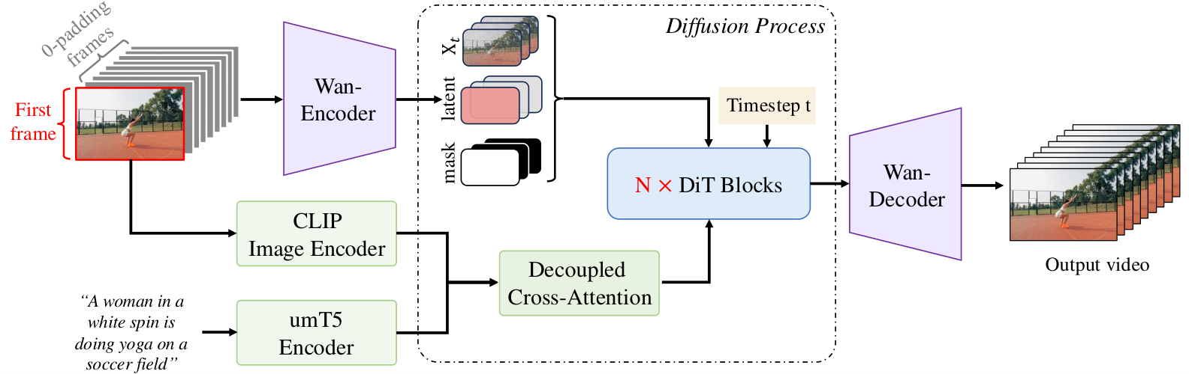
02 / WAN2.1: IMAGE CONDITIONING
I2V anchors the rollout to an observed image
A reference image provides spatial evidence that text alone cannot specify.
Local condition
Global condition
Concatenate noisy latents, condition latents and a mask.
CLIP image features add semantic guidance through attention.
The I2V input has 36 channels: 16 noisy + 16 condition + 4 mask channels.
Wan Team, 2025; Wan2.1 official code | Figure 18; Section 5.1; official I2V implementation
14 / 38
Notes:
Text-to-video leaves the initial scene underdetermined. Image-to-video adds an observed image as a spatial anchor. Wan constructs a conditional video by retaining known frames and padding unknown frames, encodes it with the VAE, and combines it with a temporal mask. The resulting patch-embedding input has 36 channels: 16 from the noisy video, 16 from the encoded condition, and four mask channels after temporal packing. CLIP image embeddings provide an additional global semantic condition through cross-attention, while UMT5 still encodes the prompt. The mask formulation supports broader variants such as continuation and first-last-frame conditioning, but the released checkpoints should be distinguished by their actual task and resolution.
PRIMARY SOURCES
Wan: Open and Advanced Large-Scale Video Generative Models
https://arxiv.org/abs/2503.20314
Wan2.1 — official implementation and checkpoints
https://github.com/Wan-Video/Wan2.1
FIGURE / DATA PROVENANCE
Figure 18; Section 5.1; official I2V implementation
Checked on 10 September 2026. Original source figures retain their own typography. Editable slide text, tables, charts and speaker notes use Microsoft YaHei.

Slide 15
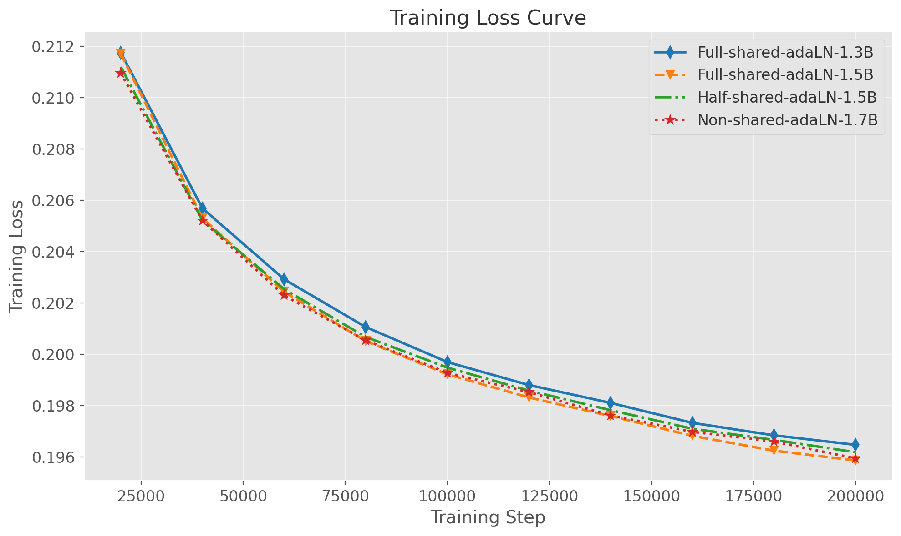
02 / WAN2.1: EVIDENCE
Ablation: allocate parameters to depth or modulation?
The same-parameter comparison favors additional transformer depth.
Controlled comparison
Shared 35-layer 1.5B versus partly shared 30-layer 1.5B.
Observation
The deeper, fully shared model reaches lower training loss.
What it supports
Shared modulation is a useful capacity-allocation choice.
This is a text-to-image training-loss ablation, not a direct video-quality or speed benchmark.
Wan Team, 2025 | Figure 16; Section 4.7.2; 200k image-training steps
15 / 38
Notes:
The architectural question is where to spend parameters. The paper compares four configurations, including a fully shared 1.3B model, a partly shared 1.5B model, a deeper fully shared 1.5B model, and an unshared 1.7B model. The key comparison controls parameter count: the deeper fully shared 1.5B configuration reaches lower loss than the partly shared 1.5B version. This supports putting capacity into transformer depth rather than a separate large modulation network in each block. The evidence is a training-loss experiment on text-to-image generation with other settings held constant. It does not isolate every effect that could matter in final video quality, and the plot should not be read as an inference-speed measurement.
PRIMARY SOURCES
Wan: Open and Advanced Large-Scale Video Generative Models
https://arxiv.org/abs/2503.20314
FIGURE / DATA PROVENANCE
Figure 16; Section 4.7.2; 200k image-training steps
Checked on 10 September 2026. Original source figures retain their own typography. Editable slide text, tables, charts and speaker notes use Microsoft YaHei.

Slide 16
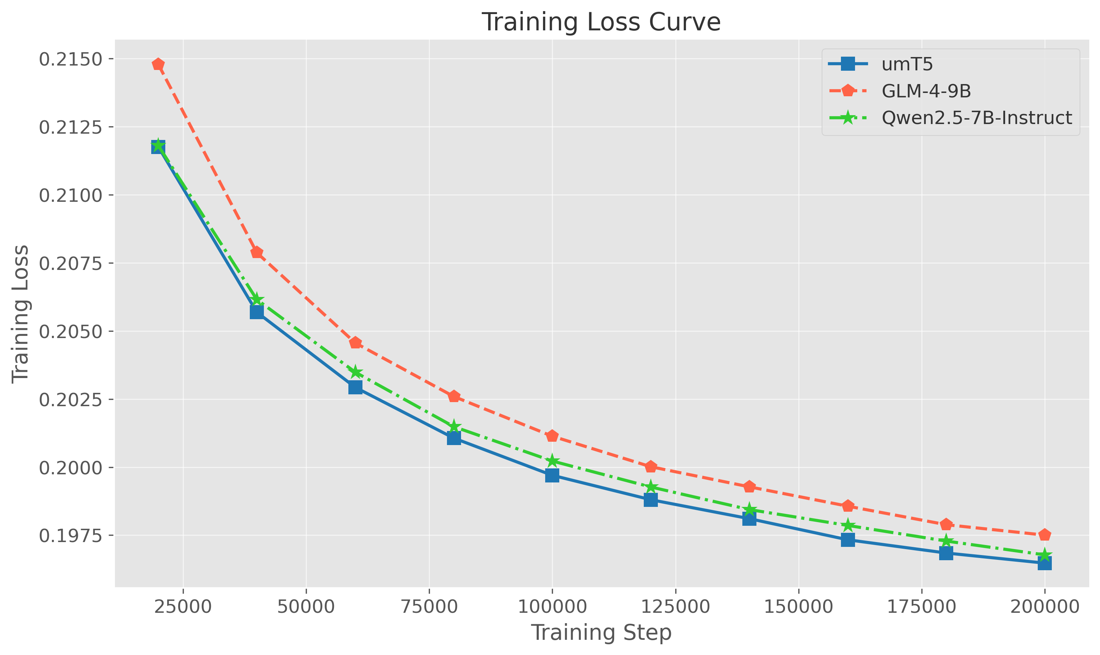
02 / WAN2.1: EVIDENCE
Ablation: a stronger chat model is not always a better encoder
UMT5 provides a well-matched condition representation for this diffusion model.
Comparison
UMT5, Qwen2.5-7B-Instruct and GLM-4-9B.
Observation
UMT5 converges favorably in this setting.
Interpretation
Encoder choice is a representation and training-interface decision.
The result supports Wan's encoder choice; it does not rank the models' general language ability.
Wan Team, 2025 | Figure 17; Section 4.7.2
16 / 38
Notes:
The authors test several bilingual text encoders under a common text-to-image training setup. UMT5 has bidirectional token representations, while the compared instruction-tuned language models originate from causal language modeling. The reported loss curve favors UMT5. The paper also explores token-refiner adapters and a multimodal language model, so the conclusion is not that decoder-only language models can never condition a diffusion generator. Instead, the existing UMT5 representation is an effective and comparatively compact interface for this specific architecture and training budget. For a lab project, this suggests testing the conditioning interface directly rather than assuming that a newer conversational model must improve visual generation.
PRIMARY SOURCES
Wan: Open and Advanced Large-Scale Video Generative Models
https://arxiv.org/abs/2503.20314
FIGURE / DATA PROVENANCE
Figure 17; Section 4.7.2
Checked on 10 September 2026. Original source figures retain their own typography. Editable slide text, tables, charts and speaker notes use Microsoft YaHei.

Slide 17
02 / WAN2.1: EVIDENCE
Generation evidence: the 14B model improves both axes
Historical VBench results reported in the Wan paper, not a current leaderboard.
Larger gain
Semantic score: +4.34 percentage points.
Overall
Total: 83.96 → 86.22.
Scope
Benchmark scores do not establish physical simulation accuracy.
The reported scaling benefit is measurable, but task-specific world-model evaluation is still needed.
Wan Team, 2025 | Table 4; percentage scores; 14B snapshot: 24 Feb 2025
17 / 38
Notes:
The editable chart reproduces three rows of metrics for the two Wan sizes from the paper's VBench table. Wan14B improves quality, semantic score and the aggregate score. The semantic improvement is 84.44 minus 80.10, or 4.34 percentage points; the aggregate improvement is 2.26 points. This is evidence of a useful scaling benefit in the authors' reported video-generation setting. It is not evidence that every larger checkpoint is better for every downstream budget. These are also historical results, with a dated 14B snapshot and benchmark-specific scoring. Consistent video appearance or semantic alignment does not by itself measure action-conditioned counterfactual prediction, scene persistence, or robot task success.
PRIMARY SOURCES
Wan: Open and Advanced Large-Scale Video Generative Models
https://arxiv.org/abs/2503.20314
FIGURE / DATA PROVENANCE
Table 4; percentage scores; 14B snapshot: 24 Feb 2025
Checked on 10 September 2026. Original source figures retain their own typography. Editable slide text, tables, charts and speaker notes use Microsoft YaHei.

Slide 18
03 / WAN2.2: TWO DESIGN DIRECTIONS
Wan2.2 develops quality and efficiency separately
A14B and TI2V-5B solve different bottlenecks.
A14B: specialize denoising
TI2V-5B: reduce token cost
Two experts
Dense transformer
Assign high-noise and low-noise stages to separate 14B denoisers.
Use one 5B generator for text-to-video and image-to-video.
Capacity
New VAE
27B expert parameters in total; 14B active at each step.
Increase spatial compression and retain more channels per latent cell.
World-model papers often choose TI2V-5B; their backbone does not inherit A14B's two-expert design.
Wan2.2 official release; Wan2.2-TI2V-5B model card
18 / 38
Notes:
Wan2.2 is easiest to understand as two design directions. The A14B models add a pair of experts specialized for different noise regimes. This increases total denoising capacity while using one expert at a time. The separate TI2V-5B release instead targets a favorable operating point for resolution, speed and memory, with a dense transformer and a redesigned VAE representation. The official Wan2.2 repository's paper link still points to the earlier Wan report; the source of the new architecture details is the official release documentation, code and model cards. This source distinction is retained throughout the slides so that Wan2.1 experiments are not accidentally presented as Wan2.2 ablations.
PRIMARY SOURCES
Wan2.2 — architecture, evaluation and deployment
https://github.com/Wan-Video/Wan2.2
Wan2.2-TI2V-5B — official model card
https://huggingface.co/Wan-AI/Wan2.2-TI2V-5B
Checked on 10 September 2026. Original source figures retain their own typography. Editable slide text, tables, charts and speaker notes use Microsoft YaHei.

Slide 19
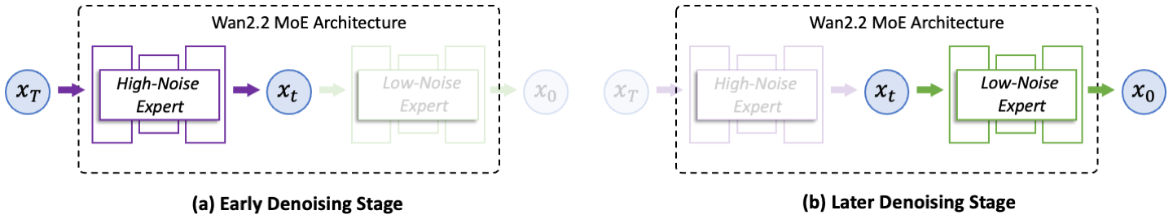
03 / WAN2.2: NOISE-SPECIALIZED EXPERTS
A14B divides the denoising trajectory into two regimes
Early steps form the global scene; later steps refine visual details.
High-noise expert
Low-noise expert
Handles the early, ambiguous part of generation.
Handles later refinement after structure has emerged.
Routing selects an entire denoiser by noise level, not different experts for individual tokens.
Wan2.2 official release; Wan2.2 official inference code | Official MoE architecture diagram
19 / 38
Notes:
The original diagram illustrates a division of labor over the diffusion trajectory. When the latent is dominated by noise, the model must decide broad layout, motion and semantic structure. Later, the latent contains clearer structure and the remaining task emphasizes refinement. Wan2.2 assigns separate denoisers to these regimes. This differs from token-routed language-model MoE layers: the routing decision is global for a denoising step, and one complete expert handles the current latent sequence. The practical consequence is higher total parameter storage but approximately the same active expert size as a 14B dense denoiser. End-to-end latency still depends on sampling steps, memory placement and implementation.
PRIMARY SOURCES
Wan2.2 — architecture, evaluation and deployment
https://github.com/Wan-Video/Wan2.2
Wan2.2 — expert selection in the T2V sampler
https://github.com/Wan-Video/Wan2.2/blob/main/wan/text2video.py
FIGURE / DATA PROVENANCE
Official MoE architecture diagram
Checked on 10 September 2026. Original source figures retain their own typography. Editable slide text, tables, charts and speaker notes use Microsoft YaHei.

Slide 20
03 / WAN2.2: NOISE-SPECIALIZED EXPERTS
Expert selection follows diffusion time
The official sampler implements a threshold on normalized noise time.
High noise
Boundary
Low noise
High-noise expert
→
Switch expert
→
Low-noise expert
Global structure
T2V: 0.875 / I2V: 0.900
Visual refinement
No token-level router • One complete expert runs at each denoising step
A boundary of 0.875 is a noise-time threshold, not "87.5% of the sampling steps."
Wan2.2 official release; Wan2.2 official inference code | Official T2V / I2V configs and sampler; time scale: 1,000
20 / 38
Notes:
The official inference code multiplies the configured boundary by the number of training time steps, which is 1000. It uses the high-noise model when the sampler time is greater than or equal to that boundary and the low-noise model otherwise. The default boundary differs between the T2V and I2V A14B configurations: 0.875 and 0.900 respectively. The diagram expresses the direction from high noise to low noise and avoids identifying this code time directly with the previous paper equation's interpolation convention. The release motivates the split with a log-SNR trajectory. Because the sampling schedule is nonuniform and can be shifted, the numerical boundary is not a percentage of the number of inference iterations.
PRIMARY SOURCES
Wan2.2 — architecture, evaluation and deployment
https://github.com/Wan-Video/Wan2.2
Wan2.2 — expert selection in the T2V sampler
https://github.com/Wan-Video/Wan2.2/blob/main/wan/text2video.py
FIGURE / DATA PROVENANCE
Official T2V / I2V configs and sampler; time scale: 1,000
Checked on 10 September 2026. Original source figures retain their own typography. Editable slide text, tables, charts and speaker notes use Microsoft YaHei.

Slide 21
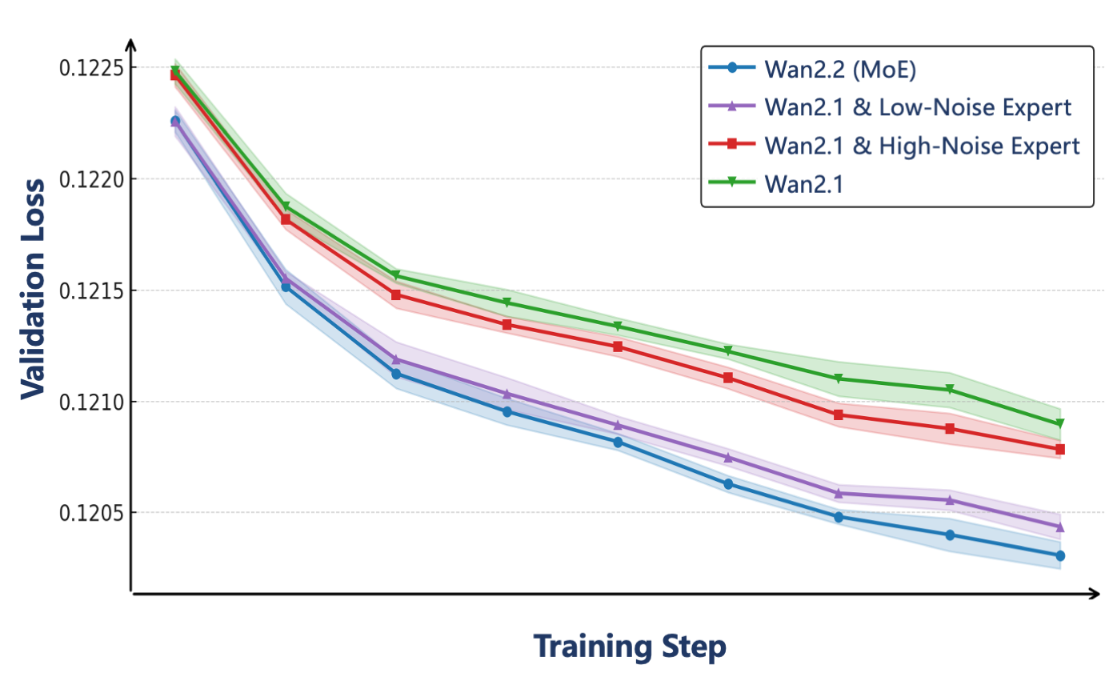
03 / WAN2.2: EVIDENCE
Why specialize? Different noise regimes learn differently
The release links the split to log-SNR and reports lower validation loss.
Motivation
Noisy and clean latents pose different denoising tasks.
Training
Specialize full denoisers for high- and low-noise regimes.
Evidence limit
The release plot is supportive; it is not a full controlled scaling study.
Treat the two-expert result as release evidence with limited disclosed experimental detail.
Wan2.2 official release | Official MoE analysis figure, validation-loss panel (cropped)
21 / 38
Notes:
The figure provides the release's motivation and validation signal for the noise-specialized design. The signal-to-noise plot uses a logarithmic vertical axis, which is relevant when interpreting the threshold discussion. The release evaluates specialized experts and mixed-expert combinations, but does not disclose a complete expert-training recipe. The loss comparison supports the usefulness of this specialization in the authors' setup. However, the public release does not provide the same breadth of training details and controlled experiments as a full independent technical report. The correct claim is that the official evidence is consistent with the proposed mechanism, rather than that a universal optimal split or scaling law has been established.
PRIMARY SOURCES
Wan2.2 — architecture, evaluation and deployment
https://github.com/Wan-Video/Wan2.2
FIGURE / DATA PROVENANCE
Official MoE analysis figure, validation-loss panel (cropped)
Checked on 10 September 2026. Original source figures retain their own typography. Editable slide text, tables, charts and speaker notes use Microsoft YaHei.

Slide 22
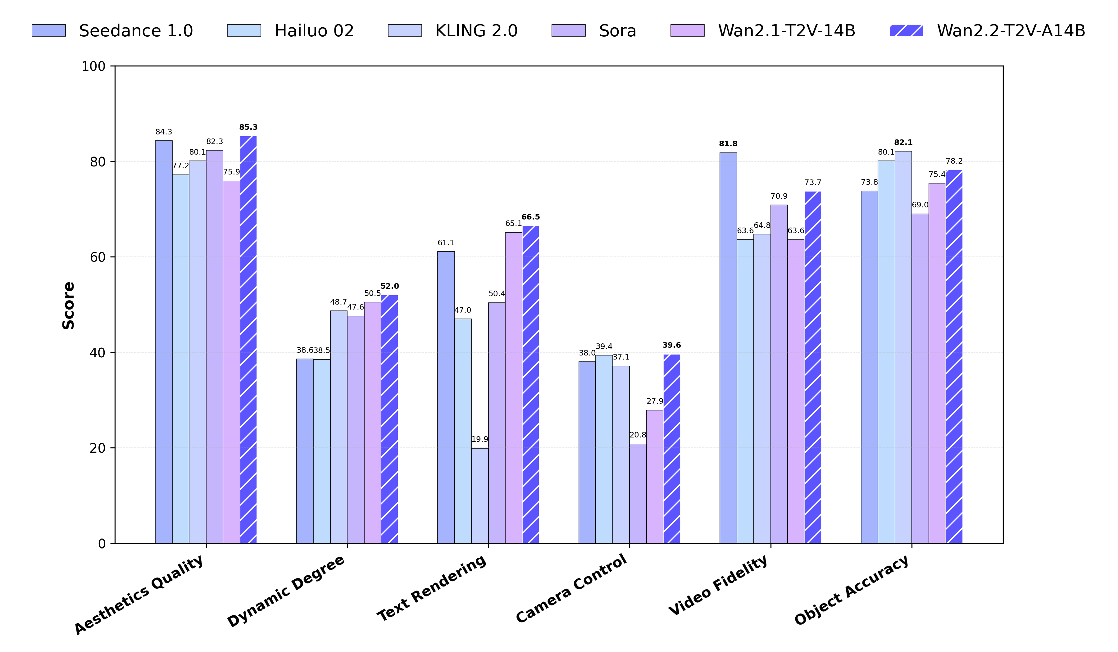
03 / WAN2.2: DATA AND GENERATION QUALITY
Quality gains also come from broader and richer data
More data: +65.6% images and +83.2% videos. Scores below compare Wan2.1 → Wan2.2.
Aesthetic quality
75.9 → 85.3
Camera control
27.9 → 39.6
Video fidelity
63.6 → 73.7
The released benchmark comparison does not isolate the causal effect of MoE alone.
Wan2.2 official release | Official Wan-Bench 2.0 figure; relative data increases reported by the authors
22 / 38
Notes:
The Wan2.2 announcement describes richer aesthetic annotations and expanded training data, including relative increases of 65.6 percent for images and 83.2 percent for videos. These are author-reported relative quantities, not public absolute dataset sizes. The original chart compares several dimensions, namely aesthetic quality, dynamic degree, text rendering, camera control, video fidelity and object accuracy. The chart supports a system-level comparison under the release's evaluation protocol. It cannot attribute each gain to the two-expert design because the data distribution and training also changed. This distinction matters when proposing a follow-up: reproducing the same MoE architecture without similar data does not guarantee the reported improvement.
PRIMARY SOURCES
Wan2.2 — architecture, evaluation and deployment
https://github.com/Wan-Video/Wan2.2
FIGURE / DATA PROVENANCE
Official Wan-Bench 2.0 figure; relative data increases reported by the authors
Checked on 10 September 2026. Original source figures retain their own typography. Editable slide text, tables, charts and speaker notes use Microsoft YaHei.

Slide 23
03 / WAN2.2: DENSE TI2V-5B
One 5B model handles both text and image inputs
Dense DiT: 30 blocks, width 3,072, 24 heads, and 48 latent input channels.
Text-to-video
Image-to-video
Initial condition
Initial condition
Begin with a complete sequence of random video latents.
Encode the image into the first latent frame with the new VAE.
Denoising
Denoising
Use the prompt through T5 cross-attention and update the latent sequence.
Set that frame's time to zero and restore its latent after each solver step.
The same dense DiT changes task through its latent condition and timestep mask.
Wan2.2 official release; Wan2.2 TI2V inference code; Wan2.2-TI2V-5B model card | Official TI2V inference and checkpoint configuration
23 / 38
Notes:
The dense 5B model shares one transformer across text-to-video and image-to-video. Its released configuration has 30 blocks, hidden width 3072, 24 attention heads and 48 latent channels. For text-to-video, all video latents begin as noise. For image-to-video, the new VAE encodes the reference image into the first latent frame. The code holds this condition fixed, assigns it zero diffusion time, and restores it after each solver update. Other frames are denoised at the current solver time. This is a different conditioning interface from the Wan2.1 I2V example with 36 concatenated input channels. A downstream model that changes checkpoints must preserve the corresponding VAE, latent convention and conditioning mask rather than treating all Wan I2V models as interchangeable.
PRIMARY SOURCES
Wan2.2 — architecture, evaluation and deployment
https://github.com/Wan-Video/Wan2.2
Wan2.2-TI2V-5B — unified text/image conditioning implementation
https://github.com/Wan-Video/Wan2.2/blob/main/wan/textimage2video.py
Wan2.2-TI2V-5B — official model card
https://huggingface.co/Wan-AI/Wan2.2-TI2V-5B
FIGURE / DATA PROVENANCE
Official TI2V inference and checkpoint configuration
Checked on 10 September 2026. Original source figures retain their own typography. Editable slide text, tables, charts and speaker notes use Microsoft YaHei.

Slide 24
03 / WAN2.2: DENSE TI2V-5B
The new VAE compresses space more aggressively
TI2V-5B uses the Wan2.2 VAE; the A14B models retain the Wan2.1-style VAE.
VAE | Grid compression | Channels | PSNR ↑ | LPIPS ↓
Wan2.1-VAE | 4 × 8 × 8 | 16 | 32.222 | 0.026
Wan2.2-VAE | 4 × 16 × 16 | 48 | 33.223 | 0.022
More latent channels compensate for a smaller spatial grid in the reported reconstruction comparison.
Wan2.2 official release; Wan2.2-TI2V-5B model card | Selected rows from the official VAE comparison table; one shared protocol
24 / 38
Notes:
The important change is not simply increasing the compression ratio. Wan2.2's VAE divides the spatial dimensions by sixteen rather than eight, while increasing the latent channel count from 16 to 48. The official comparison table reports improved PSNR and lower LPIPS for the new VAE under its evaluation. These numbers are shown as an editable table and should be compared only within that table's protocol. They should not be combined with the earlier Wan2.1 Figure 7 values, which come from a different reported setup. The architecture is associated with the dense TI2V-5B release; it should not be described as a VAE upgrade applied uniformly to every Wan2.2 checkpoint.
PRIMARY SOURCES
Wan2.2 — architecture, evaluation and deployment
https://github.com/Wan-Video/Wan2.2
Wan2.2-TI2V-5B — official model card
https://huggingface.co/Wan-AI/Wan2.2-TI2V-5B
FIGURE / DATA PROVENANCE
Selected rows from the official VAE comparison table; one shared protocol
Checked on 10 September 2026. Original source figures retain their own typography. Editable slide text, tables, charts and speaker notes use Microsoft YaHei.

Slide 25
03 / WAN2.2: DENSE TI2V-5B
Compression changes both token count and channel count
Illustrative calculation: 81 frames at 704 × 1,280, aligned to both tokenizers.
Wan2.1 representation
Wan2.2 TI2V-5B representation
Latent tensor
Latent tensor
21 × 88 × 160 × 16
21 × 44 × 80 × 48
73,920
18,480
video tokens
video tokens
21 × 44 × 80 tokens after 1 × 2 × 2 patchification
21 × 22 × 40 tokens after 1 × 2 × 2 patchification
4× fewer tokens, but only 25% fewer latent scalars; these are different notions of compression.
Wan2.1 official code; Wan2.2 official release; Wan2.2-TI2V-5B model card
25 / 38
Notes:
This example separates two quantities that are often conflated. We choose 704 by 1280 so that both spatial token grids divide exactly, and use 81 frames in both cases. Wan2.1 produces 21 by 88 by 160 latent cells with 16 channels. Wan2.2 produces 21 by 44 by 80 cells with 48 channels. Both then use one-by-two-by-two patchification, so token count falls from 73,920 to 18,480, a factor of four. However, each new latent cell has three times as many channels, so the total scalar count falls only to three quarters of the original. The new transformer can therefore process a much shorter sequence even though the latent tensor is not four times smaller in elements. This arithmetic is not an end-to-end speed prediction.
PRIMARY SOURCES
Wan2.1 — official implementation and checkpoints
https://github.com/Wan-Video/Wan2.1
Wan2.2 — architecture, evaluation and deployment
https://github.com/Wan-Video/Wan2.2
Wan2.2-TI2V-5B — official model card
https://huggingface.co/Wan-AI/Wan2.2-TI2V-5B
FIGURE / DATA PROVENANCE
Derived illustration from released VAE strides and patch sizes; not a runtime benchmark
Checked on 10 September 2026. Original source figures retain their own typography. Editable slide text, tables, charts and speaker notes use Microsoft YaHei.

Slide 26
03 / WAN2.2: EFFICIENCY
TI2V-5B: one-GPU generation time and memory
Reference setup: 1 × RTX 4090; 121 frames at 1,280 × 704; 24-FPS playback.
Task | Generation time | Peak VRAM
Text-to-video | 534.7 seconds | 22.9 GB
Image-to-video | 524.8 seconds | 22.8 GB
Model offload and dtype conversion enabled; the T5 text encoder runs on the CPU.
Generated video FPS describes playback; it is not the model's generation throughput.
Wan2.2 official release; Wan2.2-TI2V-5B model card | Selected RTX 4090 rows from the official efficiency table; model-card setup
26 / 38
Notes:
The dense 5B model is positioned as a more accessible high-resolution generator. The release describes 720p video at 24 frames per second and reports producing five seconds of video in under nine minutes on a single RTX 4090. The reference uses model offloading, dtype conversion and T5 on the CPU. The T2V row reports 534.7 seconds and 22.9 GB peak memory for 121 frames at 1280 by 704, with 24-FPS playback. This is a reference configuration, not a guarantee for arbitrary settings. Distinguish two uses of frames per second: 24 FPS describes playback of the generated clip, while generation throughput is the number of frames produced per wall-clock second. Later interactive world-model papers use additional distillation, quantization and system engineering to approach real-time generation.
PRIMARY SOURCES
Wan2.2 — architecture, evaluation and deployment
https://github.com/Wan-Video/Wan2.2
Wan2.2-TI2V-5B — official model card
https://huggingface.co/Wan-AI/Wan2.2-TI2V-5B
FIGURE / DATA PROVENANCE
Selected RTX 4090 rows from the official efficiency table; model-card setup
Checked on 10 September 2026. Original source figures retain their own typography. Editable slide text, tables, charts and speaker notes use Microsoft YaHei.

Slide 27
03 / WAN2.2: COMPARISON
Choose the checkpoint around the research bottleneck
The largest model is not automatically the most useful experimental backbone.
Starting point | Why choose it? | What to budget for
Wan2.1-T2V-1.3B | Rapid architectural iteration | Lower base visual capacity
Wan2.1-I2V-14B | Strong image-conditioned prior | Large model and long sequences
Wan2.2-TI2V-5B | Dense, compact-token foundation | Different VAE and checkpoint interface
Wan2.2-A14B | High-quality offline generation | Two expert weight sets and sampling cost
Match checkpoint, VAE, conditioning interface and latency target before comparing downstream methods.
Wan2.1 official code; Wan2.2 official release; Wan2.2-TI2V-5B model card
27 / 38
Notes:
This is a synthesis for experiment design rather than a new benchmark ranking. The 1.3B model is useful when frequent retraining and ablation matter more than maximum output quality. A 14B image-to-video checkpoint supplies a richer image-conditioned prior, but its memory and sequence cost can constrain rollout experiments. The dense 5B Wan2.2 model is attractive to several recent world models because it offers a compact-token representation without the complexity of storing and training two experts. A14B is a reasonable starting point for high-quality offline generation, but making it interactive requires additional work. A fair comparison should report exact checkpoint, resolution, frame count, precision, sampling steps and hardware.
PRIMARY SOURCES
Wan2.1 — official implementation and checkpoints
https://github.com/Wan-Video/Wan2.1
Wan2.2 — architecture, evaluation and deployment
https://github.com/Wan-Video/Wan2.2
Wan2.2-TI2V-5B — official model card
https://huggingface.co/Wan-AI/Wan2.2-TI2V-5B
Checked on 10 September 2026. Original source figures retain their own typography. Editable slide text, tables, charts and speaker notes use Microsoft YaHei.

Slide 28
04 / WAN IN RECENT WORLD MODELS
A video prior needs control, state and rollout training
These examples adapt Wan to specific world-model functions.
01
02
03
04
Video prior
→
Control
→
State
→
Rollout
Appearance + short-term motion
Camera, keyboard, task or action
History, memory or observations
Streaming, distillation or task alignment
Typical evaluation: response to controls / revisits / drift / useful decisions
Visual plausibility is only one requirement; action response and long-horizon consistency need separate tests.
Wang et al., Matrix-Game 3.0, 2026; Mao et al., Yume1.5, 2025; Wang et al., EVA, 2026; Rui et al., BiWM, 2026
28 / 38
Notes:
The section uses world model broadly enough to include interactive visual environments and goal-conditioned visual planning, while keeping their functions distinct. Wan supplies a strong prior over appearance and motion. Downstream work then adds an interface for control, a representation of past observations, and training that addresses sequential rollout or task-specific constraints. Some methods predict future views under camera actions; others generate robot visual plans that an inverse model converts to commands. These are not identical modeling problems. For each case we will name the exact checkpoint and the added mechanism. The four examples were selected for clear documented lineage and different research questions, not as evidence of overall usage frequency.
PRIMARY SOURCES
Matrix-Game 3.0: Real-Time and Streaming Interactive World Model with Long-Horizon Memory
https://arxiv.org/abs/2604.08995
Yume-1.5: A Text-Controlled Interactive World Generation Model
https://arxiv.org/abs/2512.22096
EVA: Aligning Video World Models with Executable Robot Actions via Inverse Dynamics Rewards
https://arxiv.org/abs/2603.17808
BiWM: Advancing Open-Source Interactive Video World Models with Bidirectional Autoregression
https://arxiv.org/abs/2606.10135
Checked on 10 September 2026. Original source figures retain their own typography. Editable slide text, tables, charts and speaker notes use Microsoft YaHei.

Slide 29
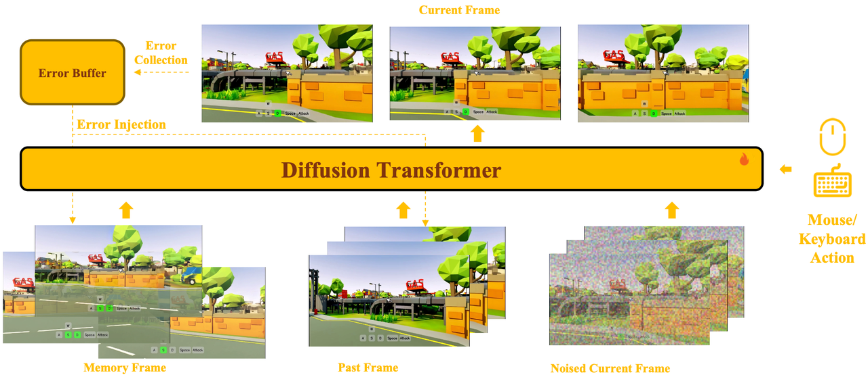
04 / WORLD MODEL EXAMPLE 1
Matrix-Game 3.0: remember views when they return
Backbone: Wan2.2-TI2V-5B | arXiv, April 2026
Control
Add keyboard cross-attention and mouse conditioning.
Memory
Retrieve old latents using camera pose and view overlap.
Rollout
Train with an error buffer; apply multi-segment DMD distillation.
Reported 720p ≈40 FPS uses an accelerated 8 + 1 GPU system, not a single GPU.
Wang et al., Matrix-Game 3.0, 2026; Matrix-Game 3.0 official model card | Figure 4; Sections 3 and 5; official model card
29 / 38
Notes:
Matrix-Game3 initializes its video backbone from Wan2.2-TI2V-5B and inserts action modules into the first 15 transformer blocks. Its distinguishing idea is to retrieve memory relevant to the current view using camera pose and field-of-view overlap, rather than simply keeping the newest frames. Relative geometry is represented with Plücker cues. The model processes retrieved memory, recent context and the current noisy chunk, while an error buffer exposes training to prediction errors and multi-segment distribution matching reduces sampling steps. Return-view examples probe whether earlier structures reappear consistently. The approximately 40-FPS, 720p result uses eight GPUs for DiT and one for VAE, plus INT8, decoder pruning and GPU retrieval. The throughput should therefore be read as a complete system result.
PRIMARY SOURCES
Matrix-Game 3.0: Real-Time and Streaming Interactive World Model with Long-Horizon Memory
https://arxiv.org/abs/2604.08995
Matrix-Game 3.0 — released model and lineage
https://huggingface.co/Skywork/Matrix-Game-3.0
FIGURE / DATA PROVENANCE
Figure 4; Sections 3 and 5; official model card
Checked on 10 September 2026. Original source figures retain their own typography. Editable slide text, tables, charts and speaker notes use Microsoft YaHei.

Slide 30
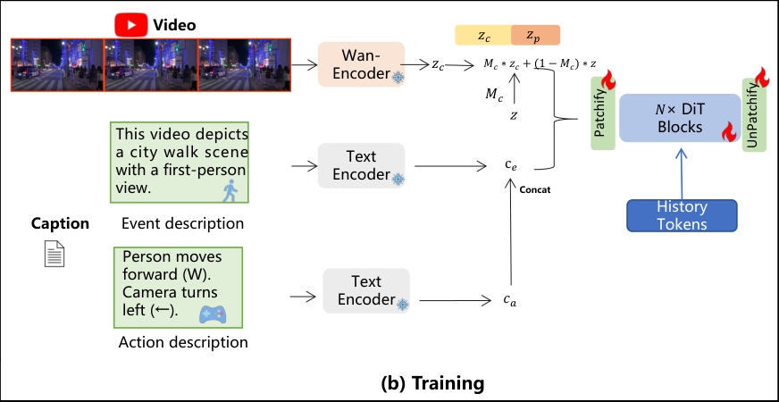
04 / WORLD MODEL EXAMPLE 2
Yume1.5: steer exploration through text conditioning
Backbone: Wan2.2-TI2V-5B | arXiv, December 2025
Control
Encode event text and action descriptions separately with T5.
History
Compress temporal, spatial and channel information with TSCM.
Rollout
Use self-rollout training and four-step generation.
The reported single-A100 result is about 12 FPS at 540p; compressed history still loses information.
Mao et al., Yume1.5, 2025; YUME official code | Figure 3(b), training panel (cropped); Sections 4–5 and 7
30 / 38
Notes:
Yume1.5 uses the dense Wan2.2-TI2V-5B backbone. It separates event descriptions from user-control descriptions and encodes both with T5, then combines the embeddings for conditioning. A finite vocabulary of actions can be cached. Its Temporal-Spatial-Channel Modeling design compresses history through sparse and multiscale tokens together with a channel-compressed linear-attention path. Rollouts use the model's own compressed history, and self-rollout distribution-matching distillation supports four-step generation. The authors report about 12 generated frames per second at 540p on one A100. The design is an example of adapting the existing text interface rather than replacing the entire backbone. Reverse motion and dense crowds remain failure cases, and continuous generation does not establish persistent three-dimensional geometry.
PRIMARY SOURCES
Yume-1.5: A Text-Controlled Interactive World Generation Model
https://arxiv.org/abs/2512.22096
YUME — official implementation and releases
https://github.com/stdstu12/YUME
FIGURE / DATA PROVENANCE
Figure 3(b), training panel (cropped); Sections 4–5 and 7
Checked on 10 September 2026. Original source figures retain their own typography. Editable slide text, tables, charts and speaker notes use Microsoft YaHei.

Slide 31
04 / WORLD MODEL EXAMPLE 3
EVA: make visual plans more executable
Lineage: Wan2.1-I2V-14B-480P → Large Video Planner → EVA | March 2026
Video planner
Frozen inverse model
Kinematic reward
GRPO update
→
→
→
History + task text
Decode video into actions
Penalize jerk and limit violations
Align the generator with LoRA
70.5% → 91.4%
68.1% → 83.8%
Human-rated kinematic plausibility
"Perfect" in the visual-rating protocol
These are visual-plan ratings on 210 RoboTwin prompts, not closed-loop robot task-success rates.
Wang et al., EVA, 2026; EVA official code | Sections 4–6; Table 1; initialization from LVP retained
31 / 38
Notes:
EVA's experimental initialization is not untouched Wan. The chain runs from Wan2.1-I2V-14B-480P through a Large Video Planner checkpoint, then embodiment-specific supervised fine-tuning and reinforcement learning. A history-conditioned video generator uses diffusion forcing to produce a plan; a frozen inverse dynamics model decodes that plan into robot commands. The reward penalizes excessive acceleration, jerk, and violations of velocity or acceleration limits, and GRPO with LoRA updates the video generator. Human ratings on 210 RoboTwin prompts improve for kinematic plausibility and a criterion called Perfect. These percentages are not task-success rates from physical robot execution. The method aligns goal-conditioned visual plans; it is not a simulator of arbitrary prescribed actions. Forces, friction and torques remain outside the explicit reward.
PRIMARY SOURCES
EVA: Aligning Video World Models with Executable Robot Actions via Inverse Dynamics Rewards
https://arxiv.org/abs/2603.17808
EVA — checkpoints and training instructions
https://github.com/RobbinW/EVA
FIGURE / DATA PROVENANCE
Sections 4–6; Table 1; initialization from LVP retained
Checked on 10 September 2026. Original source figures retain their own typography. Editable slide text, tables, charts and speaker notes use Microsoft YaHei.

Slide 32
04 / WORLD MODEL EXAMPLE 4
BiWM: reuse the conversion recipe across backbones
Demonstrated on Wan2.1-T2V-1.3B and Wan2.2-TI2V-5B | June 2026
Stage 1
Camera-text fine-tuning
Inject discrete motion descriptions through existing text conditioning.
Stage 2
Few-step distillation
Generate chunks sequentially; keep bidirectional attention in the visible window.
The paper's systematic cross-backbone quantitative study is still ongoing; this is a framework example.
Rui et al., BiWM, 2026; BiWM official code | Sections 3 and 5; official training support for both Wan generations
32 / 38
Notes:
BiWM provides a common adaptation recipe across several pretrained video generators, including both Wan versions named on the slide. First, camera motions are represented as discrete action descriptions and injected through the existing text-conditioning path. Second, few-step distillation trains sequential chunk generation while preserving bidirectional attention within the current visible window. History is re-encoded together with the current chunk, rather than being read only from a fixed key-value cache. Sliding-window history bounds the retained context and its cost. The release demonstrates four-step generation and multiple backbones, but its paper explicitly states that the systematic quantitative cross-backbone study is ongoing. The contribution is therefore useful as a conversion framework and a hypothesis about attention structure, not as a proven universal winner.
PRIMARY SOURCES
BiWM: Advancing Open-Source Interactive Video World Models with Bidirectional Autoregression
https://arxiv.org/abs/2606.10135
BiWM — cross-backbone conversion framework
https://github.com/LynnReal-AI/BiWM
FIGURE / DATA PROVENANCE
Sections 3 and 5; official training support for both Wan generations
Checked on 10 September 2026. Original source figures retain their own typography. Editable slide text, tables, charts and speaker notes use Microsoft YaHei.

Slide 33
04 / WORLD MODEL SYNTHESIS
The reused backbone is only the starting point
Four cases illustrate distinct capabilities and distinct evaluation targets.
Example | Wan lineage | Main addition | Evaluate this
Matrix-Game 3.0 | 2.2 TI2V-5B | View-relevant memory | Revisits + action response
Yume1.5 | 2.2 TI2V-5B | Text controls + TSCM | Control + long rollouts
EVA | 2.1 I2V-14B via LVP | Inverse-model reward | Plan executability
BiWM | 2.1 1.3B / 2.2 5B | Bidirectional chunk recipe | Transfer + rollout drift
A fair comparison must align the task, controls, rollout horizon, speed and evidence type.
Wang et al., Matrix-Game 3.0, 2026; Mao et al., Yume1.5, 2025; Wang et al., EVA, 2026; Rui et al., BiWM, 2026
33 / 38
Notes:
This table summarizes the common pattern without flattening different research problems into a single leaderboard. Matrix-Game3 emphasizes retrieving evidence for revisited views. Yume1.5 emphasizes controllable exploration and a compact representation of long history. EVA emphasizes whether a visual plan maps to plausible robot commands. BiWM emphasizes portability of a conversion recipe and bidirectional context processing. The two Wan2.2-based interactive examples use the dense 5B model, not A14B. EVA retains an intermediate LVP checkpoint in its lineage. A benchmark that compares these methods would need compatible control inputs, scene distributions, horizon and compute. Their published numbers are not directly interchangeable.
PRIMARY SOURCES
Matrix-Game 3.0: Real-Time and Streaming Interactive World Model with Long-Horizon Memory
https://arxiv.org/abs/2604.08995
Yume-1.5: A Text-Controlled Interactive World Generation Model
https://arxiv.org/abs/2512.22096
EVA: Aligning Video World Models with Executable Robot Actions via Inverse Dynamics Rewards
https://arxiv.org/abs/2603.17808
BiWM: Advancing Open-Source Interactive Video World Models with Bidirectional Autoregression
https://arxiv.org/abs/2606.10135
Checked on 10 September 2026. Original source figures retain their own typography. Editable slide text, tables, charts and speaker notes use Microsoft YaHei.

Slide 34
05 / READING AND RESEARCH TAKEAWAYS
Read in this order to build understanding quickly
Focus on the interfaces before reading every training or infrastructure detail.
01
Core mechanism
Wan report: Figures 5, 9, 10 and 18; Sections 4.1–4.2 and 5.1.
02
Evidence
Wan report: Figures 16–17 and Tables 2–4; separate claims from protocols.
03
Wan2.2 changes
Official MoE/VAE explanation, model configs and expert-selection code.
04
One adaptation
Matrix-Game 3.0 for memory; EVA for robot planning; BiWM for a reusable recipe.
A useful first implementation trace is: encode → condition → denoise → decode → roll out.
Wan Team, 2025; Wan2.2 official release; Wang et al., Matrix-Game 3.0, 2026; Wang et al., EVA, 2026; Rui et al., BiWM, 2026
34 / 38
Notes:
For a first reading, inspect the diagrams before attempting every implementation detail. The VAE and DiT figures establish the data representation and conditional generator; the I2V figure explains how observed frames enter. Next, read the ablations and benchmark protocols so that the architecture's evidence is clear. For Wan2.2, read the official MoE and VAE discussion together with the actual configurations and sampler branch, since there is no separate mainline Wan2.2 arXiv report linked by the repository. Finally, choose one downstream paper that matches the lab's interest. Memory-centric interactive generation, robot visual planning, and cross-backbone conversion lead to different experiments and should not be treated as the same project.
PRIMARY SOURCES
Wan: Open and Advanced Large-Scale Video Generative Models
https://arxiv.org/abs/2503.20314
Wan2.2 — architecture, evaluation and deployment
https://github.com/Wan-Video/Wan2.2
Matrix-Game 3.0: Real-Time and Streaming Interactive World Model with Long-Horizon Memory
https://arxiv.org/abs/2604.08995
EVA: Aligning Video World Models with Executable Robot Actions via Inverse Dynamics Rewards
https://arxiv.org/abs/2603.17808
BiWM: Advancing Open-Source Interactive Video World Models with Bidirectional Autoregression
https://arxiv.org/abs/2606.10135
Checked on 10 September 2026. Original source figures retain their own typography. Editable slide text, tables, charts and speaker notes use Microsoft YaHei.

Slide 35
05 / LIMITATIONS AND DISCUSSION
What Wan provides—and what a new project must prove
Use the pretrained prior to reduce learning cost, then test the missing capability directly.
Established foundation
Open research questions
Reusable components
World consistency
Open checkpoints, video VAE, text conditioning and a trainable DiT.
Does a scene remain stable after long rollouts and revisits?
Measured generation
Decision usefulness
Reconstruction, visual quality and semantic-alignment evidence.
Do action-conditioned predictions or visual plans improve task outcomes?
Choose one missing capability and design its metric before changing the backbone.
Wan Team, 2025; Wan2.2 official release; Wang et al., Matrix-Game 3.0, 2026; Mao et al., Yume1.5, 2025; Wang et al., EVA, 2026; Rui et al., BiWM, 2026
35 / 38
Notes:
The strongest common conclusion is that Wan offers a reusable video prior with enough architectural openness to support new research. It does not remove the need to define a downstream objective. For interactive environments, long-horizon drift and scene revisits need direct evaluation. For robot planning, visual plausibility should be linked to action validity and eventual task outcomes. For real-time systems, latency must be reported together with hardware and compression settings. A productive group discussion is to choose a single gap, such as memory retrieval or action fidelity, and define a falsifiable evaluation before adding architectural complexity. That makes a smaller, controlled experiment more informative than simply switching to the largest checkpoint.
PRIMARY SOURCES
Wan: Open and Advanced Large-Scale Video Generative Models
https://arxiv.org/abs/2503.20314
Wan2.2 — architecture, evaluation and deployment
https://github.com/Wan-Video/Wan2.2
Matrix-Game 3.0: Real-Time and Streaming Interactive World Model with Long-Horizon Memory
https://arxiv.org/abs/2604.08995
Yume-1.5: A Text-Controlled Interactive World Generation Model
https://arxiv.org/abs/2512.22096
EVA: Aligning Video World Models with Executable Robot Actions via Inverse Dynamics Rewards
https://arxiv.org/abs/2603.17808
BiWM: Advancing Open-Source Interactive Video World Models with Bidirectional Autoregression
https://arxiv.org/abs/2606.10135
Checked on 10 September 2026. Original source figures retain their own typography. Editable slide text, tables, charts and speaker notes use Microsoft YaHei.

Slide 36
REFERENCES / CORE MODELS
Primary sources for Wan2.1 and Wan2.2
01
Wan: Open and Advanced Large-Scale Video Generative Models
04
Wan2.2 — expert selection in the T2V sampler
arXiv: 2503.20314
Official repository / implementation
02
Wan2.1 — official implementation and checkpoints
05
Wan2.2-TI2V-5B — official model card
Official repository / implementation
Official model card
03
Wan2.2 — architecture, evaluation and deployment
06
Wan2.2-TI2V-5B — unified text/image conditioning implementation
Official repository / implementation
Official repository / implementation
Click the blue links to open primary sources. Source snapshot: 10 September 2026.
36 / 38
Notes:
These links provide the primary technical sources for the core model section. The Wan report is arXiv 2503.20314; its second version was posted in April 2025. Wan2.2 was released in July 2025, so new Wan2.2 details are attributed to its official repository, code and model cards rather than retroactively attributed to the earlier report. The slides reproduce selected original figures with attribution and recreate selected numeric comparisons as editable tables or charts. Repository links may evolve; the factual snapshot used for this presentation was checked on 10 September 2026.
PRIMARY SOURCES
Presentation framing and research synthesis.
Wan: Open and Advanced Large-Scale Video Generative Models
https://arxiv.org/abs/2503.20314
Wan2.1 — official implementation and checkpoints
https://github.com/Wan-Video/Wan2.1
Wan2.2 — architecture, evaluation and deployment
https://github.com/Wan-Video/Wan2.2
Wan2.2 — expert selection in the T2V sampler
https://github.com/Wan-Video/Wan2.2/blob/main/wan/text2video.py
Wan2.2-TI2V-5B — official model card
https://huggingface.co/Wan-AI/Wan2.2-TI2V-5B
Wan2.2-TI2V-5B — unified text/image conditioning implementation
https://github.com/Wan-Video/Wan2.2/blob/main/wan/textimage2video.py
Checked on 10 September 2026. Original source figures retain their own typography. Editable slide text, tables, charts and speaker notes use Microsoft YaHei.

Slide 37
REFERENCES / WORLD MODELS
Primary sources for the four world-model examples
01
Matrix-Game 3.0: Real-Time and Streaming Interactive World Model with Long-Horizon Memory
05
EVA: Aligning Video World Models with Executable Robot Actions via Inverse Dynamics Rewards
arXiv: 2604.08995
arXiv: 2603.17808
02
Matrix-Game 3.0 — released model and lineage
06
EVA — checkpoints and training instructions
Official model card
Official repository / implementation
03
Yume-1.5: A Text-Controlled Interactive World Generation Model
07
BiWM: Advancing Open-Source Interactive Video World Models with Bidirectional Autoregression
arXiv: 2512.22096
arXiv: 2606.10135
04
YUME — official implementation and releases
08
BiWM — cross-backbone conversion framework
Official repository / implementation
Official repository / implementation
Click the blue links to open primary sources. Source snapshot: 10 September 2026.
37 / 38
Notes:
These are representative recent arXiv papers and official implementations with explicit Wan lineage. No conference acceptance is implied by their inclusion. Matrix-Game3 and Yume1.5 use Wan2.2-TI2V-5B, EVA uses Wan2.1-I2V-14B-480P through LVP, and BiWM includes instantiations on Wan2.1-T2V-1.3B and Wan2.2-TI2V-5B. The source papers and repositories provide the exact conditions behind the performance statements. Because the tasks and protocols differ, this section intentionally presents mechanisms and evidence rather than a combined numerical ranking.
PRIMARY SOURCES
Presentation framing and research synthesis.
Matrix-Game 3.0: Real-Time and Streaming Interactive World Model with Long-Horizon Memory
https://arxiv.org/abs/2604.08995
Matrix-Game 3.0 — released model and lineage
https://huggingface.co/Skywork/Matrix-Game-3.0
Yume-1.5: A Text-Controlled Interactive World Generation Model
https://arxiv.org/abs/2512.22096
YUME — official implementation and releases
https://github.com/stdstu12/YUME
EVA: Aligning Video World Models with Executable Robot Actions via Inverse Dynamics Rewards
https://arxiv.org/abs/2603.17808
EVA — checkpoints and training instructions
https://github.com/RobbinW/EVA
BiWM: Advancing Open-Source Interactive Video World Models with Bidirectional Autoregression
https://arxiv.org/abs/2606.10135
BiWM — cross-backbone conversion framework
https://github.com/LynnReal-AI/BiWM
Checked on 10 September 2026. Original source figures retain their own typography. Editable slide text, tables, charts and speaker notes use Microsoft YaHei.

Slide 38
AVC LAB / DISCUSSION
From video priors to useful rollouts
Which missing capability should our next experiment test?
Action fidelity · Persistent memory · Long-horizon stability · Task success
Wan2.1 & Wan2.2 | Technical seminar
Notes:
The closing question is intended to guide discussion toward an experiment. If the interest is interactive environments, the group can focus on scene memory or action response. If the interest is embodied planning, the group can focus on whether a generated future helps choose executable actions. In both settings, report the exact pretrained model and separate improvements in the backbone from improvements in the surrounding system. The preceding source links and per-slide speaker notes are intended to make the deck usable as a standalone technical report.
PRIMARY SOURCES
Presentation framing and research synthesis.
Checked on 10 September 2026. Original source figures retain their own typography. Editable slide text, tables, charts and speaker notes use Microsoft YaHei.

