Slide 1
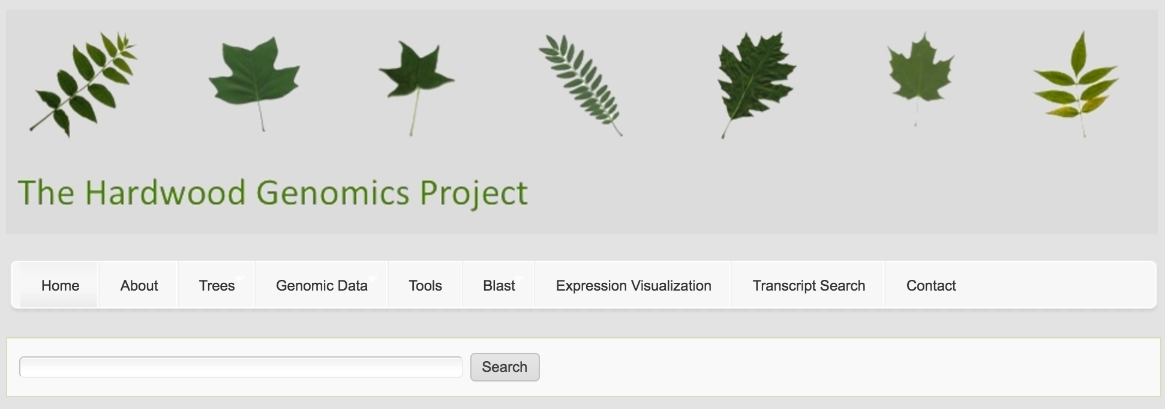
Enhancement of data searching, visualization and exploration in the Hardwood Genomics Database (HGD) by integration of new Tripal extensions
Chen, M¹; Henry, NL¹; Lane, T¹; Zhou, X¹; Wegrzyn, J²; Ficklin, SP³; Staton ME¹;
¹University of Tennessee, Knoxville, Tennessee (USA)
²University of Connecticut, Storrs, Connecticut (USA)
³Washington State University, Pullman, Washington (USA)
http://www.hardwoodgenomics.org
https://github.com/MingChen0919/PAG-2017-computer-demo/blob/master/README.md
Notes:
Odd theme,

Slide 2





Funding and Acknowledgements
University of Tennessee
Meg Staton
Nathan Henry
Abdullah Almsaeed
Michelle Zhou
The Tripal Community
Stephen Ficklin (Washington State Univesity)
Lacey Anne Sanderson (University of Saskatchwan)
Anthony Bretaudeau (INRIA/Irisa)
Sudhansu Dash (NCGR)

