Slide 1
Sparkling Water

Slide 2
Why use Sparkling Water?
Spark Cluster
Leverage Spark Cluster
Launch H2O-3 Machine Learning Engine on top of your Spark Cluster
Spark Data Munging
Leverage Spark Data Munging Functionality
Transparent integration of H2O with Spark ecosystem
Spark Pipelines
Leverage Spark Pipelines
Incorporate H2O-3 models into existing Spark pipelines
Transparent use of H2O data structures and algorithms with Spark API
Excels in existing Spark workflows requiring advanced Machine Learning algorithms

Slide 3
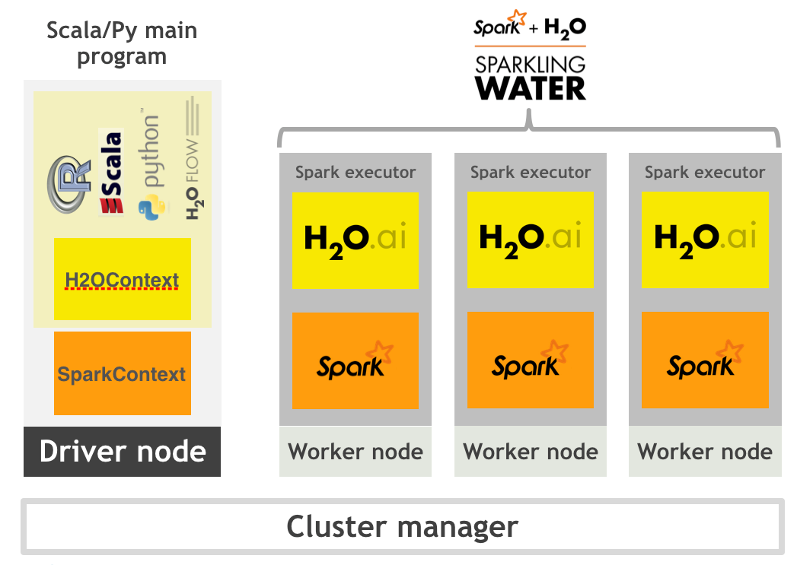
High Level Architecture

Slide 4
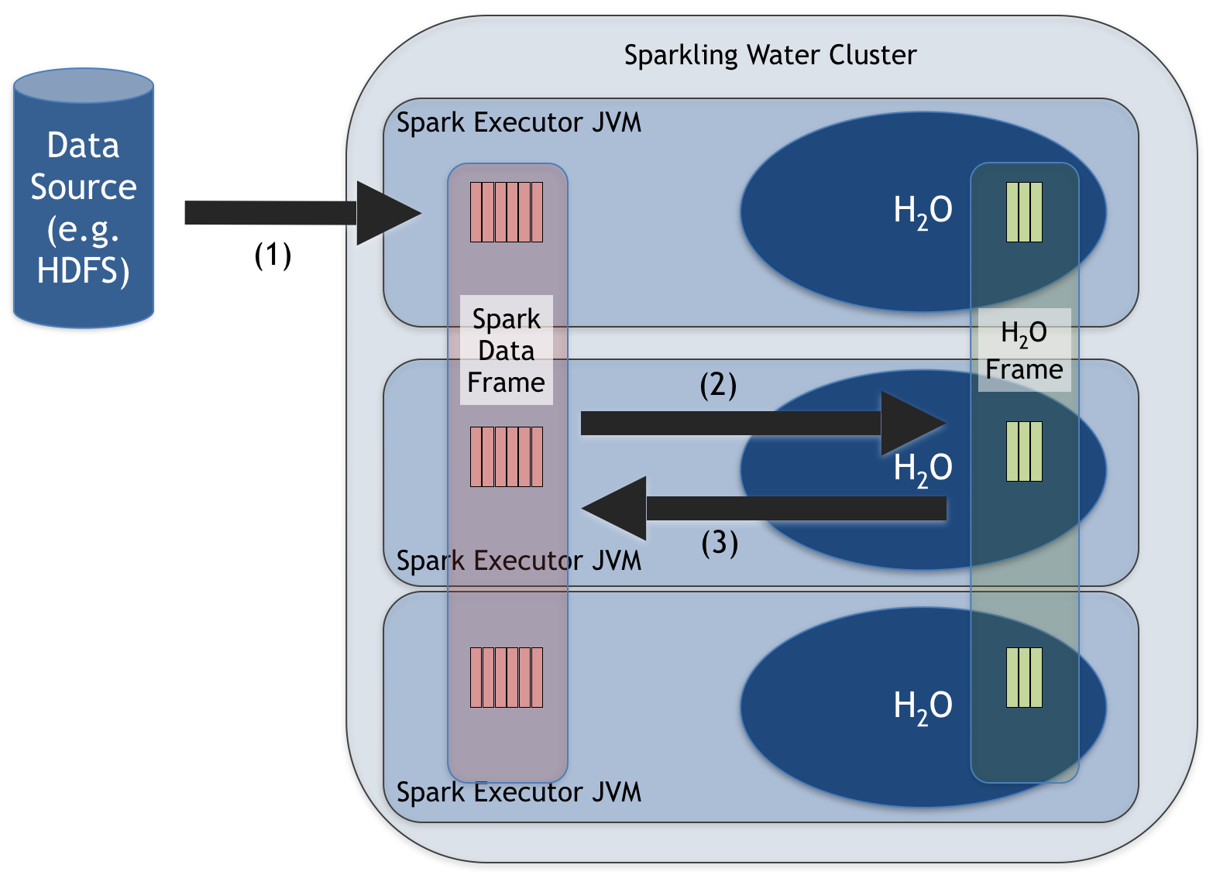
Sparkling Water Data Management

Slide 5
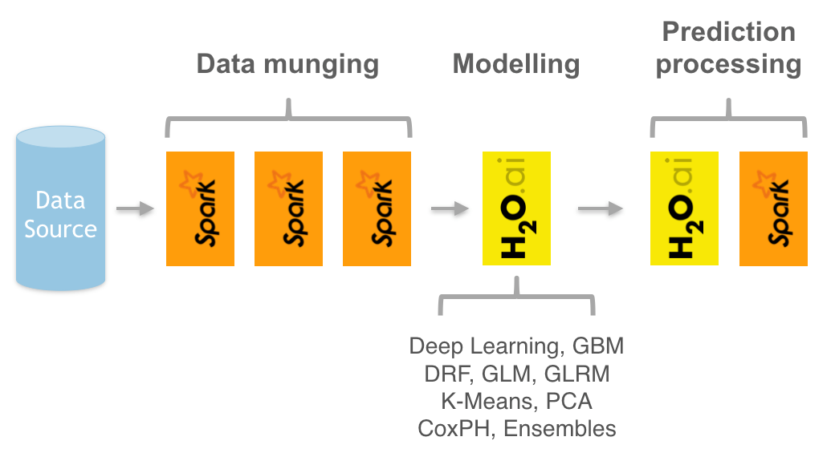
Use Case

Slide 6
Sparkling Water Data Conversion Functions
Converting an H2OFrame into an RDD[T]
def asRDD[A <: Product: TypeTag: ClassTag](fr : H2OFrame) : RDD[A]
Converting an H2OFrame into a DataFrame
def asDataFrame(fr : H2OFrame)(implicit sqlContext: SQLContext) : DataFrame
Converting an RDD[T] into an H2OFrame
def asH2OFrame[A <: Product : TypeTag](rdd : RDD[A], frameName: Option[String]) : H2OFrame
Converting a DataFrame into an H2OFrame
def asH2OFrame(rdd : DataFrame, frameName: Option[String]) : H2OFrame

Slide 7
Sparkling Water Hands On

Slide 8
The Data
Dow Jones Industrial Average data from 2006-2017
93,612 rows
Forecasting for these groups
What we want to predict
Time Unit
Additional Attributes
Name | Date | Volume | Open | High | Low | Close
AABA | 2006-01-03 | 24,232,729 | $39.69 | $41.22 | $38.79 | $40.91
AABA | 2006-01-04 | 20,553,479 | $41.22 | $41.90 | $40.77 | $40.97
AABA | 2006-01-05 | 12,829,610 | $40.98 | $41.73 | $40.85 | $41.53
AABA | 2006-01-06 | 29,422,828 | $42.88 | $43.57 | $42.80 | $43.21

Slide 9
The Data
Original Data
Name | Date | Volume | Open | High | Low | Close
AABA | 2006-01-03 | 24,232,729 | $39.69 | $41.22 | $38.79 | $40.91
AABA | 2006-01-04 | 20,553,479 | $41.22 | $41.90 | $40.77 | $40.97
AABA | 2006-01-05 | 12,829,610 | $40.98 | $41.73 | $40.85 | $41.53
AABA | 2006-01-06 | 29,422,828 | $42.88 | $43.57 | $42.80 | $43.21
Formulated for Machine Learning
Name | Close Yesterday | Volume 2 Days Ago | Volume Yesterday | Volume (Target)
AABA | NA | NA | NA | 24,232,729
AABA | $40.91 | NA | 24,232,729 | 20,553,479
AABA | $41.53 | 24,232,729 | 20,553,479 | 12,829,610
AABA | $43.21 | 20,553,479 | 12,829,610 | 29,422,828

Slide 10
Performance Comparison
Data | Mean Absolute Percent Error
Original Data | 134%
Data with Lags | 21%

